Slide 1


Understanding and solving the complex problem of Job dissatisfaction amongst UK workers
Lecturer – Ernest Ovia
Module – Problem solving and Decision making
Module code – BMW4004
Tahiya Ahmed 1919719

Slide 2
The nature and the impact of the complex problem of job dissatisfaction in UK workers
Nature of the Problem
The complex problem UK workers face is job dissatisfaction.
Impact of the problem
Employees – disappointed due to poor pay with overloaded hours and unpaid work.
Notes:
Nature of the Problem
The complex problem UK workers face is job dissatisfaction.
The problems in UK workers being dissatisfied has many causes.
These causes exist internally (e.g. less interest within the job role) and externally (reduction in pay and nature of work changes during the last three years) in the organisation/s.
Impact of the problem
The job dissatisfaction and UK's long-hour culture makes it difficult for UK workers to concentrate and connect resulting in a lack of security in their job roles.
Employees – disappointed due to pitiable pay with overloaded hours and unpaid work.
Workers amongst the UK are the most discouraged in Europe and this has many problems that influence a diversity of people and groups.

Slide 3
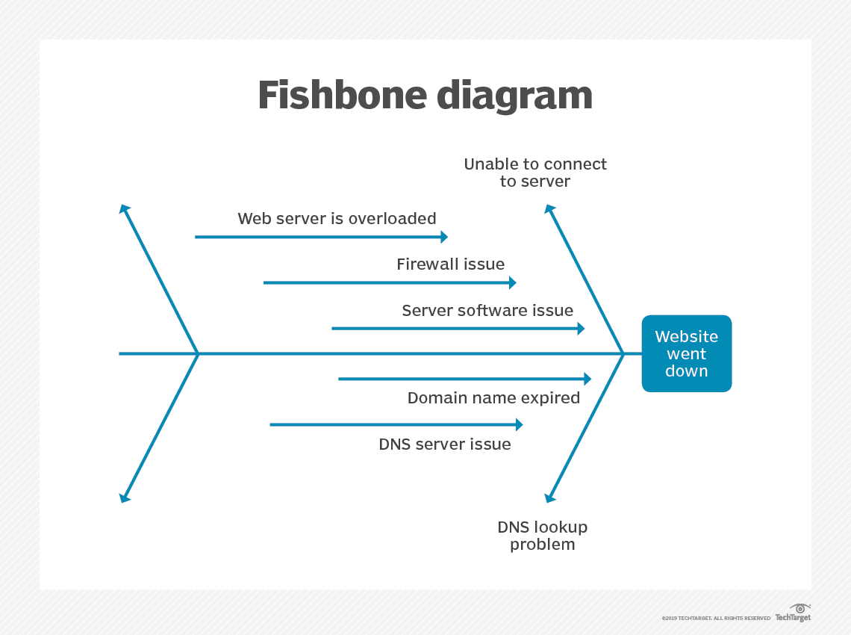
Fishbone Diagram
The fishbone diagram was created by Kaoru Ishikawa in 1960s to show the root causes of a problem (Hayes, 2020).
Notes:
The fishbone figure analyses the cause and effect of an occurring problem in depth. This tool is applied to work towards getting rid of occurring problems by recognizing the reasons of the possible causes and controlling the causes (NHS, 2018).
At certain times, the small causes create bigger problems (Usmani, 2020).
The fishbone diagram gives you a well–defined perspective of the problem and helps you to easily recognize and evaluate.
The fishbone diagram for job dissatisfaction faced by UK employees has been practised to see what the causes of the problems are, and the explanations of the problems are provided on the next slide.

Slide 4
Fishbone analysis of the complex problems of job dissatisfaction in UK workers
GOVERNMENT
MANAGEMENT
FINANCES
Lack of funds available to increase pay
Increased financial difficulty.
Lack of stress management programs.
Working hours are too long in the UK.
1 in 5 workers took a reduction in pay in the last three years.
Lack of flexible working hours.
44% of workers have been unpaid.
Lack of support for work-life balance.
Job dissatisfaction faced by UK employees
Job conditions have changed due to economic downfall.
Limited career growth at an organization.
Demotivated employees.
Lack of communication.
Deplorable conditions.
48% of UK employees take on overtime hours per week.
‘Always on’ culture increases staff burnout.
Lack of job security and variability.
A ¼ of employees felt a lack of interest in their job roles.
ENVIRONMENT
PEOPLE

Slide 5
PESTLE Analysis
A PESTLE analysis is a structure used to evaluate the fundamental elements (Political, Economic, Sociological, Technological, Legal and Environmental) affecting an institution externally (CIPD, 2020).
Notes:
A PESTLE analysis is a structure used to evaluate the fundamental elements (Political, Economic, Sociological, Technological, Legal and Environmental) affecting an institution externally (CIPD, 2020).
Many internal and external factors alter the performance of an organization/business/project/brand.
This form of investigation offers individual experts with observation and understanding into the external causes affecting the businesses/projects/brands.
The PESTLE analysis is adaptable therefore making it useful for a series of situations and influencing business decisions (Morgan, 2017).
This tool can be applied and studied by professionals, directors and senior managers to oversee crucial conclusions.
The PESTLE analysis has been implemented to recognize what the macro-environmental causes leading to the job dissatisfaction faced by UK employees are, and the explanations of the problems are specified on the next slide.

Slide 6
PESTLE analysis of the complex problems of job dissatisfaction in UK workers
P - Political | E - Economical | S - Social
Current tax policy Political stability Brexit Covid-19 rules/lockdowns Government policy | Exchange rates Disposable income Interest rates Unemployment rate Economic downfall | Changes in lifestyles Health consciousness Population growth Cultural barriers Target demographics
T - Technological | L - Legal | E - Environmental
Internet availability/speed Rapid technological progress Technological awareness Cyber security | Employment laws Discrimination laws Copyright protection Health & safety | Weather Climate change Environmental policies Recycling Pollution Suitability

Slide 7
Possible solutions from Fishbone and PESTLE analysis
To recognize the issues affecting the problem In accordance with the evidence from the Fishbone and the PESTLE analysis.
The following are possible solutions that can be applied:
Stress management programmes
Reduce repetitive work
Appreciate employees
Hold controversial meetings
Introduce flexible working hours
Notes:
1. Inclusive stress management programmes should be acquired to result a healthy wellbeing and develop employee commitment.
2. Employers should reduce repetitive work to promote good work-life balance for employees.
3. Employers should verbally appreciate employees, give promotions, target awards and increase in wages.
4. Employers should conduct one to one meetings, team parties with staff to address any problems they may be facing. This will ensure a good working relationship.
5. Introduce flexible working hours to build a clear, active and beneficial environment.
The possible resolutions mentioned above will be applied in the Grid analysis to evaluate and to help make the right decision.

Slide 8
Evaluating Possible Solutions using Grid Analysis
Factors: | Work and life balance | Unsupportive employer | Career growth | Employee's flexibility | Underpaid | Interest | Total
Weights: | 5 | 5 | 4 | 2 | 5 | 4
Reduce repetitive work | 3-15 | 4-20 | 5-20 | 1-2 | 3-15 | 3-12 | 84
Verbal appraisal, work promotions, increase in wages and awards. | 5-25 | 5-25 | 4-16 | 1-2 | 3-15 | 2-8 | 91
Conduct one to one meetings | 4-20 | 4-20 | 4-16 | 3-6 | 5-25 | 5-20 | 107
Flexible working hours | 5-25 | 4-20 | 4-16 | 1-2 | 3-15 | 5-20 | 98
Implement Inclusive stress management programmes | 5-25 | 5-25 | 5-20 | 5-10 | 5-25 | 5-20 | 125

Slide 9
Reference list
Notes:
Adam H. (2020). Ishikawa diagram. [Online]. Available at: https://www.investopedia.com/terms/i/ishikawa-diagram.asp
(Accessed on 24 November 2021)
Boyce, P. (2021). PESTLE analysis definition and template. [Online]. Available at: https://boycewire.com/pestle-analysis-definition-and-template/ (Accessed: 20 November 2021)
British Library. (no, date). Bright ideas inspiring people. [Online]. Available at: https://www.bl.uk/business-and-ip-centre/articles/what-is-swot-analysis#:~:text=The%20SWOT%20framework%20is%20credit,the%201960s%20and%20early%201970s
(Accessed 19 November 2021)
CIPD. (2020). PESTLE analysis. [Online]. Available at: https://www.cipd.co.uk/knowledge/strategy/organisational-development/pestle-analysis-factsheet#gref (Accessed on 19 November 2021)
Fahad, U. (2020). Fishbone (Cause and Effect or Ishikawa) Diagram. [Online]. Available at: https://pmstudycircle.com/2014/07/fishbone-cause-and-effect-or-ishikawa-diagram/ (Accessed 21 November 2021)
MBA skool team. (2020) Anchor Care Homes SWOT Analysis, Competitors, Segmentation, Target Market, Positioning & USP. [Online]. Available at: https://www.mbaskool.com/brandguide/pharmaceuticals-and-healthcare/10286-anchor-care-homes.html (Accessed on 25 November 2021)
Mckinsey&company. (2020). COVID-19 in the United Kingdom: Assessing jobs at risk and the impact on people and places. Available at: https://www.mckinsey.com/industries/public-and-social-sector/our-insights/covid-19-in-the-united-kingdom-assessing-jobs-at-risk-and-the-impact-on-people-and-places# (Accessed: 22 November 2021)
Mindtools. (no, date). SWOT analysis. [Online]. Available at: https://www.mindtools.com/pages/article/newTMC_05.htm
(Accessed on 24 November 2021)
Morgan, P. (2017). The Business student’s guide to study and employability. [Book]. Available at: The Business Student’s Guide to Study and Employability | Online Resources (sagepub.com) (Accessed 25 November 2021)
Peeps hr. (2021). Brexit- The impact on your people and workforce planning. [Online]. Available at: https://www.peepshr.co.uk/resource-centre/brexit/
(Accessed: 6 December 2021)
NHS. (2018). Cause and effect (Fishbone). [Online]. Available at: https://improvement.nhs.uk/documents/2093/cause-effect-fishbone.pdf (Accessed 9 December 2021)
Sarah, K, W. (2018). What is SWOT analysis? A strategic tool for achievement objectives. [Online]. Available at: https://www.cio.com/article/3328853/swot-analysis-defined.html (Accessed 20 November 2021)
Unionsafety. (2013). UK Workers Among The Most Dissatisfied In Europe. [Online]. Available at: https://unionsafety.eu/docs/HSNewsItems%2013/UKWorkersAmongTheMostDissatisfiedInEurope.html (Accessed: 18 November 2021)

