Slide 1
Case study of Amira using Bowlby’s theory
Nejma Begum
Student Number: 2419975
Module Code: LCH4010
Psychology in Health and Social Care
Lecturer Name: Samuel Assan

Slide 2

Nature vs Nurture pt1
Nature vs Nurture is an ongoing psychological argument between environmental/life factors (Nurture) or genetic influence (Nature) contribute to explaining different behaviours displayed by humans.
Linking Amira’s situation to the concept of Nature, biological factors are displayed. In the scenario it is shown that Amira has a temperament, which is why she is more cautious in certain setting such as the nursey. Research by Kagan 1997 shows how temperament is biologically influenced.
Furthermore Amira’s stress response with actions such as crying and her clinginess is shown at separation. Gunnar and Quevedo, 2007 shows that cortisol levels are risen when young children are separated from caregivers.
Also pointing out her language development, Amira’s verbal communication is limited

Slide 3

Nature vs Nurture part 2
Linking to the scenario Amira has spent her first 3 years with her carers limiting social interaction with other people, Amira going to nursery is a huge environmental change for her. The theory which supports this is Bowlby 1969 where his studies show that caregiver consistency affects separation.
Due to the fact Amira hasn’t had much social interaction with other people, her joining groups will prove difficult for her
The setting of the nursery will also impact her as it’s a more noisy and triggering for since she is sensitive and will further enhance her separation anxiety
Therefore, the staff recognising her behaviour as naughty is physiologically wrong and should respond with patience

Slide 4
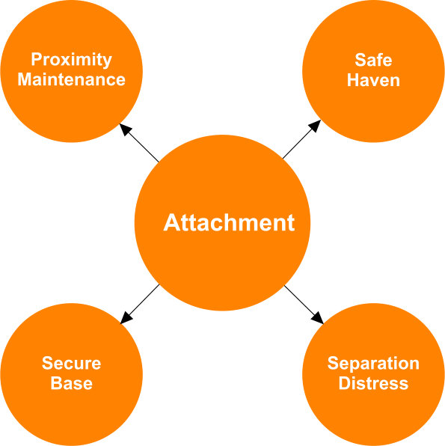
Bowlby attachment theory
He suggests that children needs a secure based in order for them to feel safe to venture, however Amira’s clinginess shows she doesn’t see the nursery as a secure base for her to explore limiting her confidence and curiosity, thus explaining her separation anxiety.
As well as this due to her limited communication hinders her performance to do well in the nursery alone.
With Amira avoiding her peers lies with the fact that she is not confident in the nursery and prefers to stay close with adults who represent an attachment figure for her highlighting a requirement for a key worker in the nursery
The stress behaviour which Amira displays are physical signs of attachment seeking behaviour from Bowlby's theory

Slide 5

Criticisms of Bowlby’s theory pt 1
ADVANTAGES- gives us explanations and framework for Amira’s separation anxiety
Helps people in this case the staff as well as parents to understands her needs rather than giving her blame.
Furthermore, the theory can be used as an method of direction to help Amira settle in the nursey. For example, a key person, gradual settlement and understanding Amira’s feeling, these are strategies from the principles of Ainsworth et al 1978.
The theory help supporting the importance of early relationships and having a secure base

Slide 6

Criticisms of Bowlby’s theory pt2
One disadvantage to Bowlby’s theory is that he suggested the idea of having one form of attachment however other studies like Rutter,1972 show that children can form multiple attachments at once. Therefore Amira can have more than one relationship at once.
Limited discussion of sensory or motor development.
Biologically simplified

Slide 7

Practical Strategies and Interventions
This would be to promote and encourage Amira in confidence, independence and stability by using Bowlby’s theory as guidance.
One key person: assign one person to Amira which helps reduces her separation theory
Gradual settlement with Parent involvement: build up of Amira’s internal working model
Allow her to have something with her that makes her feel safe, for example a cuddly toy providing her emotional security and comfort.
Sensitive communication and label emotions with care, Denham et al 2012
A relationship should be established between the parent and nursery.

Slide 8

References for presentation
Gunnar, M.R. and Quevedo, K. (2007) ‘The neurobiology of stress and development’, Annual Review of Psychology, 58(1), pp. 145–173.
Kagan, J. (1997) Galen’s Prophecy: Temperament in Human Nature. New York: Basic Books.
Bowlby, J. (1969) Attachment and Loss: Volume 1. Attachment. London: Hogarth Press.
Ainsworth, M.D.S., Blehar, M.C., Waters, E. and Wall, S. (1978) Patterns of Attachment: A Psychological Study of the Strange Situation. Hillsdale, NJ: Erlbaum.
Denham, S.A. et al. (2012) ‘The socialization of emotional competence’, Educational Psychology Review, 24(2), pp. 165–199
.
McLeod, S. (2025). John Bowlby’s Attachment Theory. [online] Simply Psychology. Available at: https://www.simplypsychology.org/bowlby.html.

