Slide 1
Student name: Rufsana Begum
Student ID:2208636
Module name & number: Foreign Language BMIH5003
Lecturer: Giulia Chifari

Slide 2
Diversity Hotel & Spa london

Slide 3
Benefits of multilinguism:
Being bilingual and having linguistic awareness abilities are crucial benefits for hotel workers at Diversity Hotel & Spa London in a globalized world where the hospitality sector caters to a broad clientele (Oliinyk et al., 2022).
For the employees at Diversity Hotel & Spa in London, the benefits of bilingualism and language awareness are crucial in an increasingly globalized society. Employees are better able to communicate with a wide range of foreign clients thanks to their diversified skill set, which improves the overall visitor experience in the thriving hospitality sector.
Effective Communication: Knowledge of the language helps workers communicate ideas clearly, reducing misunderstandings and ensuring that guests' requirements are satisfied as soon as possible.
Cultural Sensitivity: Recognizing subtle cultural differences helps avoid accidental offense, producing satisfying visitor experiences (Nguyễn, 2022).
By efficiently promoting the hotel's offerings, staff members may upsell and cross-sell, resulting in more income.
For the employees at Diversity Hotel & Spa, having a strong command of the language is essential to promoting efficient communication that reduces miscommunication and quickly attends to guest demands. Furthermore, avoiding inadvertent offense by being sensitive to cultural differences and cognizant of them helps to create very positive tourist experiences (Nguyễn, 2022). As a result of the staff's enhanced ability to market the hotel's services, upselling and cross-selling techniques that boost income are made possible.

Slide 4
European language of choice:Germany
Germany, Austria, Switzerland, as well as portions of Belgium, Luxembourg, and Italy all speak German, an important language in Europe. Although it's frequently seen as a difficult language to master, its importance in the European economic environment cannot be denied.
an learning difficulties
German has a rich vocabulary and complicated syntax, making it difficult for non-native speakers to learn.
It might be challenging to pronounce some words because of the difference between the sounds "ö" and "ü."
courtesy in a professional setting:
Prior to being asked to use first names, only address guests using formal titles (Herr or Frau) and last names.
German society places a great priority on punctuality, thus it is rude to arrive late for appointments.
Direct eye contact and a solid handshake are seen as symbols of respect (Ferjani and Boudabbous, 2023).
Examples from the hotel industry
German-speaking visitors can be served by a bilingual staff person who is fluent in the language, resulting in a quicker check-in procedure.
Understanding the language can help avoid misunderstandings. Understanding dietary requirements, such as "vegan" or "gluten-free," is essential, for example, at the hotel restaurant (Baquero, 2023).
When staff honors German visitors' penchant for set mealtimes and high-quality drinks and food, they are demonstrating cultural awareness.

Slide 5
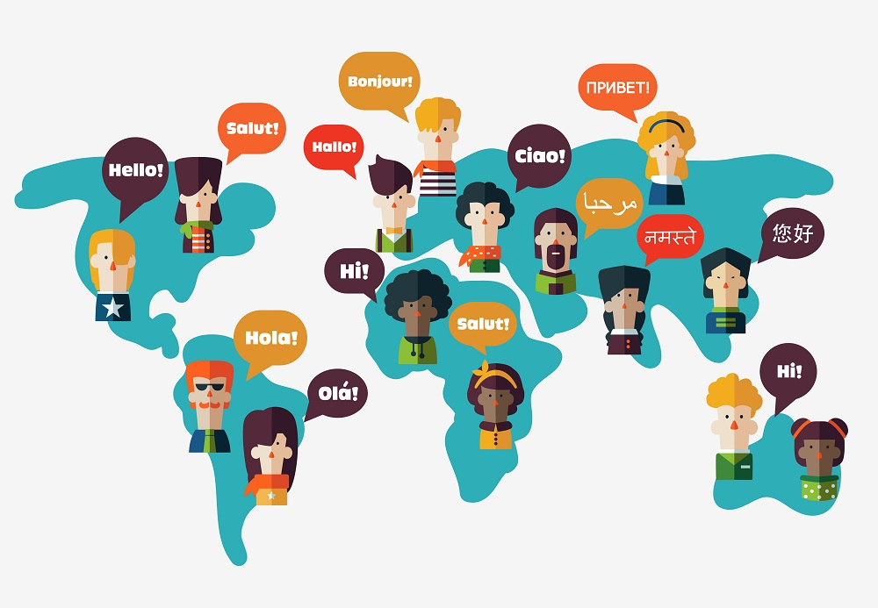
What is considered to be polite/impolite in a business context?
Improved Guest Experience: Speaking the visitor's language fosters a friendly and welcoming atmosphere. It promotes rapport, which results in favorable ratings and repeats business.
Offering a polite greeting and having good etiquettes
Good impression and making positive impact.
Impolitness could be taken so many ways. Interrupting, actively not listening
Speaking rudely or not being judgemental.
Competitive Advantage: Diversity Hotel & Spa has an advantage over rivals in London, where many visitors have different language origins.
The Diversity Hotel & Spa in London has multilingual personnel who provide several advantages. They increase the hotel's guest base and draw in a wider range of customers. By doing so, they improve the tourist experience, develop positive connections, which encourage positive ratings and return business. Given that visitors to London come from a variety of linguistic backgrounds, the hotel has an advantage in the market thanks to this competitive edge. If these services aren’t available would be impolite and disadvantage for business.
Notes:
.

Slide 6
Direct examples:
Many hotels sectors work thrivingly to provide their best and to support and fullfill needs of clients throughout many hotels in the industry for example The Ritz London. They have staff who are trained and are fluent in several languages including English, French, German and Italian. This way they can provide and fulfill customer needs.
A crucial differentiation in the diversified and cutthroat hotel sector is the ability to speak many languages and have a good grasp of linguistic concepts. In order to deliver a remarkable client experience, Diversity Hotel & Spa London encourages all workers to adopt these abilities.
We may learn from the German culture how important it is to be culturally aware and use proper business etiquette, which will definitely improve our reputation and bottom line. Let's work together to continue providing expert and gracious service to our international clients.

Slide 7
Reference list
Fagbolu, O.O., Edu, C.S. and Adewale, A.J., 2021. Multilingual Social Media Platform-based Tourism Operations In Uganda. Acta Technica Corviniensis - Bulletin Of Engineering, 14(4), Pp. 55-59.
Ferjani, M. and Boudabbous, S., 2023. Culture And Performance Of Non-equity Alliances In The Tunisian Hotel Industry. International Journal Of Research In Business And Social Science, 12(3), Pp. 55-67.
Nguyễn, N., 2022. University-community Partnerships In Language Teacher Education Through Work-integrated Learning. Issues In Educational Research, 32(1), Pp. 292-314.
Baquero, A., 2023. Is Customer Satisfaction Achieved Only with Good Hotel Facilities? A Moderated Mediation Model. Administrative Sciences, 13(4), pp. 108.
Oliinyk, O., Krasovskyi, S., Vasylenko, O., Prykhod'ko, K., Pliuta, O. and Tonkykh, O., 2022. Digitalization of Business Processes in the Hospitality Industry. Economic Affairs, 67(4), pp. 725-733.

