Slide 1

Flight Foods Ltd
Group Presentation

Slide 2
Members of group
Zara Haq (2439013)
Sonam Akhtar (2439007)
Zaffar Hussain (2436275)
Munir Ahmed (2441102)

Slide 3

Overview
Good morning, in our presentation, we will:
Provide an overview of Flight Foods Ltd.
Communication barriers faced by Flight Foods Ltd.
Analyse and apply the Shannon and Weaver model.
Analyse and apply Berlo’s Model of communication.
Provide solutions to overcome barriers.
Summary
Reference List.

Slide 4
Flight Foods Ltd
Flight Foods Ltd provide food for airlines.
Flight Foods is trying to increase its market share.
Has 40 people working from ages 16-60 years old.
Employees are mainly immigrants from 5 distinct cultures.

Slide 5
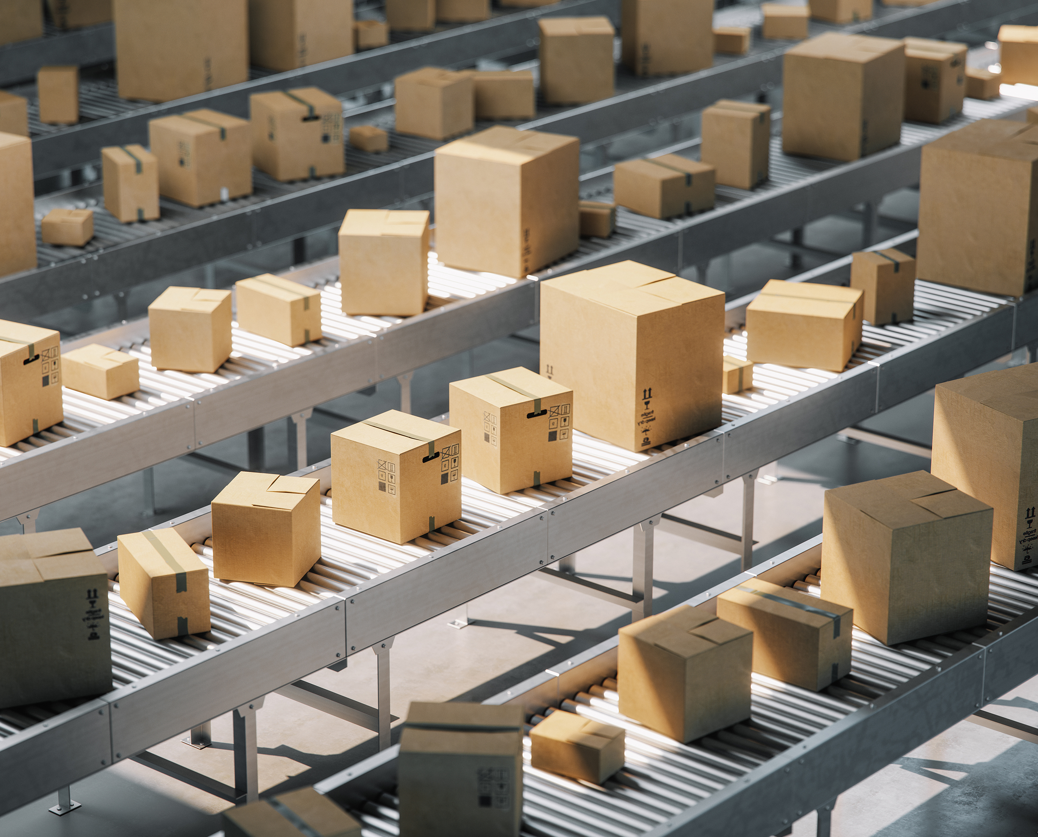
Problems faced at Flight Foods Ltd
Language barriers – many workers don’t speak fluent English.
Cultural barriers – different views on hygiene and teamwork.
Noise distractions – loud machines being used.
Lack of training – no training is being provided.
Poor management – management is not setting a good example for hygiene standards.

Slide 6
Shannon and Weaver Model 1949
The Shannon and Weaver Model (1949) has five elements. Sender, message, channel, receiver and noise.
Dickinson, G. & Hendricks, B. (2023), believe it outlines the process through which information moves from one person to another.
An advantage of using this model is that it emphasises the noise element of the model.
The disadvantage identified by Venkateswarlu, S., Rani, C.R., and Sitara, S.N.M. (2018) is that the model treats communication as a one-way process.

Slide 7
Apply the Shannon and Weaver model to Flight Foods Ltd
Sender:
Gary
Message:
Food hygiene
Channel:
Verbal and signs.
Receiver:
Multicultural Staff
Noise:
Language, factory noise
This has led to a distortion of messages, misunderstandings about hygiene standards, and a decline in food quality.

Slide 8
Berlo’s SMCR Model of Communication
Berlo’s Model covers 4 main factors: Source, message, channel, and receiver.
According to Communication Theory (2025), Berlo’s model, effective communication occurs when the source and receiver are on the same level.
An advantage of using this model, as noted by Hapieri, Z. and Daukšte, D. (2018), it is important to consider the personal backgrounds and experiences of communicators when trying to understand their messages.
Omojuwa, B.A. (2025), believes that a disadvantage of using this model is that it does not consider 'noise' that can hinder message transmission.

Slide 9
Apply Berlo’s SMCR Model of Communication to Flight Foods Ltd
Source:
  Gary can only speak English.
Message:
  Hygiene rules are unclear.
Channel:
  Workers do not understand English.
Receiver:
  Workers with diverse language.

Slide 10
Solutions to overcome communication barriers
Make short videos as well as visual posters.
Upgrade machines to reduce physical noise.
Managers should set a perfect example of what employees should expect.
Hire translators so there is no break in communication.
Provide hygiene and food standard training in various languages.

Slide 11
Summary
Food Flights Ltd have many communication barriers; due to this, the company is unable to grow its shares.
The company suffers from ineffective communication and cultural diversity, leading to unsatisfactory hygiene standards and miscommunications.
This issue can be resolved if the company takes immediate action by providing visual posters and creating informative videos.
Additionally, there should be improved training on hygiene and food safety standards.
Managers can also serve as role models to help employees understand the expected standards of behavior.

Slide 12
Reference List
CommunicationTheory.org. (2025). Berlo’s SMCR model of communication. Available at: https://www.communicationtheory.org/berlos-smcr-model-of-communication/ (Accessed: 31 October 2025).
Dickinson, G. & Hendricks, B., (2023). Shannon‑Weaver model of communication | History & examples. Study.com. [online] Available at: https://study.com/academy/lesson/shannon-weaver-model-of-communication-history-features-application.html [Accessed 30 October 2025].
Hapieri, Z. & Daukšte, D. (2018) ‘Communication Models and Common Basis for Multicultural Communication in Latvia’, Society. Integration. Education, 8(2), pp. 103-114. Available at: https://journals.rta.lv/index.php/SIE/article/view/1555/2164 (Accessed: 31 October 2025).
Omojuwa, B.A., (2025). Exploring the Communication Process Model (Doctoral dissertation, Mount Saint Vincent University).
Shannon, C. E., & Weaver, W. (1949). The Mathematical Theory of Communication. Urbana, IL: The University of Illinois Press, 1-117.
Venkateswarlu, S., Rani, C.R. and Sitara, S.N.M. (2018). Study on Various Receiver Models in Wireless Communication Systems. Available at: https://d1wqtxts1xzle7.cloudfront.net/94854971/ijraset.2018-libre.pdf [Accessed 31 Oct. 2025].

Slide 13

Thank you
Any Questions

