Slide 1

Student name: Hiren Kishorbhai Adroja
Student ID number: 2527939
Programme: Master of Business Administration
Module: Marketing Management
Module code: LCMB7024
Contribution to Overall Module Assessment (%): 50%
Lecturer: Taonga Kaonga Sobere-Snithers (Birmingham)
Internal Verifier: Vasilios Tavlaridis; Hoang Nguyen

Slide 2
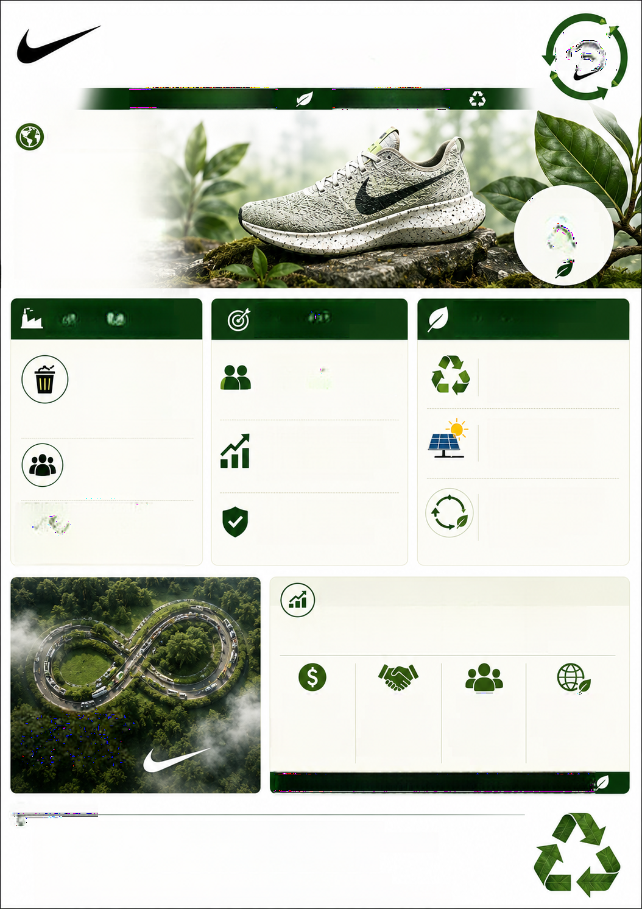
NIKE CIRCULAR COLLECTION:
MOVE
A SUSTAINABLE BRAND EXTENSION INTO CIRCULAR FOOTWEAR
TO ZERO
PERFORMANCE YOU TRUST.
FUTURE WE PROTECT.
BRAND OVERVIEW
Nike is a leading global athletic
footwear brand, known for
innovative design, performance,
CIRCULAR
and deep consumer trust
BY DESIGN.
(Nike, 2024). This strong brand
BETTER FOR
equity and loyal base provide a
THE PLANET.
solid foundation for entering the
sustainable fashion market.
INDUSTRY CHALLENGE &
CONSUMER DEMAND &
ENVIRONMENTAL IMPACT &
STRATEGIC OPPORTUNITY
MARKET DRIVERS
CIRCULAR ACTIONS
The global fashion
The primary target is the eco-conscious
ZERO WASTE
industry produces over
athlete and Gen Z consumer who
The sneakers use at least
92
MILLION
prioritizes environmental impact over
50% recycled content.
TONNES
traditional branding (Deloitte, 2024).
of textile waste yearly
CARBON REDUCTION
Ellen Macarthur Foundation, 2021).
The circular economy is gaining
Manufacturing relies on
Furthermore, 73% of consumers
traction across sportswear, and
renewable solar energy.
expect brands to take meaningful
demand for recycled materials is
action on sustainability
increasing (Mckinsey, 2023).
(Statista, 2023).
MATERIAL INNOVATION
Nike Circular Collection addresses
Robust ESG commitments reduce
The shoe is fully recyclable
this environmental crisis. This strategic
regulatory risks and attract
at end-of-life, closing the
extension offers high-performance
sustainable investment funds.
production loop.
footwear made from recycled materials
and engineered for complete disassembly.
STRATEGIC IMPACT & FUTURE PROMISE
By leveraging Nike's globally trusted name, this strategic
brand extension offers profitable growth to investors and
a guilt-free, ethically sound choice to customers.
PROFITABLE
INVESTOR
CUSTOMER
RESPONSIBLE
CLOSING THE LOOP.
GROWTH
CONFIDENCE
LOYALTY
FUTURE
REDUCING WASTE.
Unlocks new revenue
Strengthens brand
Delivers a guilt-free,
Nike Circular Collection
streams in the growing
value and attracts
ethical choice that
is the future of
CREATING IMPACT.
sustainable footwear
sustainable investment
builds long-term
responsible
market.
funds
trust.
sportswear.
NIKE CIRCULAR COLLECTION IS THE FUTURE OF RESPONSIBLE SPORTSWEAR.
m
REFERENCES
1. Nike (2024) Sustainable Innovation Report. Available at: https://about.nike.com (Accessed: 28 June 2026).
2. Ellen Macarthur Foundation (2021) The Circular Economy in Fashion. Available at: https://ellenmacarthurfoundation.org
(Accessed: 28 June 2026).
3. Statista (2023) Consumer expectations on brand sustainability. Available at: https://www.statista.com
(Accessed: 28 June 2026).
4. Deloitte (2024) Gen Z and Sustainability. Available at: https://www.deloitte.com (Accessed: 28 June 2026).
5. Mckinsey (2023) State of Fashion 2023: Sustainability. Available at: https://www.mckinsey.com (Accessed: 28 June 2026).
Notes:
Good morning everyone.
Today, I am presenting my sustainable brand extension proposal, Nike Circular Collection: A Sustainable Brand Extension into Circular Footwear. Nike is one of the world's leading sportswear brands, recognised for innovation, product quality, and strong customer trust. This established brand reputation creates an excellent opportunity to expand into the growing circular fashion market, where consumers increasingly expect brands to combine performance with environmental responsibility.
The main challenge addressed by this proposal is the environmental impact of the fashion industry. Every year, the industry generates over 92 million tonnes of textile waste, creating significant pressure on natural resources. At the same time, consumers, particularly Gen Z and environmentally conscious athletes, are demanding more sustainable products. Research also shows that many consumers expect brands to take meaningful action on sustainability, while the circular economy continues to gain momentum within the sportswear industry. This creates both a market opportunity and a competitive advantage for Nike.
To respond to these challenges, I propose the Nike Circular Collection. These trainers are designed using at least 50% recycled materials, manufactured with renewable solar energy, and engineered for complete recycling at the end of their life cycle. Rather than following the traditional take, make, and dispose model, the collection supports a circular economy by reducing waste, lowering carbon emissions, and keeping valuable materials in continuous use.
This brand extension also creates significant strategic value. For customers, it provides a high-performance product that aligns with their environmental values. For Nike, it strengthens customer loyalty, enhances brand reputation, and creates new revenue opportunities within the rapidly expanding sustainable footwear market. For investors, stronger environmental, social, and governance performance increases confidence while reducing long-term regulatory and sustainability risks.
In conclusion, the Nike Circular Collection demonstrates how sustainability and business growth can work together. By leveraging Nike's trusted global brand, this extension supports responsible consumption, reduces environmental impact, and positions Nike as a leader in the future of circular sportswear. Thank you for listening, and I welcome any questions.

