Slide 1
Contributing to Coaching and Mentoring
5ADCM

Slide 2
Schedule for Today
Reflections
Portfolio guidance/learning plan, personal statements
Emerging and existing trends driving coaching/mentoring
Coaching and Mentoring Recap
Coaching and mentoring skills – activity
Break around 10:30am for 10 minutes
Coaching and mentoring behaviours
Coaching and mentoring models – practical exercises
Giving feedback principles
Evaluation
Questions
Session Close

Slide 3
Portfolio Guidance
5ADCM– Contributing to Coaching and Mentoring

Slide 4
LO1: Be able to assess the impact of coaching and mentoring activity within an organisation and make recommendations for further development
LO2: Be able to support the implementation of coaching and/or mentoring programmes within an organisation

Slide 5
Requirements
Learners should provide a portfolio (electronic) of evidence, with some basic referencing to show how evidence meets the criteria.
Evidence should primarily be from work activities undertaken by the learner (i.e. work products) although this may be supplemented by other types of evidence, such as: observation, witness testimony, explanatory personal report, professional discussion (with an assessor), question and answer.
Evidence provided for assessment should reflect, or clearly equate to, that stated in the evidence requirements (ER) sections.

Slide 6
Structure
Title page
Contents page
Evidence Matrix – listing evidence for each Assessment Criteria
Personal Statement for LO1 including reference list
Evidence
Personal Statement for LO2 including reference list
Evidence

Slide 7
Personal Statements
Approximately 1000-1500 words each
Use references to support your points (refer to theory, models, research)
Be clear on how you meet the criteria – use the learning outcomes and criteria as headings
Refer to your evidence (number each piece of evidence)

Slide 8
Remember to Consider the Stakeholders in your Organisation
Key Stakeholders:
Employees / Coachees/Mentees
Coach/Mentor/Line Manager
The organisation
Shareholders
Customers
Suppliers

Slide 9
LO1 -Be able to assess the impact of coaching and mentoring activity within an organisation and make recommendations for further development
1.1 & 1.2 Learners should investigate the extent to which coaching and mentoring takes place within their organisation and evaluate how effective this is in supporting achievement of objectives.
1.3 Learners should then assess factors in the organisation which could impact on the further development of coaching and mentoring.
1.4 Findings from all these activities should be used to make and justify recommendations for how coaching and or mentoring could be further developed.

Slide 10
Evidence for LO1
Notes from investigations
Written explanation of extent and effectiveness of current coaching and mentoring activity
Written assessment of factors which could impact on further implementation
Written recommendations for appropriate strategies to further develop coaching and/or mentoring in the organisation.

Slide 11
LO2 – Be able to support the implementation of coaching and/or mentoring programmes within an organisation
2.1 & 2.2 Learners should actively promote and contribute to the development of coaching and/or mentoring in their organisation.
2.3 Learners should also identify the skills, knowledge and behaviours needed by coach/mentors and support the development of these roles
2.4 Assist potential coaches/mentees to understand and participate fully in programmes
2.5 Learners should contribute to on-going evaluation and improvement (e.g. by establishing or co-ordinating evaluation systems, collecting feedback, co-ordinating coach/mentor meetings and/or communications).

Slide 12
Evidence for LO2
Explanation of and/or materials or communications (work products) from: promoting coaching and/or mentoring and contributing to processes.
Evidence of directly supporting coach/mentor capability and assisting coach/mentee participation.
Explanation of how on-going evaluation and improvement has been supported.
Confirmation from other(s) that the learner’s support was effective and met requirements.

Slide 13
Importance of Reflection
Forms the basis of Continuous Professional Development
Constantly learning from our experiences and applying what we have learnt – a continuous cycle
When reflecting you can use a model such as Gibb’s reflective cycle as a framework
State what you have learnt, what you will do differently next time, using theory to underpin your work.
Write in the first person.

Slide 14
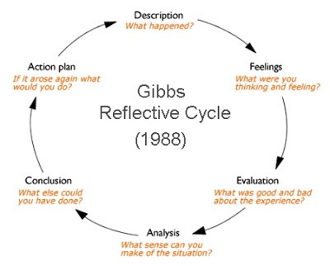
Gibb’s Reflective Cycle

Slide 15
Coaching & Mentoring Trends
Existing
From ‘push’ to ‘pull
From capitalist to spiritualist
From ‘owning’ to ‘accessing’
From ‘traditional mentoring’ to ‘reverse mentoring’
From achievement to balance
Virtual coaches and coaching programmes
Growth in ‘influencers’
Emerging
Artificial intelligence coaching
Augmented reality learning
More emphasis on creative work and collaboration
Remote coaching
The ‘pc’ has given the individual the capability of a business – Apple’s ethos are driving this (“First Start with Why” book.

Slide 16
Broader Trends
Existing
Demographic differences
Agile working
Volatility, uncertainty, complexity, and ambiguity (VUCA)
Emerging
Dramatic upskilling agenda
BREXIT uncertainty
Emerging Asian economies
Neuro-science developments

Slide 17
Coaching and Mentoring
Key Ingredients Recap
Definitions
Similarities and differences
Academic viewpoints
Business leader viewpoints
Best practice examples
Line Manager as the coach / mentor
Evaluating a ROI
Regulatory practices
Quality assurance of coaching / mentoring
Barriers – culture/structure/resources
Other similar learning interventions
Emerging and future trends driving coaching and mentoring
Coaching and mentoring and AI / technology

Slide 18
Skills for effective coaching - activity
Building rapport
Questioning
Listening
Using pauses effectively
Paraphrasing
Demonstrating empathy
7. ‘Serving’ the other person
8. Not operating from our own autobiography
Demonstrating Patience
Any more?

Slide 19
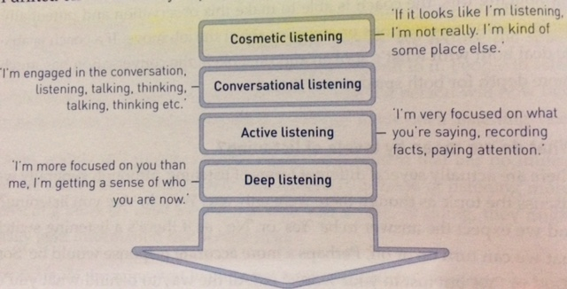
Listening (Starr, 2011)

Slide 20
Questioning Skills
Non – Directive
Helping someone solve their own problem
Reflecting
Asking questions to raise awareness
Giving feedback
Making suggestions
Offering advice
Giving advice
Instructing
Directive
Solve someone’s problem for them
Telling
Notes:
.

Slide 21

Pausing
This Photo by Unknown Author is licensed under CC BY-SA

Slide 22

Effective communication
In any communication, the listener’s impression is based on…
Body language (55%)
Tone (38%)
Words (7%)
Notes:
.

Slide 23
Betari’s Box
My Attitude
EFFECT
Your Behaviour
My Behaviour
Your Attitude

Slide 24
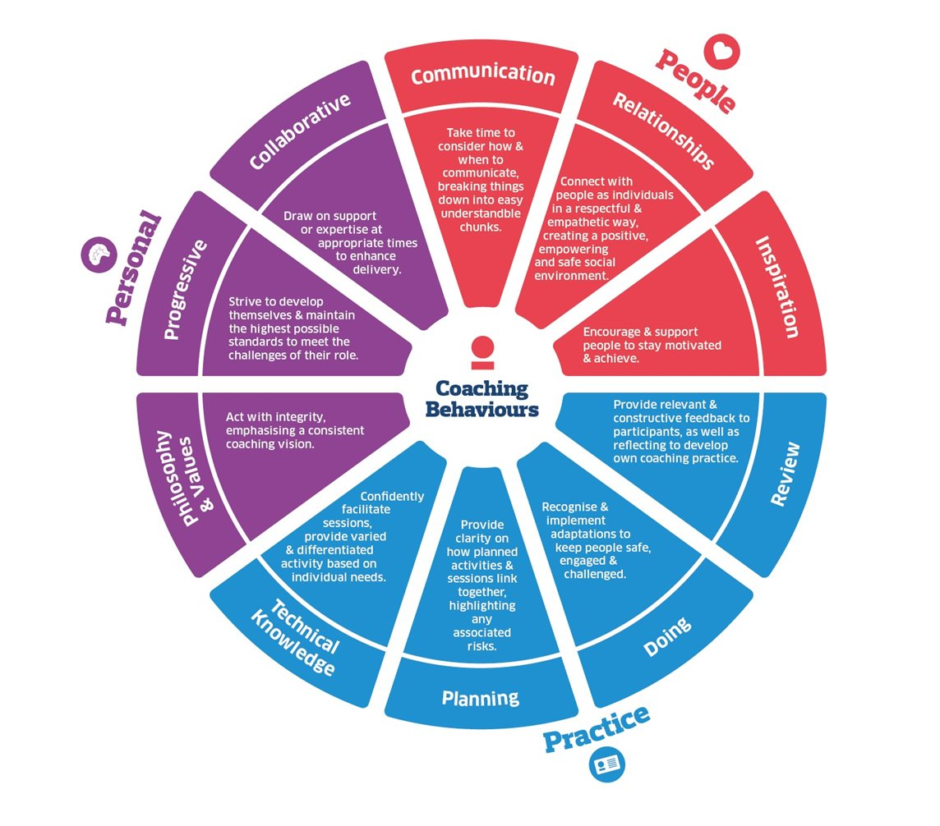
Behaviours https://www.ukcoaching.org/resources/guides/coaching-behaviours

Slide 25
Johari’s window
 | Known by Self | Unknown by Self
Known by others | Open Area | Blind Area
Unknown by others | Hidden Area | Unknown Area
https://www.thecoachingtoolscompany.com/how-to-use-the-johari-window-tool-for-a-new-perspective-on-the-inner-critic-by-ruby-mcguire/

Slide 26
Coaching and Mentoring Models
GROW – Performance Coaching
CLEAR – Performance / transformational
OSCAR – Performance Coaching
Instant pay-off – Corridor coaching and coaching conversations
Transpersonal – Enlightened thinking – “beyond the person”. (See academic view points document).

Slide 27
Principles in giving feedback
1. Prepare for the feedback
session
2. As soon as possible
3. Be specific
4. Ask for their evaluation of the
performance
5. Do not be judgemental
6. Praise or criticise the act not
the person
7. Speak for yourself not others
8. Pitch at the correct level
9. Ask recipient to
summarise feedback
10. Summarise as coach at
regular intervals
11. ‘Put yourself in the others
shoes’ (NLP)

Slide 28
Evaluation
360° feedback questionnaires
Coaching self assessment form – Landsberg (2015) on Moodle
Drawing up coaching plans – keeping track and monitoring
Kirkpatrick’s model – useful guide can be found at https://www.businessballs.com/facilitation-workshops-and-training/kirkpatrick-evaluation-method/
Reflection – Gibbs model as seen earlier
Arema document on Moodle

Slide 29
Further Resources
Resources on Moodle
Cox, E. and Bachkriova, T. and Clutterbuck, D.(2018) The Complete Handbook of Coaching 3rd Ed. London: SAGE.
Clutterbuck, D. and Megginson, D. and Bajer, A. (2016) Building and Sustaining a Coaching Culture. London: Chartered Institute of Personnel and Development.
Clutterbuck, D. and Megginson, D. (2012) Making Coaching Work. London: Chartered Institute of Personnel and Development.
Stewart, J. and Cureton, P. (2016) Designing, Delivering and Evaluating L&D: Essentials for Practice. London: Chartered Institute of Personnel and Development.
Hoyle, R (2015) Informal Learning in Organizations: how to create a continuous learning culture London: Kogan Page

Slide 30
Further Resources
Clutterbuck, D. (2014) Powerful Questions with Professor David Clutterbuck [Internet] Available at: https://www.youtube.com/watch?v=QXU-tAkz_TY (Accessed: 3rd February 2021).
Whitmore, J. (2017) Coaching for Performance The Principals and Practice of Coaching and Leadership 5th Ed. London: Nicholas Brealey Publishing.
Nawalkha, A. Bhushan, N. (2017) The Book of Coaching for Extraordinary Coaches. Mindvalley Beaverton: USA.
Covey, S. (2013) The 7 Habits of highly effective people: powerful lessons in personal change. New York: Free Press
Landsberg, M (2015) The Tao of Coaching: Boost your effectiveness at work by developing those around you. London: Profile Books
Dweck, C (2012) Mindset: How you can fulfil your potential. London: Robinson

