Slide 1
BMSK6006 Developing Emotional Intelligence for the Work Place
Evening Session One

Slide 2
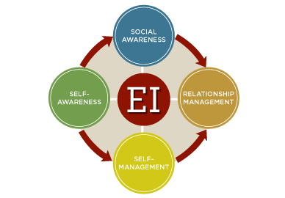

Leadership, Business Performance & EI
What’s driving change?

Slide 3
Megatrends impacting the global business environment
Globalisation
The environmental crisis
Digitisation
Technological convergence
Individualism
Demographic change

Slide 4
Megatrend - Individualism
Driving the need for EI leaders
Individualism
Question
Individual focus - a single entity
Understanding & responding to individual needs
Customer, employee, shareholder
Treating each group as single entity will no longer suffice
Reflect on all four dimensions
What are the implications for workforce development & business performance ?
Notes:
Individualism
will mean having to understand and respond to the individual needs, desires and preferences of each customer, employee, shareholder, and so on. Treating each group as a single entity will no longer suffice.

Slide 5
Megatrend – Demographic Change Driving the need for EI leaders
Demographic change
Question
Increasingly diverse workforce
Managing - a wide variety of age groups, backgrounds, cultures, nationalities and ethnicities
Managing - teams composed of four generations at the same time
Reflect on all three dimensions
What are the implications for workforce development & business performance ?
Notes:
Demographic change
will forge a diverse workforce, made up of men and women from a wide variety of age groups, backgrounds, cultures, nationalities and ethnicities. A particular challenge will be the need to manage teams composed of four generations at the same time, each with different ways of working and outlooks on the workplace

Slide 6
The five ‘reinforcers’ brought about by the megatrends
1. Stakeholder proliferation
  Businesses will need to pay attention to the expectations of a rapidly expanding network of stakeholders
2. Power shift
  Leaders’ power will shift to their stakeholders, reducing their authority
3. New working practices
  New ways of working will emerge, as work goes remote; the boundaries between our personal and professional lives crumble; and a resistance to formal authority takes hold among younger generations.
4. Cost explosion
  Business’ costs will explode due to a scarcity of talent and natural resources; the research, development and use of advanced technology; and the demands of globalisation
5. Ethicisation of business
  Concerns over the environment and technological advancement, coupled with the transparency of the digital era, will demand the highest ethical standards of organisation
.

Slide 7
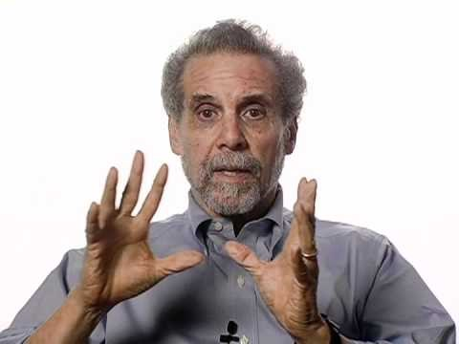
So, what is Emotional Intelligence?
Notes:
If you have problems with the video, please use the URL and paste into your Browser. URL for Daniel Goleman introducing ‘Emotional Intelligence’
https://www.youtube.com/watch?v=Y7m9eNoB3NU

Slide 8
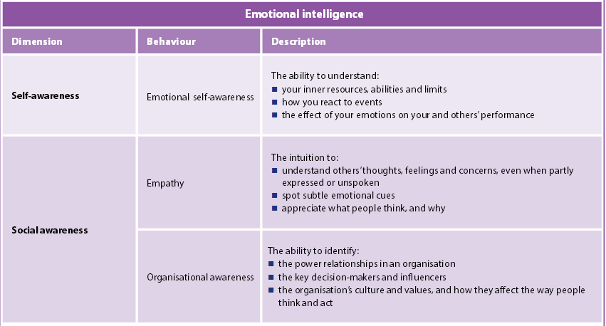

Slide 9
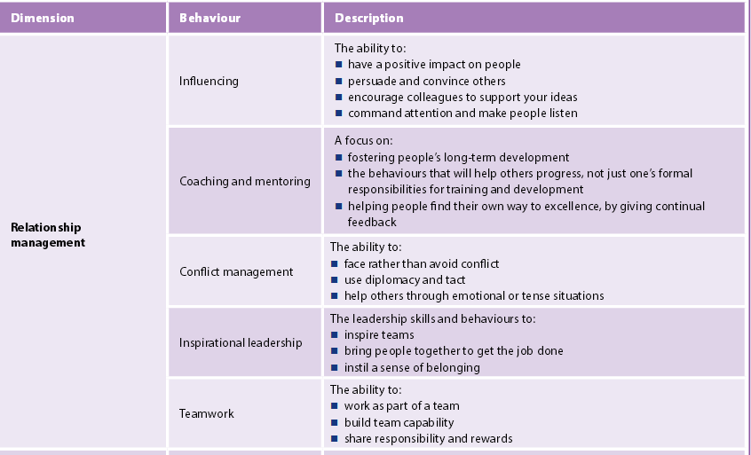

Slide 10
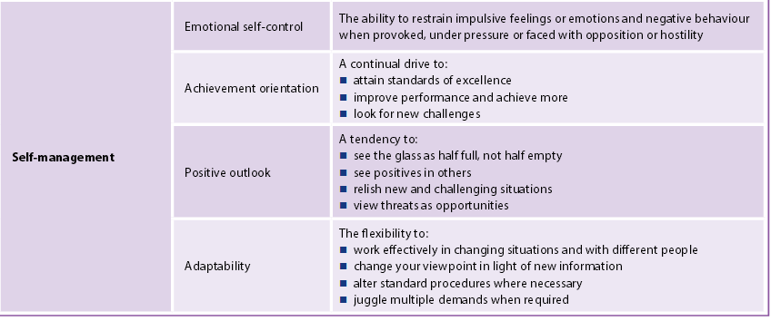
Source:
Hay Group (2015) Is emotional intelligence the key to future leaders’ success? Compiled in partnership with Goleman and Boyatzisersh

Slide 11

Summary/Reflection
Take 5 minutes to reflect on the issues we have covered today…

