Slide 1
BMSS7002 Sport & Exercise Nutrition & Metabolism
To develop an understanding of the structures and processes involved in maintaining physical activity.
To develop an understanding of the nutritional requirements.
To develop and understanding of the acute and chronic adaptations to physical activity.
To develop skills required to assess athletes in metrics relevant to the development of diet and nutritional strategies.

Slide 2
Module Structure
Delivery
Two weekends
One evening session – to be arranged & will be recorded.
Tutorials agreed on an individual basis.
Assessments – each 4500 words
Review article – 22nd Nov 2024
Experimental research – 17th Jan 2025

Slide 3
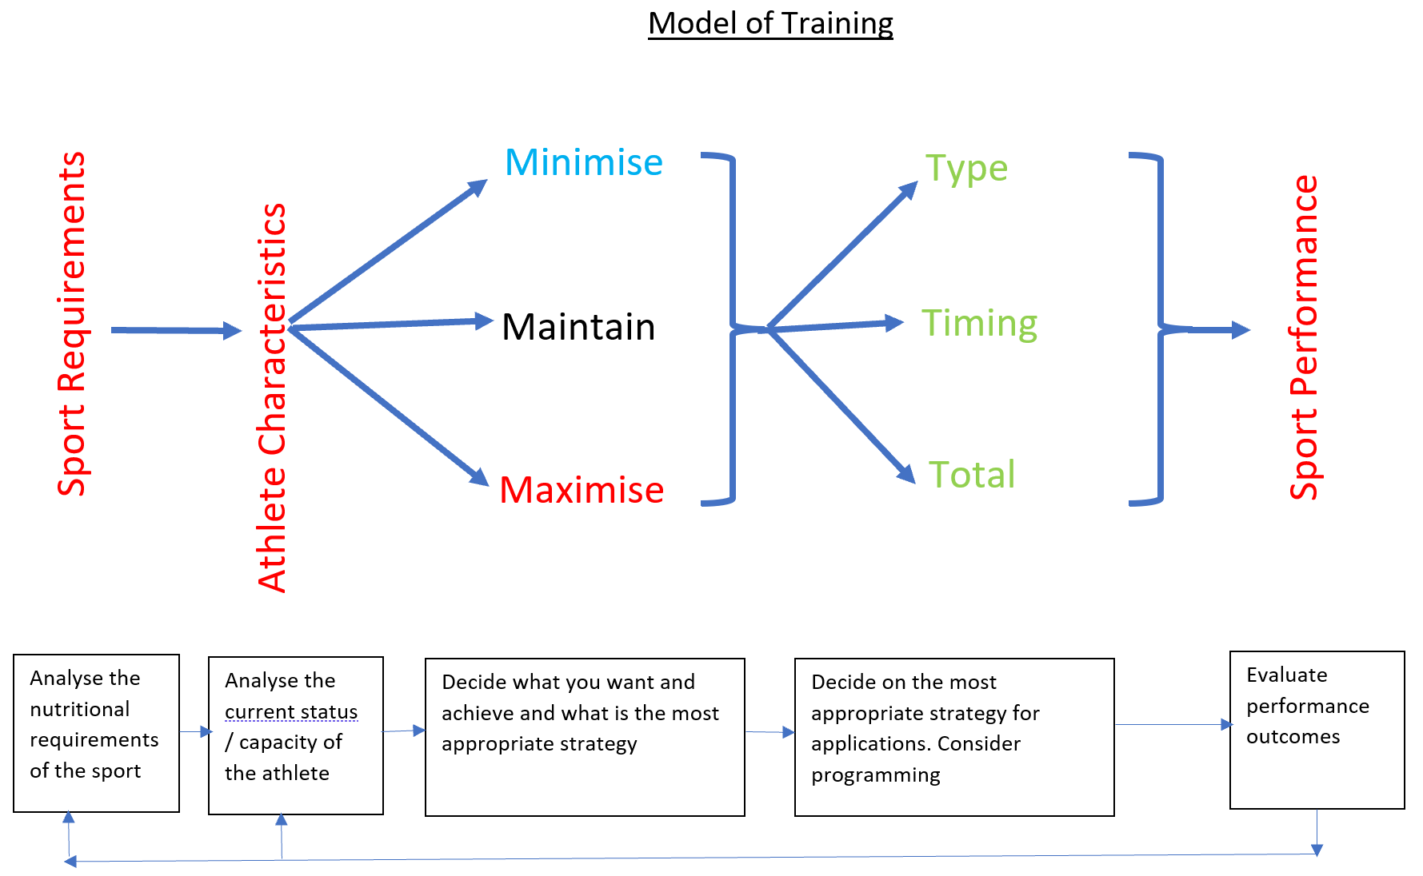

Slide 4
Profiling
The nature of sporting performance
The nature of the athlete
Developing the nutritional strategy - lifestyle
- pre-activity
- during-activity
- post-activity
- overreaching & overtraining

Slide 5
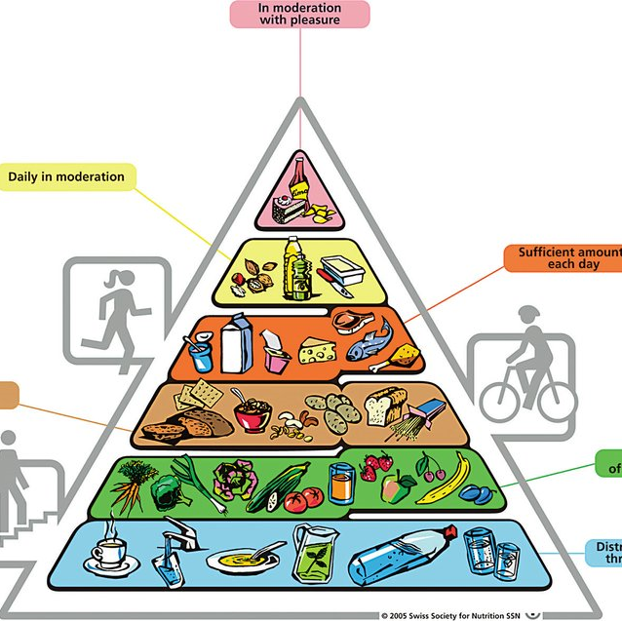
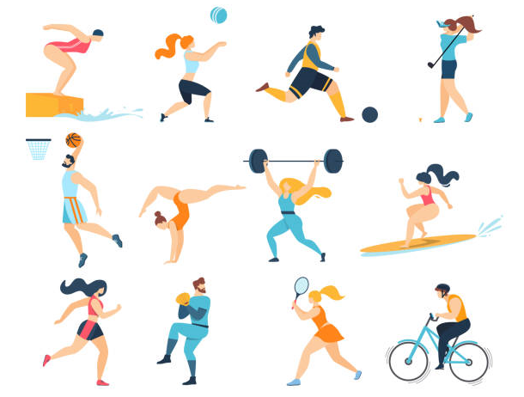
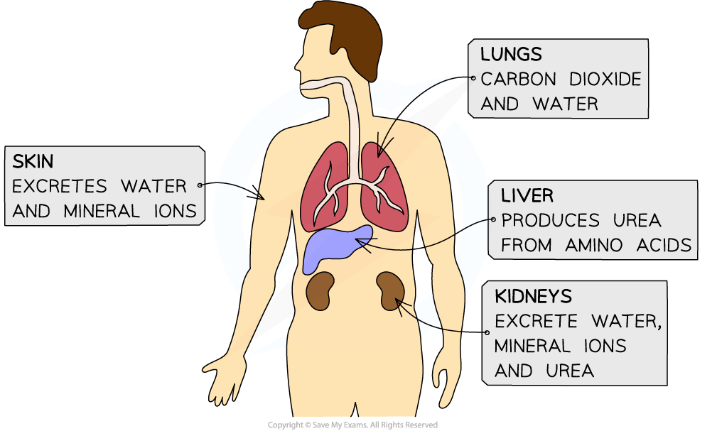
Sport Nutrition
  Oxygen 58.50kg
  Carbon 16.65 kg
  Hydrogen 8.55 kg
  Nitrogen 2.88 kg
  Calcium 1.35 kg
  Phosphorus 0.9kg
  Potassium 0.36kg
  Sodium 0.18kg
  Chlorine 0.18kg
  Magnesium 0.09kg
  Sulphur 0.036kg
  Other stuff 0.09 kg
The purpose of sport nutrition is the supply sufficient atoms in a format that allows an athlete to optimise their performance without undue fatigue
Nutrition
Physiology
Psychology
Biomechanics
Performance

Slide 6
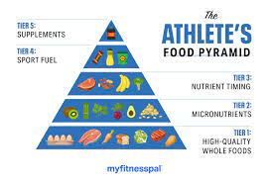
Managing the Dietary Behaviours of your Athletes
Healthy Living
Before Exercise
During Exercise
Post Exercise
Specific training Requirement

Slide 7
What is a Healthy Diet?
Diet v Nutrition
Supplements
Additives
Chemicals
Drugs
Poisons
Carbohydrates
Protein
Fat
Water
Vitamins
Minerals
Phytochemicals

Slide 8
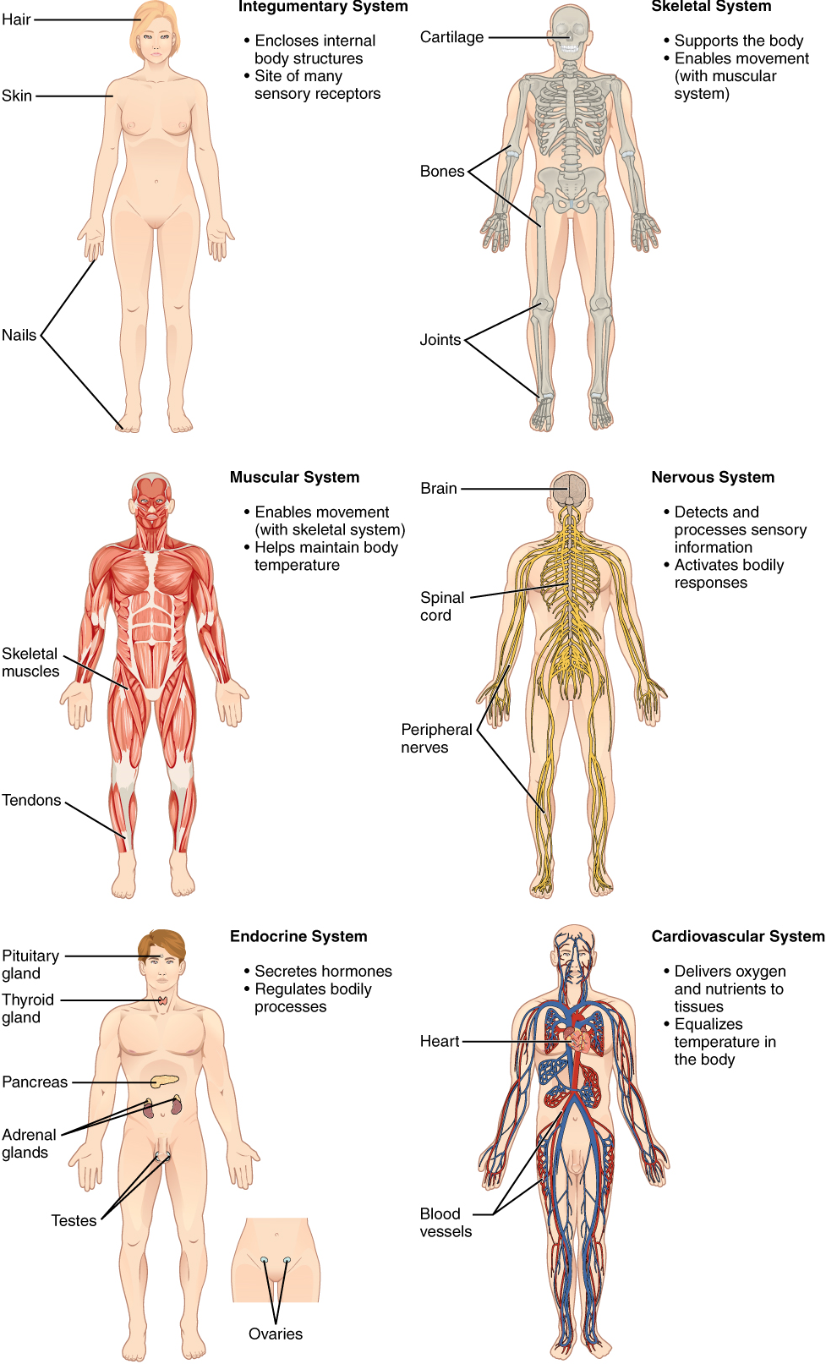
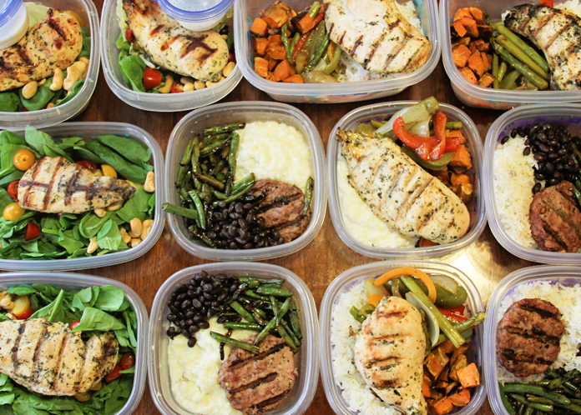
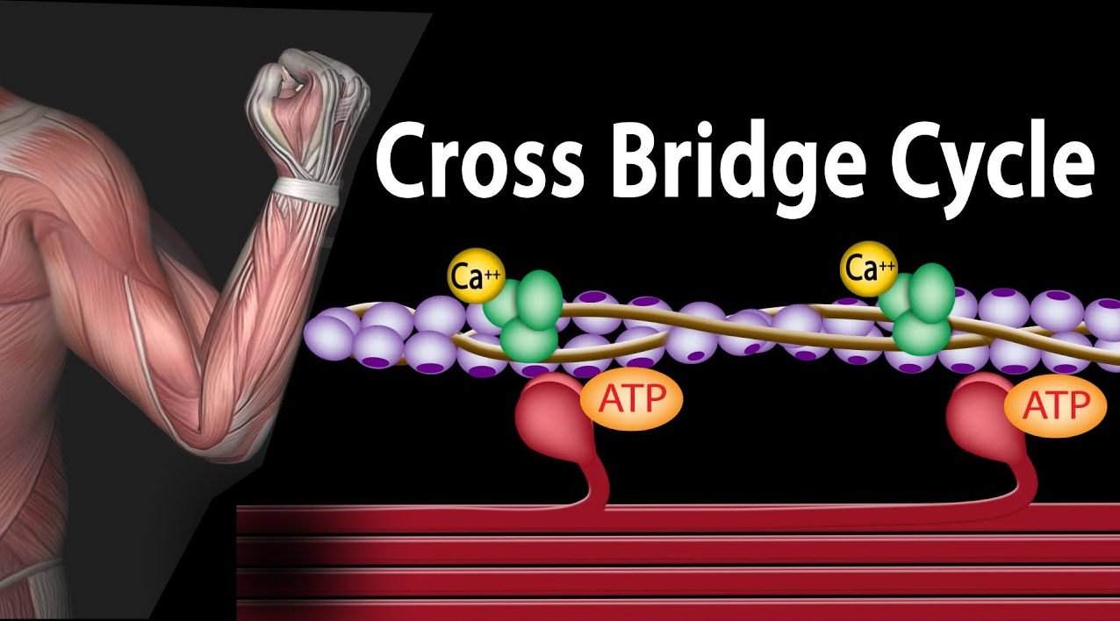
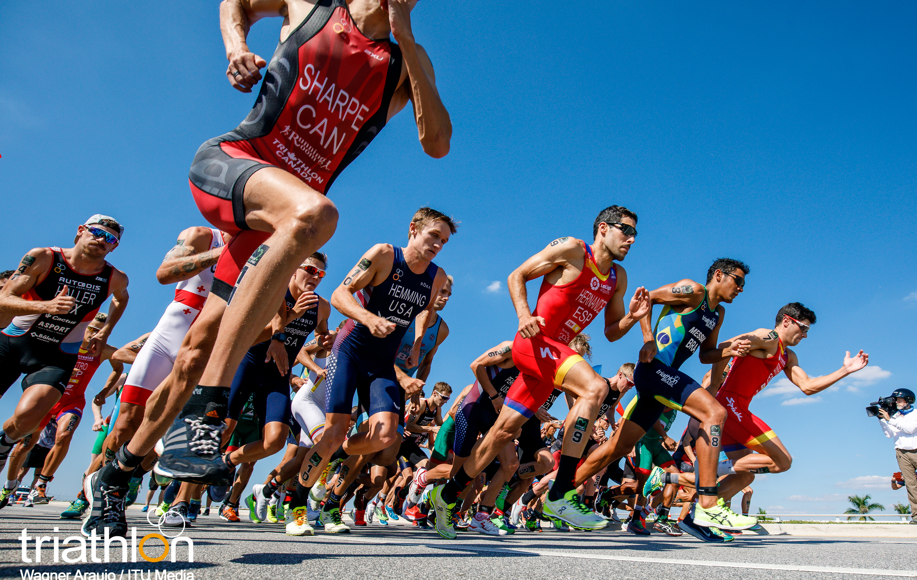
Meals for Athletes

Slide 9
Processing of the Meal
Ingestion
Digestion
Absorption
Assimilation
Utilisation
Elimination

Slide 10
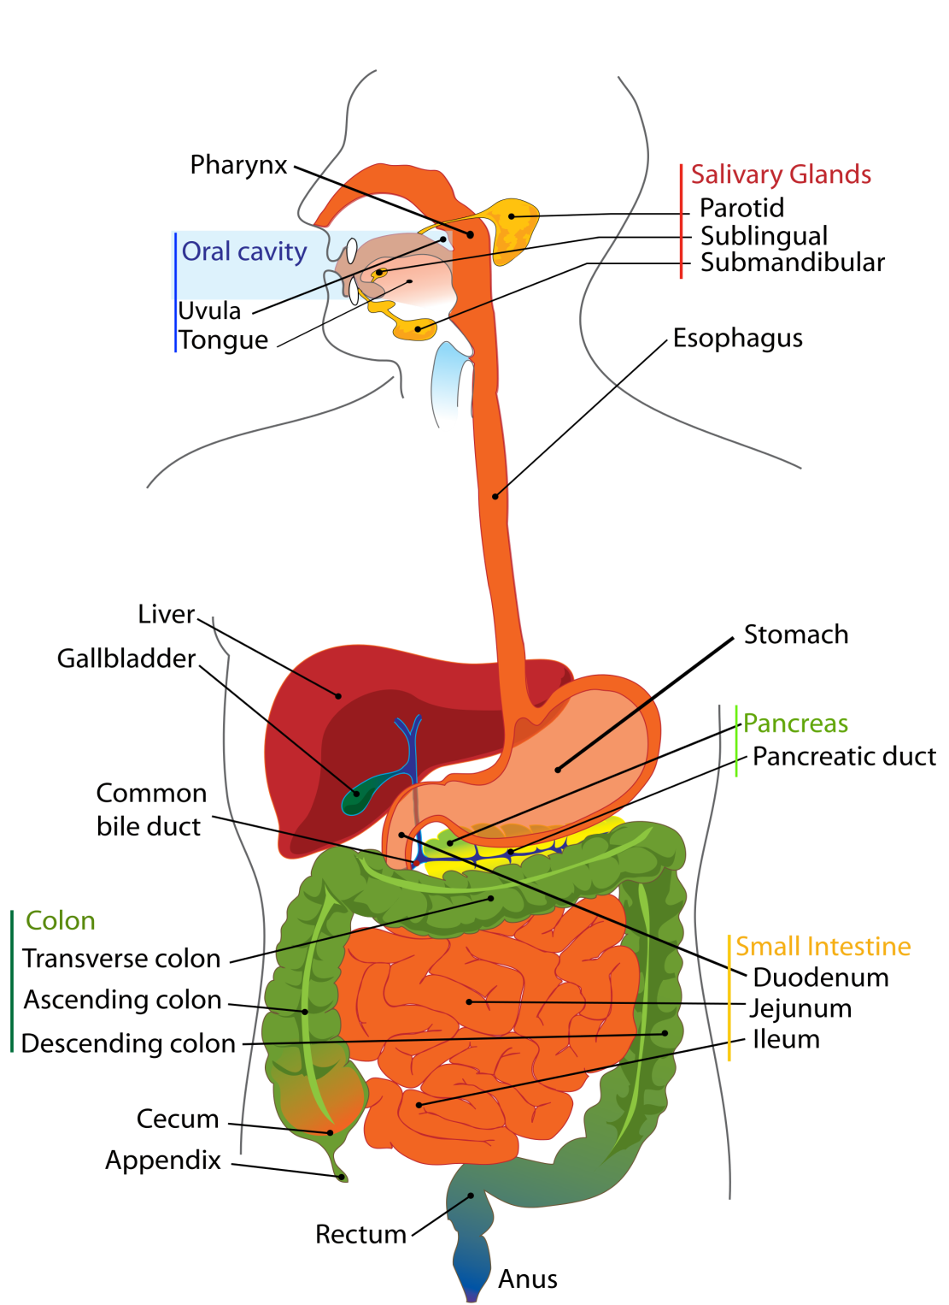
Digestion
Mouth
Oesophagus
Stomach
Small Intestine
Large Intestine
Rectum

Slide 11
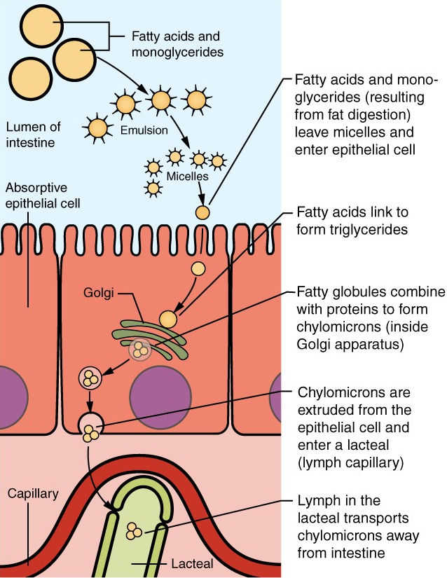
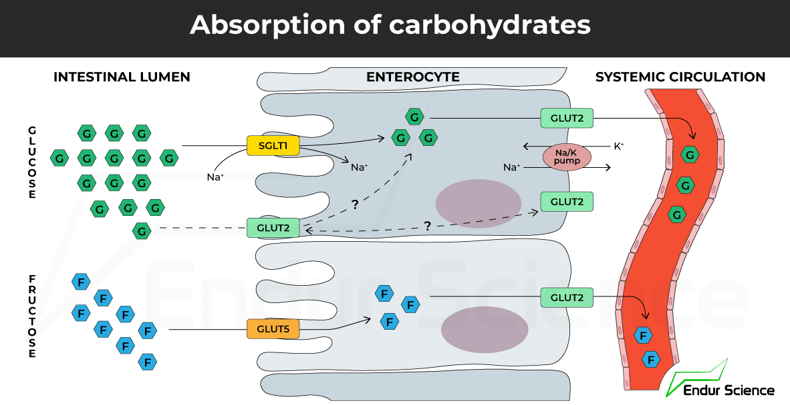
The Enterocyte
The brush border microvilli absorb nutrient in the enterocyte where is transported to either the lacteal (fat) or capillaries (CHO + protein.
Absorption of Fats

Slide 12
Gut Flora
Approx – 100,000,000,000,000 bacteria within the digestive system.
Consisting of between about 40 main types but up to 300-1000 varieties and having a symbiotic relationship.
Roles within the body
  Carbohydrate fermentation and absorption
  Trophic effects
  Repression of pathogenic microbial growth
  Immunity
  Metabolic function
  Preventing allergy
  Preventing inflammatory bowel disease
Continually die and make about 60% of faecal mass

Slide 13
Hormone regulation
Leptin – regulates long term storage of fat in adipocytes
Ghrelin – short term regulation of hunger
Insulin – uptake of blood glucose
Glucagon – secretion of glucose into the blood
Somatostatin – regulates Insulin and Glucagon & down regulates digestive enzymes and hormones.

Slide 14
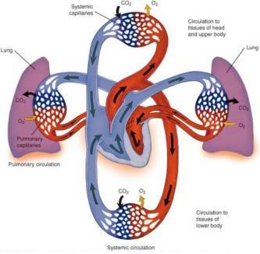
Transport of Nutrients & Oxygen
Cardiovascular system
Pulmonary system
Diffusion, active transport, osmosis
pH, temperature

Slide 15
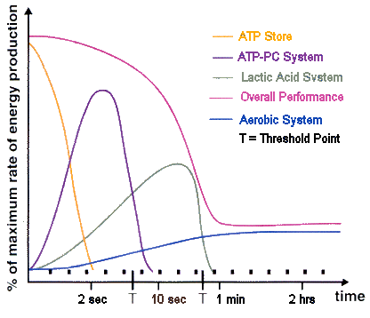
Energy Systems
ATP
PCr
Glycolysis & Lactic acid
Kreb’s cycle
Electron transport
Beta-oxidation

Slide 16
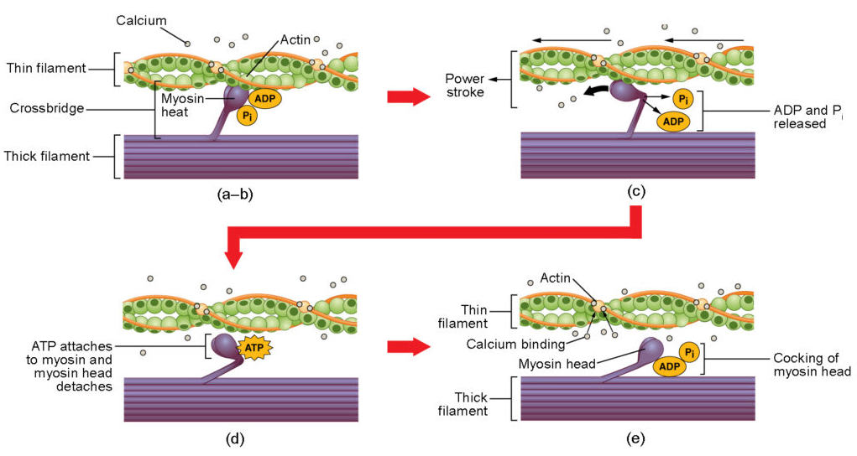
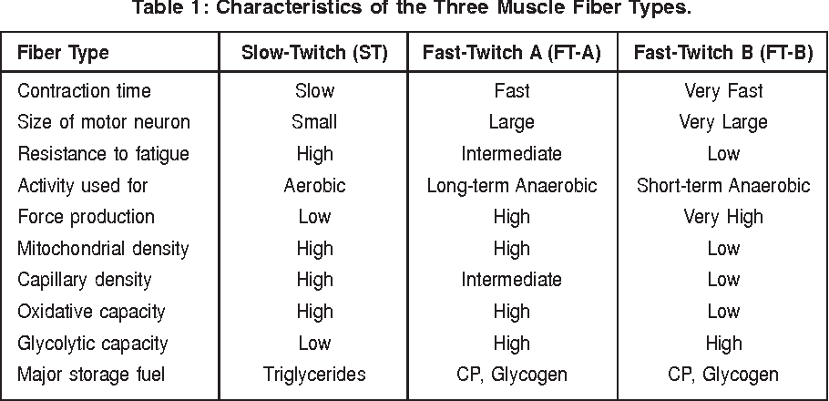
Muscle Contraction
Sliding filament theory
Fibre Types
Physiological adaptation

Slide 17
Excretion
Blood
Lungs & breathing
Skin
Kidneys & urination
Defecation

Slide 18
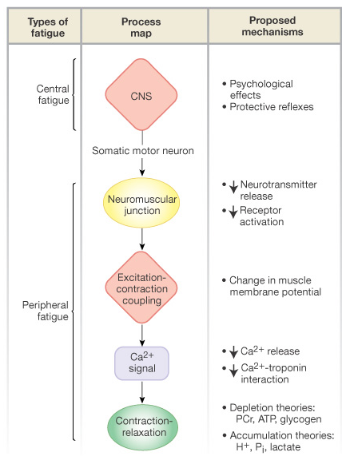
Fatigue
Central v Peripheral Mechanisms

