Slide 1
Assessment for Learning
Hannah John

Slide 2
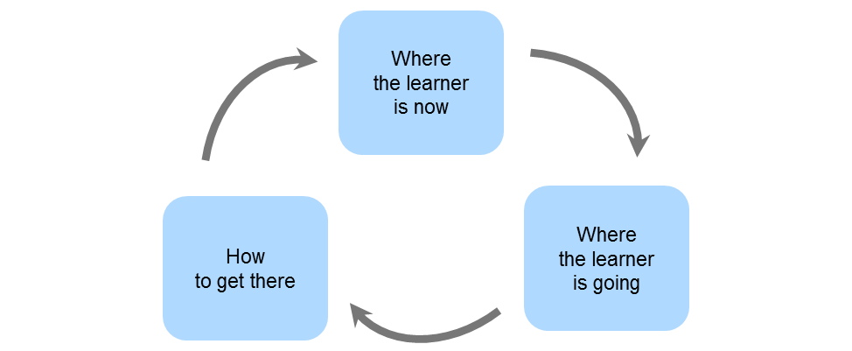
What is Assessment?
Cambridge Assessment International Education (no date)

Slide 3
Principles of AFL
Part of effective planning
Central to classroom practice
Promotes understanding of goals and criteria
Sensitive and constructive
Fosters motivation
Recognises all educational achievement
Focuses on how pupils learn
Helps learners know how to improve
Develops the capacity for peer and self-assessment
A key professional skill
Assessment Reform Group (2002)

Slide 4
Types of assessment
Lancashire Assessment Support Team (2018)

Slide 5
WHAT ARE THE BENEFITS?
Improves outcomes
Increases confidence
Increases independence
Changes the culture in the classroom

Slide 6
Misconceptions
Same as testing
No exams
Teachers lose control
of the class
Peer feedback involves
chatting
No grades

Slide 7
Target setting
Target
Book
Photo
Name:__________
Class: _________
Literacy
Numeracy
Foundation Phase
Key Stage 2

Slide 8
Talk Partners
https://www.tes.com/teaching-resource/talk-partners-poster-11685921

Slide 9
Any questions?

Slide 10
references
Assessment Reform Group (2002) Assessment for learning: 10 principles, Available at: https://www.aaia.org.uk/content/uploads/2010/06/Assessment-for-Learning-10-principles.pdf (Accessed 11th February 2018)
Black, P. and Wiliam, D. (1998) Inside the Black Box: Raising Standards through Classroom Assessment. London: School of Education, King’s College
Cambridge Assessment International Education (no date) Available at: https://cambridge-community.org.uk/professional-development/gswafl/index.html (Accessed 2nd February 2018)
Lancashire Assessment Support Team (2018) Available at: http://www.lancsngfl.ac.uk/curriculum/assessment/index.php?category_id=102 (Accessed 4th February 2018)

