Slide 1
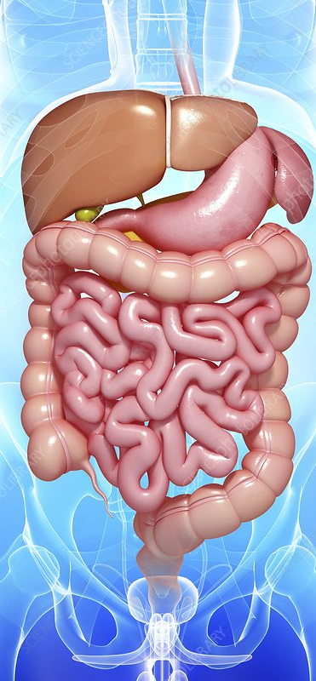
Student Name: Imtiaz Begum
Student ID: 2128130
Module: Introduction to Physiology
Module Code: BMHP5003
Assignment Title: Assessment 1 Academic Poster presentation (Digestive System)
Lecturers Name: Raheela Shaikh.
Human Digestive System

Slide 2
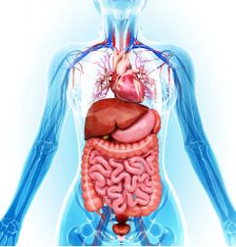
Journey through the digestive system
Ingestion: The process begins when you eat or drink something. The food enters your mouth.
1:Mouth: In the mouth, mechanical digestion starts as your teeth break down food into smaller pieces. Saliva, which contains enzymes, is also released to begin the chemical digestion of carbohydrates.
2:Pancreas: From the mouth, food is swallowed and passes through the pharynx, a junction leading to both the esophagus and the trachea (windpipe). A flap called the epiglottis covers the trachea to prevent food from entering it.
3:Esophagus: The food travels down the esophagus via a wave-like motion known as peristalsis. The esophagus connects the pancreas to the stomach.
4:Stomach: In the stomach, the food is mixed with gastric juices, which contain hydrochloric acid and pepsin, to break down proteins. The stomach's muscular walls churn and mix the food, turning it into a semi-liquid substance called chyme.
5:Small Intestine: The partially digested food, now chyme, enters the small intestine, where most of the digestion and nutrient absorption takes place. The pancreas secretes digestive enzymes, and the liver releases bile to aid in the digestion of fats (Viola, 2021)..
a. Duodenum: The first part of the small intestine is the duodenum. Here, chyme is mixed with pancreatic enzymes and bile.
b. Jejunum and Ileum: The majority of nutrient absorption occurs in the jejunum and ileum, the remaining sections of the small intestine. The inner lining of the small intestine contains numerous villi and microvilli, increasing the surface area for absorption.
5:Large Intestine (Colon): The undigested and unabsorbed material moves into the large intestine, where water and some minerals are absorbed, and the remaining contents are formed into feces.
a. Cecum: The beginning of the large intestine, where the appendix is located.
b. Colon: The colon is divided into several sections, including the ascending colon, transverse colon, descending colon, and sigmoid colon. It absorbs water and electrolytes, forming feces from the remaining waste.
c. Rectum: The rectum stores feces until they are ready to be eliminated.
6:Anus: The final part of the digestive system is the anus. When the rectum is full, a series of muscles and reflexes allow you to voluntarily release feces through the anus, a process known as defecation ((Sircus, 2022).
Mm MOUTH
ESOPHAGUS
STOMACH
PANCREAS
SMALL INTESTINE
LIVER
GALLBLADER
LARGE INTESTINE
(Team, 2018)
(Lorenzo, 2023)
ANUS
Conditions and illnesses
Gastroesophageal Reflux Disease (GERD) - A chronic condition where stomach acid flows back into the esophagus, causing symptoms like heartburn and irritation.-
Irritable Bowel Syndrome (IBS) - A functional gastrointestinal disorder that can cause abdominal pain, bloating, and changes in bowel habits. -
Inflammatory Bowel Disease (IBD) - Includes Crohn's disease and ulcerative colitis, characterized by chronic inflammation of the digestive tract (Medical News Today, 2020).
Peptic Ulcers - Sores that develop on the inner lining of the stomach/small intestine, often due to H. pylori infection or NSAID use.-
Gallstones - Hardened deposits of digestive fluid that can form in the gallbladder, leading to pain. -
Gastrointestinal Cancers - Including colorectal, stomach, and pancreatic cancers.-
Lactose Intolerance - Difficulty digesting lactose, leading to bloating/diarrhoea.
Celiac Disease - An autoimmune disorder where gluten damages the small intestine, causing digestive and systemic symptoms (Kumar, 2022),
Causes of GERD:
Obesity: increased abdominal pressure can force stomach contents back up.
Hiatal Hernia: When part of the stomach pushes up through the diaphragm, allowing acid to reflux more easily.
Smoking and Alcohol: This can increase stomach acid production (Soliman, 2023).
Family history.
Diet and Lifestyle: Large meals, lying down after eating, and certain foods and drinks can increase GERD risk (Guts UK, 2021).
Recommendations for Managing GERD:
.Lifestyle Changes:
a. Diet: Avoid trigger foods and have smaller, more frequent meals.
b. Position: Raise the head of your bed or use extra pillows when sleeping.
c. Weight Management: If overweight, losing weight can help.
d. Smoking Cessation: Quit smoking to improve LES function.
e. Stress Management: Reduce stress through techniques like meditation or yoga.
Medications:
a. Antacids: Provide short-term relief by neutralizing stomach acid.
b. H2 Blockers: Reduce acid production.
c. Proton Pump Inhibitors (PPIs): Prescribed to reduce stomach acid production.
d. Surgery: In severe cases, surgery can be considered to strengthen the LES or repair a hiatal hernia.
e. Regular Follow-up: Keep seeing your healthcare provider for monitoring and adjustments to patients' treatment plan
(Lewis, 2020).

Slide 3

References
Guts UK (2021) Healthy eating and the digestive system. Available at: https://gutscharity.org.uk/advice-and-information/health-and-lifestyle/diet/ (Accessed: 12 October 2023).
Kumar, K. (2022) What are 13 common diseases of the digestive system?, MedicineNet. Available at: https://www.medicinenet.com/13_common_diseases_of_the_digestive_system/article.htm (Accessed: 12 October 2023).
Lewis, S. (2020) Digestive conditions, Healthgrades. Available at: https://www.healthgrades.com/right-care/digestive-health/digestive-conditions (Accessed: 11 October 2023).
Lorenzo Crumbie MBBS, Bs. (2023) Digestive system, Kenhub. Available at: https://www.kenhub.com/en/library/anatomy/the-digestive-system (Accessed: 11 October 2023).
Medical News Today (2020) common digestive disorders, symptoms and treatments: Available at: https://www.medicalnewstoday.com/articals/list-of-digestive disorders (Accessed: 17 October 2023).
Soliman, Y. (2023) Common digestive disorders: Symptoms and treatments, Medical News Today. Available at: https://www.medicalnewstoday.com/articles/list-of-digestive-disorders (Accessed: 11 October 2023).
Sircus, W. (2022) Human digestive system, Encyclopædia Britannica. Available at: https://www.britannica.com/science/human-digestive-system (Accessed: 11 October 2023).
Team, T.H.E. (2018) Digestive system anatomy, area, and diagram | body maps, Healthline. Available at: https://www.healthline.com/human-body-maps/digestive-system (Accessed: 11 October 2023).
Viola, J. and Ristaino, A. (2021) The digestive system: A tour through your guts. New York, NY: First Second Books. (Accessed: 12 October 2023).

