Slide 1
Dr Fahad Khan
PhD (Medical sciences), MSc. in Public health
BDS (Bachelor of Dentistry)
Diploma in Public health, Diploma in Epidemiology
Module: LCHS7002 Health Care System Organization and Leadership
Leadership- Leadership Style-
Week 4

Slide 2
Learning Objectives
- To recap on last week’s session
- To discuss leadership by reference to different leadership styles including:
  The Michigan and Ohio studies of leadership
  Contingency theory of leadership

Slide 3
Leadership Style
In order to influence others, every individual conveys the message across in a different manner, that particular method adopted by the individual forms part of a leadership style.
Good leaders are always good communicators – there are few exceptions! Such as……………………….?

Slide 4
Leadership Style Continuum:
Authoritarian/Autocratic/Directive
Focus of power with leader
Democratic/consultative/participative
Focus of power more group-based
Laissez-faire/delegative
Focus of power with followers
Kurt Lewin
(Lewin et al 1939)
Notes:
4

Slide 5
Classifications of Leadership Style
Authoritarian or Autocratic style.
Democratic style.
Laissez-faire or Genuine style.

Slide 6
Autocratic Leaders
Make decisions without much consultation from the subordinates.
The followers have a high dependency on the leader to perform any actions.
Autocratic leaders will make choices based on their personal ideas and judgments instead of following a framework or taking any advice from the followers.
Autocratic style of leadership has absolute control over a group.
This style of leadership, alongside generating results, can result in de-motivation and alienation of team members.
Autocratic leadership is useful in situations when decisions need to be made quickly without consulting a large group of people.
Some situations require strong leadership styles in order to produce results and accomplishment of the tasks.
Video: First Staff Meeting ( Movie “Lean On Me”, 1989 )
https://www.youtube.com/watch?v=0YRGKK6uCXk

Slide 7
Autocratic Leader
Centralises authority
Dictates work methods
Limits employee participation
Makes and imposes unilateral decisions
Notes:
7

Slide 8
Advantages - Autocratic
Faster decision-making
When there is no need for input and when any input will not strengthen the outcomes of the decision
During times of uncertainty and ambiguity and when people make be looking for direction and support
Notes:
8

Slide 9
Disadvantages - Autocratic
Employee frustration
Decisions may not be successfully implemented without the involvement and input of subordinates
Decisions may even be damaged
Notes:
9

Slide 10
Activity- Discussion – Workshops
15 Minutes
Working individually, write down your responses to the following questions;
1- Can you think of situations where authoritarian leadership style is most suitable?
2- How would you feel as a subordinate if you are not consulted in any decision making and you have to strictly follow the instructions?

Slide 11
Democratic Leaders
Encourage decision making and creativity by participation from various stakeholders.
Could be categorised as consultative, where they consult others before taking a decision.
Democratic leadership is sometimes referred to as rational leadership.
An individual manifesting this type of leadership recognises each person’s self-worth and esteem.
The leader’s actions are based upon trust, integrity, honesty, equality, openness and mutual respect.
Democratic leadership style may help in motivating the team members by giving them a sense of involvement.
It can also improve the sharing of ideas and expectations within the organisation.
However, this style of leadership may result in delayed decision making as the leader awaits input from others.

Slide 12
Democratic Leader
Involves employees in decision-making
Delegates authority
Encourages participation in deciding work methods and goals
Adopts a wholly consultative approach
Uses feedback as opportunity to coach employees
Notes:
12

Slide 13
Advantages - Democratic
Participation sometimes results in higher satisfaction when leaders do not have full insight into the consequences of a specific decision and when the involvement of subordinates may strengthen the outcome of the decision
Enrichment of a decision
It may be that the subordinates feel better motivated through the consultation and involvement
Notes:
13

Slide 14
Disadvantages - Democratic
Decision-making is slow
Difficult to reach a consensus
Notes:
14

Slide 15
Laissez-Faire leaders
Share responsibility with all.
This can help in sharing creative ideas and can be highly motivating for team members.
Leaders act like facilitators rather than dictators.
According to Mullins (2016), a laissez-faire style is where the manager observes that members of the group are working well on their own.
The manager consciously makes a decision to pass the focus of power to members, to allow them freedom of action ‘to do as they think best’, and not to interfere; but is readily available if help is needed.

Slide 16
Laissez-faire Leader
Gives employees complete freedom to make decisions and complete their work in their own way
Minimises involvement in decision making
Provides materials and resources and answers employees’ questions
Notes:
16

Slide 17
Advantages - Laissez Faire
Employees have all the decision making power to make decisions within the realm of expertise
Subordinates may feel motivated by this devolution of power = enrichment of their jobs and improved performance
Notes:
17

Slide 18
Disadvantages – Laissez Faire
Employees are not coordinated
Work may be unstructured
Little direction in order to coordinate and structure
Notes:
18

Slide 19
The Nature of Leadership I
Visionary leadership:
A leader who brings to the situation a clear and compelling sense of the future as well as an understanding of the actions needed to get there successfully
  Vision (A future that one hopes to create or achieve in order to improve upon the present state of affairs)

Slide 20
The Nature of Leadership II
Empowerment
  The process through which managers enable and help others to gain power and achieve influence
  Effective leaders empower others by providing them with:
Information
Responsibility
Authority
Trust

Slide 21
Leadership Traits & Behaviour
Important traits for leadership success
Drive
Self-confidence
Creativity
Cognitive ability
Job-relevant knowledge
Motivation
Flexibility
Honesty and integrity

Slide 22
Styles and leadership
Michigan University studies (1950’s)
Two Styles:
  Job centred - (emphasis on getting job done, achieving goals, subordinates a means to getting task done)
  Employee centred - (special attention to needs of individual, individuals valued for their contributions)
Notes:
22

Slide 23
Styles and leadership
Ohio State University studies (1940’s)
Two Styles:
  Initiating structure (defining roles, allocating work, structuring the work)
  Consideration (building relationships, developing trust, team spirit etc)
Notes:
23

Slide 24
Comparing the two...
 | Michigan study | Ohio study
Leadership style type 1 | Employee-centred | Consideration
Leadership style type 2 | Job-centred | Initiating structure
A remarkable similarity?

Slide 25
The ‘job-centred’
(or initiating structure) leadership style:
decides how things are going to be done
structures tasks and designs work
makes expectations clear
emphasizes deadlines
expects subordinates to follow instructions
stresses production and achievement of goals
The ‘employee-centred’
(or considerate) leadership style:
is interested in and listens to subordinates
allows participation in decision-making
is friendly and approachable
supports subordinates with personal problems
inspires trust, respect, warmth and rapport
Broadly commensurate with
scientific management
Broadly commensurate with the
human relations approach to management

Slide 26

The Michigan and Ohio studies developed the contradiction between democratic (employee-centred/considerate) and autocratic (job-centred/initiating structure) styles of leadership. However, they suggested that a leader can emphasize one style or both styles.
Indeed, it followed that if a leader is to maximize his or her staff’s job satisfaction and task performance, that leader will need to emphasize both. In this way, the Michigan and Ohio studies sought to offer leaders ‘one best way’ to handle followers by adopting the ‘high-consideration, high-structure’ ideal.
Question: But what is the problem with this?
Answer: One size doesn’t fit all.

Slide 27
Leader needs - follower motivation
While trait-based theories explain behavioral tendencies and a leader, they don't explain why people want to lead or indeed why or how people want to be led?????

Slide 28
In order to examine this, we will look at some motivation needs theories that try to explain how and why a leader becomes a leader. …….
It suggests that leadership needs our power affiliation and achievement. Whereas followers needs a much small simple, it's just physical, intellectual, and emotional.

Slide 29
This can be described through three theories, conveniently named, Theory X, Theory Y, and Theory Z, that they described three different attitudes leaders have about the people they are leading or their followers.
This was a theory initially set up in the 1960s by Douglas McGregor, that's Theory X and Theory Y, and Theory Z was added in the early 1980s by William Ouchi.

Slide 30
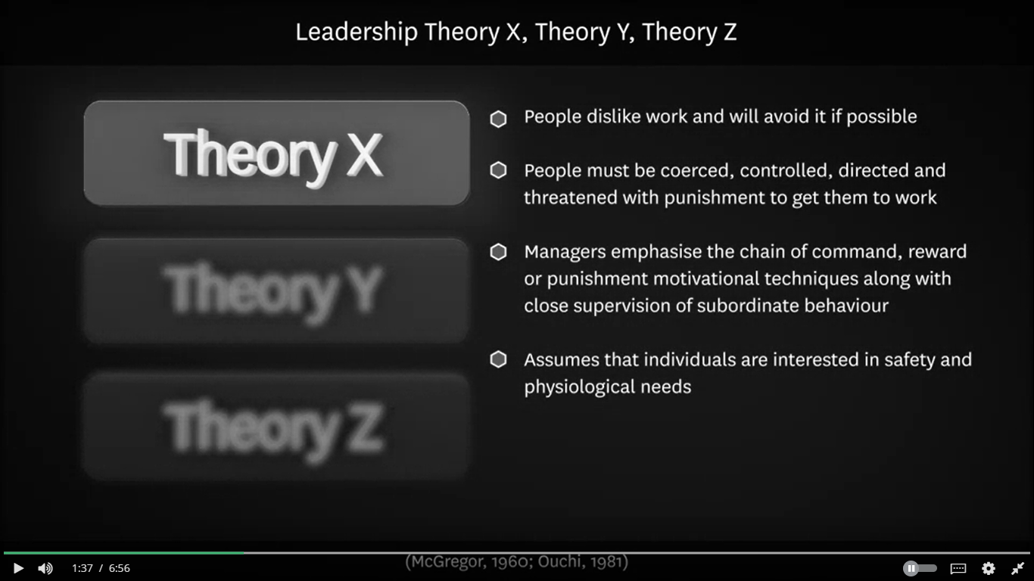
Notes:
Theory X leaders believe that
their employees dislike work,
that they're lazy and they're
automatically going to resist.
Now because of that belief,
there very likely to use coercive practices,
lots of punishment systems
to get the workers working hard.
There will be a strong autocratic tendency,
I say, you do,
don't think, just follow.
Theory Y leaders believe that
employees naturally like work,
they can be enthusiastic,
energetic, and they want to be engaged.
Now because of that positive view of employees,
they have a very participatory style of management.
They want employees to participate in
decisions and they motivate through praise,
recognition, motivating rewards,
either intrinsic or extrinsic.
Theory Z leaders believe that employees want to have
an intimate and happy working environment
with others they work with,
that they want to like
their colleagues and spend time with their colleagues,
and that they value the idea
of organizational culture and
the values in the organization
and family-style relationships.
They believe that workers have a well-developed sense
of order, internal discipline,
a desire to work hard,
and a desire to be cohesive
with the other people they're working with.
There's this ongoing desire to be
part of a social group and part of a wider culture,
and you can set that up within the organization.

Slide 31
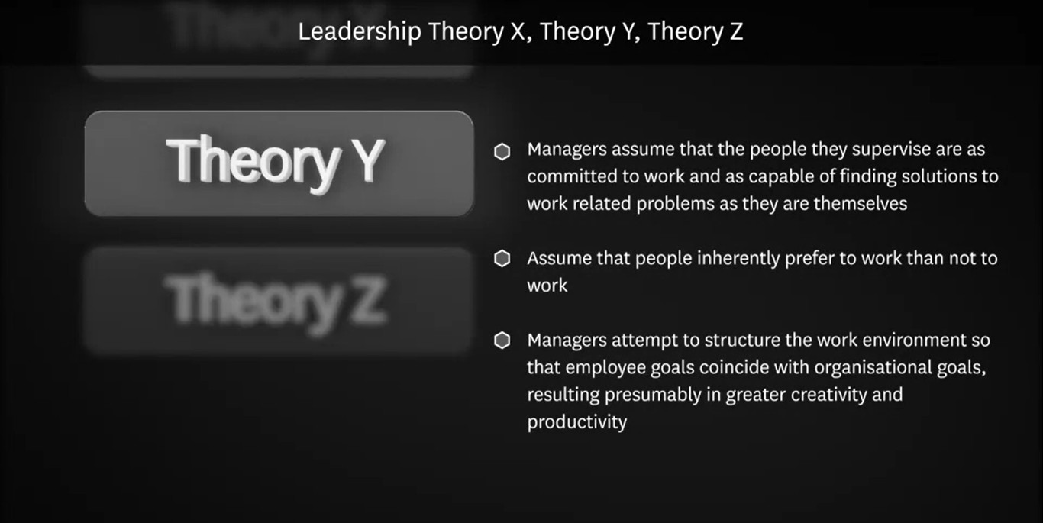

Slide 32
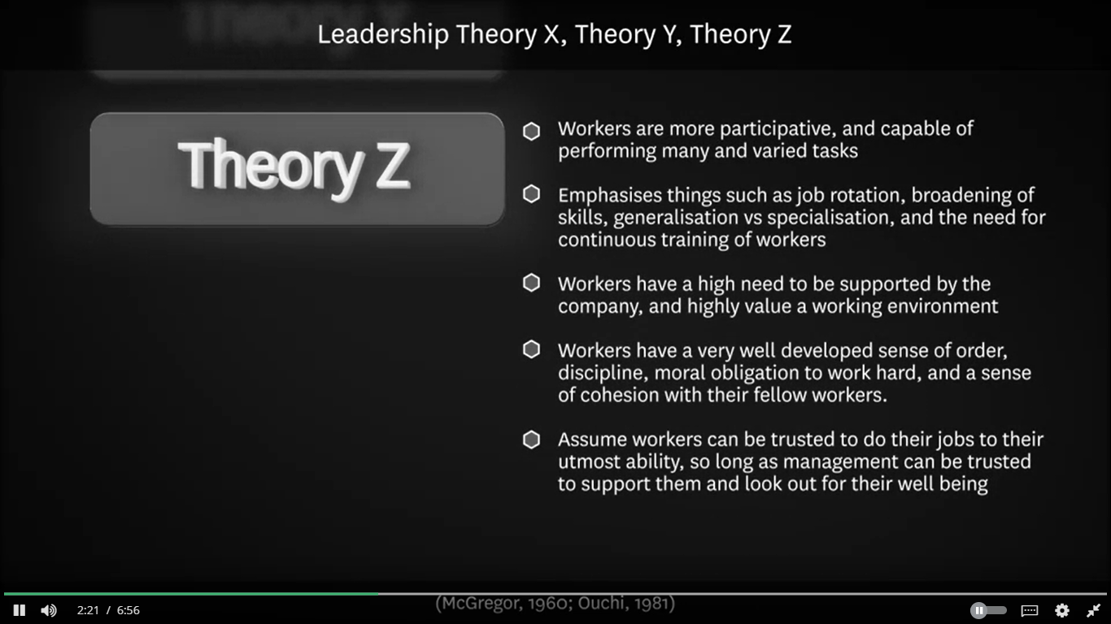

Slide 33
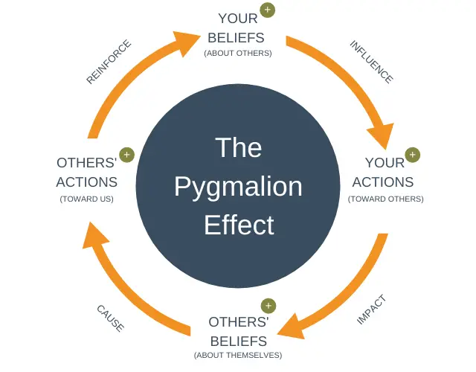
Pygmalion effect
(Rosenthal and Jacobsen, 1968)
Notes:
Self-efficacy self-concept

Slide 34
Activity
Now use RCA, 5 whys and leadership theories with reference to Lewis Blackman story and discuss in the group

Slide 35
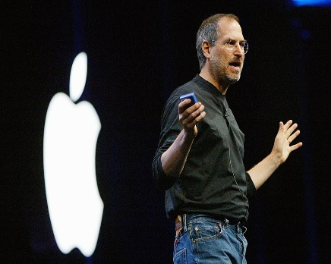
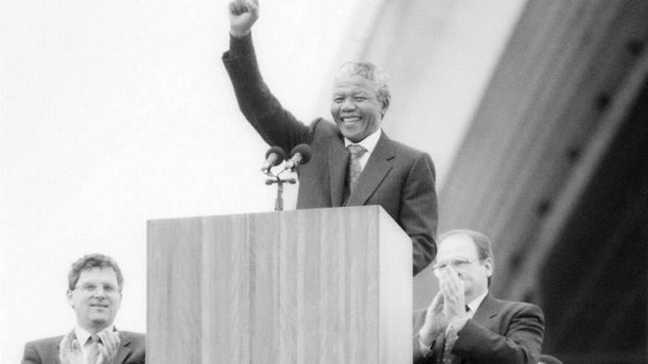
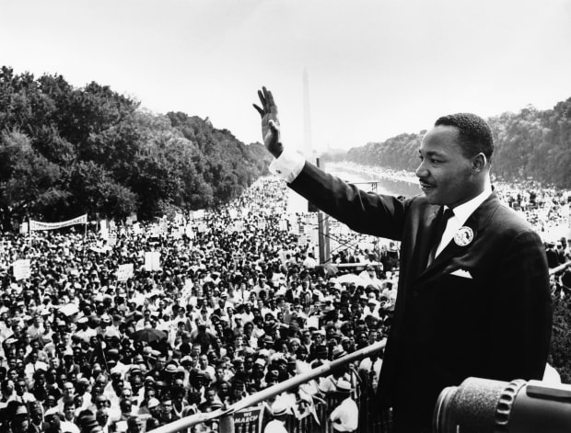
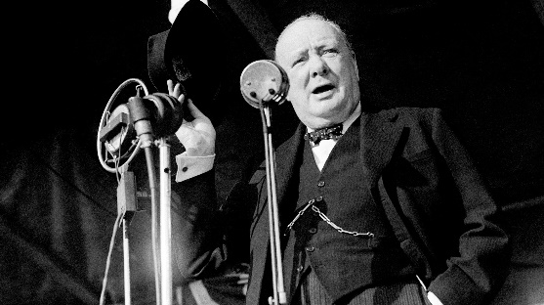
https://www.youtube.com/watch?v=6lQAc6Y_A48
https://www.youtube.com/watch?time_continue=4&v=UF8uR6Z6KLc&feature=emb_logo
https://www.youtube.com/watch?v=vP4iY1TtS3s
https://www.nobelprize.org/prizes/peace/1964/king/acceptance-speech/
https://www.youtube.com/watch?v=MkTw3_PmKtc

Slide 36
Towards a contingency approach
Moving away from a ‘one best way’ model, Tannehaum & Schmidt (1958) presented the autocratic-democratic choice as a continuum, from ‘boss-centred’ leadership at one extreme to ‘subordinate-centred’ leadership at the other.

Slide 37
Situational Leadership
Also known as the contingency model, the situational approach to leadership requires leaders to adapt their style according to the situation they face.
There is no one best style, rather leaders should be able to be flexible and adaptable.
This approach has generated a number of theories, the most significant of which are identified on the following slide.
https://www.youtube.com/watch?v=pykuvuA-QFU

Slide 38
Contingency leadership model
As we have seen, a leadership theory examines some aspect of leadership.
Here we're going to look at leadership models, which is when, rather than just examining one aspect of leadership, we're going to put them all together in a model that explains what is happening and what this leader is doing. It's a whole theory explaining exactly what is going on at all times.
Now, we're going to be looking at three different contingency theory models. One is contingency leadership theory, two is leadership continuum theory, and the third is path-goal theory.

Slide 39
Fiedler's leadership contingency model-
a leader's style was related to their traits and their behaviors and their personality.
It wasn't something that was that adaptable.
It is more about where you should be leading and who you should be leading rather than the level of adaptability that you might have.
There are two styles, task and relationship based, very similar to, on one hand, autocratic, on the other hand, democratic.

Slide 40
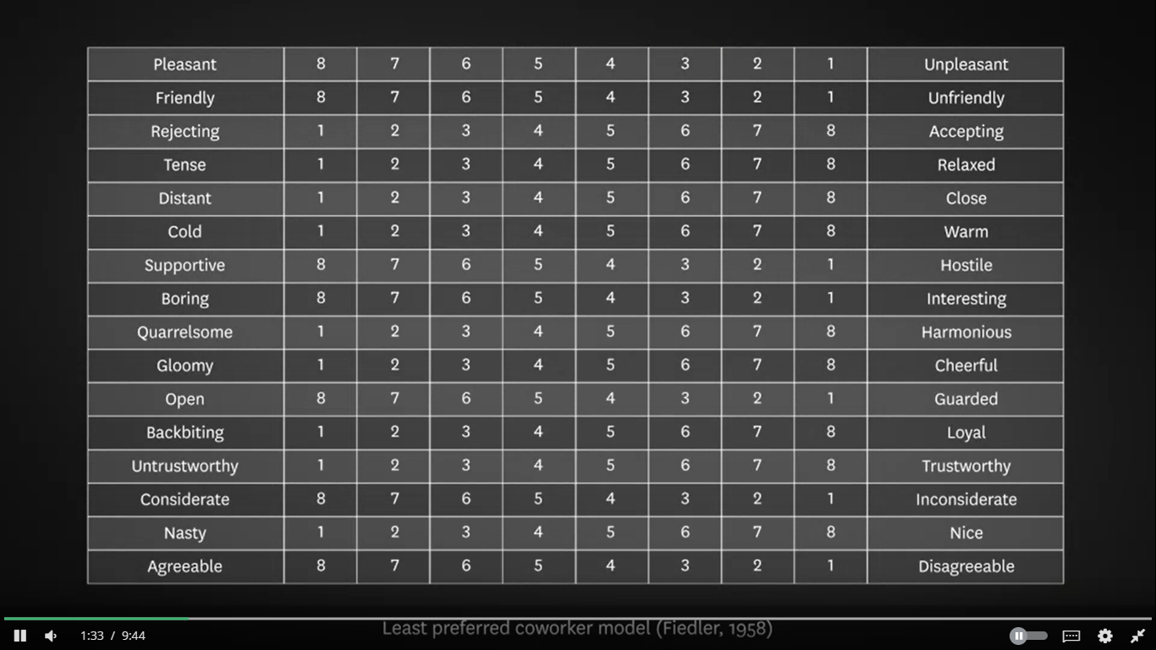
(Fiedler, 1958)

Slide 41
leadership continuum model
Tannenbaum Schmidt’s leadership continuum model-
Now, this model has seven styles and three variables. We've got on one hand fully autocratic and the other hand fully participative, and there's just various different levels of continuum so that you can be almost strongly autocratic to the semi-strongly autocratic to right in the middle all the way down to participative. There is a very fluid set of measurements, there's no seven specific styles. It's just a continuum from one dimension to another.

Slide 42
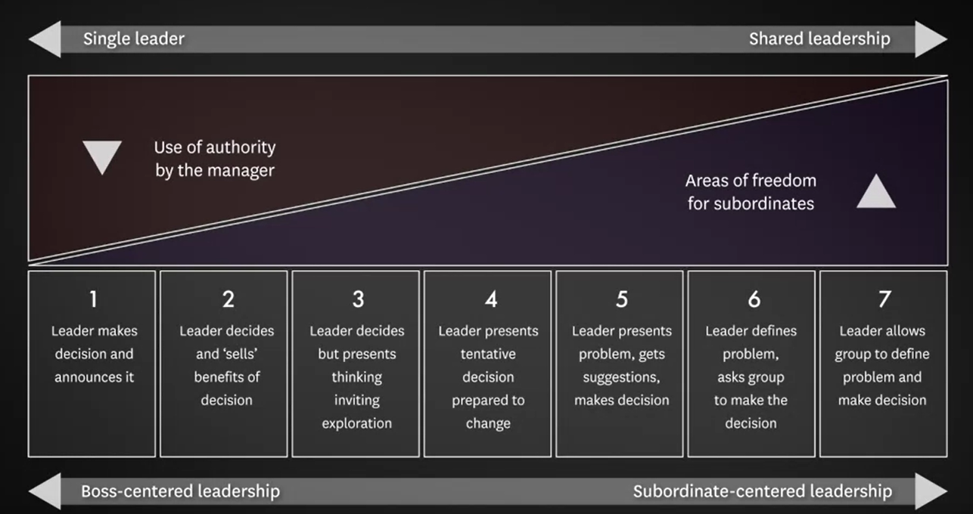
(Tannenbaum & Schmidt, 1973)

Slide 43
The path-goal leadership model.
This one has four styles and six variables. It is a theory of somebody called Robert House. The first of these styles is directive, in which the leader provide high structure, so the policies and the ways in which the job should be done. The second is supportive, in which a leader shows high consideration to the feelings of the employees and make sure that they're actually happy to do the job. The third is participative, in which the leader takes seriously the participative considerations of the employees, how will they going to contribute to the decision making process? The fourth is achievement based, is how does a leader believe that the employees are going to be responding to highly complex difficult challenges. Is that going to drive them forward or not?

Slide 44
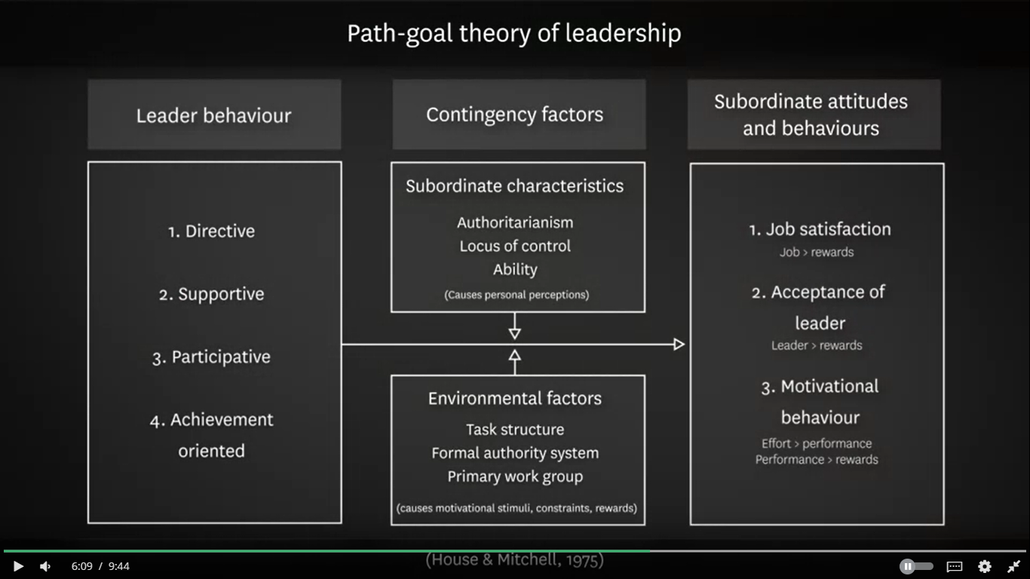
(House & Mitchell, 1975)

Slide 45
In the Next Session
The rise of the team
The role of leaders
The role of followers
Leading with psychological safety
Teams and the future of work

Slide 46
Week 4- Closing
YOUR TAKEAWAY FROM WEEK 4 ………..

Slide 47
References
Hamel states that we need to find ways to "unleash the latent leadership talent" within organisations. Mintzberg says, "from everywhere... come little insights that can emerge into big strategies." What does this mean from your perspective? How do they propose this can be achieved? What leader behaviours does Birkenshaw identify that might support this "unleashing"?:
Hamel, G. (2013). A conversation with Gary Hamel: Transformation of leadership, step-by-step. McKinsey & Company. (4:52)
Birkinshaw, J. (2016, September 7). The ambidextrous leader: when to step in and how to step back. What's best: dictatorial top-down leadership or empowering from the bottom up? London Business School.
Mintzberg, H. (2017, March 22). Some half-truths of management.
Lebowitz uses the OCEAN model to predict leadership emergence and effectiveness; while Grant (2014, Sept) reports that EQ is an ineffective prediction measure. How reasonable and justifiable are these claims?:
Goleman, D. (2012). Emotional Intelligence. Big Think. (5:31)
Global Leadership Foundation (2002). The global emotional intelligence test – sampler.
Lebowitz, S. (2016, December 8). The 'big 5' personality traits could predict who will and won't become a leader. Business Insider.
Which motivation techniques does Pink identify? Which, if any, are used in your current team or organisation? Are they applied effectively? Which would you like to apply to your current team or organisation and why?:
Pink, D. (2010, April 1). Drive: The surprising truth about what motivates us. The Royal Society for the encouragement of Arts, Manufactures and Commerce (RSA). (10:47)

