Slide 1
Female Figurine
By Sean Kirkham

Slide 2
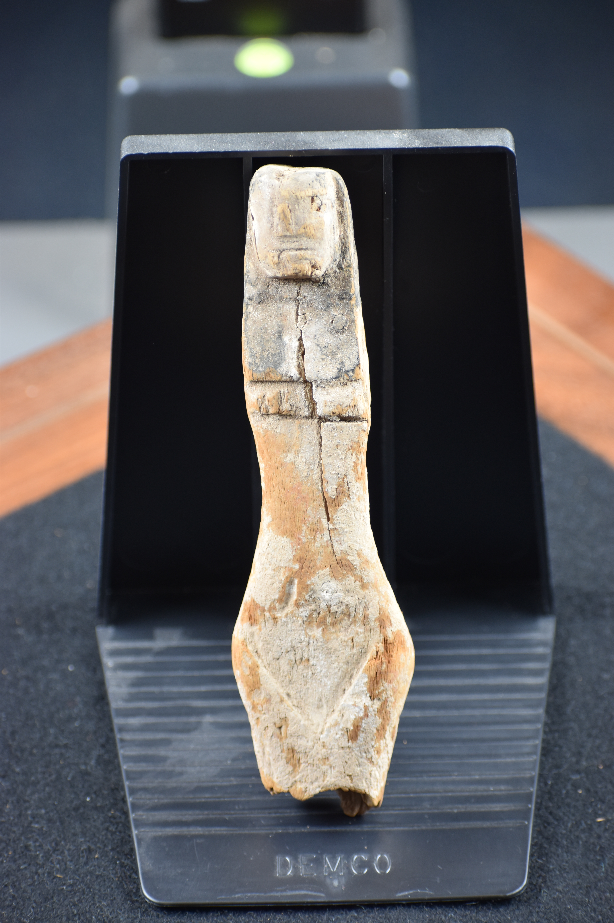
Dimensions
Width at the Head: 2.5cm
Width at the waist: 2.5cm
Width at the hips: 4.5cm
Width at base (broken): 3cm
Overall length: 17cm
Depth at the head: 2.5cm
Depth at the waist: 8mm
Depth at the hips: 2.5cm
Base depth: 2cm
Wooden female figurine

Slide 3
Features
The figurine is made of wood, due to its perishable nature, it may not have been meant to last. Waraksa (2009)
Painted in red and black, the red pigment possibly a symbol of bodily health and linked to magic. Waraksa (2009)
The black pigment likely just represents hair; however, it too has symbolic meaning elsewhere, representing fertility. Waraksa (2009)
Triangle at the bottom of the figure represents the genitalia, it is usually strongly marked as to attract attention, clearly shows that this figurine is female. Murray 1934

Slide 4
Death and burial uses
They have been believed to serve as concubines when found Buriel in male tombs, however they have also been found in female and children's tombs, therefore this is unlikely. Waraksa (2008)
These types of wooden figurines, broken and wooden are not typically found in tombs. Likely due to woods perishable nature. Waraksa (2009)

Slide 5
Religious significance
There are associations with Hathor, Mut, Nut, Taweret, Isis and Selqet. Waraksa (2009)
One figurine could have represented multiple goddesses. Waraksa (2009)
The figurines could have symbolized a promise/vow to a goddess, particularly in reference to fertility, in this context fertility could extend up until the child has reached a certain age. Waraksa (2009)

Slide 6
Other uses
The figurines were primarily for medicinal/magical purposes. Waraksa (2008)
Spells specifically calling for wooden/clay female figurines that repelled snakes or healed stomach aches. The spells also call for the figurine to be broken. Waraksa (2009)
The breaking of the figurine was also a ritual act. Waraksa (2009)
The red paint also indicates the intended medicinal function of the figurines. The red representing the evil of disease and the blood within the body. Waraksa (2009).
The figurines typically represented Isis or Selqet in reference to specific spells. Waraksa (2008)
The figurines were typically a part of a magician's kit. Waraksa (2008)

Slide 7
Conclusion
Most likely not linked to any death or burial rituals
Most likely not used similarly to a shabti, to represent something else in the afterlife.
Could possibly have been buried as a part of a medical kit that could have been needed in the afterlife.
May also have been buried as it was a depiction of a goddess and thus needed to be respected.

Slide 8
Bibliography
Waraksa E, (2009) 'Female Figurines from the Mut Precinct: Context and Ritual Function' . University of Zurich
Waraksa E (2008) 'Female figurines (Pharaonic period)' UCLA Encyclopedia of Egyptology,
Murray M A (1934) 'Female Fertility Figures' The Journal of the Royal Anthropological Institute of Great Britain and Ireland. Vol 64. Royal Anthropological institute of Great Britain and Ireland.

