Slide 1
Critically explore one International Humanitarian Care organization that supports people within one of the following areas:
Poverty and Inequality
Health and Nutrition
Education
Gender and Youth

Slide 2
OXFAM
This presentation will critically discuss the International Humanitarian Care organization OXFAM and demonstrate the policies and practices of humanitarian care through the work of OXFAM and the ways in which this engages with meeting human need.

Slide 3
This presentation will discuss..
What is meant by humanitarian care?
Who are Oxfam and what do they do?
What research has found struggles Oxfam are facing right now?
What has been a success for Oxfam international?
Ongoing humanitarian aid challenges
Similarities and differences in research
What has worked well and what isn’t?

Slide 4
What is meant by humanitarian care?
Aid in emergencies
Gender in emergencies
Keeping people safe
Emergency food security
Refugees
Public Health

Slide 5
OXFAM
Who are Oxfam?
What are their goals and values?
How do they make a difference?
What resources do they use?
Where can they be found?

Slide 6
What struggles are Oxfam facing?
Yemens shattered food economy
What are Oxfam doing to help?
What other problems are the people of Yemen facing?
Is the programme provided by Oxfam a success?
What are Oxfam doing to try and make peace?

Slide 7
The economy of Yemen has halved since 2015. The people of Yemen do not have much salary of any sort and over 80% of the population live beneath the poverty line. In 2018, retail costs in 2018 on products of nourishment were much higher than in the pre-emergency period. Fuel costs had also increased and the breakdown of earnings and increase in costs has pushed food far beyond their reach. (Oxfam, 2019)

Slide 8
West Sumatra earthquake (2009)
What has been a success for Oxfam international?
Gender Equality
Humanitarian responses should meet 'safe programming' ethics for women and young girls, just as men and young boys, in order to handle dangers. Likewise, responses ought to guarantee access to great quality, safe, and confidential services for survivors of gender-based violence.

Slide 9
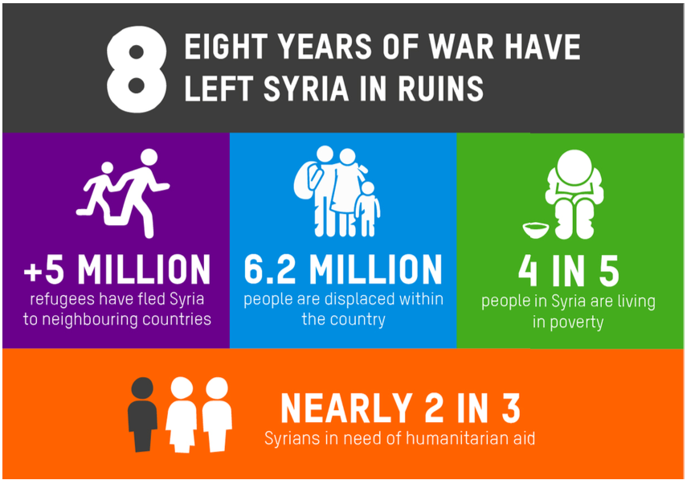
Ongoing Humanitarian Aid Challenges
Humanitarian access is challenging due to the government of Syria’s restrictions. Different parts of Syria are run by the government and other parts can be controlled by other authorities and groups.
This is making humanitarian organizations and other partners unable to provide access to the basic needs of civilians.
The humanitarian organizations and the government of Syria need to work closely together to be able to provide access to sustainable basic needs.
Achilles & Hemsley, (2019)

Slide 10
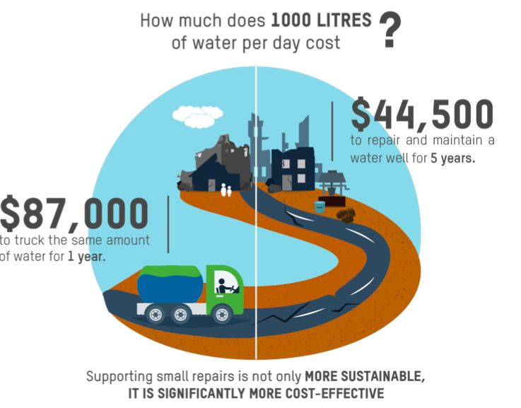
Achilles & Hemsley, (2019)

Slide 11
SIMILARITIES
There can be many similarities and differences within humanitarian crisis across the world and from research found by Yaseen and Hillier, (2019), oxfam international, (2013) and Achilles and Hemsley, (2019) it seems that gender inequality is a strong issue in all areas of research in tackling poverty and helping rebuild lives.

Slide 12
Archilles and Hemsley, (2019)
Found that one in three households are headed by women
Women were found to previously struggle to claim their HLP rights.
This means that they as the social norm they are not on any property deeds which makes it harder for women to have ownership
There can be found that there is lack of access in legal services
Acts of violence affecting ability to claim rights

Slide 13
Oxfam International, (2013)
Found that males are often targeted and killed even though research on 141 different countries found more women are killed during disasters in communities that are poor.
Age, class, ethnicity and disability can all be causes of vulnerability and can form gender inequality
Women face restriction in owning valuable animals
Unequal roles of men and women affect women, girls, boys and men differently in disasters and times of crisis
Women and girls face a higher risk of displacement
Men feel pressured to gain status
Gender based violence increases during and after a disaster

Slide 14
Yaseen and Hillier, (2019)
Women often eat last and least
Further suffering by high rates of physical, psychological and sexual violence
There can be 1.1 million pregnant women who are malnourished
More vulnerable and exposed to further harm because of displacement, access to rights and family instability
Yemen lacks national policies/legislation in protection of gender based violence

Slide 15
POLICY IN PRACTICE
Research can be one of the main areas that Oxfam’s approach is made of. In a world that is fast changing, research can enable organizations such as Oxfam to pinpoint credibility in campaigns that help design programmes to recognize new priorities and add to external debates.
Integrating Gender in research planning is a new guideline for Oxfam. Adding strong gender analysis to research that is surrounded by information on the differences and inequalities in lives of all women, men, girls and women and members of other gender diverse groups can make gender fairer futures and take people out of the norms that dictate attitudes and roles.
Not acknowledging gender in research is seen as not useful research. By not adding gender into the research will question the validity of the findings and social real life situations that people are facing. This would also cause programmes being developed to reinforce and go against challenging the inequalities faced within gender.
Guidelines followed within procedure by Parvez, Butt., Jayasinghe and Zaaroura, (2019)

Slide 16
WHAT IS WORKING FOR OXFAM AND WHAT ISN’T?
There are many policies and laws in which aim to protect and support women in poverty and challenge inequalities. Oxfam’s aim as stated by Oxfam,(2019) by creating programmes within the humanitarian response is to enable women in poverty to hold leadership in all sectors and help take part in the process of recovery after disaster.
An assessment conducted by Oxfam, (2019) found that once a number of women had cash assistance, the money was used to buy medicine rather than food and 14% of female-headed households continued to have a poor food consumption which a lot more compared to the 6% of male-headed households.

Slide 17
Conclusion..
To conclude this presentation has critically explored the humanitarian organization OXFAM that can support people all over the world in areas of poverty and inequality, health and nutrition, education and gender and youth. Research found within this presentation found to focus mainly on poverty, nutrition and gender. It was found hard to directly pin point one area of support within humanitarian need as all of the basic needs surround and fall into each other.
Research by Oxfam International, (2013) states how Oxfam want to involve women in all aspects of the programme in decision making which does allow women to get involved, be able to speak up and has been proven to be a success in humanitarian aid BUT research by Yaseen and Hillier, (2019) really does emphasize the current gender inequality still at large within places of humanitarian need and there can be other issues that act as barriers to the women who want to take part in the response such as cultural restrictions.

Slide 18
References
Achilles, K. & Hemsley, M.(2019) AID IN LIMBO. Oxford, Oxfam.
C. Harvey & I. Smyth (2012) ‘Post-Earthquake Response and Reconstruction: Gender-sensitive advocacy in Indonesia’, Oxfam, http://oxf.am/UvR
Oxfam International. (2013) GENDER ISSUES IN CONFLICT AND HUMANITARIAN ACTION. Oxford, Oxfam GB.
Oxfam International & Hami. (2019) FIGHTING INEQUALITY IN NEPAL. Oxford, Oxfam GB.
Parvez, Butt. A., Jayasinghe, N. and Zaaroura, M. (2019) Integrating Gender In Research. Available at https://oxfamilibrary.openrepository.com/bitstream/handle/10546/620621/gd-integrating-gender-research-planning-210219-en.pdf?sequence=1 Date accessed 18/03/2019
Yaseen, T. & Hillier D. (2019) Yemens shattered food economy. Oxford, Oxfam GB.

