Slide 1
Compare a Global Curriculum with an UK Curriculum.
ECES6013C
Curriculum Studies: Principles and Innovation
Angharad Boswell, 1800739.

Slide 2
Introduction
Develop knowledge of the Finnish Curriculum and the Curriculum for Wales (Foundation Phase Framework)
To be aware of the drawbacks and benefits that come with the Finnish Educational System and their Curriculum
To state the similarities and differences between both the Finnish and Welsh Curriculum
Main Objectives
Notes:
Introduce topic
Explain the main objectives
Key words/terminology

Slide 3
Key Terms and Background Information
Definitions
Curriculum: ‘the subjects studied in a school, college, etc. and what each subject includes’ (Cambridge, 2020)
Global Curriculum: ‘A global education is one that incorporates learning about the cultures, geographies, histories, and current issues of all the world's regions. ... Global education develops students' skills to engage with their global peers and highlights actions students can take as citizens of the world’ (Primary Source, 2020)
Importance of Curriculum
Global learning is essential in the 21st Century
Creates a structure
Responsibility
Meaningful learning opportunities
Inclusivity
Cambridge, 2020.
Primary Source, 2020.

Slide 4
Finnish Curriculum
Main Overview
The curriculum is now managed by the Finnish National Agency for Education (EDUFI)
Main aim: to view the development of each child as a human begin and citizen
School begins at age 7
Breaks after each 45 minute lesson
Up to speed with rapidly changing, complex world
Equal and high-quality education for all
Holistic Approach
The new reform allowed learners to improve their interactions with learning, creating more meaningful lessons and skills that could be transferred into later life
Short school days and minimum homework assignments
Integrative Approach
Vygotsky Theory
Values
Halinen, 2018.
Jokivuori, 2019
Lahdemaki, 2018.
Uniqueness of each individual
High quality education is deemed a basic human right
Education is needed to allow a sustainable life
Looks deeply at humanity, culture, civilisation, equity and democracy
Views cultural variety as richness (Lahdemaki, 2018)

Slide 5
Finnish Curriculum
Benefits
Drawbacks
Lack of self-belonging
Poor attitude
More peer pressure
Treated as Equals
Not enough learning time
Late age start
Free education, even at university level
Pupil centred
Child centred learning approaches
Teachers are highly valued and educated professionals
The new reforms purpose was to improve students opportunities surrounding their learning
Teachers have pedagogical autonomy
Social mobility
Treated as equals
Halinen, 2018.
Jokivuori, 2019.
Kaila, 2017.

Slide 6
Curriculum for Wales: Foundation Phase
Main Overview
Foundation Phase Framework introduced 2010, and updated in 2015 by the Welsh Government
Framework aimed at children aged 3-7 years
Encourages children to be initiative, imaginative and creative
Get the Best for Wales Approach
Main approach is to educate and building context for lifelong success
Aim to ensure that all children are receiving positive, inclusive education
Pedagogy – experimental, play-based, outdoor learning, practitioner-directed activities
Vygotsky Theory
Statutory Areas of Learning
Personal and Social Development, Well-being and Cultural Diversity.
Language, Literacy and Communication Skills.
Mathematical Development.
Welsh Language Development.
Knowledge and Understanding of the World.
Physical Development.
Creative Development (GOV, 2015).
Wainwright, 2019.
GOV, 2015.
GOV, 2012.

Slide 7
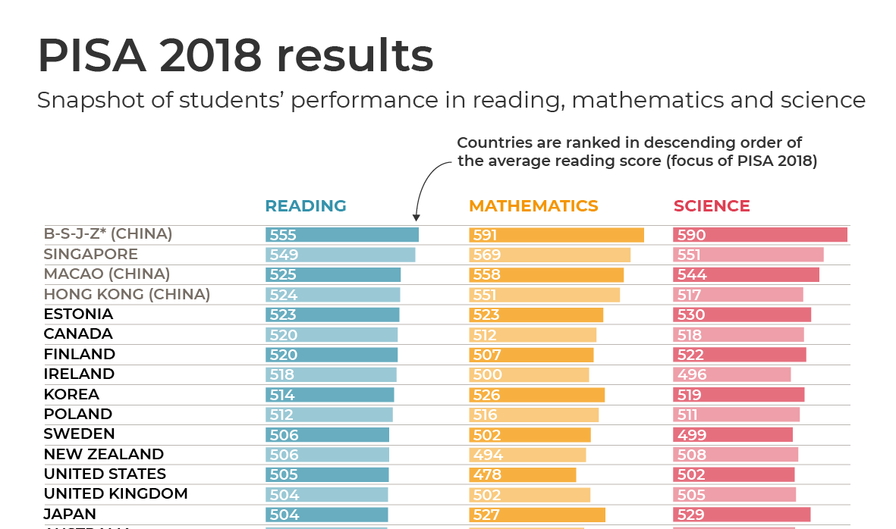
PISA Results
OECD, 2018.
Figure 1: PISA Results 2018 (OECD, 2018).

Slide 8
Compare and Contrast
Similarities
Differences
Child-based learning
All rights of each individual are considered
The use of play (pedagogy)
Vygotsky Theory
Degree level required to become a teacher
Finland lack test assessments
Finland show less variation between the most able and least able students
Wales look at equity and equality
Longer breaks in Finland
BBC, 2011.

Slide 9
Conclusion
Even though all Curriculum’s show different approaches, they are all aimed towards building strong, socially acceptable individuals.
‘Article 28 of the UNCRC says that children and young people have the right to education no matter who they are: regardless of race, gender or disability; if they’re in detention, or if they’re a refugee’ (CYCPS, 2017).

Slide 10
References
BBC. 2011. Can Welsh schools learn lessons from Finland? [online]. Available at: https://www.bbc.co.uk/news/uk-wales-14727587 [Accessed: 18 October 2020].
Cambridge Dictionary. 2020. Meaning of Curriculum in English [online]. Available at: https://dictionary.cambridge.org/dictionary/english/curriculum [Accessed: 15 October 2020].
CYCPS. 2017. UNCRC Simplified Articles. [online]. Available at: https://cypcs.org.uk/rights/uncrc/articles/article-28/ [Accessed: 18 October 2020].
GOV. 2015. Curriculum for Wales. Foundation Phase Framework (Revised 2015) [online]. Available at: https://hwb.gov.wales/api/storage/d5d8e39c-b534-40cb-a3f5-7e2e126d8077/foundation-phase-framework.pdf [Accessed: 17 October 2020].
GOV. 2012. Evaluating the Foundation Phase: Policy Logical Model and Programme Theory. [online]. Available at: https://orca.cf.ac.uk/88812/1/130318-evaluating-foundation-phase-policy-logic-model-programme-theory-en.pdf [Accessed: 17 October 2020].
Halinen, I. 2018. The New Educational Curriculum In Finland [online]. Available at: http://www.allianceforchildhood.eu/files/Improving_the_quality_of_Childhood_Vol_7/QOC%20V7%20CH06%20DEF%20WEB.pdf [Accessed: 16 October 2020].
Jokivuori, S. 2019. The Advantages of the Finnish Education System [online]. Available at: https://www.baronarelocation.com/blog/the-advantages-of-the-finnish-education-system#:~:text=Finnish%20education%20system%20promotes%20a,methods%20of%20teaching%20and%20styles. [Accessed: 16 October 2020].
Kaila. K. 2017. What are the pros and cons of Finland's education system? [online]. Available at: https://www.quora.com/What-are-the-pros-and-cons-of-Finlands-education-system [Accessed: 18 Octoer 2020].
PISA, 2018. PROGRAMME FOR INTERNATIONAL STUDENT ASSESSMENT (PISA) RESULTS FROM PISA 2018. [online] Available at: https://www.oecd.org/pisa/publications/PISA2018_CN_GBR.pdf [Accessed: 18 October 2020].
Primary Source. 2020. What is Global Education? Educating Global Citizens [online]. Available at: https://www.primarysource.org/about-us/what-is-global-education [Accessed: 15 October 2020].
Wainwright, N. 2019. Early Child Development and Care. Playful pedagogy for deeper learning: exploring the implementation of the lay-based foundation phase in Wales. [online].Available at: https://www.tandfonline.com/doi/abs/10.1080/03004430.2019.1653551?journalCode=gecd20#:~:text=The%20Foundation%20Phase%20framework%20advocates,(2015). [Accessed: 17 October 2020].

