Slide 1
Materialities
Theory:
Gender

Slide 2
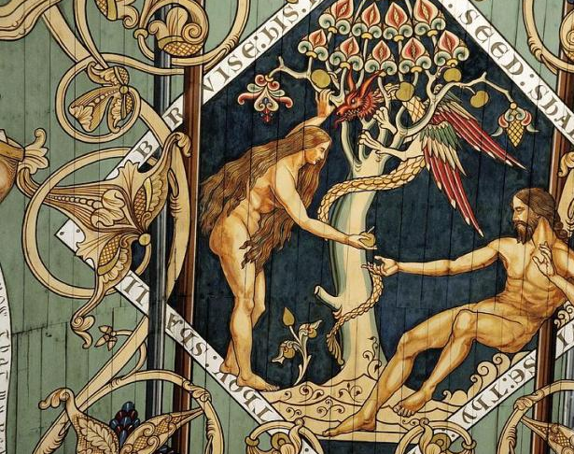
We’ve all got bodies
Women and men have different bodies
We were all assigned a sex at birth
Gender does not equal sex
There are two sexes but many different genders: age, status, sexuality, group affiliation, national affiliation, race etc.
Gender theory is about identity

Slide 3
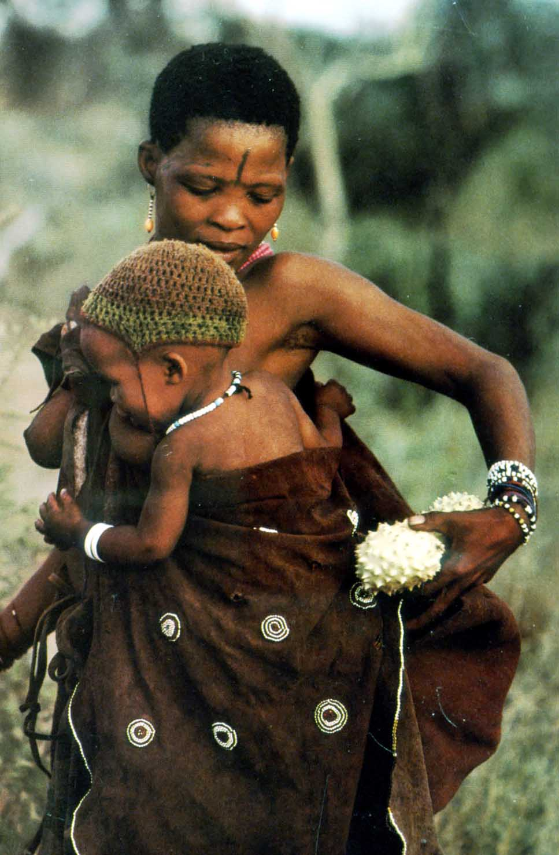
Sexual division of labour:
Women and men have different roles because of their differing bodies
Women give birth to children
Women are the prime child carers
(especially when breastfeeding)
Women contribute their labour while caring for children
Women stay near the home (private sphere)
!Kung San woman the gatherer
!

Slide 4
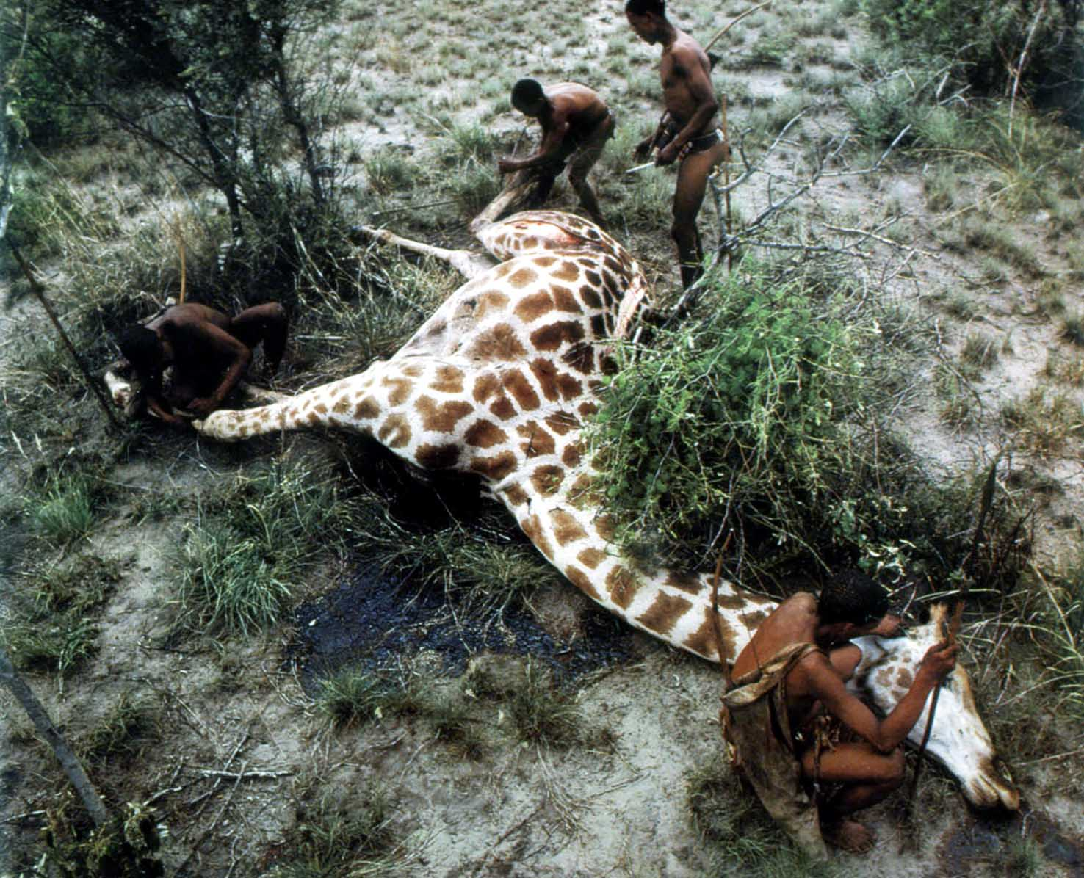
Sexual division of labour:
Women and men have different roles because of their differing bodies
Men are stronger than women
Men can be freed up from childcare
They can work away from the home base (public sphere)
!Kung San, man the hunter

Slide 5
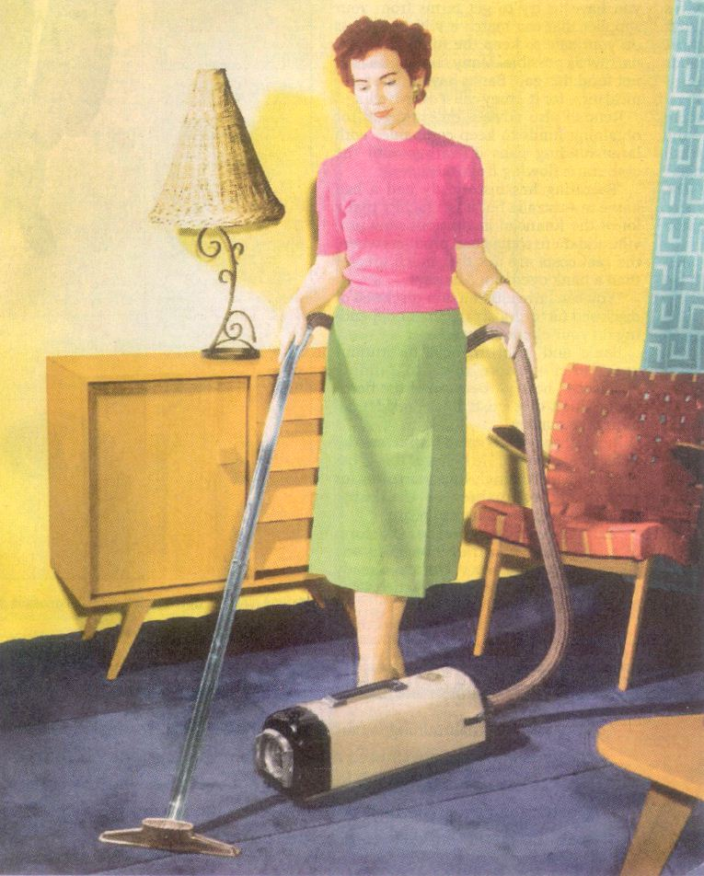
1950s
Western men and women
Women worked at home (in the private sphere)
looking after children
doing housework, cooking, shopping
Men went OUT to work (public sphere)
Earning wages

Slide 6

1960s
The contraceptive pill
Women could choose whether they had children or not, they could choose when they had children
Women could go OUT to work
They could earn their own money

Slide 7

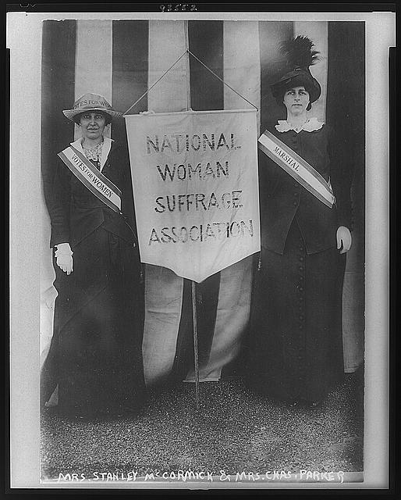
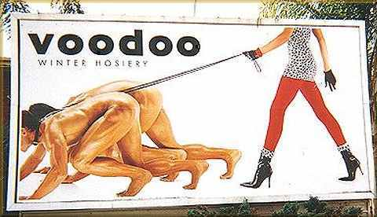
Feminism in history first, second and third wave
Womens rights
Equality
Superiority?

Slide 8


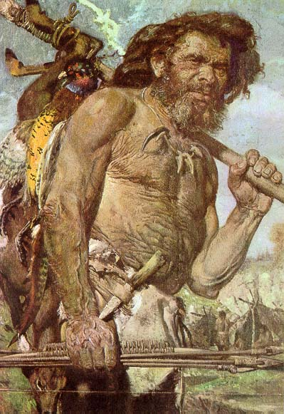


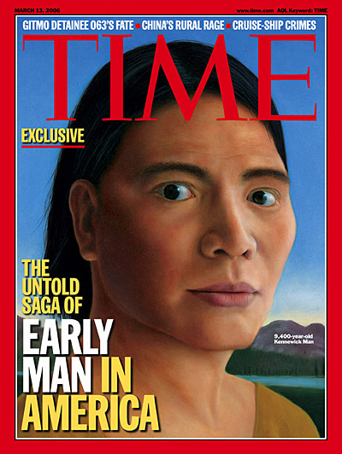
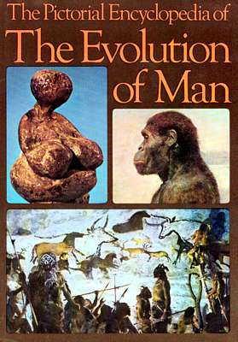
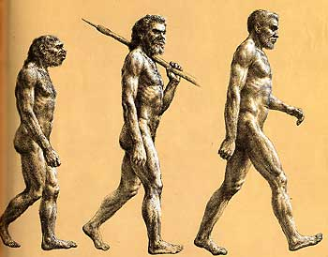
Women in academia

Slide 9
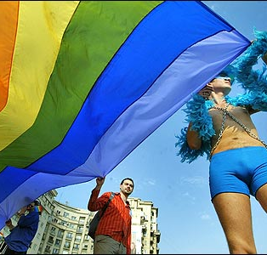
What else do gender theorists concern themselves with?
Sexualities
LGTBQ plus
Sexuality, like any identity, is
performance
embodiment
We perform our identities through our bodies
Performance, identity and signals change according to context

Slide 10

Queer theory
‘”the kind of sex that one is and the kind of sex that one does belong to two separate kinds of analysis: feminist and lesbian/gay, respectively’ (Butler 1990, 7).
‘Queer theory is…very definitely not restricted to homosexual men and women, but to anyone who feels their position (sexual, intellectual or cultural, to be marginalized’ (Dowson 2000, 287)

Slide 11
Material culture, case study
So what kind of material culture do gender theorists tend to concentrate on?
Dress
Body modification
Schneider, J. 2006 Cloth and clothing In C. Tilley, W. Keane, S. Küchler, et al (eds.) Handbook of Material Culture Sage: London pp203-220
Hansen, K.T. 2007 The world in dress: anthropological perspectives on clothing, fashion and culture Annual Review of Anthropology 33; 369-392

Slide 12
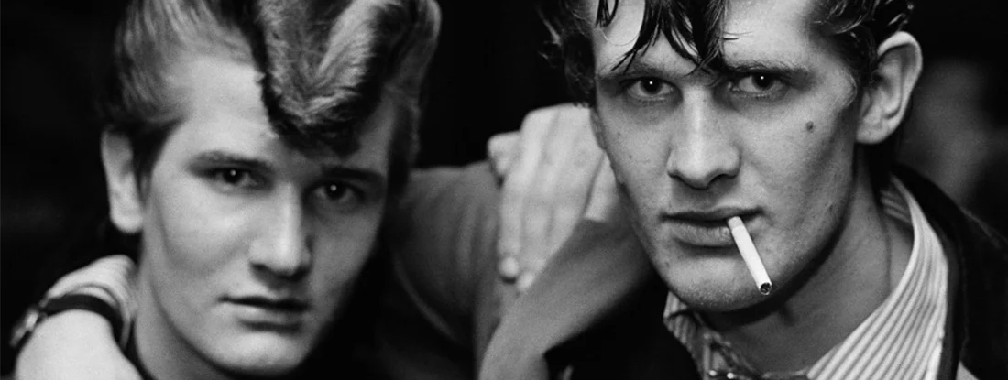
Potential material case study: Teddy boys, Britain 1950’s
Hebdige, D. 1979 Subcultures and the Meaning of Style London: Methuen

Slide 13
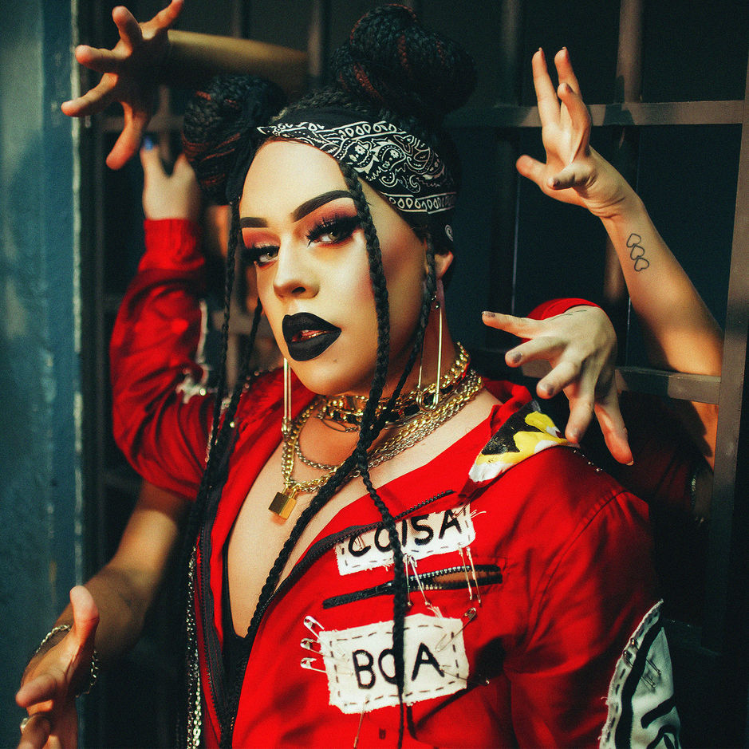
Potential material case study Travesti, Brazil
Kulick, D. 1998 Travesti: Sex, Gender and Culture among Brazilian Transgendered Prostitutes Chicago University Press: Chicago
Cornwall, A. 1994 Gendered identities and gender ambiguity among travestis in Salvador, Brazil In A. Cornwall and N. Lindisfarne (eds.) Dislocating Masculinities: Comparative ethnographies London: Routledge

Slide 14
Potential material culture case study “Western clothes”
Weston, K. 1993 Do clothes make the woman? Gender, performance theory and lesbian eroticism Genders 17 (2) pp1-21
Ferguson, J. 2002 Of mimicry and membership, Africans and the ‘new world’ society Cultural Anthropology 17 551-569
Images for the power point?
The article itself
Internet

Slide 15
Bibliography Theory
Moore, H. 1999 Whatever happened to women and men? Gender and other crises in anthropology In H. Moore (ed.) Anthropological Theory Today Polity Press: Cambridge pp 151-171
Dowson, T. 2000 Homosexuality, queer theory and archaeology In J.Thomas (ed.) Interpretive Archaeology: A reader Polity Press; Cambridge pp283-289
Butler, J. 1990 Gender Trouble: Feminism and the Subversion of Identity

Slide 16
Bibliography
Potential material culture case study
Schneider, J. 2006 Cloth and clothing In C. Tilley, W. Keane, S. Küchler, et al (eds.) Handbook of Material Culture Sage: London pp203-220
Hansen, K.T. 2007 The world in dress: anthropological perspectives on clothing, fashion and culture Annual Review of Anthropology 33; 369-392
EITHER
Hebdige, D. 1979 Subcultures and the Meaning of Style London: Methuen
OR
Kulick, D. 1998 Travesti: Sex, Gender and Culture among Brazilian Transgendered Prostitutes Chicago University Press: Chicago
Cornwall, A. 1994 Gendered identities and gender ambiguity among travestis in Salvador, Brazil In A. Cornwall and N. Lindisfarne (eds.) Dislocating Masculinities: Comparative ethnographies London: Routledge
OR
Weston, K. 1993 Do clothes make the woman? Gender, performance theory and lesbian eroticism Genders 17 (2) pp1-21
Ferguson, J. 2002 Of mimicry and membership, Africans and the ‘new world’ society Cultural Anthropology 17 551-569
OR
something you have found interesting in the literature

