Slide 1
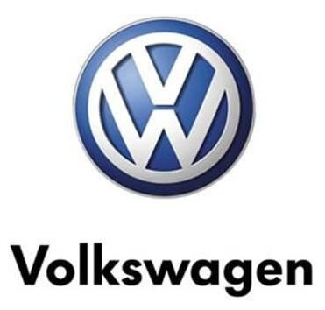

Volkswagen Group Analysis
Xiaoxia Han (2218616)

Slide 2
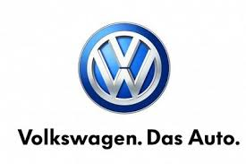
Background
Volkswagen Group was founded in 1937 and is a multinational automotive company headquartered in Wolfsburg, Germany (Volkswagen 2023)
Over 670,000 employees worldwide and operations in 150 countries (Volkswagen 2023)
In 2022, Volkswagen Group sold 8.3 million cars to consumers worldwide (Automotive News Europe 2023)
68 wholly-owned and joint-stock enterprises in the world (Volkswagen 2023)
Business areas include automobile research and development, production, sales, logistics, services, auto parts, auto leasing, financial services, auto insurance, banking, IT services, etc. (Volkswagen 2023)
Automotive News Europe 2023, VW Group’s annual deliveries fall 7% to lowest in over a decade, https://europe.autonews.com/automakers/vw-groups-2022-sales-fall-7-lowest-over-decade#:~:text=The%20group%2C%20whose%20brands%20range,the%20best%2Dselling%20electric%20models.
Volkswagen.com 2023, Volkswagen, https://www.vw-eg.com/about-volkswagen-and-EATc/.

Slide 3
Marketing Strategy
Product
Diverse range of vehicles across 12 brands (VW Group, 2022)
More SUVs and Evs (Schmitt, 2016)
Price
P
Place
P
China, its largest single market
North America, which has significant growth potential
Digital Transformation (VW Group, 2022)
Marketing Mix Model
4Ps
Place
Price
Competitive pricing strategy
Offer financial services and products to improve affordability (VW Group, 2022)
Product
P
P
Promotion
Prioritizes customer satisfaction
Retain and win new customers by measuring various indicators
  customer satisfaction
  emotional connection
  loyalty rates
  conquest rates. (VW Group, 2022)
Promotion
VW Group 2022. VW Group’s Annual Report. https://www.volkswagenag.com/presence/investorrelation/publications/annual-media-conference/2023/volkswagen-konzern/Consolidated%20Financial%20Statements%20of%20Volkswagen%20AG%20as%20of%20December%2031,%202022.pdf
Schmitt, B 2016, Volkswagen’s Brand Strategy: Finally, Something That Makes Some Sense, https://www.forbes.com/sites/bertelschmitt/2016/11/23/volkswagens-brand-strategy-finally-something-that-makes-some-sense/?sh=72a6bc4e62e4.

Slide 4
Critics on Marketing Strategy
Ethics
Limited focus on the social and ethical impacts
Channel
Heavy reliance on traditional sales channels

Slide 5
Reference
Volkswagen 2023, Volkswagen, https://www.vw-eg.com/about-volkswagen-and-EATc/.
Automotive News Europe 2023, VW Group’s annual deliveries fall 7% to lowest in over a decade, https://europe.autonews.com/automakers/vw-groups-2022-sales-fall-7-lowest-over-decade#:~:text=The%20group%2C%20whose%20brands%20range,the%20best%2Dselling%20electric%20models.
VW Group 2022. VW Group’s Annual Report. https://www.volkswagenag.com/presence/investorrelation/publications/annual-media-conference/2023/volkswagen-konzern/Consolidated%20Financial%20Statements%20of%20Volkswagen%20AG%20as%20of%20December%2031,%202022.pdf
Schmitt, B 2016, Volkswagen’s Brand Strategy: Finally, Something That Makes Some Sense, https://www.forbes.com/sites/bertelschmitt/2016/11/23/volkswagens-brand-strategy-finally-something-that-makes-some-sense/?sh=72a6bc4e62e4.

