Slide 1

MANAGING ENTERPRISE IN THE 21ST CENTURY

Slide 2

Introduction
Enterprise management in the twenty-first century places a sole focus on the idea of developing and implementing various enterprise concepts and theories. It is justified based on how well each hypothesis fits the data and how it affects how long a business lasts. A comprehensive assessment of the theories and processes must be followed by the necessary adjustments and suggestions for designing a better operating environment. The suggestions are the result of a careful analysis of the problem, with a focus on the enterprise's long-term goals and prospects.

Slide 3
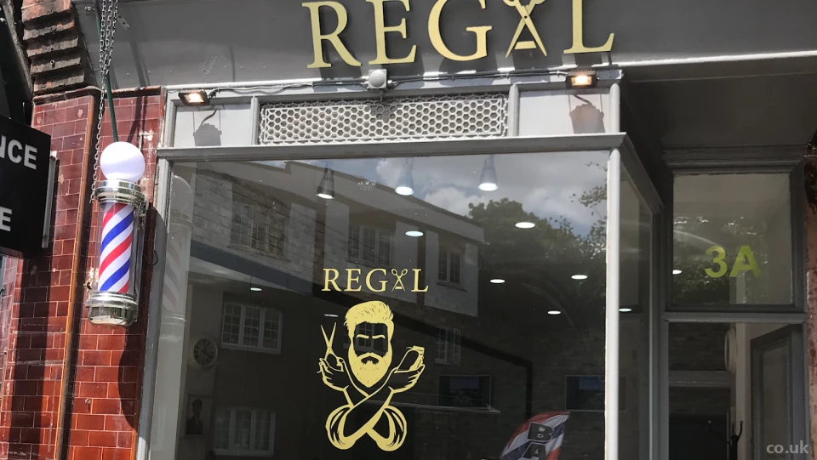
Business Overview
Locals administer and oversee the operations of the brand-new Regal Men Barber Shop in London, UK.
The owner is Maxwell Jackson, a barber in the neighbourhood who provides skilled and stylish haircuts for men of all ages (Ebinger et al. 2020).
The Regal Men Barber Shop will be in a busy strip mall on one of the main streets in London.
(Localcharm.co.uk, 2022)
Notes:
The barbershop will be close to places for dining, shopping, exercising, and doing laundry. That location was chosen by Maxwell because it will be convenient for a guy to drop off his clothing there and then head over to the barbershop for a trim while they wait for their laundry. Since a gym is nearby, clients may stop by before or after their workout to receive a haircut (Dill et al. 2020). Hot-towel shaves, stubble trims, shampoos, fades, and designs are all available at the barbershop known as Regal Men. He's building a barbershop with two shampoo chairs, two shampoo stations, and a comfortable waiting room. The scissors, combs, and razors will be thoroughly cleaned after each use. Always warm and fresh air is allowed to dry the towels.

Slide 4
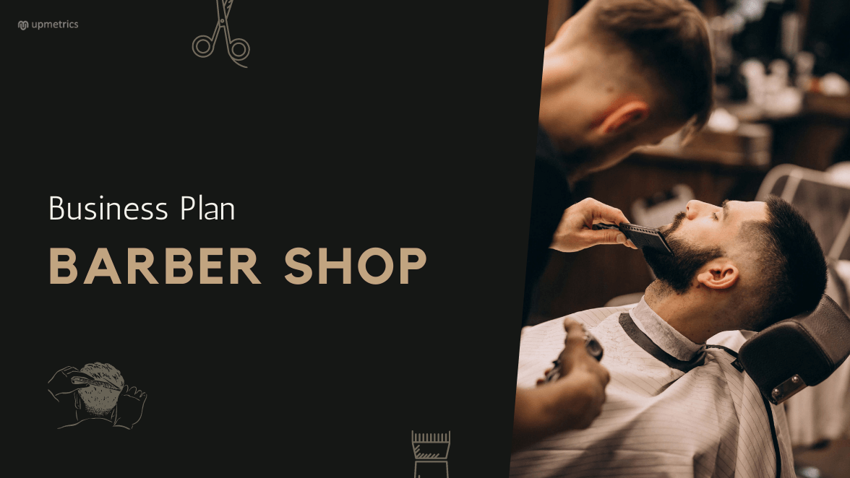
Business Concept
It is crucial to ensure that the client is satisfied with the services offered because a barber's primary goal is to build a clientele of repeat customers and new clients through word-of-mouth advertising.
For highly skilled barbers, it is exceedingly common for them to establish a following of loyal customers who employ their services for years on end (Mbilishaka et al. 2021).
As a result, a lot of barbershops in the area act as meeting places where men can socialise and enjoy one another's company, which only helps to grow the number of happy and loyal customers.
Upmetrics.co, 2022
Notes:
These clients expect barbers of today to perform at a professional level. In addition to carefully trimming hair, they do several operations on the face, scalp, beard, moustache, and moustache. The tools barbers use to trim, cut, shape, and taper hair include combs, clippers, and scissors. In order to provide exceptional customer and personal services, barbers must be aware of the regulations and practises required. Barbers must thus be able to ascertain what their customers want, provide those needs, and assess how satisfied their clients are with the services they get (Carlton et al. 2021). Barbers need to be able to offer their customers their full attention while taking the time to understand their requirements and wants and, if necessary, asking questions.

Slide 5
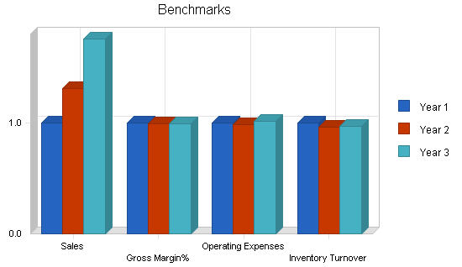
Financial Plan
The fees for the given barber services are one of Regal Men Barber Shop's main sources of income.
Grooming, beard trims, shaves, and laundry will provide the necessary funds.
The rent for the barbershop will be the most expensive thing. The key expenditures for the 1,500 square foot location will include rent, utilities, all equipment linked to the barber shop, and all essential supplies (Oliffe et al. 2020).
Rent collected from the other barbers that operate there will help the firm generate more revenue.
Amazonaws.com, 2022
Notes:
Sales or revenue refers to the sum of money a company makes over a specific period, less discounts and adjustments for returned goods. perpetually increasing unit sales revenue. Therefore, modifications to activity or volume have a similar impact on total income. Retail sales are a fantastic method to increase a barbershop's profitability. In the UK, where sales of hair products are increasing significantly, one-third of men who purchase hair products base their choices on stylist recommendations (Baker et al. 2018). Customers will remember a business's products and services after using specialty hair products, which might aid in building brand recognition. For successful barber businesses in the past, word-of-mouth marketing and minimal advertising worked well to create a clientele.

Slide 6
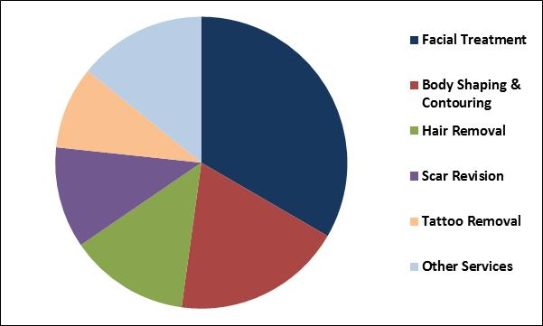
Market Analysis
The population increase has benefited the bottom line of the barbering sector since more individuals are using barbershops.
The population of the US is projected to expand by 0.7% a year (Putra et al. 2020).
Considering how stable the business is, macroeconomic events seldom have a significant influence on it.
Kbvresearch.com, 2022
Notes:
Future growth of the industry is projected to be attributed to social media usage. This change will lead to a greater need for specialised services. Barbers can reach a wide audience and advertise their services effectively on social media. Customers who regularly read the barbers' online content will seek them out as they gain a following for their excellent services (Romero et al. 2021). Because customers have a high need for different types of barbers and the barbershop's potential supply is limited, prices may increase as excess demand increases. The expectation is that premium product price hikes will thereby enhance demand for industrial products.

Slide 7
Marketing Plan
Numerous services are available to help anyone seem dapper and royal.
A highly competent group of experts' main objective is to provide the best possible client service.
Trained barbers who stay up to date on the newest trends in cuts and services
Without sacrificing top-notch luxury services, with rates that might surpass the competition (Abrahamsson et al. 2019).
Notes:
On the Regal Men Barber Shop's official Facebook and Instagram profiles, Maxwell will publish photos of his clients after they have one of his distinctive haircuts or shaves. Additionally, he will display pictures of the designs he can create for clients. For Regal Men Barber Shop, a highly thorough and attractive website will be developed and maintained by Maxwell's nephew, a graphic designer. On the user-friendly website, there will be a list of services, costs, contact details, and a location. If someone searches "barber shop near me" or "barber shop Minneapolis," The Regal Men Barber Shop will be the top result shown in the Bing or Google search results (Sarmiento, 2022). Maxwell will still have a long number of committed clients when he transitions to owning his barbershop. People who are looking for a new place to get a good, crisp haircut will learn about Regal Men Barber Shop through those clients. Regal Men Barber Shop's price will be competitive with its competition and reasonable, giving customers the impression that they are getting a good deal.

Slide 8
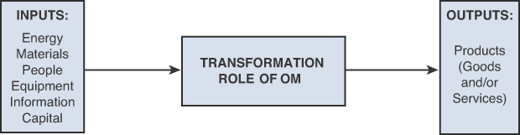
Management Team
A service organisation's success is greatly influenced by its people resources. Because a large workforce is required in the service industry, labour expenditures represent a considerable part of total spending (Barber et al. 2020).
Although there is unquestionably a distinction between physical and intangible outputs, it is unusual for an organisation to just provide services or tangible goods.
The goal of capacity management is to balance costs and service levels by adapting operations to demand.
Sanders, 2018
Notes:
Maxwell Jackson has trimmed hair for clients for almost fifteen years. He has cut the hair of men and boys of all ages, and he has a significant clientele of loyal clients who come to him at least twice a month, year after year. Since they were little boys, several of his patients have been. Because they are now adults, they bring their boys to Maxwell (Bateson, 2020). He has spent the entire fifteen years working at the same location, despite the previous owner's recent intention to retire and close the firm. With his own name, branding, and image, Maxwell may now reopen the same company.

Slide 9

Management Plan
Maxwell Jackson alone will own and manage the barbershop.
He will be responsible for covering all expenses, including the property manager's rent, electricity, and the cost of stocking the barbershop (Sattari et al. 2020).
The extra barbers who will be employed by Regal Men Barber Shop will rent a space and equipment from Maxwell (Cho et al. 2021).
Referenceforbusiness.com, 2022)
Notes:
Though they usually receive excellent haircuts there, customers continue to patronise well-known barbershops. Employees must be highly competent and motivated by their work for this to succeed. Customers will feel good about themselves when they leave the barbershop if the barbers did a decent job (Timmons and Thornton, 2019). Customers should be made to feel welcome when they visit a barbershop. In order to avoid a customer being stubborn, make sure they are comfortable, have enough entertaining reading material, and something to do.

Slide 10
Conclusion
Barbershops are under the service industry's purview. The organisation offers its customers fantastic customer service. From trustworthy vendors, they will buy the goods needed for barbershops. In this study, the management team and their operational strategy for a barbershop were largely discussed. Today's barber shops provide a wide range of grooming services that are all tailored exclusively for men, including hair styles, hair tattoos, grooming, facials, cream baths, colouring, and other grooming operations. In the past, tooth extraction was a common minor surgical procedure performed in barbershops. Leeches, an animal used in medicine, were another method of drawing blood.

Slide 11
Reference list
Abrahamsson, J., Maga, A. and Nicol, C., 2019. The effect of business model innovation on share prices–A study of us listed technology firms. Journal of Business Models, 7(2), pp.37-52.
Baker, J.L., Stevenson, H.C., Talley, L.M., Jemmott, L.S. and Jemmott, J.B., 2018. Development of a barbershop based violence intervention for young Black emerging adult men. Journal of Community Psychology, 46(6), pp.762-774.
Barber, T.M., Kabisch, S., Pfeiffer, A.F. and Weickert, M.O., 2020. The health benefits of dietary fibre. Nutrients, 12(10), p.3209.
Bateson, R., 2020. Strategic discrimination. Perspectives on Politics, 18(4), pp.1068-1087.
Carlton, L., Woods-Giscombe, C.L., Palmer, C. and Rodgers, S.G., 2021. Barbers as community mental health advocates for African American men: ADAAM-QR web design to address social determinants of depression and access to culturally relevant resources. Archives of Psychiatric Nursing, 35(1), pp.137-140.
Cho, L., Vest, A.R., O’Donoghue, M.L., Ogunniyi, M.O., Sarma, A.A., Denby, K.J., Lau, E.S., Poole, J.E., Lindley, K.J., Mehran, R. and Cardiovascular Disease in Women Committee Leadership Council, 2021. Increasing participation of women in cardiovascular trials: JACC council perspectives. Journal of the American College of Cardiology, 78(7), pp.737-751.
Dill, L.J., Gousse, Y., Huggins, K., Fraser, M.A., Browne, R.C., Stewart, M., Salifu, M., Joseph, M.A. and Wilson, T.E., 2020. Adjournment in community HIV prevention: Exploring transitions in community–academic partnerships. Health promotion practice, 21(4), pp.544-551.
Ebinger, J., Blyler, C.A., Brettler, J. and Rader, F., 2020. Barbershop management of hypertension in the African American population: pitfalls and opportunities for extension to other underserved communities. Current Cardiology Reports, 22(8), pp.1-8.
Mbilishaka, A.M., Mbande, A., Gulley, C. and Mbande, T., 2021. Faded fresh tapers and line-ups: Centering barbershop hair stories in understanding gendered racial socialization for black men. Psychology of Men & Masculinities, 22(1), p.166.
Oliffe, J.L., Rossnagel, E., Bottorff, J.L., Chambers, S.K., Caperchione, C. and Rice, S.M., 2020. Community-based men’s health promotion programs: eight lessons learnt and their caveats. Health promotion international, 35(5), pp.1230-1240.
Putra, K.D.K., Piarsa, I.N. and Sukarsa, I.M., 2020. Geographic Information System for Booking Beauty Salon and Barber Shop with an Android-Based ECRM Approach. Scientific Journal of Informatics, 7(1), pp.52-65.
Romero, M.C., Lara, P. and Villalobos, J., 2021. Evolution of the business model: Arriving at open business model dynamics. Journal of Open Innovation: Technology, Market, and Complexity, 7(1), p.86.
Sarmiento, C., 2022. Not diverse enough? Displacement, diversity discourse, and commercial gentrification in Santa Ana, California, a majority-Mexican city. Urban Studies, 59(9), pp.1782-1799.
Sattari, S., Wessman, A. and Borders, L., 2020. Business model innovation for sustainability: An investigation of consumers’ willingness to adopt product-service systems. Journal of Global Scholars of Marketing Science, 30(3), pp.274-290.
Timmons, E.J. and Thornton, R.J., 2019. There and Back again: The De‐licensing and re‐licensing of barbers in Alabama. British Journal of Industrial Relations, 57(4), pp.764-790.

Slide 12

Thank You

