Slide 1

Discuss how individual differences affect responses to illness.
Presented by: Thomas Morgan, Olivia Lovell and Seren Levi Cassell

Slide 2
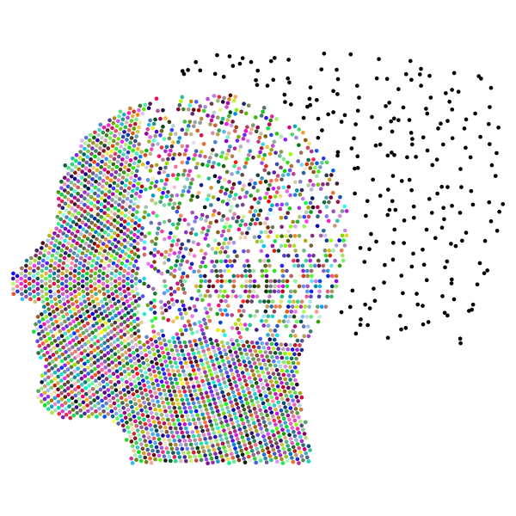
Personality Traits and Coping With Depression
Presented by: Olivia Lovell

Slide 3
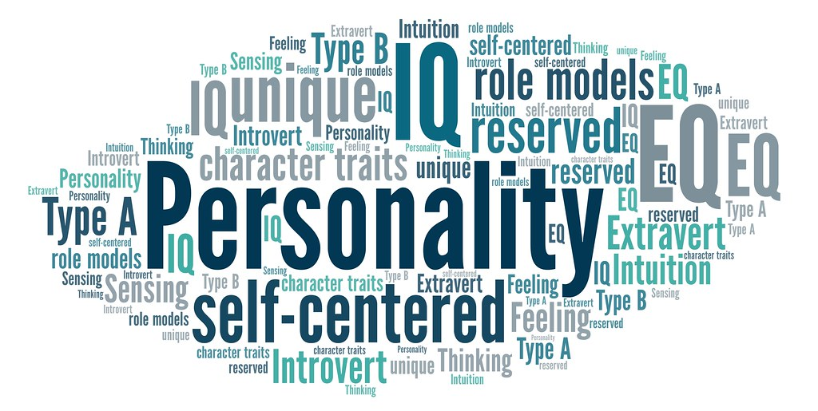
Personality
Personality, as defined by the American Psychological Association (2014), describes an individual's behavioural characteristics (Shiraev, 2017).
This is additionally described as a "dynamic organisation" of characteristics (Allport, 1961).
Notes:
There have been many theories underpinning core beliefs of personality, such as the Five Factor Model (FFM; Costa and McCrae, 1992).

Slide 4

How does personality link to illness?
The trait of 'neuroticism' within the Five Factor Model of personality (Costa and McCrae, 1992) has many associations with poorer health outcomes (e.g., Brickman et al., 1996).
This includes an increased rish of asthma (Huovinen, Kaprio and Ksokenvuo, 2001), cardiovascular disease (Suls and Bunde, 2005), etc.
Notes:
There are many bodies of research indicating that individuals with high levels of neuroticism have an increased chance of experiencing physical or mental ailments, such as asthma (Huovinen, Kaprio and Koskenvuo, 2001) and cardiovascular disease (Suls and Bunde, 2005).

Slide 5
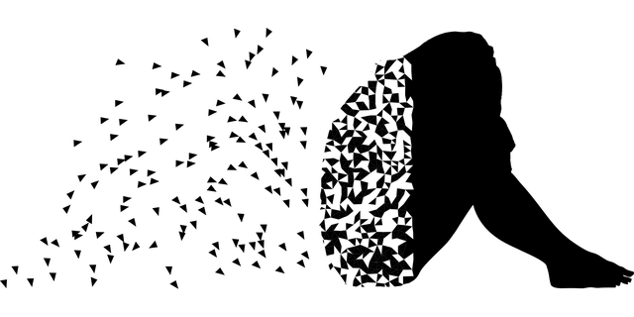
Depression
Depression is one of the leading causes of illness according to the World Health Organisation (WHO, 2018).
Over 10% of the population will experience depression at some point in their lives (Lim et al., 2018).

Slide 6

Key research
A study conducted by Pang and Wu (2021) assessed the correlation between neuroticism and depression amongst 1035 college students. Findings indicates that participants with higher levels of neuroticism also had a higher likelihood of depression.
A study by Goldstein et al. (2020) examined the link between neuroticism and depression in females, as well as the impact of environmental stress on these factors.
Notes:
Pang and Wu's (2021) study primarily examined the correlation between neuroticism, depression and negative affect. Negative affect is strongly associated with depression (Yeo et al., 2017), and is additionally commonly observed in individuals with high levels of neuroticism (Diener, Oishi and Lucas, 2003; Wang, Shi and Li, 2009).
Goldstein et al. (2020) examined the correlation between neuroticism, depression and environmental stress using the dynamic vulnerability models (DVM). Findings indicate stress as a fairly strong predictor of neuroticism, and neuroticism as a strong predictor of depression. Although the research is valid, all participants were female, meaning that this may not be an accurate representation of non-females.

Slide 7
References (Olivia Lovell)
Goldstein, B. L., Perlman, G., Eaton, N. R., Kotov, R. & Klein, D. N. (2020). Testing explanatory models of the interplay between depression, neuroticism, and stressful life events: a dynamic trait-stress generation approach. Psychological medicine, 50(16), 2780-2789.
Maltby, J., Day, L. & Macaskill, A. (2017). Personality, individual differences and intelligence.
Shiraev, E. (2017). Personality theories: a global view.
Pang, Y. & Wu, S. (2021). Mediating effects of negative cognitive bias and negative affect on neuroticism and depression. Current psychology, 42(9), 7060-7069.
Wegemer, C. M. (2020). Selflessness, depression, and neuroticism: an interactionist perspective on the effects of self-transcendence, perspective-taking, and materialism. Frontiers in psychology, 11.
Widiger, T. A. (2015). The Oxford handbook of the five factor model of personality.

Slide 8
Image links (Olivia Lovell)
https://freesvg.org/img/Mental-Health-VII-Prismatic.png
https://live.staticflickr.com/65535/49044418531_29932672d8_b.jpg
Smiley face with a handkerchief | Public domain vectors
https://upload.wikimedia.org/wikipedia/commons/a/ab/Depression_man.png
Market research laptop survey - Free Stock Illustrations | Creazilla

