Slide 1
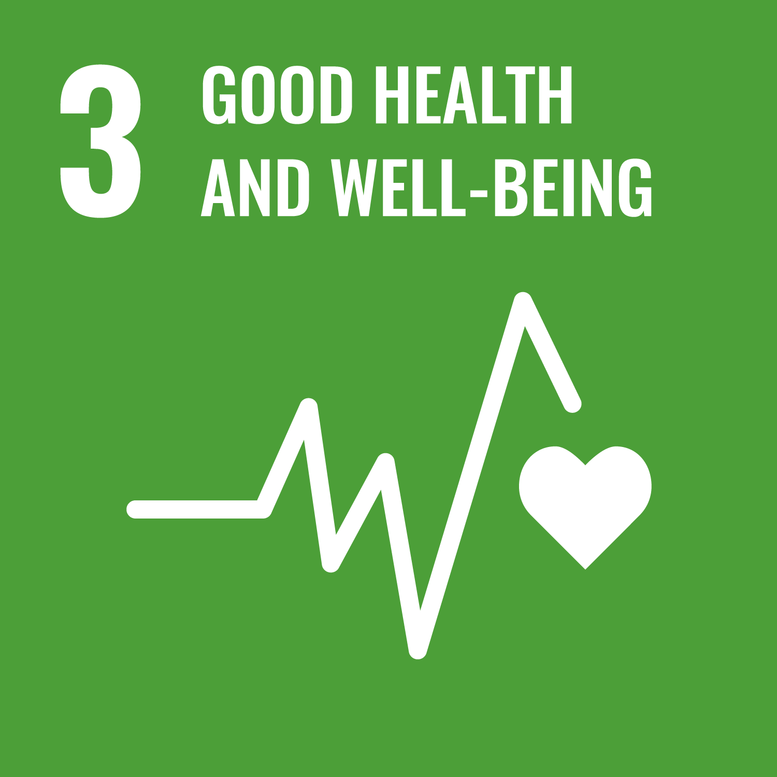
Integrating Health, Wellbeing and Sustainable Development
Programme: BSc (Hons) Health and Social Care
Module: Health, Wellbeing and Sustainable Development
Module Code: BMHP6030
Assessment: Component 1 – Presentation
Student Name: Eunice-Naomi Labou
Student ID: 2322368
Notes:
Good morning/afternoon, everyone.
Today, I will discuss the importance of integrating health, wellbeing and sustainable development within health and social care services.
I will explore how these three concepts are connected and how they influence healthcare policies, professional practice and the delivery of services.
I will also examine relevant theories, government policies and practical examples from the UK healthcare system.
Finally, I will consider some of the challenges affecting integration and provide recommendations for improving services at both local and national levels.

Slide 2
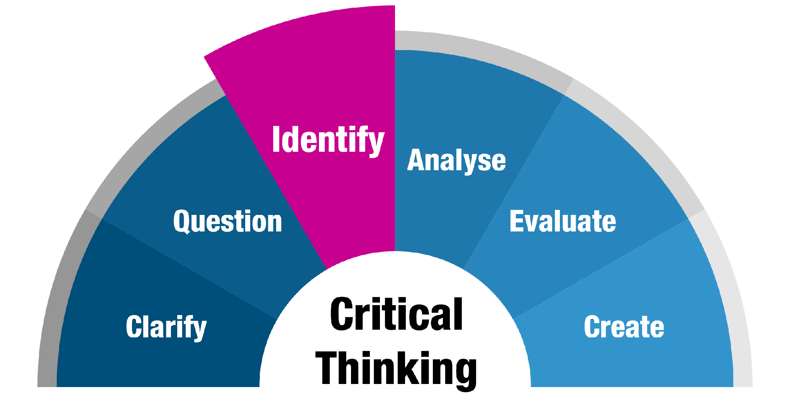
Introduction: Purpose and Key Argument
Health, wellbeing and sustainability are interconnected priorities in modern healthcare (WHO, 2021).
Integration supports disease prevention, patient experience and long-term service resilience.
Holistic healthcare considers physical, psychological and social needs.
Funding pressures, workforce shortages and inequalities create implementation challenges (The King's Fund, 2024).
Focus: Health and social care in England, with local and national implications.
Notes:
Health, wellbeing and sustainable development are increasingly important within modern health and social care.
Healthcare services are expected not only to treat illnesses but also to prevent health problems, support people's wellbeing and use resources responsibly.
According to the World Health Organization (2021), health promotion involves enabling people to improve their health and wellbeing.
However, achieving these goals can be challenging. Healthcare organisations face financial pressures, increasing demand for services and workforce shortages.
The main argument of this presentation is that sustainable healthcare involves more than reducing environmental damage. It also means providing accessible, effective and person-centred services that can continue meeting the needs of future generations.

Slide 3
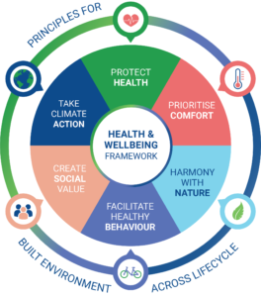
Defining Health, Wellbeing and Sustainable Development
Health
- Physical, mental and social wellbeing, rather than simply the absence of illness (WHO, 1948).
Wellbeing
- A multidimensional concept involving emotional, psychological, physical and social quality of life (Dodge et al., 2012).
Sustainable Development
- Meeting present needs without compromising the ability of future generations to meet their needs (WCED, 1987).
Global Perspective
- Sustainable Development Goal 3 promotes good health and wellbeing for all (United Nations, 2015).
Notes:
Health, wellbeing and sustainable development are closely connected, although they have different meanings.
The World Health Organization (1948) defines health as more than simply being free from disease. It also includes physical, mental and social wellbeing.
Wellbeing takes this further by considering how individuals feel about their lives, relationships and overall quality of life.
Dodge et al. (2012) explain that wellbeing involves maintaining a balance between personal resources and the challenges people experience.
Sustainable development focuses on protecting resources and opportunities for future generations.
In healthcare, this means providing good-quality services today while ensuring that future populations can also access appropriate care.
The United Nations Sustainable Development Goals reinforce this connection, particularly Goal 3, which focuses on health and wellbeing.

Slide 4
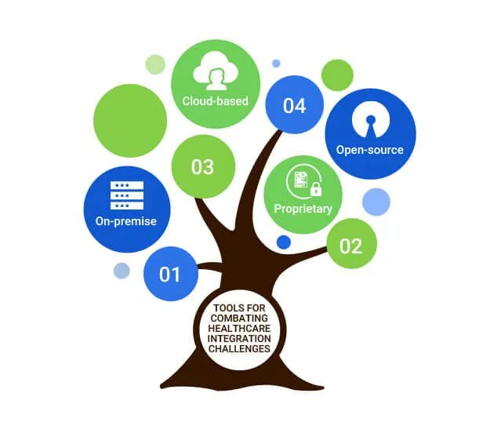
Why Integration Matters in Healthcare
Social determinants such as housing, education, employment and income influence health outcomes (Marmot et al., 2020).
Climate change creates additional health risks, including heat-related illness and respiratory problems (WHO, 2023).
Preventative healthcare can reduce avoidable illness and pressure on services (NHS England, 2019).
Integrated approaches encourage cooperation between healthcare, social care and community organisations.
Challenge: Prevention requires investment, while its benefits may take years to become visible.
Notes:
Integrating health, wellbeing and sustainable development is important because people's health is influenced by many factors outside healthcare settings.
For example, poor housing, unemployment, financial difficulties and social isolation can contribute to physical and mental health problems.
Marmot et al. (2020) highlight how social inequalities continue to influence health outcomes in England.
Environmental issues also affect population health. Climate change can increase risks associated with extreme temperatures, air pollution and other environmental conditions.
Preventative healthcare offers opportunities to address these problems before they become more serious.
However, prevention programmes require financial resources, trained professionals and long-term planning.
This means healthcare organisations must balance immediate service demands with investment in future population health.

Slide 5
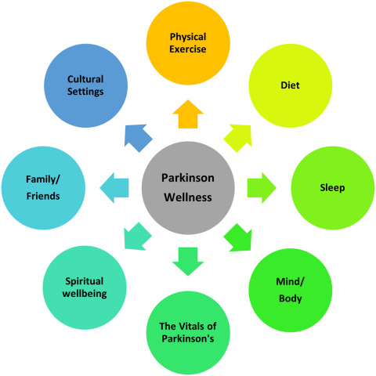
Integration of Holistic Health and Wellbeing Approaches
Holistic care addresses physical, psychological, emotional and social needs.
Person-centred approaches consider individual preferences, circumstances and goals (NICE, 2021).
Multidisciplinary teams improve coordination between healthcare professionals and social care providers.
Shared decision-making supports patient independence and participation.
Challenges include fragmented services, communication difficulties and workforce pressures.
Notes:
A holistic approach means looking at the whole person rather than focusing only on their illness.
For example, an older adult living with diabetes may need medical treatment, but they may also require nutritional advice, emotional support and assistance with everyday activities.
By considering these different needs, healthcare professionals can develop more personalised care plans.
NICE (2021) highlights the importance of shared decision-making, where patients and professionals work together to make informed choices about treatment and care.
Multidisciplinary teams also play an important role because doctors, nurses, social workers and community organisations can contribute different forms of support.
However, effective integration requires good communication and coordination.
Without adequate staffing and information-sharing systems, patients may still experience fragmented services.

Slide 6
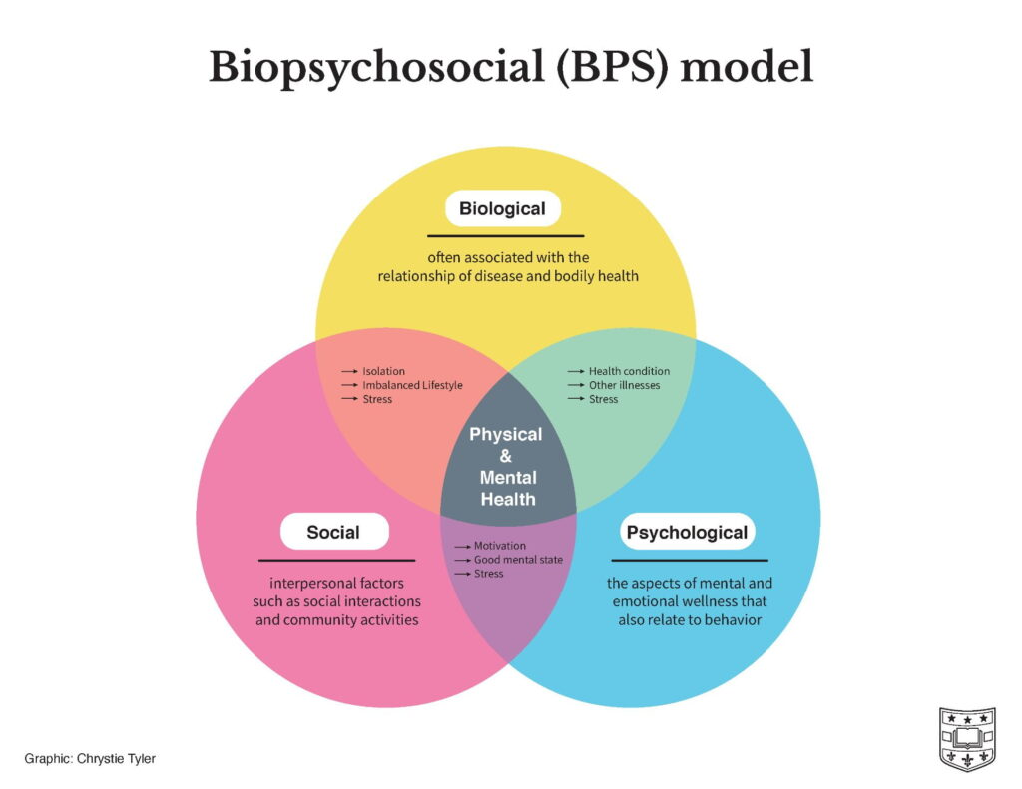
Theoretical Perspective: The Biopsychosocial Model
Biopsychosocial Model – Engel (1977)
Biological factors: Genetics, physical illness, disability and medical conditions.
Psychological factors: Emotions, stress, coping mechanisms and mental health.
Social factors: Family relationships, employment, housing and social support.
Application to Healthcare
Encourages holistic assessment and personalised care.
Recognises the interaction between different influences on health.
Limitation: Complex social needs can be difficult to address within healthcare budgets.
Notes:
One important theory supporting holistic healthcare is the biopsychosocial model developed by Engel in 1977.
This model suggests that health and illness are influenced by biological, psychological and social factors.
For example, someone living with a long-term medical condition may experience physical symptoms alongside anxiety, financial difficulties or social isolation.
The model encourages healthcare professionals to consider all these factors when assessing a person's needs.
Its main strength is that it supports person-centred care and recognises that individuals experience illness differently.
However, the model also has limitations.
It can be difficult to apply consistently because social and psychological problems often require support from organisations outside the healthcare system.
Nevertheless, the biopsychosocial model provides a valuable framework for integrating health and wellbeing into everyday practice.

Slide 7
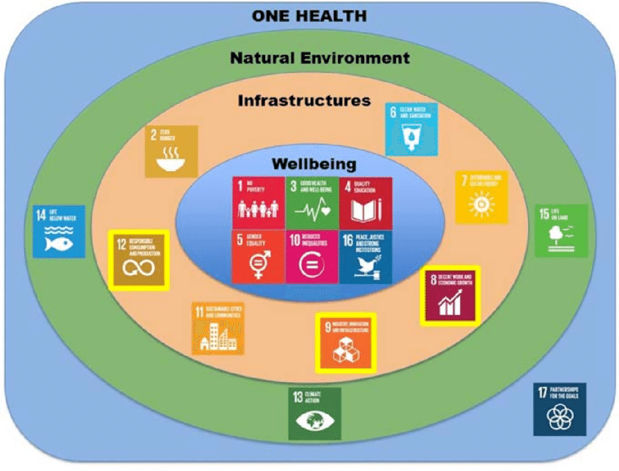
Sustainable Development Frameworks in Healthcare
United Nations Sustainable Development Goals (SDGs)
SDG 3: Good Health and Wellbeing.
SDG 10: Reduced Inequalities.
SDG 11: Sustainable Cities and Communities.
SDG 13: Climate Action (United Nations, 2015).
Health in All Policies
- Encourages consideration of health impacts across government sectors (WHO, 2014).
NHS Sustainability
- The NHS Net Zero Strategy promotes environmentally responsible healthcare (NHS England, 2020).
Notes:
Sustainable development frameworks provide guidance for improving population health while protecting environmental and social resources.
The United Nations Sustainable Development Goals are particularly relevant.
Goal 3 focuses on improving health and wellbeing, while other goals address inequalities, sustainable communities and climate change.
These goals recognise that good health depends on wider social and environmental conditions.
Another important framework is Health in All Policies, promoted by the World Health Organization.
This approach encourages governments to consider health outcomes when developing policies related to transport, housing, education and the environment.
In England, the NHS has also introduced a net-zero strategy to reduce the environmental impact of healthcare services.
However, achieving sustainability requires cooperation between different organisations, consistent funding and clear accountability.

Slide 8
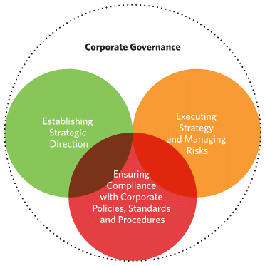
Policy and Governance in England
Slide Content
Key Policies
NHS Long Term Plan (2019): Prevention, integrated services and improved population health (NHS England, 2019).
Health and Care Act 2022: Establishes statutory Integrated Care Systems to improve coordination (UK Parliament, 2022).
Care Act 2014: Promotes wellbeing, independence and preventative support within adult social care (UK Parliament, 2014).
Challenges
Financial pressures and unequal resource distribution.
Workforce shortages and increasing service demand.
Differences between policy ambitions and practical implementation.
Notes:
Government policies play an important role in supporting the integration of health, wellbeing and sustainable development.
The NHS Long Term Plan focuses on prevention, improving population health and developing more coordinated services.
The Health and Care Act 2022 strengthened the role of Integrated Care Systems, which bring NHS organisations, local authorities and other partners together.
The Care Act 2014 also places wellbeing at the centre of adult social care and emphasises prevention and independence.
Together, these policies provide a foundation for more holistic healthcare.
However, introducing policies does not automatically improve services.
Healthcare organisations may struggle to implement reforms because of limited funding, staffing difficulties and increasing demand.
Therefore, policy effectiveness should be evaluated through improvements in patient experiences, access and health outcomes.

Slide 9

Service Delivery: Practical Integration
Social prescribing connects individuals with community activities and support services (NHS England, 2023).
Telehealth enables remote consultations and health monitoring (Topol, 2019).
Integrated discharge planning improves coordination between hospitals and social care.
Community-based programmed support prevention and independent living.
Effectiveness should be measured through accessibility, patient satisfaction, continuity and health outcomes.
Notes:
Integrating health and wellbeing approaches can improve the way healthcare services are delivered.
Social prescribing is one example. It allows healthcare professionals to connect patients with community-based support, such as exercise groups, social activities and financial advice.
Telehealth is another important development because it allows patients to receive consultations and monitoring remotely.
This can improve convenience, particularly for people with mobility difficulties or those living in rural areas.
However, digital services may not be suitable for everyone.
Some patients lack internet access, digital skills or confidence using technology.
Integrated hospital discharge planning is also important because patients may require social care support after leaving hospital.
Overall, successful service delivery requires coordination, accessibility and regular evaluation of patient outcomes.

Slide 10
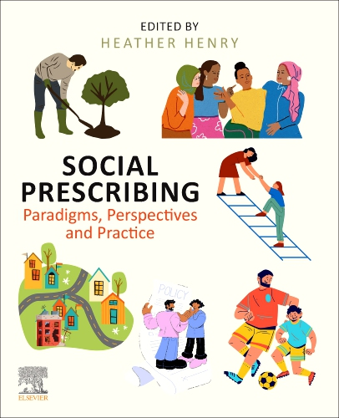
Case Example: Social Prescribing in Primary Care
Social Prescribing – NHS England
Link workers connect patients with non-medical community support (NHS England, 2023).
Services may include exercise programmes, community groups and welfare advice.
Supports mental wellbeing, social participation and healthier lifestyles.
Reflects the biopsychosocial approach to healthcare.
Limitations include unequal availability of local services and variable referral quality.
Notes:
Social prescribing provides a practical example of holistic healthcare.
For instance, someone experiencing loneliness and anxiety may regularly visit their GP even when they do not require additional medical treatment.
Through social prescribing, a link worker may help them access local activities, exercise groups or community support.
This approach recognises that health problems are not always purely medical.
It also reflects the biopsychosocial model because it considers psychological and social influences on wellbeing.
Social prescribing may help people develop stronger social connections and improve their quality of life.
However, its effectiveness depends on the availability and quality of community services.
In areas with limited voluntary-sector resources, patients may struggle to access appropriate support.
Therefore, social prescribing should complement clinical treatment rather than replace it.

Slide 11
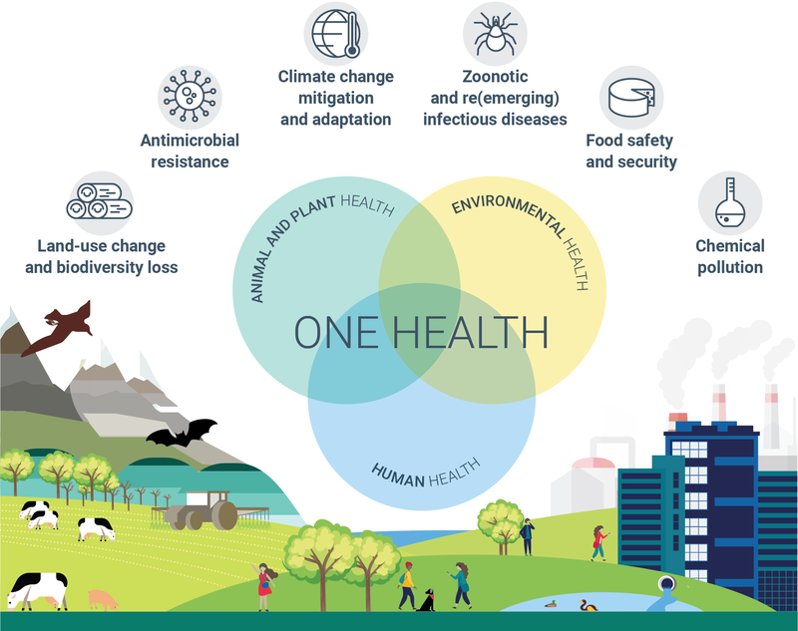
Public Health Initiatives and Healthier Environments
Public health initiatives promote disease prevention and healthier lifestyles.
Examples include vaccination, smoking cessation, physical activity and healthy eating programmed.
Housing quality, clean air and safe neighborhoods influence population wellbeing (Marmot et al., 2020).
Health campaigns increase awareness but may not always produce lasting behavior change.
Targeted interventions are necessary to support disadvantaged communities.
Notes:
Public health initiatives play an important role in improving health and wellbeing across communities.
Examples include vaccination programmes, smoking cessation services and campaigns encouraging physical activity and healthy eating.
These initiatives aim to prevent illness and reduce the need for more intensive healthcare services.
However, providing health information alone may not always lead to healthier behaviour.
For example, encouraging people to exercise may be less effective if their neighbourhood lacks safe parks or affordable recreational facilities.
Similarly, healthy eating advice may be difficult to follow for households experiencing financial difficulties.
Marmot et al. (2020) emphasise that wider social conditions influence people's opportunities to maintain good health.
Therefore, successful public health initiatives should combine education with practical support and improvements to local environments.

Slide 12

Equity and Access to Healthcare
Health inequalities are influenced by income, deprivation, housing and employment (Marmot et al., 2020).
Digital exclusion can prevent some individuals from accessing online healthcare services (Good Things Foundation, 2024).
Language barriers, disability, geographical location and transport affect accessibility.
Universal healthcare supports access, but equal availability does not guarantee equal outcomes.
Targeted interventions and accessible alternatives can reduce inequalities.
Notes:
Equity is an essential part of sustainable healthcare because not everyone has the same opportunities to access services.
People living in deprived communities may experience poorer health outcomes and greater difficulties accessing support.
Marmot et al. (2020) demonstrate the continuing relationship between social inequalities and health outcomes in England.
Digital exclusion is another concern.
Although online consultations and digital healthcare platforms can improve convenience, some older adults and disadvantaged individuals may struggle to use them.
Other barriers include language difficulties, disabilities, transport problems and geographical distance.
Providing the same services to everyone does not necessarily create equal outcomes.
Instead, healthcare organisations should provide additional support to people facing greater barriers.
This may include accessible information, community outreach and non-digital alternatives.

Slide 13

Critical Analysis of Secondary Evidence
Evidence from Existing Research and Policy
Marmot et al. (2020) identify persistent inequalities linked to social determinants of health.
NHS England (2020) highlights the need for system-wide environmental sustainability.
The King's Fund (2024) discusses pressures affecting healthcare performance and reform.
Critical Interpretation
Policy commitments do not always translate into consistent service improvements.
Funding, workforce capacity and inequalities can delay implementation.
Evidence should be assessed according to its methodology, relevance and limitations.
Notes:
The secondary evidence suggests that integrating health, wellbeing and sustainability remains an important but challenging objective.
Marmot et al. (2020) show that social inequalities continue to affect population health.
NHS England's sustainability strategy demonstrates a commitment to reducing the environmental impact of healthcare.
Meanwhile, The King's Fund discusses pressures affecting healthcare services and their ability to implement improvements.
When considering these sources together, a gap can be identified between policy ambitions and the practical capacity of organisations to deliver change.
However, the evidence also has limitations.
For example, policy documents describe intended actions, while research reports may examine broader social trends rather than the effectiveness of individual programmes.
Therefore, a critical assessment should distinguish between policy commitments, actual implementation and measurable outcomes.

Slide 14

Recommendations for Local and National Improvement
Local Recommendations
Develop targeted outreach programmed for underserved communities.
Maintain face-to-face and telephone alternatives alongside digital healthcare.
Strengthen cooperation between NHS services, councils and voluntary organizations.
Evaluate social prescribing and prevention programmed using patient outcomes.
National Recommendations
Increase long-term investment in preventative healthcare.
Strengthen health and social care workforce development.
Introduce consistent measures of health equity and environmental performance (Marmot et al., 2020; NHS England, 2020).
Notes:
Improving health, wellbeing and sustainable development requires action at both local and national levels.
At local level, healthcare organisations should work closely with communities to identify barriers to accessing services.
For example, Integrated Care Boards and local councils could develop targeted outreach programmes for disadvantaged groups.
Maintaining face-to-face and telephone services is also important because digital healthcare is not accessible to everyone.
Local organisations should strengthen partnerships with community groups and evaluate whether preventative services are improving patient outcomes.
At national level, greater long-term investment is needed to support prevention, workforce development and integrated care.
National policymakers should also introduce clear measures for monitoring inequalities and environmental performance.
These recommendations could help create services that are more accessible, effective and sustainable.

Slide 15
Conclusion
Health, wellbeing and sustainable development are closely connected within modern healthcare.
Holistic and biopsychosocial approaches support more personalised services.
Policies encourage prevention, integration and environmental responsibility.
Funding pressures, workforce shortages and inequalities remain significant challenges.
Sustainable healthcare requires prevention, equitable access, cooperation and measurable accountability.
Notes:
In conclusion, health, wellbeing and sustainable development should not be viewed as separate priorities.
A holistic approach means looking at the whole person rather than focusing only on their illness.
This includes understanding how physical health, mental wellbeing, relationships and living conditions influence an individual's quality of life.
Prevention and public health initiatives can help people stay healthier and reduce the risk of serious health problems.
At the same time, cooperation between healthcare professionals, social care services and community organisations can improve access to appropriate support.
However, challenges such as limited funding, workforce shortages and health inequalities continue to affect implementation.
The key message is that sustainable healthcare requires more than environmental initiatives.
It requires person-centred, equitable and prevention-focused services that can meet the needs of both current and future generations.

Slide 16

References
1. Dodge, R., Daly, A.P., Huyton, J. and Sanders, L.D. (2012) ‘The challenge of defining wellbeing’, International Journal of Wellbeing, 2(3), pp. 222–235. Available at: https://doi.org/10.5502/ijw.v2i3.4
2. Engel, G.L. (1977) ‘The need for a new medical model: A challenge for biomedicine’, Science, 196(4286), pp. 129–136. Available at: https://doi.org/10.1126/science.847460
3. Good Things Foundation (2024) Digital inclusion resources. Available at: https://www.goodthingsfoundation.org/ (Accessed: 14 October 2026).
4. Marmot, M., Allen, J., Boyce, T., Goldblatt, P. and Morrison, J. (2020) Health Equity in England: The Marmot Review 10 Years On. London: Institute of Health Equity.
5. National Institute for Health and Care Excellence (NICE) (2021) Shared decision making (NG197). London: NICE. Available at: https://www.nice.org.uk/guidance/ng197 (Accessed: 14 October 2026).
6. NHS England (2019) The NHS Long Term Plan. London: NHS England. Available at: https://www.longtermplan.nhs.uk/ (Accessed: 14 October 2026).
7. NHS England (2020) Delivering a ‘Net Zero’ National Health Service. London: NHS England.
8. NHS England (2023) Social prescribing. Available at: https://www.england.nhs.uk/personalisedcare/social-prescribing/ (Accessed: 14 October 2026).
9. The King's Fund (2024) The NHS in a nutshell. Available at: https://www.kingsfund.org.uk/insight-and-analysis/projects/nhs-in-nutshell (Accessed: 14 October 2026).
10. Topol, E. (2019) The Topol Review: Preparing the Healthcare Workforce to Deliver the Digital Future. London: Health Education England.

Slide 17
References
11. UK Parliament (2014) Care Act 2014. London: The Stationery Office. Available at: https://www.legislation.gov.uk/ukpga/2014/23/contents (Accessed: 14 October 2026).
12. UK Parliament (2022) Health and Care Act 2022. London: The Stationery Office. Available at: https://www.legislation.gov.uk/ukpga/2022/31/contents (Accessed: 14 October 2026).
13. United Nations (2015) Transforming our world: The 2030 Agenda for Sustainable Development. New York: United Nations. Available at: https://sdgs.un.org/2030agenda (Accessed: 14 October 2026).
14. World Commission on Environment and Development (WCED) (1987) Our Common Future. Oxford: Oxford University Press.
15. World Health Organization (1948) Constitution of the World Health Organization. Geneva: WHO.
16. World Health Organization (2014) Health in all policies: Helsinki statement. Framework for country action. Geneva: WHO. Available at: https://www.who.int/publications/i/item/9789241506908 (Accessed: 14 October 2026).
World Health Organization
17. World Health Organization (2021) Health promotion glossary of terms 2021. Geneva: WHO. Available at: https://www.who.int/publications-detail-redirect/9789240038349 (Accessed: 14 October 2026).
World Health Organization
18. World Health Organization (2023) Climate change and health. Geneva: WHO. Available at: https://www.who.int/news-room/fact-sheets/detail/climate-change-and-health (Accessed: 14 October 2026).

