Slide 1

Introduction to criminology
BMLC4004
Laura Knight

Slide 2

Learning objectives
By the end of this session, you should be able to ……
Explain what is required of you for assessment 1
Describe the origins of criminology within the UK
Identify the skills and competencies of a criminologist

Slide 3
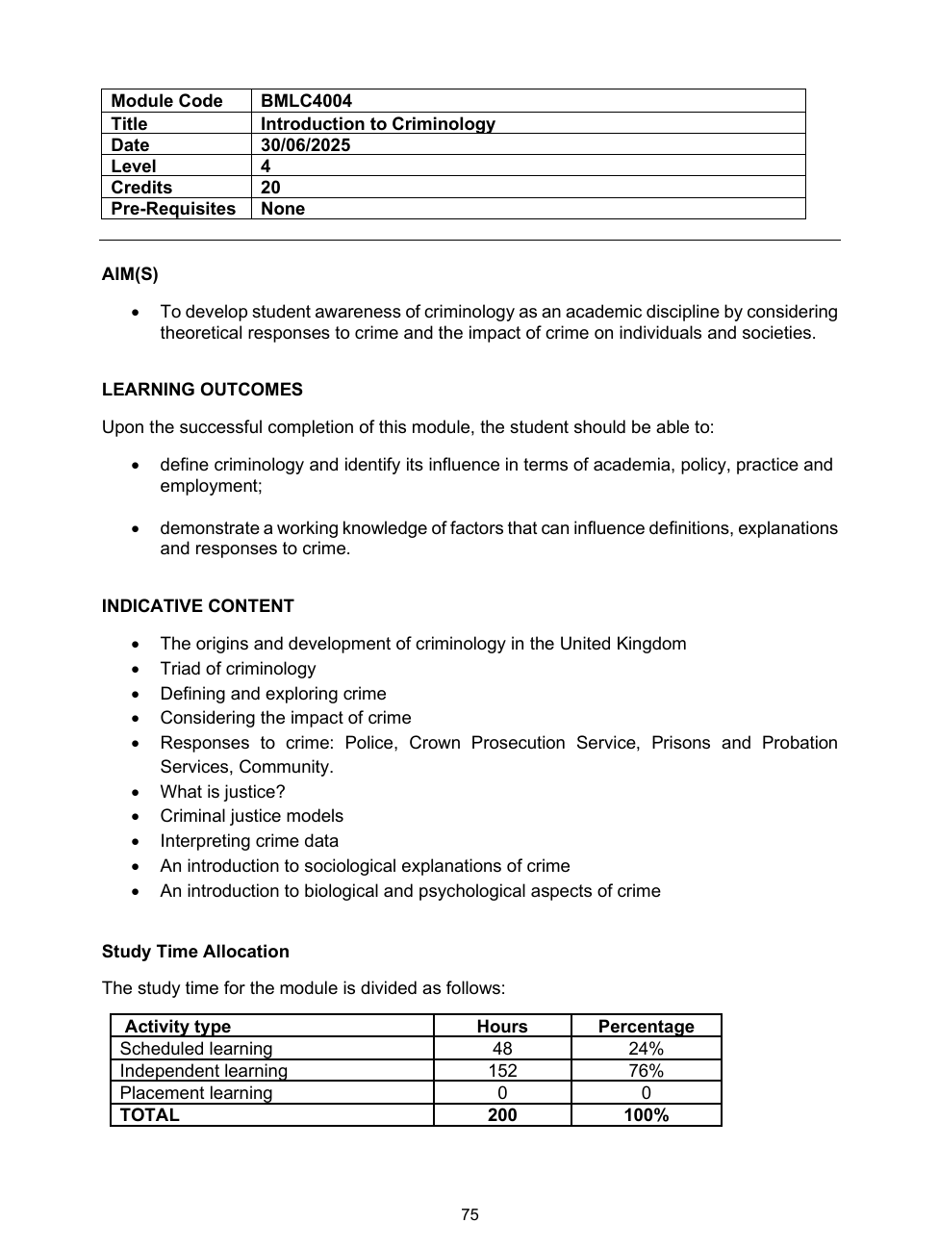
Introduction to the module
AIM(S)
To develop student awareness of criminology as an academic discipline by considering theoretical responses to crime and the impact of crime on individuals and societies.
LEARNING OUTCOMES
Upon the successful completion of this module, the student should be able to:
Define criminology and identify its influence in terms of academia, policy, practice and employment.
Demonstrate a working knowledge of factors that can influence definitions, explanations and responses to crime.

Slide 4
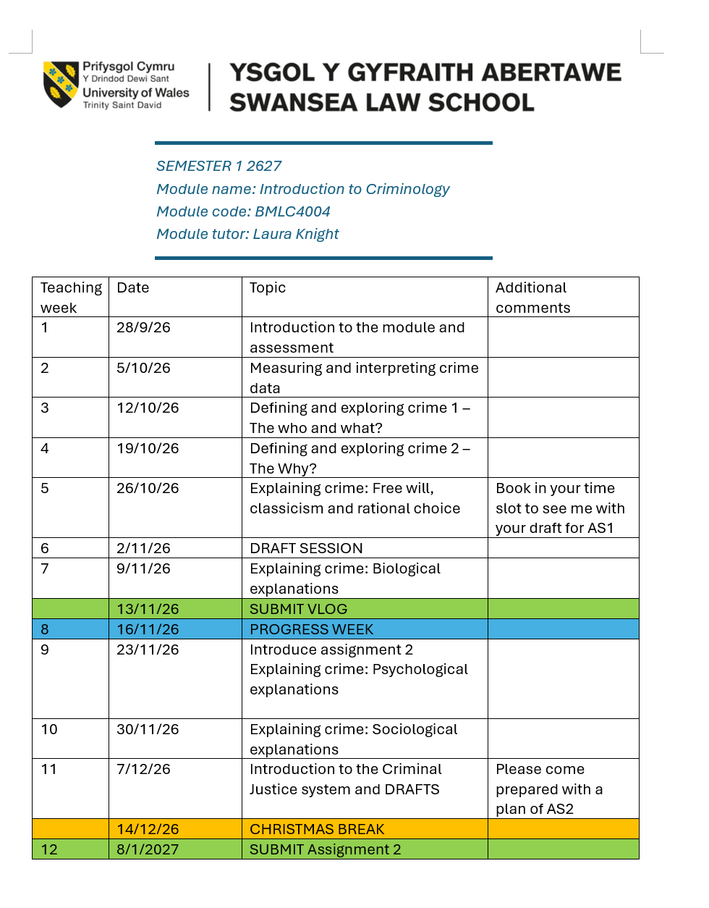
What will we study?
Please note this may be subject to change without prior notice

Slide 5
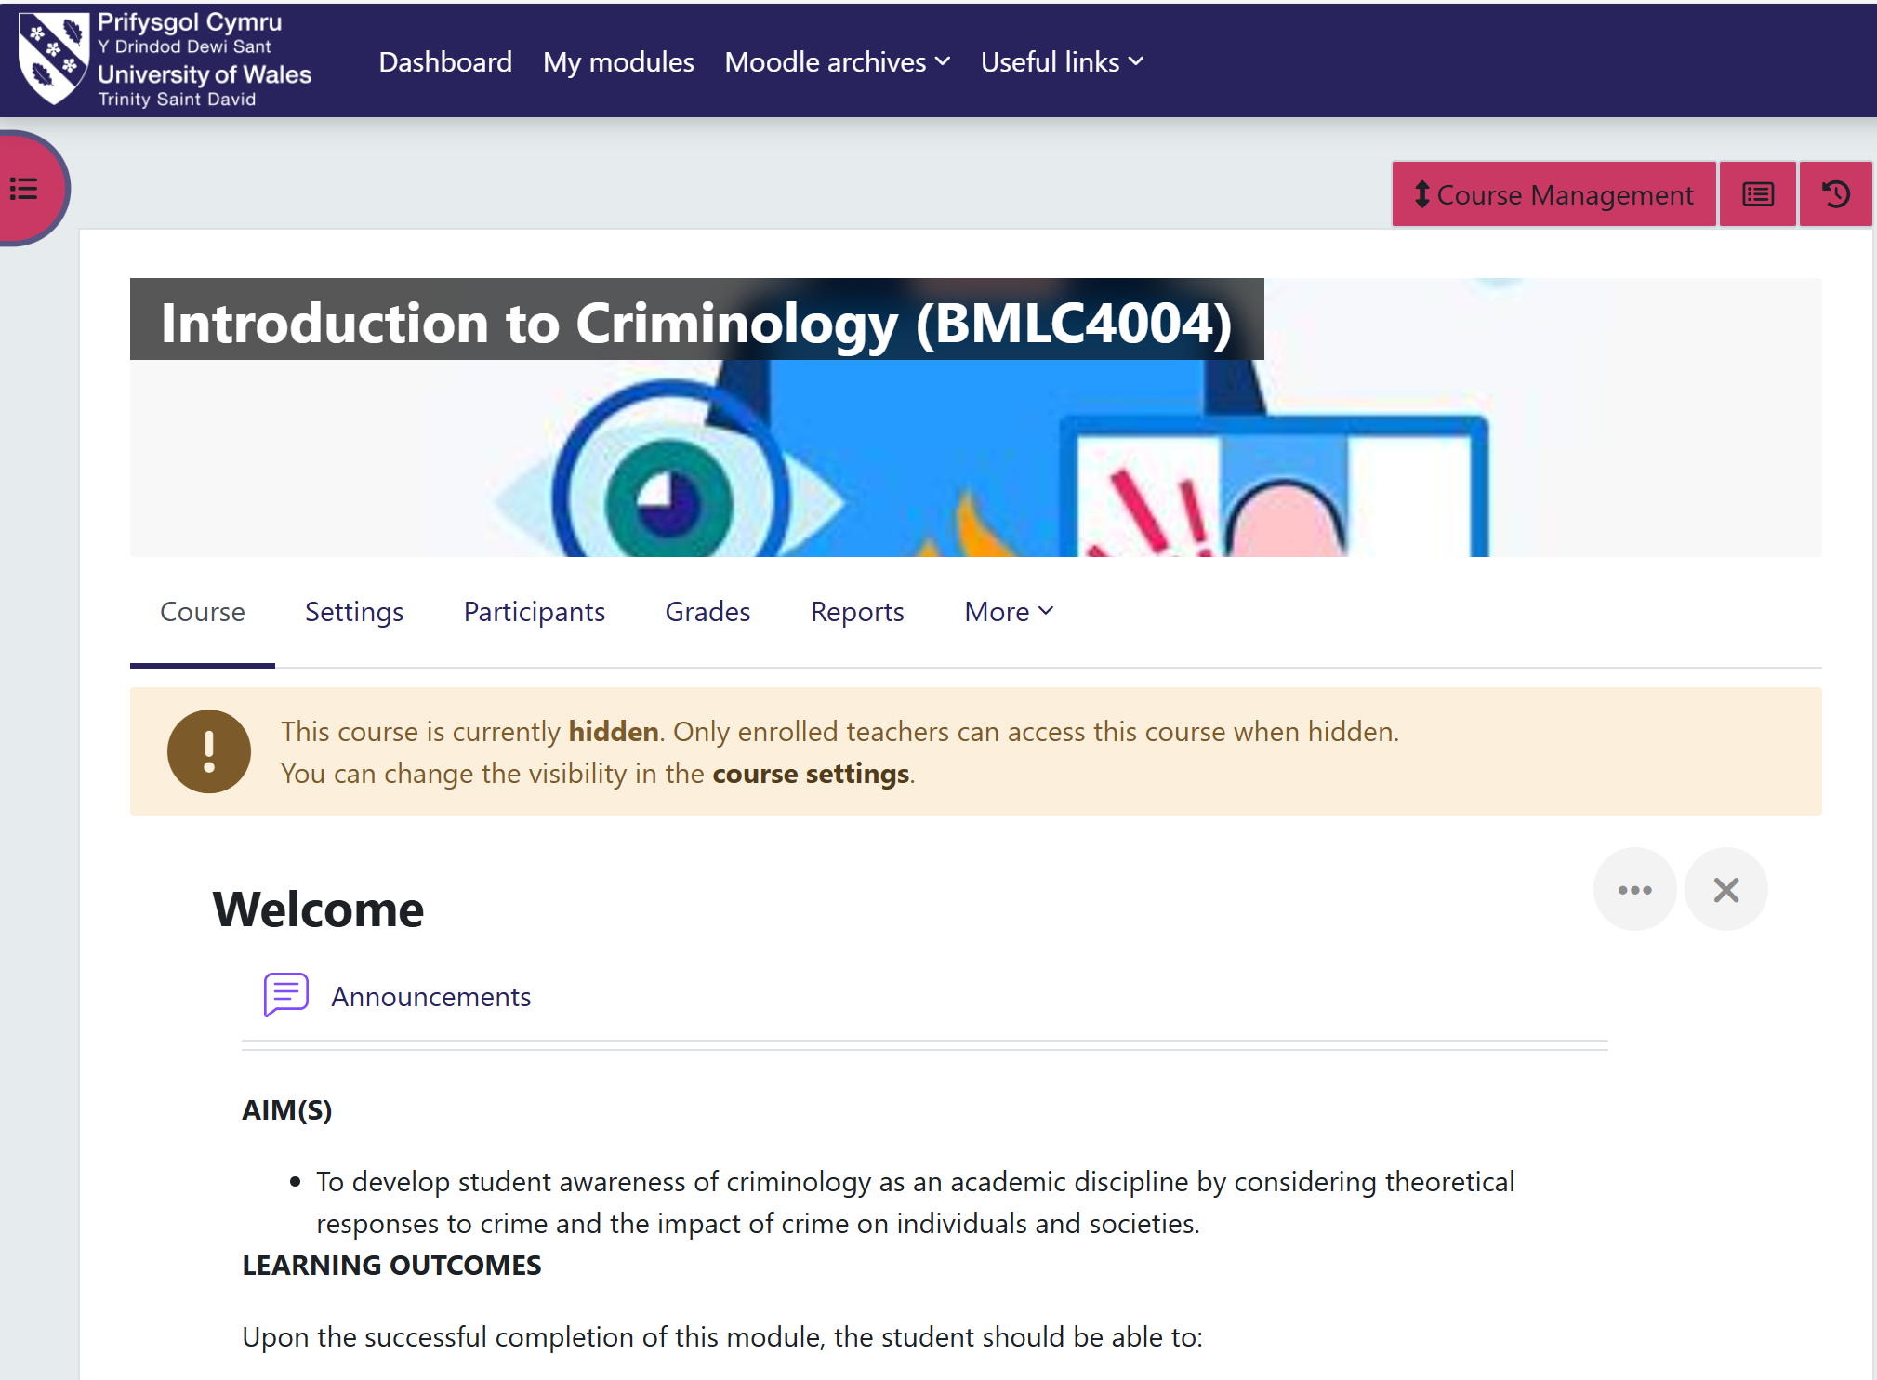
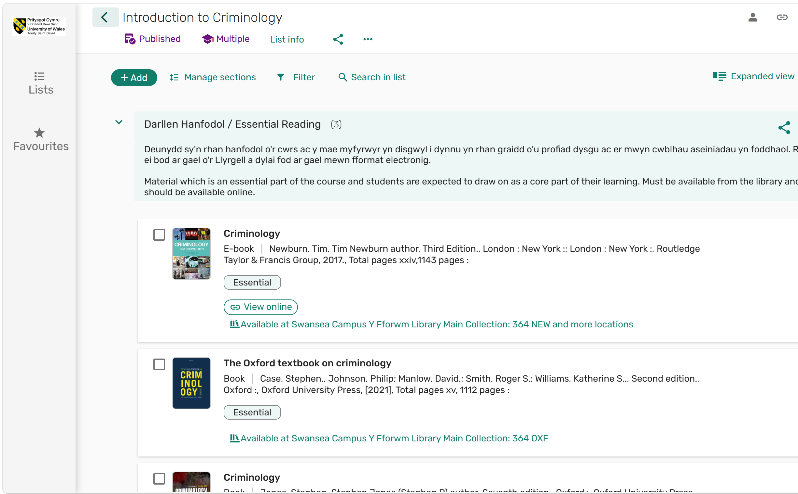
Moodle and reading list

Slide 6
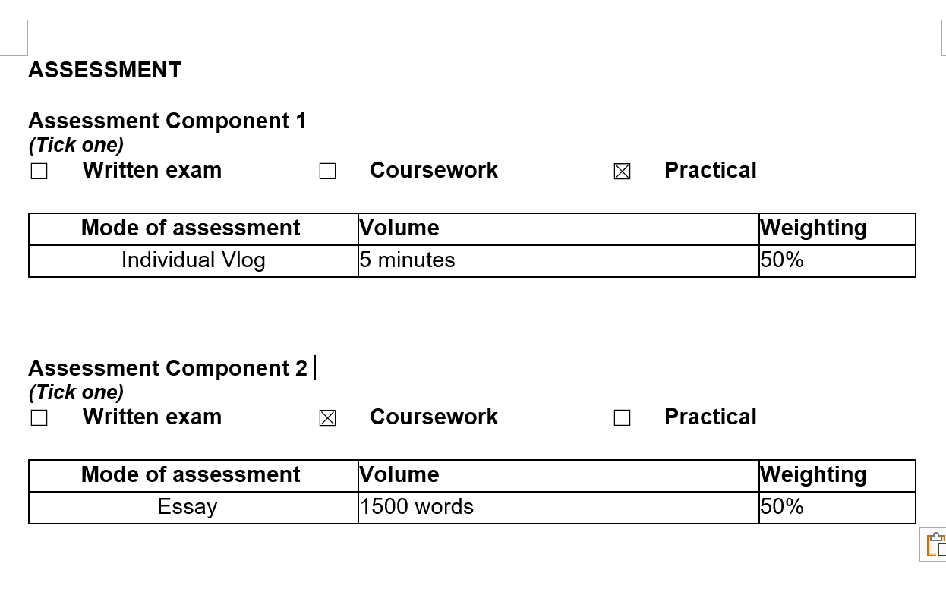
Assessment

Slide 7
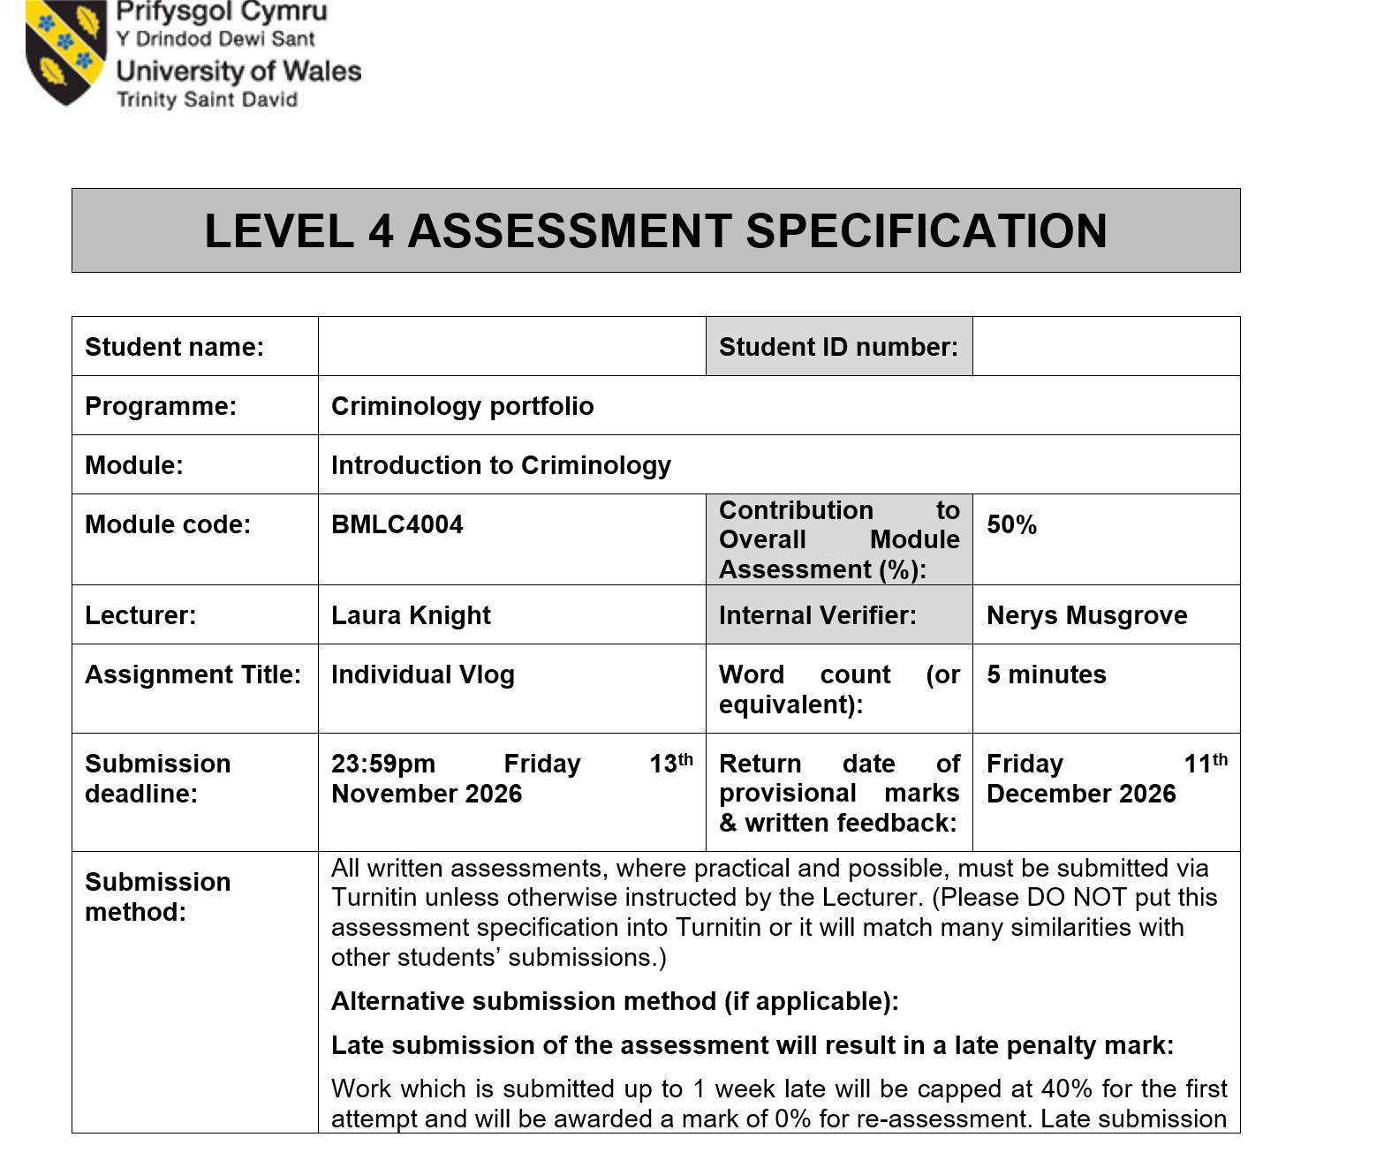
Assessment 1
Let’s take a look at the brief . . .

Slide 8

Vlog tips

Slide 9

Let’s give it a go . . . .
Set up a FREE Youtube account
2. Record a short 2-minute tester video introducing yourself
3. Upload your video to the Youtube account and ensure you enable permissions as ‘unlisted’ – (only people with the link can access the video).
If you have used a phone to record your video, you can upload it by downloading the Youtube app.

Slide 10
WHAT IS CRIMINOLOGY?

Slide 11
WHY BECOME A CRIMINOLOGIST?

Slide 12
WHAT IS CRIME?

Slide 13

WHAT IS CRIME?
A set of rules that if broken lead to criminal sanctions?
CRIME AS A SOCIAL CONSTRUCT
-What we consider to be crime is socially constructed
-Crime is was society thinks it should be at one time
-The powerful within the state may use the law to protect their own interests
-What any one society considers to be criminal changes over time
Newburn, 2017

Slide 14
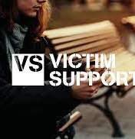
What is crime?
Victim support: ‘deliberate act that causes physical or psychological harm, damage to or loss of property, and is against the law’.
Does some harm have to be used?
Becker (1963), a sociologist who examined deviance, argues that crime or deviances are created by social groups who make the rules and when these are broken, a crime occurs. In essence, crime takes place when it is seen by society to have taken place.

Slide 15
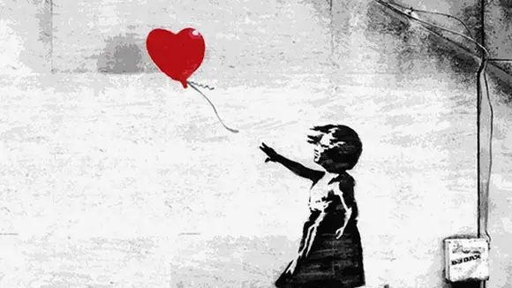

Slide 16
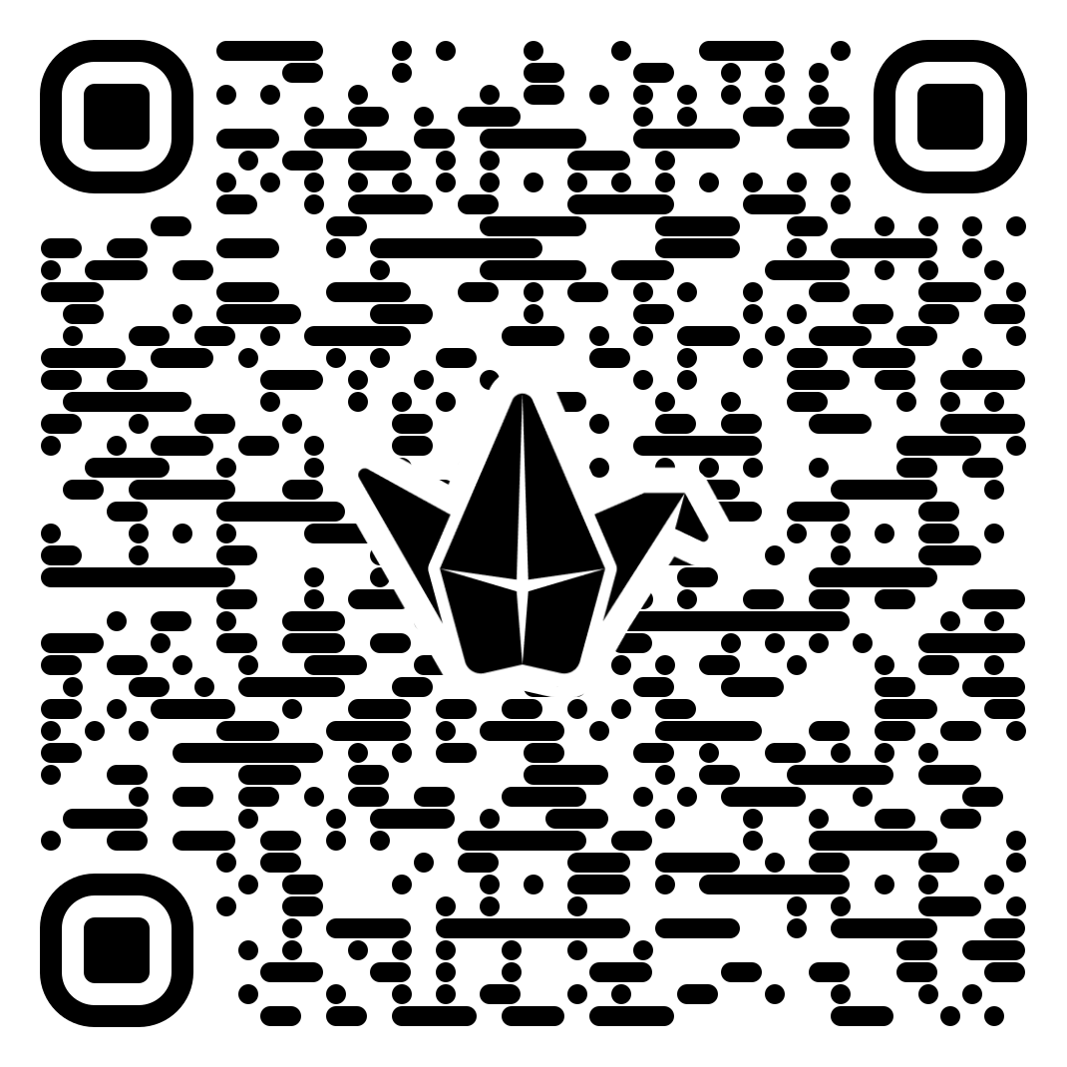
How does public perception shape crime?
3. Exploring Media and Narrative
  Language used (e.g., emotive, sensationalist)
  Imagery and framing
  Who is portrayed as the victim or perpetrator?
  What message is being sent?
1. Crime perception Padlet
2. How does this compare with the actual data?
Groups identify:
  Key mismatches
  Possible reasons for these mismatches (e.g., media influence, personal experience)
RESEARCH TASK

Slide 17
TASK: Historical variation of crime
Can you find some examples of how crime is socially constructed?
How do laws change over time and vary geographically?

Slide 18
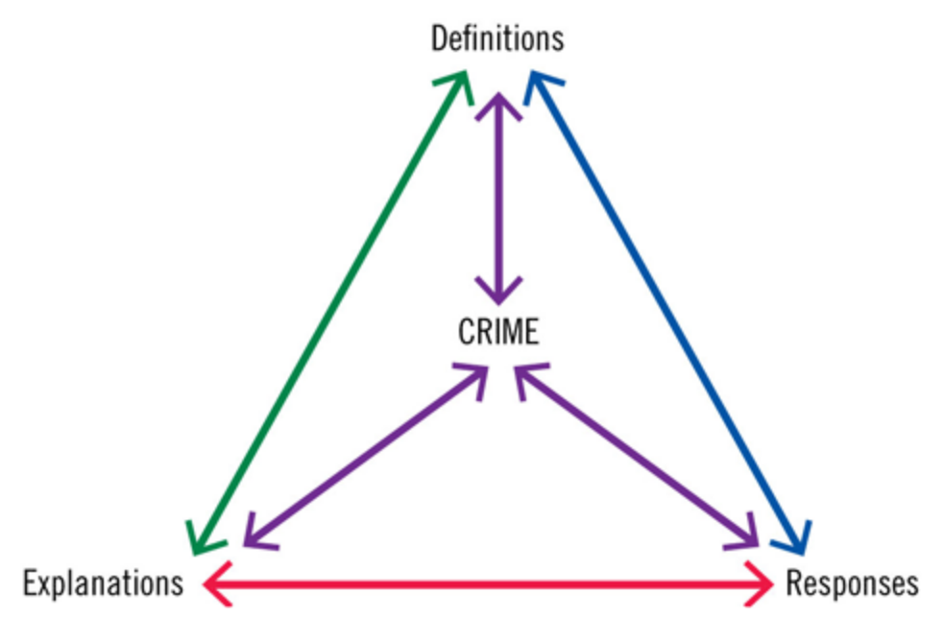
TRIAD OF CRIMINOLOGY
Case et al (2021)

Slide 19
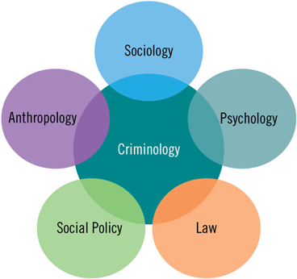
David Downes called criminology ‘a rendezvous subject’ (2008, in Millie, 2016) as it is a point at which several other subjects meet and overlap, and the discipline is shaped by both academic and non-academic influences.
(Downes 2008, in Millie, 2016)

Slide 20
INDIVIDUAL TASK
•Why do/did you want to study criminology?
•What do/did you expect your studies to look like?
•What do you hope to gain from them?
•What do you expect yourself to look like as a learner, a potential employee, and an individual at the end of your studies?
You might like to write down your responses to these questions in a notebook or save them in a Word document so that you can refer back to them during and at the end of your degree.

Slide 21
The evolution of student knowledge production
Each stage builds on the one before – moving from taking in knowledge to creating it
5
4
Knowledge production
Creating new information, understandings, applications, analyses and evaluations
3
Critical analysis and evaluation
Splitting knowledge into its parts, weighing strengths and weaknesses, and judging its value, worth or contribution
2
Application
Being able to use knowledge in another way, for another purpose, in the real world
1
Understanding
Developing an appreciation of the meaning of different sources of knowledge
Knowledge
Obtaining information, statistics, evidence, arguments, debates, theories and concepts about a subject
(Case et al, 2021)
Increasing depth of learning →

Slide 22
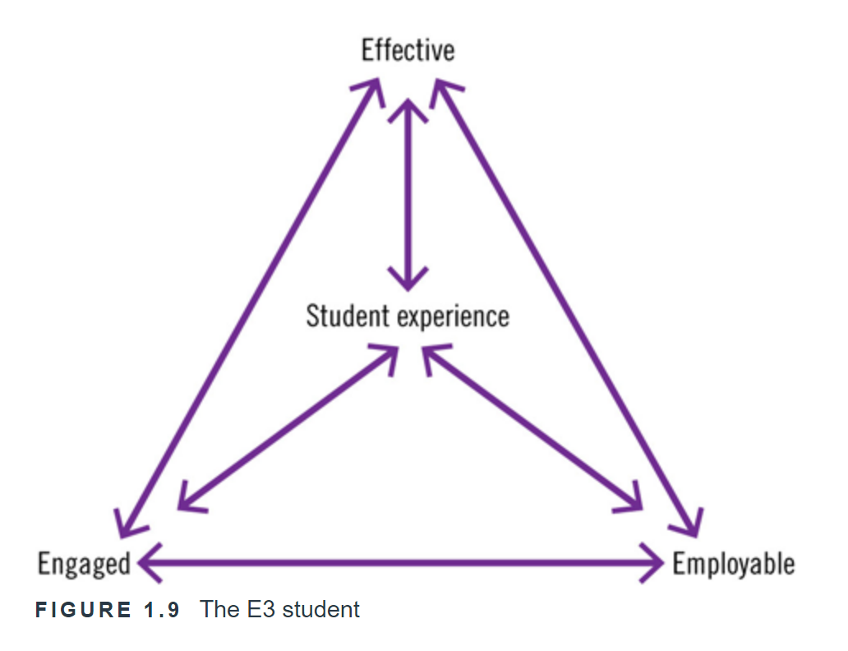
The goal… An E3 student
Effective: Being fully informed and aware of what you need to do, what and who you need to know to help you succeed.
Engaged: Being willing and committed to maximizing your student experience through full and active participation.
Employable: Developing the skills and mindset to make you attractive to potential employers.
Case et al, 2021

Slide 23
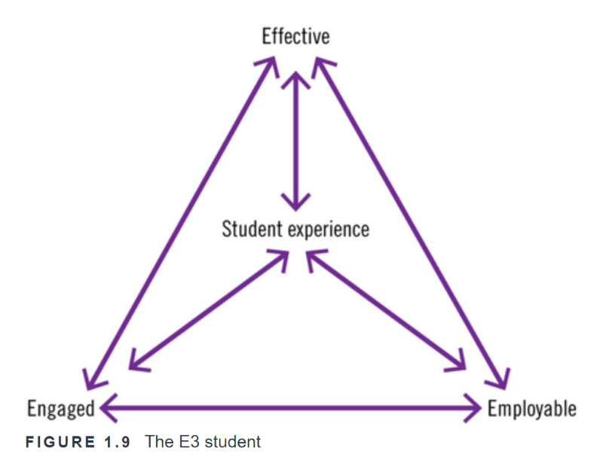
THINKPOINT
•What factors increase/have increased your ability to be effective and engaged whilst at university and to become employable by the time you leave?
•What differences do/did you anticipate experiencing between college or sixth form (further education) and university (higher education) study? How do you plan to manage them?
•Who and what can help you to become effective, engaged, and employable?
•How can you help yourself? What exactly do you need to do?

Slide 24
Unconscious bias
1. Can you think of some areas within the criminal justice system where unconscious bias may influence decisions?
2. Discuss the potential consequences of unconscious bias on the fairness, equity and trustworthiness of the criminal justice system. Consider how it may impact individuals from marginalised or minority groups
3. Personal reflection: Reflect on your own biases and discuss steps you can take to identify and overcome them when engaging with crime-related issues.
A father and son are in a car crash and are rushed to the hospital. The father dies. The boy is taken to the operating room and the surgeon says, “I can’t operate on this boy, because he’s my son.”

Slide 25

Always Be Critical
Critical – be focused, deliberate and analytical
Ensure the information you gain suits the type of learner that you are. What is the usefulness of the information to you?
Case et al, 2021

Slide 26


