Slide 1

HUMAN RESOURCE MANAGEMENT

Slide 2
Student name: MohammedakibMahammediqbal Shaikh
Student id: 2237233
Professor: Prof D G Pepple
Programme: MASTER OF BUSINESS ADMINITRATION
Module: HUMAN RESOURCE MANAGEMENT

Slide 3
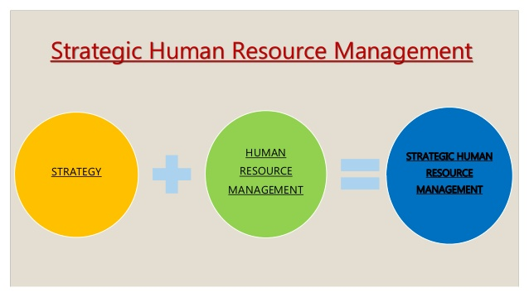
INTRODUCTION
The changing business landscape made operations of HR dynamic in terms of making it a department of strategy development. In order to meet current market needs, HR aligns its process and management accordingly to create a link between the strategic action and organisational goals. This literature review intends to undertake three core article papers to make a review based on the evolution of HR strategy and adding competitive advantage to the organisation. It also includes analysis of models and analysis of multifaceted aspects influenced by HR strategy of organisations. Along with this, it also includes conceptual framework showcasing key variables and making literature review more comprehensible with a visual presentation.

Slide 4
SUMMARY OF LITERATURE BASED ON THREE ARTICLES
References . | Title | Key methodology used | Summary | Key objective | Results
“Hamadamin, H.H. and Atan, T., (2019). The impact of strategic human resource management practices on competitive advantage sustainability: The mediation of human capital development and employee commitment. Sustainability, 11(20), p.5782.” | “The impact of strategic human resource management practices on competitive advantage sustainability: The mediation of human capital development and employee commitment” | Primary data collection mode has been used with the use of “Structural equation modeling (SEM) technique” | The research has shown a positive link between HR strategy and competitive advantage as both these factors are proportionally linked to each other. This implies that an effective strategy leads to the enhancement of organisational competitive advantage | The key objective of this study lies in determining the relationship between HR strategy and competitive advantage | The SEM technique has provided that HR strategy with sustainability in it influences competitive advantage in a positive manner.
“Malik, A., (2019). Creating competitive advantage through source basic capital strategic humanity in the industrial age 4.0. International Research Journal of Advanced Engineering and Science, 4(1), pp.209-215” | “Creating competitive advantage through source basic capital strategic humanity in the industrial age 4.0” | The study followed a “qualitative descriptive method” to interpret results in a systematic manner. | This study shows that current operational parameters are driven by technology, which can be managed accordingly by applying “Source Basic Capital Strategic Humanity”. | This study lies in determining the challenges of technology and contribution of “Source Basic Capital Strategic Humanity” in mitigating this challenge | This research highlights that labour intensive sectors are becoming vulnerable due to rapid transformation into automation. However, adequate HR management in terms of “Source Basic Capital Strategic Humanity” can be beneficial in creating balance between automation and human labour.
“Anwar, G. and Abdullah, N.N., (2021). The impact of Human resource management practice on Organizational performance. International journal of Engineering, Business and Management (IJEBM), 5.” | “The impact of Human resource management practice on Organizational performance” | “Primary quantitative method” has been utilised to conduct this study. | The findings of the study elucidates that decentralisation HR management enhances organisational performances and adds momentum to competitive advantage. | The study centres around the objective of determining the impact of HR strategy on improving organisational performance | It clearly highlights that decentralisation of HR strategy allows active participation from employees, which in turn increases organisational performances.

Slide 5
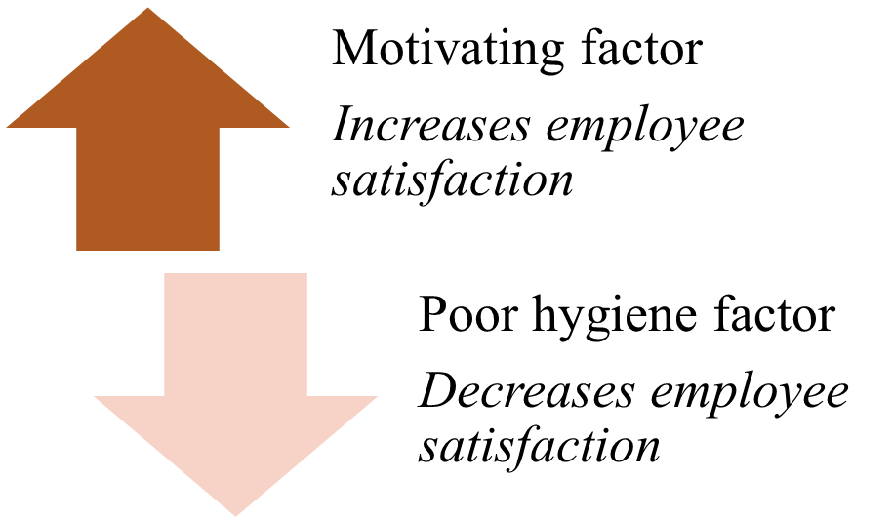
A MODEL LINKING HR STRATEGY OF COMPETITIVE ADVANTAGE
In view of Kaufman (2020), HRM has evolved as an “input and output mechanism”, which constantly brings new action in management prospects followed by improving the performance of organisations
The “standard causal model” of HRM helps in identifying the causal factors
Herzberg’s two factor theory can be beneficial for managing organisational performances
Notes:
Over the years, HRM has changed radically from transition to principle driven to emerging as a value driven model. In view of Kaufman (2020), HRM has evolved as an “input and output mechanism”, which constantly brings new action in management prospects followed by improving the performance of organisations. It can be depicted that input is the strategic parameters whereas output defines the organisational performance and competitive model. The “standard causal model” of HRM helps in identifying the causal factors, which drives the prospects of productivity and performance within an organisation. Therefore, it is constantly emphasised that HR managers need to provide effective input, which can help in bringing best possible results. In defining this “input and output mechanism”, it is important to understand the key factors, which constitute the input activities of HRM. As stated by Mehrad (2020), employees are driven by motivation and these motivations come from two factors mostly “hygiene and motivation”. These two factors are best understood by the “Herzberg’s two factor theory”, where hygiene stands for organisational policy and motivation stands for monetary including non-monetary achievements, which adds to employee satisfaction.

Slide 6
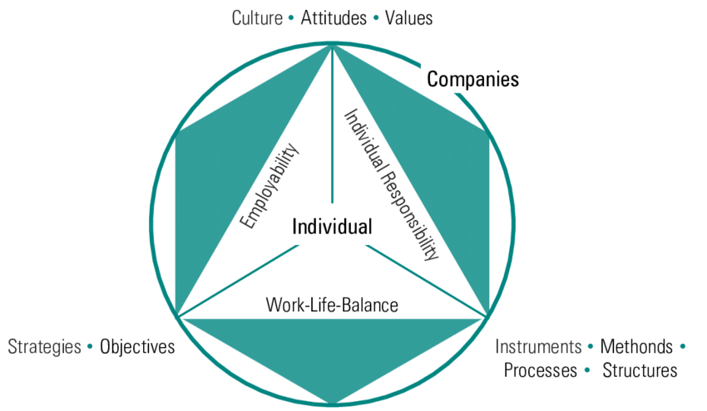
IMPACT OF HR STRATEGY ON ENHANCING COMPETITIVE ADVANTAGE OF ORGANISATIONS
The organisational approach has evolved continuously in course of changing needs of employees and it also transformed the strategic parameters of the organisations
As opined by Rosnizam et al. (2020), HRM strategy is important for managing operational processes and linking the process with the respective organisational goals
. As opined by Amjad et al. (2021), lack of HR sustainability and uniform approach in employee management leads to the disruption in the effective workflow.
Notes:
The organisational approach has evolved continuously in course of changing needs of employees and it also transformed the strategic parameters of the organisations. In this context, training and development programmes constitute the key strategic approach with the aim of enhancing the skill base of the workforce coupled with adding momentum to organisations. As opined by Rosnizam et al. (2020), HRM strategy is important for managing operational processes and linking the process with the respective organisational goals. In identifying the link between operational management and HRM, the study analysed the case study of Tesco, whereby it has been found “training and development” can act as a boon for the one of the largest retail companies of UK to enhance its competitive advantage in the market. Therefore, it can be stated that “training and development programme” has become a medium in the hands of HR to add dimensions and momentum in organisational performances.
Despite the overwhelming contribution of HRM strategy, there still lie loopholes in these strategic actions, which can result in the development of disorientation in organisational performances. This can be seen in terms of deficiency in building commitment and resilience while managing workforce within an organisation. As opined by Amjad et al. (2021), lack of HR sustainability and uniform approach in employee management leads to the disruption in the effective workflow. It is argued that HR strategy in the current situation is mostly driven by organisational goals, where it fails to address the concerns of employees. This shows that competitive advantage has become a key force that leads to rapid transition and transformation of operational aspects. In turn, this exerts pressure on the employees, which leads to potential burnout and employee dissatisfaction. As proposed by Kareem and Hussein (2019), HR strategy needs to develop further association with employee concern and goals, which is to result in streamlining workflow coupled with bringing the desired results. It depicts that the strategic parameters of HRM has several loopholes, which can be seen in terms of biased principles and approach. Therefore, having a pragmatic view can help in overcoming this challenge and enabling organisations to move towards uniform implementation of policy to retain competitive advantage for a long time.

Slide 7
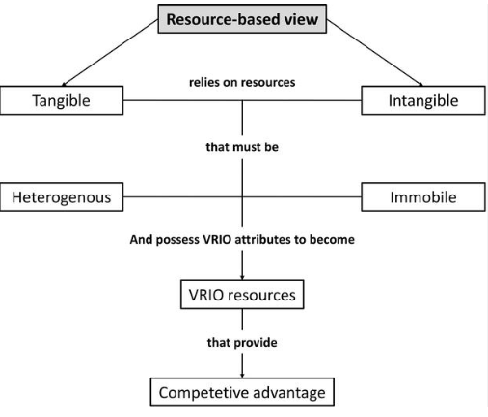
EXPLANATION OF RESOURCE BASED VIEW
"Resource based view" is a managerial framework that allows organisations in making full use of the strategic resources to achieve organisational goals
In view of Davis and DeWitt (2021) RBV helps organisations in positioning its strategic resources in a tactical manner
As observed by Harsch and Festing (2020), tangible and intangible resources allow organisations in creating prominence in the market by adding value to the operations
Notes:
"Resource based view" is a managerial framework that allows organisations in making full use of the strategic resources to achieve organisational goals. In view of Davis and DeWitt (2021) RBV helps organisations in positioning its strategic resources in a tactical manner, which boosts operations and adds competitive advantage to the company. This framework highlights that "tangible, non-tangible, and capabilities" are three core resources, which enables organisations in adding momentum to the organisation. In the present scenario, the changing dynamics makes it inevitable for HRM to recognise these resources with the intention of making appropriate usage. As observed by Harsch and Festing (2020), tangible and intangible resources allow organisations in creating prominence in the market by adding value to the operations. In this RBV model, tangible resources stand for physical assets, which are used to boost production and services. On the other hand, intangible resources can be found in human resources, which further allows construction of brand identity and its image in the market. Additionally, this helps in shaping the perceptions about the brand in the minds of customers.
As employees are the key agents in contributing to organisational success. Therefore, it is necessary to manage them properly to add an impetus VRIO factor in the RBV model. Having a better recognition of the resources is beneficial for HRM to determine opportunities within operations and make best use of the human resources. The VRIO factor ensures that these resources can be valuable and rare to the organisation as this helps in producing distinct results compared to the competitors in the market. The study by Khanra et al. (2022) states that determination of position of resources within an organisation is important, which further enables in constructing better strategic frames to alleviate its position. It is observable that constant commitment in alleviating their position can enhance the competitive advantage of the company further.

Slide 8
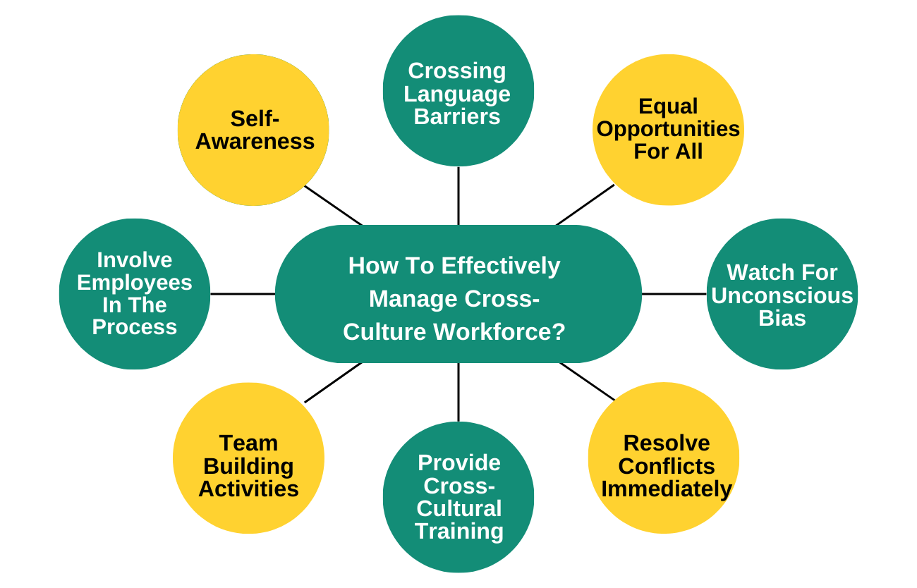
IMPACT OF CULTURAL AND FUNCTIONAL ASPECTS IN INFLUENCING COMPETITIVE ADVANTAGE
Internationalisation has become a key strategic tool in the hands of the organisations to expand brand reach and profitability
As opined by Malik et al. (2020), the rapid internationalisation has provided further momentum in the operations of IHRM in terms of managing a multicultural workforce
The cultural dynamics has come to play an extensive role in employee management as organisations are getting more inclined towards securing talent for the advancement of competitive advantage
Notes:
Internationalisation has become a key strategic tool in the hands of the organisations to expand brand reach and profitability. As opined by Malik et al. (2020), the rapid internationalisation has provided further momentum in the operations of IHRM in terms of managing a multicultural workforce. The cultural dynamics has come to play an extensive role in employee management as organisations are getting more inclined towards securing talent for the advancement of competitive advantage in the market. Cultural aspects include recognising the wider cultural preferences coupled with developing an organisational environment, which boots employee productivity. The HR management process has become highly decentralised in terms of providing preference to employees coming from different cultures provided with offering an inclusive workspace. It is argued by Hongal and Kinange (2020), cross cultural management has become a key force in enabling HR managers to bring inclusivity and diversification in the operational, which also increases the probability in the incorporation of new ideas that brings new ideas to the organisation.

Slide 9
IMPACT OF CULTURAL AND FUNCTIONAL ASPECTS IN INFLUENCING COMPETITIVE ADVANTAGE
As stated by Nagano (2019), competition is constantly rising in the market, which requires both leadership potentials and defensive strategic mechanisms
IHRM needs to evolve its traditional strategic model with the “people-centric approach”, which provides more concern to the employees coupled with their incorporation in the decision making process (Muda Abdul Fattaah et al. 2020)
According to Ererdi et al. (2022), employees are the key drivers of an organisation, in this regard their contribution and commitment allows companies to expand their market prominence
Developing inclusive culture
People management
Retaining productivity
Notes:
In this context, the approach to functional aspects include mapping and designing the process of employee management followed by bringing new policies to have a better control in operational management. As stated by Nagano (2019), competition is constantly rising in the market, which requires both leadership potentials and defensive strategic mechanisms. It is observable that having these strategic parameters allow proper division of tasks enabling organisations in streamlining their operations further. IHRM needs to evolve its traditional strategic model with the “people-centric approach”, which provides more concern to the employees coupled with their incorporation in the decision making process. In turn, all these accumulated factors enable employees to work with full commitment, which can be seen in the positive outcome of the company. According to Ererdi et al. (2022), employees are the key drivers of an organisation, in this regard their contribution and commitment allows companies to expand their market prominence. Therefore, it can be stated that both cultural and functional aspects of competitive advantage are closely linked with changing policy and protocols of the company to tap the full potential of the employees.

Slide 10
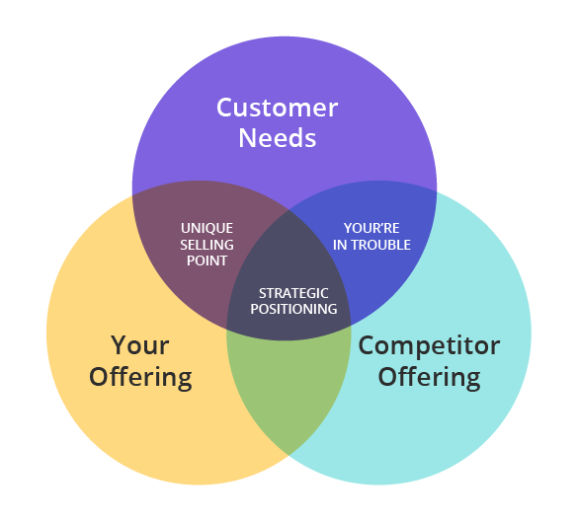
IMPACT OF POSITIONAL AND REGULATIONAL ASPECTS IN INFLUENCING COMPETITIVE ADVANTAGE
Position of an organisation refers to the distinct share it holds in the market, which also allows an organisation in creating brand perception (Rodrigues and Franco, 2019)
In view of Pambreni et al. (2019), “quality product and servicing” are two key factors that enable organisations in strengthening their competitive advantage.
It is observable by Wilkinson et al. (2020), Regulational aspects indicate following legal structure and implications properly and ensuring a healthy organisational culture for the employees
Notes:
Position of an organisation refers to the distinct share it holds in the market, which also allows an organisation in creating brand perception. In view of Pambreni et al. (2019), “quality product and servicing” are two key factors that enable organisations in strengthening their competitive advantage. These two factors are also linked to enhancing the positional factor of the organisation. Continuous rise in the breach of the employee rights can significantly affect the brand’s position in the market. It is observable by Wilkinson et al. (2020), Regulational aspects indicate following legal structure and implications properly and ensuring a healthy organisational culture for the employees. On several occasions, it has been observed that discrimination, involuntary quitting, and any form of abuse has come to be some key factors, which can bring legal suits before an organisation. In turn, the organisation can lose its brand image in the market, which can result in decreasing competitive advantage.

Slide 11
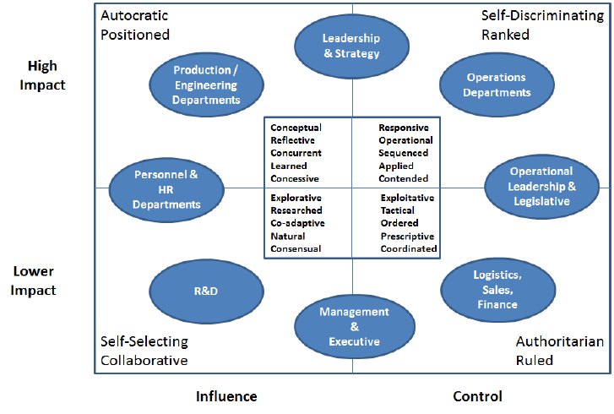
IMPACT OF POSITIONAL AND REGULATIONAL ASPECTS IN INFLUENCING COMPETITIVE ADVANTAGE
In view of Stahl et al. (2020), HR management works closely with designing protocols to the management operations, which allows framing adequate protocol to minimise negative implication of Regulational aspect
As the organisational landscape is constantly changing, therefore inclusion of a sustainable HRM approach followed by cross-cultural management is essential (Pleodpring and Sivabrovornvatana, 2021)
As observed by Roscoe et al. (2019), the company needs to develop flexible protocols, which can be changed according to the changing needs in the external environment.
Notes:
The analysis highlights that both “positional and Regulational aspects” are interlinked with the competitive advantage. It is observable that a positive approach and design towards these factors result in the enhancement of competitive advantage. On the other hand, a fragile and robust approach can in this stead become detrimental for an organisation in terms of decreasing its potential in the market followed by lowering its operational scope. In view of Stahl et al. (2020), HR management works closely with designing protocols to the management operations, which allows framing adequate protocol to minimise negative implication of Regulational aspect. As the organisational landscape is constantly changing, therefore inclusion of a sustainable HRM approach followed by cross-cultural management is essential. All these parameters need to be understood effectively along with the expansion of general knowledge and conceptual scope to help the organisation in maintaining its operational fleet. As observed by Roscoe et al. (2019), the company needs to develop flexible protocols, which can be changed according to the changing needs in the external environment. Therefore, it can be determined that application of a proper strategic model can be beneficial in order to retain positions in the market.

Slide 12
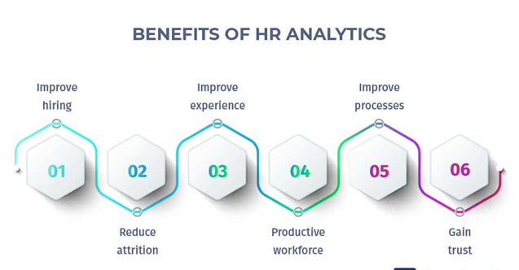
IMPACT OF POSITIONAL AND REGULATIONAL ASPECTS IN INFLUENCING COMPETITIVE ADVANTAGE
In this context, HR analytics can add further dynamics to employee management followed by synthesising employee action in line with organisational goals
As per the view of Giermindl et al. (2022), HR analytics refers to the process of collecting “talent data” with the aim of improving business outcome
It is analysed that having better knowledge of employee concerns including the motivation factors can help in increasing their performance significantly (Jamal et al. 2021)
Notes:
In this context, HR analytics can add further dynamics to employee management followed by synthesising employee action in line with organisational goals. As per the view of Giermindl et al. (2022), HR analytics refers to the process of collecting “talent data” with the aim of improving business outcome. It is important for HR managers to understand current market dynamics followed by positional strategy that helps companies in developing market prominence. It is analysed that having better knowledge of employee concerns including the motivation factors can help in increasing their performance significantly. Therefore, it can be stated that exploring strategic parameters like training, following cultural management and designing strict protocols are necessary.

Slide 13
CONCEPTUAL FRAMEWORK
Conceptual Framework
The “standard causal model” of HRM helps in identifying the causal factors, which drives the prospects of productivity and performance within an organisation.
A model linking HR strategy of competitive advantage
The organisational approach has evolved continuously in course of changing needs of employees and it also transformed the strategic parameters of the organisations.
Human Resource Management
Impact of cultural and functional aspects in influencing competitive advantage
Impact of Positional and Regulational aspects in influencing competitive advantage
Despite the overwhelming contribution of HRM strategy, there still lie loopholes in these strategic actions, which can result in the development of disorientation in organisational performances.
Explanation of Resource Based view
In this RBV model, tangible resources stand for physical assets, which are used to boost production and services.
Notes:
The conceptual framework highlights the key variables coupled with the models utilised in the overall study.

Slide 14
CONCLUSION AND SUMMARY
The study concludes that HR strategy is important as this helps employees in bringing their best performance followed by enhancing organisational success. It has been found that effective HR strategies are useful for generating further competitive advantage for the company. Summarising the three articles show that different HR strategies are linked with some aspects of the competitive advantage, which is required to be maintained through proper management of employees. In addition, the analysis of RBV model shows positioning resources accordingly can be beneficial for organisations and HR equally to retain competitive advantage of the company. Furthermore, the “cultural, functional, positional and regulational aspect of competitive advantage highlighted that these factors are important for organisations to add momentum in their operations.

Slide 15
RECOMMENDATIONS
Emphasising on HR analytics
Designing a healthy organisational culture
As observed by Jensen and van der Voordt (2020), an inclusive work culture fosters employee growth and helps them in achieving their productivity and full performance
As opined by Nocker and Sena (2019), HR analytics enable organisations in synthesising actions of employees with that of organisational goals
In turn, this helps in bringing consistency in operational management as well as employee performance.
Notes:
Designing a healthy organisational culture
Healthy organisational culture acts as a key factor that influences employees performances significantly. It is observable that employee satisfaction is proportionally related to employee performance, which implies that higher level of satisfaction helps in maintaining high performance among employees. As observed by Jensen and van der Voordt (2020), an inclusive work culture fosters employee growth and helps them in achieving their productivity and full performance. It is important to note that HRM needs to make a specific strategy in retaining integrity within the organisational culture. It can be recommended that having healthy organisational culture is beneficial for increasing employee productivity, which in turn is to enhance operational outcomes further.
Emphasising on HR analytics
HR analytics ensure that organisational goals can be in line with employee performance as this helps in advancing organisational performances. In this context, emphasising on training, meeting employee needs and generating productivity among employees is essentially important. As opined by Nocker and Sena (2019), HR analytics enable organisations in synthesising actions of employees with that of organisational goals. In turn, this helps in bringing consistency in operational management as well as employee performance. Therefore, it can be recommended that incorporating HR analytics is beneficial for enhancing the competitive advantage of the company.

Slide 16
REFERENCES
References
“Anwar, G. and Abdullah, N.N., (2021). The impact of Human resource management practice on Organizational performance. International journal of Engineering, Business and Management (IJEBM), 5.”
“Hamadamin, H.H. and Atan, T., (2019). The impact of strategic human resource management practices on competitive advantage sustainability: The mediation of human capital development and employee commitment. Sustainability, 11(20), p.5782.”
“Malik, A., (2019). Creating competitive advantage through source basic capital strategic humanity in the industrial age 4.0. International Research Journal of Advanced Engineering and Science, 4(1), pp.209-215.”
Bibliography
“Amjad, F., Abbas, W., Zia-Ur-Rehman, M., Baig, S.A., Hashim, M., Khan, A. and Rehman, H.U., (2021). Effect of green human resource management practices on organizational sustainability: the mediating role of environmental and employee performance. Environmental Science and Pollution Research, 28, pp.28191-28206.”
“Davis, G.F. and DeWitt, T., (2021). Organization theory and the resource-based view of the firm: The great divide. Journal of Management, 47(7), pp.1684-1697.”
“Ererdi, C., Nurgabdeshov, A., Kozhakhmet, S., Rofcanin, Y. and Demirbag, M., (2022). International HRM in the context of uncertainty and crisis: A systematic review of literature (2000–2018). The International Journal of Human Resource Management, 33(12), pp.2503-2540.”
“Giermindl, L.M., Strich, F., Christ, O., Leicht-Deobald, U. and Redzepi, A., (2022). The dark sides of people analytics: reviewing the perils for organisations and employees. European Journal of Information Systems, 31(3), pp.410-435.”
“Harsch, K. and Festing, M., (2020). Dynamic talent management capabilities and organizational agility—A qualitative exploration. Human Resource Management, 59(1), pp.43-61.”
“Hongal, P. and Kinange, U., (2020). A study on talent management and its impact on organization performance-an empirical review. International Journal of Engineering and Management Research, 10.”
“Jensen, P.A. and van der Voordt, T.J., (2020). Healthy workplaces: What we know and what else we need to know. Journal of Corporate Real Estate, 22(2), pp.95-112.”
“Kareem, M.A. and Hussein, I.J., (2019). The impact of human resource development on employee performance and organizational effectiveness. Management Dynamics in the Knowledge Economy, 7(3), pp.307-322.”
“Kaufman, B.E., (2020). The real problem: The deadly combination of psychologisation, scientism, and normative promotionalism takes strategic human resource management down a 30‐year dead end. Human Resource Management Journal, 30(1), pp.49-72.”
“Khanra, S., Kaur, P., Joseph, R.P., Malik, A. and Dhir, A., (2022). A resource‐based view of green innovation as a strategic firm resource: Present status and future directions. Business Strategy and the Environment, 31(4), pp.1395-1413.”
“Malik, S.Y., Cao, Y., Mughal, Y.H., Kundi, G.M., Mughal, M.H. and Ramayah, T., (2020). Pathways towards sustainability in organizations: Empirical evidence on the role of green human resource management practices and green intellectual capital. Sustainability, 12(8), p.3228.”
“Mehrad, A., (2020). Evaluation of academic staff job satisfaction at Malaysian universities in the context of Herzberg’s Motivation-Hygiene Theory. Journal of Social Science Research, 15(1), pp.157-166.”
“Nagano, H., (2019). The growth of knowledge through the resource-based view. Management Decision, 58(1), pp.98-111.”
“Nocker, M. and Sena, V., (2019). Big data and human resources management: The rise of talent analytics. Social Sciences, 8(10), p.273.”
“Pambreni, Y., Khatibi, A., Azam, S. and Tham, J.J.M.S.L., (2019). The influence of total quality management toward organization performance. Management Science Letters, 9(9), pp.1397-1406.”
“Roscoe, S., Subramanian, N., Jabbour, C.J. and Chong, T., (2019). Green human resource management and the enablers of green organisational culture: Enhancing a firm's environmental performance for sustainable development. Business Strategy and the Environment, 28(5), pp.737-749.”
“Rosnizam, M.R.A.B., Kee, D.M.H., Akhir, M.E.H.B.M., Shahqira, M., Yusoff, M.A.H.B.M., Budiman, R.S. and Alajmi, A.M., (2020). Market opportunities and challenges: A case study of Tesco. Journal of the community development in Asia, 3(2), pp.18-27.”
“Stahl, G.K., Brewster, C.J., Collings, D.G. and Hajro, A., (2020). Enhancing the role of human resource management in corporate sustainability and social responsibility: A multi-stakeholder, multidimensional approach to HRM. Human Resource Management Review, 30(3), p.100708.”
“Wilkinson, A., Barry, M. and Morrison, E., (2020). Toward an integration of research on employee voice. Human Resource Management Review, 30(1).”
“Jamal, T., Zahid, M., Martins, J.M., Mata, M.N., Rahman, H.U. and Mata, P.N., (2021). Perceived green human resource management practices and corporate sustainability: Multigroup analysis and major industries perspectives. Sustainability, 13(6), p.3045.”
“Muda Abdul Fattaah, P., Haak-Saheem, W., Brewster, C. and Darwish, T.K., (2020). International human resource management.”
“Pleodpring, W. and Sivabrovornvatana, N., (2021). A Study of the Causal Factors of Human Resource Management on the Organizational Commitment and Competitive Advantages in the Context of Eastern Economic Corridor of Thailand. The Journal of Pacific Institute of Management Science (Humanities and Social Science), 7(3), pp.441-456.”
“Rodrigues, M. and Franco, M., (2019). The corporate sustainability strategy in organisations: A systematic review and future directions. Sustainability, 11(22), p.6214.”

Slide 17
Thank You!!

