Slide 1
MAJOR PROJECT MODULE
PRESENTATION OF YOUR RESEARCH PROPOSAL
[Disseminating Research]
ASIGNMENT ONE: Research Presentation

Slide 2

OPENING ROUND…. Any questions on asynchronous learning or work over reading week?

Slide 3

Ways to achieve higher marks….

Slide 4
Upcoming work schedule:
10th November : Library session
17th November : Writing the main body of your literature review / critiquing literature
24th November : No workshop : Asynchronous learning on line
1st December : Last lesson before Christmas. Recap on Assignment 2. Writing your conclusion section.
8th December : No workshop : Asynchronous learning on line
26th January : Review of work in Semester One and expectations and preparation for supervision in Semester Two

Slide 5
This lesson will address … … …
Assignment One
Research presentation … … …
Ontology and epistemology

Slide 6
The Assignment…..
Assessment Component 1 – 25%
Practical: Oral Presentation (20 minutes)
Present a project proposal for your major project to your peers

Slide 7
Assignment 1: Presentation
Determine, refine, adapt and use appropriate methods and skills.
Maintain and improve professional knowledge, skills and application.
Skilfully communicate with others in a clear and articulate manner, both verbally and in writing.
Apply research and research methodologies to locate, review and evaluate research findings relevant to care and well-being issues, across a range of disciplines
Employ appropriate academic conventions in the production and presentation of work.

Slide 8
Assignment 1: Presentation
20 minute presentation
25% of overall mark
Purpose: To present your research proposal

Slide 9
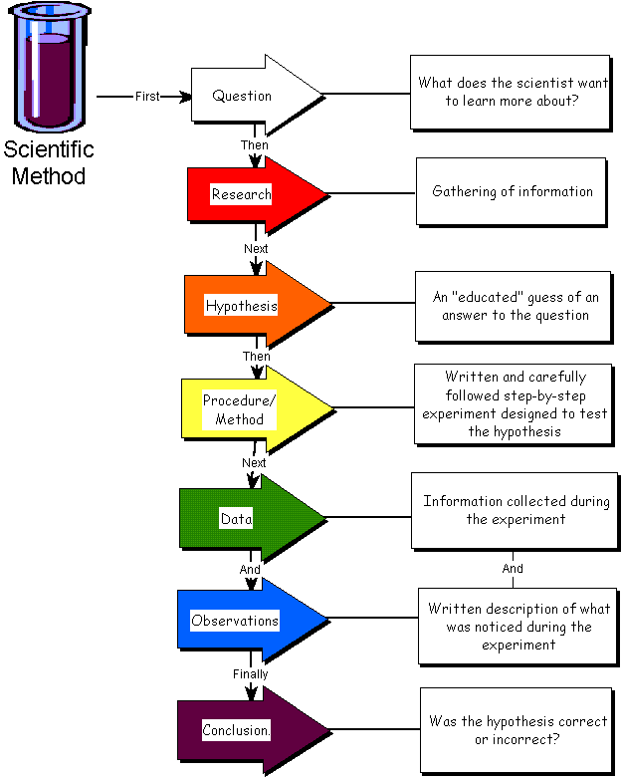






Disseminating Research Findings
Variety of ways…
Research Posters
Presentations
Today
Press Release
Journal Articles
Workshops
Research Reports

Slide 10

Assignment 1: Presentation
Upload video on the 8th December before 11.59 p.m.

Slide 11
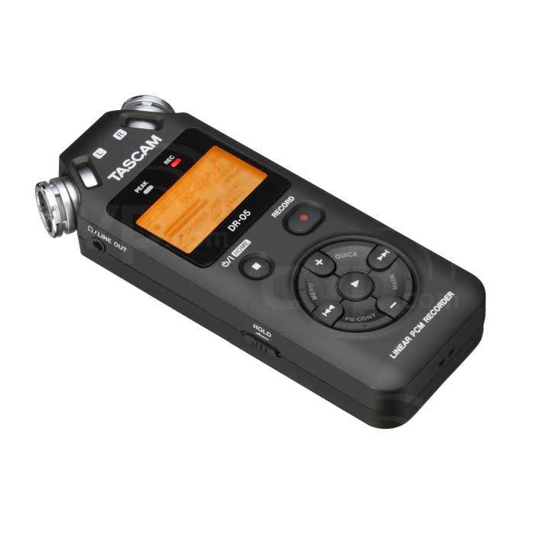

RECORDING AND UPLOADING OF YOUR PRESENTATION IS YOUR RESPONSIBILITY

Slide 12


Have you all been able to write your purpose statement?
Any questions?

Slide 13
A purpose statement … … …
The purpose of this critical literature review will be to ...................[explore, understand, describe, discover] [central concept being explored] as experienced by .................... At this stage of research ................. will be generally described as............................................ ↘

Slide 14

Any questions about your purpose statement
The purpose of this critical literature review will be to explore Dementia as experienced by the over fifties. At this stage of research Dementia will be generally described as the loss of mental capacity to an extend which impacts upon health and wellbeing

Slide 15

Discussion:
Ontological and epistemological reflexivity: A core skill for therapists [and researchers]
A point you take away from this paper…

Slide 16

Recap: What do these terms mean?
What do these words mean?
Ontology –
Epistemology –
Axiology –
Rhetorical structure –
Methodology –

Slide 17
Answers to the quiz on the previous slide
Ontology – the nature of reality and being
Epistemology – the study of knowledge, the gaining of knowledge, and the relationship between the ‘knower’ (the research participant) and the ‘would-be knower’ (the researcher)
Axiology – the role and place of values in the research process
Rhetorical structure – the language and presentation of the research
Methodology – the process and procedures of the research

Slide 18


Discussion on differing views….

Slide 19
Library Session next week: How to Search for literature:
Library data bases
Key words
Truncate
American/English spelling
And/or
Use quotation marks

Slide 20
My major project … … …
I feel … … …
I sense … … …
I imagine … … …
I may need … … …

Slide 21
References
Dawson, C (2009) Introduction to Research Methods, Glasgow: Bell and Bain Ltd.
Greetham, B. 2020. How to write your literature review. Macmillan Study Skills
Kumar, R (2014) Research Methodology, London: Sage Publications Ltd.

Slide 22
DISSEMINATING RESEARCH & PRESENTATION SKILLS (RESOURCES)
Buckroyd, J. and Rother, S. (2008) How to write a research paper and get it published. R10 Information Sheet. BACP: UK
Undergraduate Advising & Research, Dartmouth - Guide to Designing and Printing a Research Poster
http://www.dartmouth.edu/~ugar/undergrad/posterinstructions.html
Deborah Grayson Riegel (2011) Overcoming nerves when giving a presentation
https://www.youtube.com/watch?v=mbDipVRt5aE
Simon Sez Creating a Presentation Part 1 - PowerPoint 2013 Tutorial
https://www.youtube.com/watch?v=LTWf8Ck8Dk8

Slide 23
This lesson has addressed … … …
Assignment One
Research presentation … … …
Ontology and epistemology

Slide 24

ANY QUESTIONS…

Slide 25
CLOSING ROUND….

