Slide 1
The birth of psychoanalysis

Slide 2
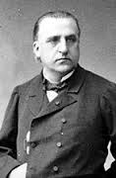
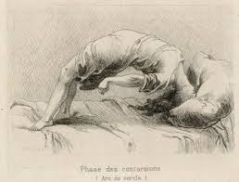
What do we know about Charcot?
Notes:
He specialised in treating patients who were suffering from a variety of unexplained physical symptoms, including paralyses, contractures and seizures.
Some of these patients sporadically and compulsively adopted a bizarre posture (acr-de-circle) in which they arched their body backwards until they were supported only by their head and their heels.
Charcot eventually came to the conclusion that may of his patients were suffering rom a form of hysteria which had been induced by their emotional response to a traumatic accident in their past. In Charcot’s belief, these patients suffered not from the physical effects of the accident, but more of the idea they had formed from it.
Charcot confidently declared that Hysteria was a dsorder of the nervous system, not of the female reproductive organs. It was, morevaer, as real and as somatic a diseas as any of the other neurological catastrophes he had earlier elucidated.

Slide 3
Psychoanalysis was born towards the end of the 19th century.
It was a period of exploration, hysteria and nervousness were being examined by alienists, neurologists and other medical men.
Jean Martin Charcot played a significant role in it’s early development.
Freud met Charcot in 1886, a time when the understanding of the brain was minimal and a map of the brain had barely been drawn.
Early neurologists were fairly ignorant of the brain and it was thought that the understanding of the brain was almost complete.
Notes:
Charcot was a neurologist, he practiced neurology at a time when x-rays had not been invented, tissue staining was primitive and other instruments of investigation did not exit.
The map of the brain, in 1886, when Freud met Charcot, was scarcely drawn.

Slide 4
Charcot’s understanding of epilepsy
During the late 19th century there was little if no understanding of epilepsy, including temporal lobe epilepsy and frontal lobe epilepsy.
The physical damage to the brain, caused by accidents and trauma, was not recognised.
Concussion was not recognised, it produced no outward sign of injury and physicians of the time were reliant on outward behaviours.

Slide 5
Le Log____
Florist delivery driver, hit by a carriage. He was taken to Beaujon hospital where he remained unconscious for almost a week.
He was then transferred to La Salpetriere.
The lower parts of his body were almost completely paralysed, he had tremors at the corner of his mouth and there were blank spaces in his memory.
Because there were no physical signs of trauma or injury, Charcot felt that Le Log___ was suffering from traumatic hysteria.
Charcot believed that the seizures and nosebleeds that Le Log___ was experiencing were caused by the hysterical symptoms.
Notes:
Today, we would recognise this as a closed head injury and might suggest that he had epilepsy and intracranial pressure. Possibly a part of his brain had been significantly damaged in the accident.
Le Log__, the classic example of a patient who supposedly suffered from traumatic hysteria, did not forget because he was frightened, he forgot because he had physical trauma to the brain.
Charcot’s failure to recognise cases of closed head injuries, and the symptoms they gave rise to, would shape the development of psychoanalysis.
It was the main factor which would eventually lead Freud to elaborate his entire theory of unconscious symptom-formation – or ‘repression’

Slide 6
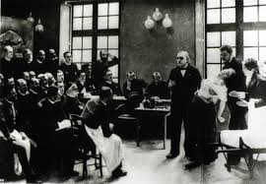
Hypnosis and Charcot’s demonstrations
In studying hypnosis and noticing the impact that hypnosis had on hysterics, they unreservedly recognised the power and the importance of the ‘unconscious’.
The first developments of the understanding of the ‘unconscious’ began in the field of neurology.
Charcot presented his work to the community (medical and artistic) twice a week.
He used the hospital amphitheatre and would use hypnosis to bring on an hysterical episode in a young person.
Notes:
They emphasised the underground work of memory, which stored certain mental experiences in a wahy that they are not accessible through will or conscious efforts of retrieval.
Charcot demonstrated that those with hysteria were not play acting. He would publicly demonstrate his hysterical patients.
Charcot believed that Hysteria was a disorder that attacked men and women. But it was not these men that the audience came to see, instead they wanted to see the scantily clad women who were under the influence of the mesmerizing male gaze, who repeatedly enacted the various stages of the hysterical fit.
Blanche whittman One of Charcot’s favourites, here we see her swooning over the outstretched arm of his assistant, Joseph Babinski, her pelvis thrust forward, her breasts barely covered by her bluse and pointing suggestively at the professor, her head twisted to the side and her face contorted in what looks like the throes of orgasm.

Slide 7
Demonstrations
So popular that a 500 seat auditorium was constructed.
His patients would be required to sometimes wear elaborate head dresses so that his audience could witness the patient’s tremors.
Critics mocked the theatricality of the lectures and suggested that the hysteria was in fact a “cultural hysteria” Were the theatres encouraging a more flamboyant behaviour in the patients?

Slide 8
Criticisms of the Demonstrations
Charcot was so keen to demonstrate and show off his talent, he was often “ruthlessly insensitive to the pain and anguish of his patients, and so enamoured of his scientific mission that he dispensed with ethical proprieties when presenting them to the public” (Harris, 1991)
Those patients who were to be shown to the audience that day were often poked, examined and hypnotized in front of a gleeful audience and were made the centre of entertainment.
Notes:
Ruth Harris, “Introduction” to the reprint edition of J. M. Charcot, Clinical Lectures on Diseases of the Nervous System (London: Routledge, 1991), p. xiv.

Slide 9
Charcot’s four stages of hysteria
1. Epileptiode: Patient suffered fits
2: Grande Mouvements: period of contortions
3: Attitudes Passionelles: posing as if in ecstatic throes.
4: Hallucinations or delusions
Notes:
2: often accompanied by cries and shrieks, and culminating in some cases in the adoption of an arc-en-cercle position, in which the patient is bent backwards into a seemingly impossible contortion, . Charcot also referred to these epsidoes as clownisme.

Slide 10
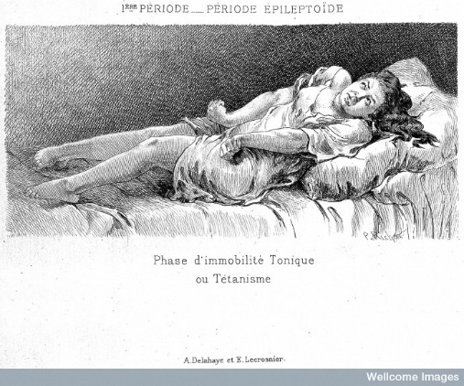
Notes:
This is the first phase: the patient, having suffered a seizure, is locked into a tonic immobility, arms rigid, nightgown rucked up

Slide 11
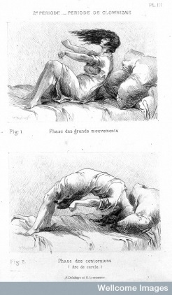
Notes:
Clownisme: Second stage of a hysterical attack. The bottom plate shows the characteristic arc en cercle adopted by many of his patients

Slide 12
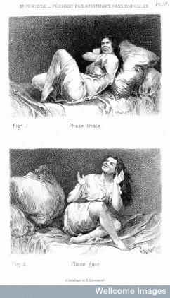
Notes:
Attitudes passionelle, the third phase of grand hysterie. These were engravings based on one of the many photographic studies of the female patients who made up Charcot’s circus.

Slide 13
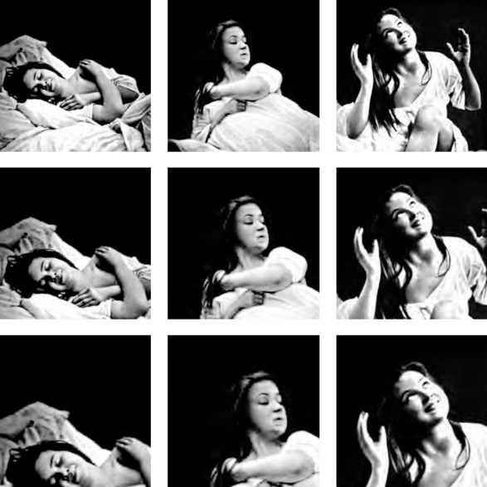
Iconographies
The collection of photographs that were taken demonstrating the patients that were in the throes of hysteria.
Augustine
Notes:
The limitations of lighting, and the technical requirements of picture-taking with wet collodian plates suggest that the pathologies were stages, posed and manufactured as facts.
Augustine was a 19 year old patient who suffered from “hysteria”. Charcot diagnosed Augustine with “ovarian hysteria”.
Augustine was just under 16 when she was admitted. We now know, that she had been threatened with a razor and raped by her mother’s lover when only 13, and sexually attacked by other men in her neighbourhood. She was admitted for paralysis of sensation in her right arm, preceded by pains in her lower right abdomen.
Once in the hospital, she was stripped and displayed, physically and emotionally laid bare, photographged incessantly in diaphanous and revealing hospital gowns for the multi-volume catalogue of images that constituted the iconographie and the Nouvelle Iconographie of the Salpetriere.
Augustine would play a starring role in the circus for five years, till, one day, in September 1880, she abruptly stole away, disguised as a man, never to be heard from again.

Slide 14
Question
Did the psychiatrists find more hysterical patients…because they were looking for them?
Charcot states:
“It would seem by some accounts that hysteroepilipsy exists only in France; in fact, it has been said that it exists only at the Salpetriere, as if I have created this condition by my own willpower. What a marvel this would be if I could, in fact, fabricate illnesses according to my whims or fantasies. But in fact all I am is a photographer. I describe what I see.”
Notes:
At Charenton, hysterics accounted for only 7.7. percent of women admitted during the period 1879-88 as compared to the Salpetriere’s 20.5

Slide 15
Charcot’s work
Over the time that Charcot spent in Salpetriere he identified:
Multiple sclerosis
Aphasia
Locomotor ataxia (a complication of tertiary syphilis)
Tourette’s syndrome (named after one of Charcot’s assistants)
Chorea
Prior to Charcot’s work the patients with tremors would often be seen as having multiple sclerosis. Charcot’s diligent work identified the difference between Parkinson’s and Multiple Sclerosis.
Notes:
Multiple sclerosis: a serious progressive disease of the central nervous system, occurring mainly in young adults and thought to be caused by a malfunction of the immune system
Aphasia: inability to understand or produce speech. Which we now know is aresult of brain damage
Locomotor ataxia: loss of coordination of movement, especially as a result of syphilitic infection of the spinal cord
Chorea: a neurological disorder characterised by jerky involuntary movements affecting especially the shoulders, hips and face
Prior
Following his death there was a move away from the label of “hysteria! In fact within two decades the term “hysteria” had vanished from the French scene, and the epicentre of the hysterical imperioum moved towards Vienna.

Slide 16
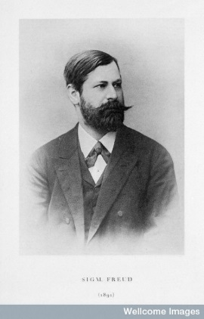
Sigmund Freud
1885 Austrian physician Sigmund Freud travelled to Paris to try to revive his foundering career. He was making one last attempt to try to develop his career back in Vienna before perhaps heading on to the USA.
Went to work under Jean-Martin Charcot for 6 months.
Came back to work in Vienna, having to start a private practice in order to support his family (6 children)
Freud’s clients would include neurological patients, including children with cerebral palsy and those with hysterical symptoms.
Notes:
He was fleeing from a growing controversy following his use of cocaine with his patients. He claimed that this was a wonder drug, but one that others had found lead to addiction, destruction of the personality and ultimately death.
Became the translator of Charcot’s words into German translation.

Slide 17
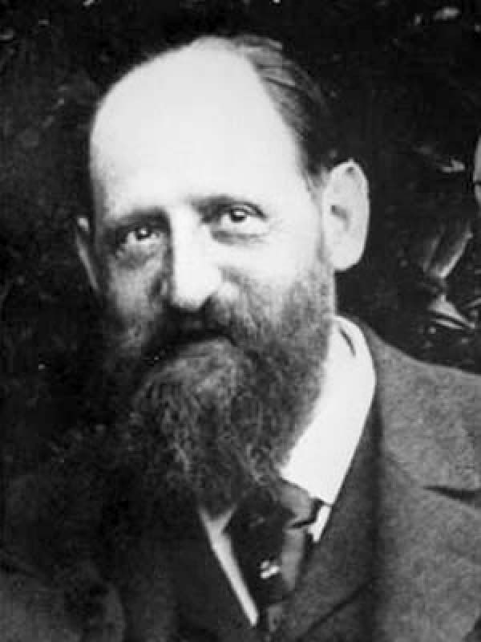
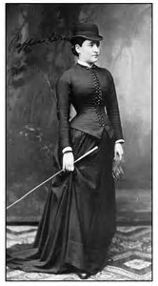
Sigmund Freud and Josef Breuer
Josef Breuer was one source of referrals for Freud.
Bertha Pappenheim – Anna O
1880-1882 – Treatment. Symptoms were trance-like states, hallucinations, coughing spasms, sleeplessness, disturbed vision, uncontrollable anger and finally loss of her own German language, although she could still speak and comprehend English.
“the talking cure”.
Notes:
Clients and small loans. The two became very close.
Bertha Pappenheim,. Breuer found that by talking about her experiences, tracing them back to her apast they could disappear. The catharsis was proving very therapeutic.
Subsequent studies have demolished Breuer’s assertions that Anna O was cured. She actually ended up being institutionalised in Switzerland where she remained for almost four months, continuing to exhibit hysterical symptoms and being addicted to morphine, which was an aspect of Breuer’s treatment which he never admitted to in print.
She continued to be treated for a further decade in Switzerland after the “cure” of Josef Breuer.

Slide 18
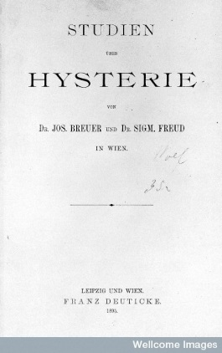
Hysteria and the talking cure.
we found, to our great surprise at first, that each individual hysterical symptom immediately and permanently disappeared when we had succeeded in bringing clearly to light the memory of the event by which it was provoked and in arousing its accompanying affect, and when the patient had described that event in the greatest possible detail and had put the affect into words.
Notes:
Freud and Breuer’s shared experiences prompted them to write a book on hysteria
Charcot’s patients were drawn up from the ranks of the poor. Freud and Breuer’s patients were priveledged vienesse, who were not degenerates!
Breuer and Freud began to emphasise again the idea that hysteria was a sign of superiority.

Slide 19
Freud, Breuer and Hysteria
Hysteria was again viewed as being an issue that the elite would experience, rather than the dengerate, lower classes of society. This was in direct contrast to Charcot and his patients.
Freud started to drift away and eventually fall out with Breuer. He felt that there needed to be a more detailed approach to the dealing with the trauma of his patients.
Freud sought a treatment that would allow his patients to free up some of the strangled emotions that were stored as a result of past memories.
One of his methods, which is still used today is to enable the patient to “free associate”.

Slide 20
Freud’s theories
Freud felt that repressed memories of a traumatic event were the cause of female hysteria. (1)
He then felt that the repressed “memories” were actual fantasies from childhood (2)
He felt that childhood fantasies were the cause of neuroses.
The central tenet was that the core of all humans was the libido, the energy that is supplied by “unconscious sexual drives”
Hysteria and the study of hysterics was one of the reasons for the birth of psychoanalysis, a form of treatment that would dominate American psychiatry for at least a quarter of a century and is still being utilised today.

