Slide 1
Bianca Llewellyn
2307253
Human Development
EYEY4001/C

Slide 2

An Early Years
Practitioners Handbook on a Child’s Transition to Nursery

Slide 3
CONTENTS
Pages 1&2 — What do we mean by Transition?
Pages 3&4 — The Needs Of The Child
Pages 5&6 — The Role Of The Adult
Page 7 — Insecure Attachment
Page 8 — The Nurture Class Intervention
Pages —

Slide 4
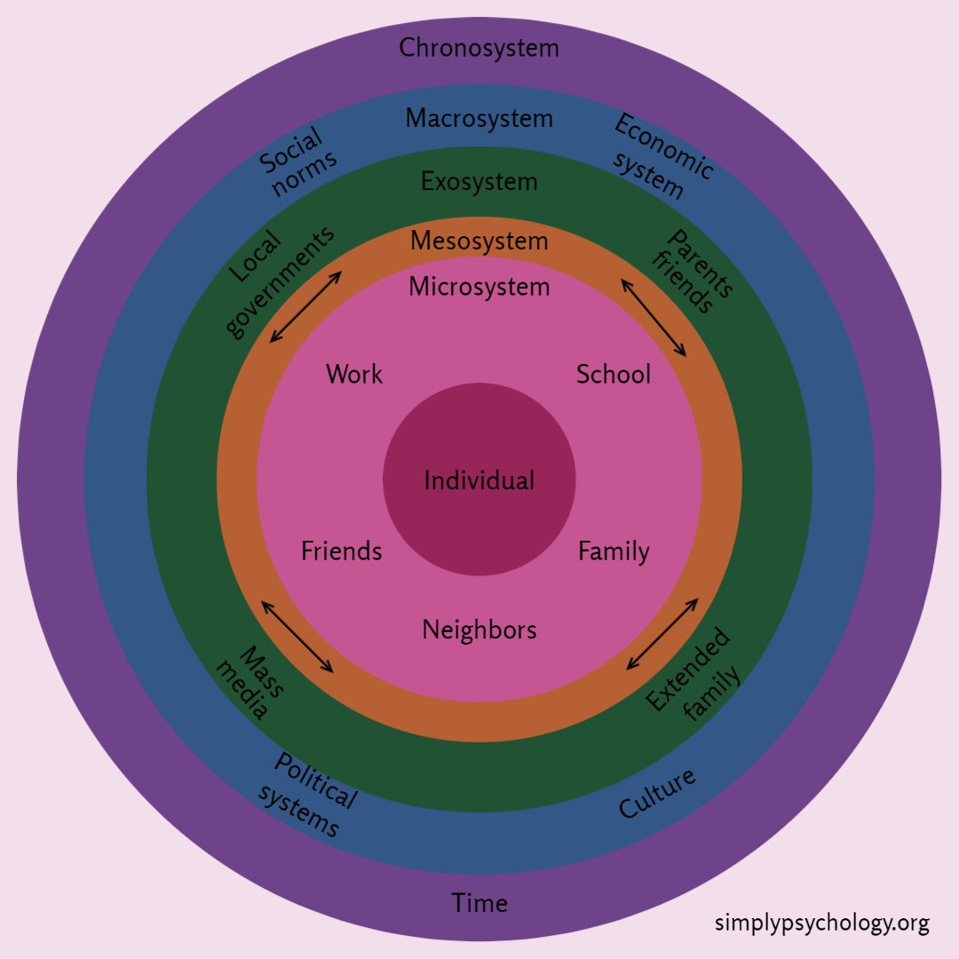
What do we mean by Transition?
Throughout our lives we undertake many periods of transition. We might move house, start a new job, travel to a different country or even change our identity. We may lose someone we love, get married, start school or take up a new hobby. A transition is when we move from one situation to another, moving through a period of change or “To make or undergo a transition from one place, state, or system (to or into another); to change over or switch. ” (Oxford University Press, 1989).
Transitions are an important part of life because they help us to learn and grow. We need changes in our lives in order to develop. We need to learn to feel secure in our environment, physically and emotionally as we grow so successful transitions need to be undertaken in the early years of a child's life. These successful transitions will help to give a child the necessary tools to learn to cope with and manage change when they are adults. Transitions could be seen as a key part of human development.
Urie Bronfenbrenner's ecological systems theory helps to explain this. According to Bronfenbrenner, a child’s environment has 5 different , interconnecting layers as shown in the diagram below. They all play an important role and impact on how a child develops into an adult as they all affect each other. The child is at the centre of the circle on the left. Their microsystem directly around them includes a child’s relationship with it’s primary caregivers and the Mesosystem involves communication between these caregivers. This communication can be pivotal to a child’s development. For example a parent needs to have a good relationship with their child’s nursery staff to help support them at home and vice versa.
The Exosystem is part of the child’s environment of which can affect them but of which they cannot control. Such things as transport, media, government and extended family and friends. These can have a positive or negative impact on their development.
(Guy-Evans, 2023)

Slide 5
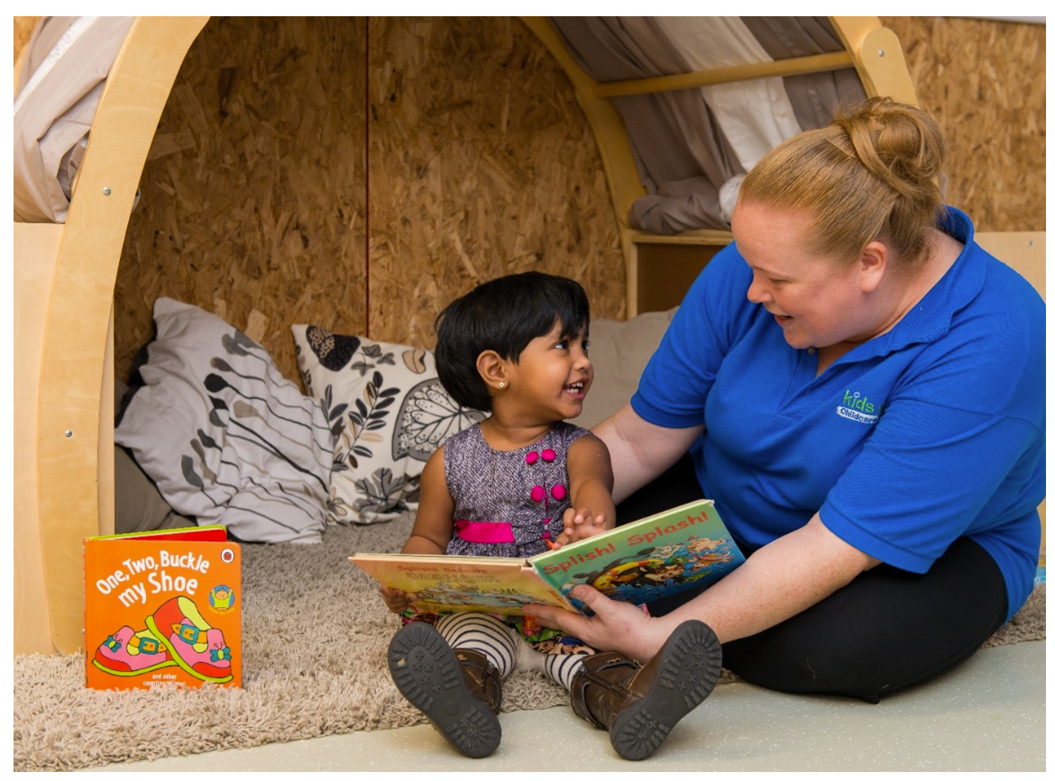
The Macrosystem includes laws, customs and cultural values. These have a direct impact on the other layers. For example The United Convention For The Rights Of The Child (UNCRC) is a list of the rights that all children under the age of 18 are entitled to. These rights are there to ensure a child is safe, is able to play, has an education and to be healthy and happy. All of these support human development
Finally the Chronosystem which was added to this model at a later date is where human development can be effected over time by changes in relationships such as divorce or illness.
Every child is unique and so are their interactions within their environment. The manner in which their transitions occur through their environment in early childhood will shape the adult they become in later life. Aubrey and Riley (2016).
One of the most significant and important transitions a child undertakes is the move from their family home into a more formal setting such as a school nursery.
When considering transitioning into an early years setting Bronfenbrenner believes that a child needs to be accompanied by a primary care giver as “this will be significant for the way in which a developing person is able to function in new settings” (Bronfenbrenner, 1977, p.211)
The success of future transitions, for example from Nursery to Reception can depend on how positive first transitions have been and can also impact on the child’s future engagement in their educational setting.

Slide 6
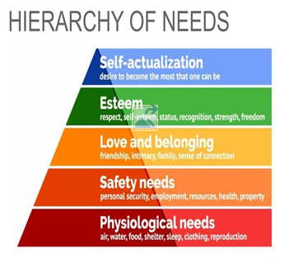
The Needs Of The Child
John Maslows hierarchy of needs is a motivational theory which can be applied to both a child’s home and their educational setting. It demonstrates that at the bottom of the pyramid, the basic needs should be met before progressing on to the next level. If a child does not have food, warmth and shelter they might not feel safe and secure. Without the feeling of safety they may find forming attachments and friendships more difficult. If a child doesn’t form attachments in the early years they may have difficult and more complex relationships in adulthood and therefore be prevented from reaching their full potential. “Maslow felt that teachers should ensure that a child’s basic human needs of food, shelter and safety should be met before learners could start to reach their ultimate goal of self-actualisation” (Aubrey and Riley, 2016, p.80)
However as every child is unique, some of the needs at the top of Maslows pyramid might be just as important as those at the bottom. If the basic needs can’t be met then family and friendships can be more of a need to some than others and therefore the hierarchical form can be different depending on circumstances. In fact according to Maslow (1943) himself, he explains that some people find that a high self-esteem is more important than love and that some people have such a high creative drive that they put this before anything else. Others who have no need for self-actualization or any aspirations may only desire basic needs such as shelter and food.
Maslows Hierarchy of Needs
(Eckstein-Koas, 2021)

Slide 7

It is important that the emotional needs of a child are met at a young age and that they are able to express their emotions and feelings within the nursery setting safely. This will support them in learning how to self-regulate and redirect strong feelings as they grow older when they may find themselves in difficult situations. According to Susan Isaacs, central to emotional development is giving a child the opportunity to learn about relationships through play. This will help them to develop their social skills and emotional literacy. The nursery setting should therefore be an extension of the home where there is love and warmth. Macblain (2022)
Playing with peers in nursery is important in children’s learning and development. They need to be able to be curious and follow their own interests, act out their fears and fantasies and be able to express their true feelings without limitations.
“Imagination and play are vital ingredients of the child’s existence. They are the fabric of the child’s expanding inner world”. (Davids, 2010, p.5)

Slide 8
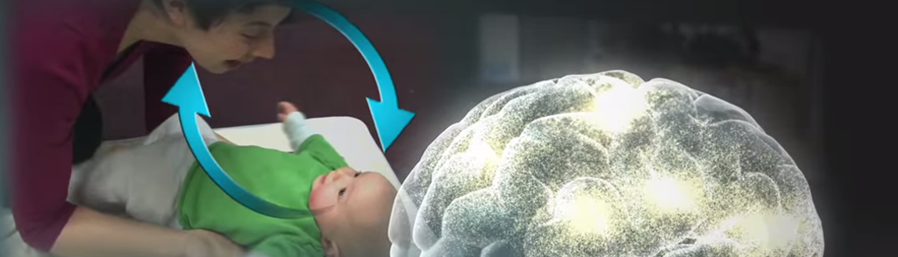
The Role Of The Adult
During their time in nursery, a child’s brain is undergoing huge developmental changes. As they play, their social learning is intense as they figure out how to co-operate with their peers. Research suggests that their growing brains alter structurally as they practice their social skills. (Wallace 2001)
So how can the adult support brain development?
In the nursery setting, childcare staff need to provide a rich and stimulating environment where they are able to play and explore for long, uninterrupted periods of time. They need to have the opportunity to experiment with real life objects, indoors and outdoors to help develop their thought processes. Open-ended activities will support a child in having some control over their learning and staff should observe children playing so they can understand where support might be needed. All of these practices were recommended by theorist Jean Piaget (Pound 2006) Providing regular opportunities for genuine interaction in play will benefit a child’s brain development and therefore should be at the heart of early years provision.
Adults and parents can also promote brain development through showing warmth, love and attention. The “serve and return” reciprocal interaction starts as soon as a baby is born. Hugs, eye contact and words help to build neural connections in a baby’s brain which support the development of healthy social and communication skills. Similar to a back and forth game of ping pong and being responsive to signals and needs. (Harvard University 2021).
“Higher levels of parental sensitivity in early childhood were associated with larger total brain volume and gray matter volume at 8 years” (Kok et al., 2015)
Continuing their journey into the nursery setting, caring staff will follow on with this interaction by providing the same reciprocal relationships with the children. This will ensure that healthy and secure attachments are formed by all primary care givers thus enabling the child to have a high level of emotional wellbeing.
Centre On The Developing Child. Harvard University

Slide 9
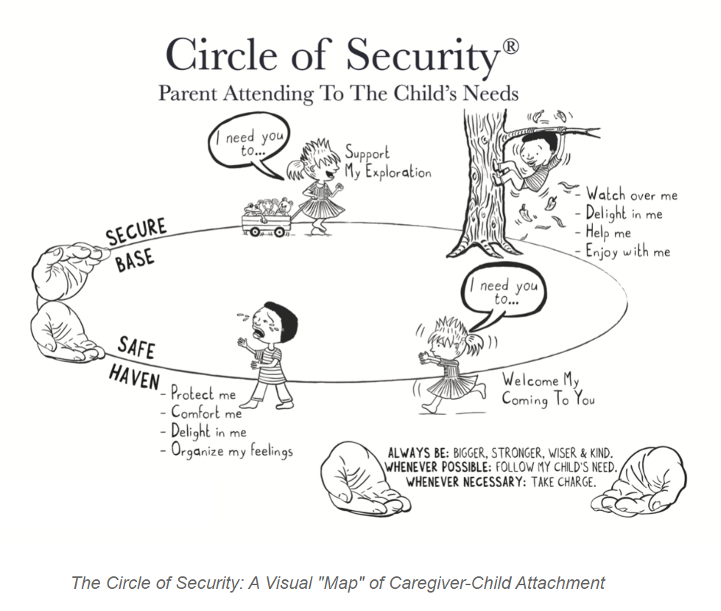
According to John Bowlby, babies are biologically programmed to attach to one key person, their mother. This very early period in a baby’s life is crucial and a comforting response is essential when they cry to help them to learn how to emotionally regulate and develop a sense of security and attachment. (Macblain, 2022)
Their social, emotional and cognitive development rely on how safe and loved they feel. The more secure they are, they more safe they will feel in going out to explore the world. This is demonstrated in the Circle Of Security model here. The caregivers hands are there to show the child going out on the circle, having the freedom and confidence to leave in the knowledge they are being watched and encouraged and will be given help if needed. When they are ready to come back in they need to know there is someone kind and strong there to support their emotions and welcome their return. (The Circle of Security International, 2022)
Being a responsive, caring and consistent adult will help a child develop a sense of security and enable them to happily explore. Early years staff in a child’s nursery play a key role in further developing secure attachments. When children are shown empathy and feel safe in their environment they are more likely to learn and be curious, play and socialise.
“It is critical that educators understand the importance of secure relationships and their impact on children’s future wellbeing.” (Wilson-Ali, Barratt-Pugh and Knaus, 2019, p.3) . A child’s successful transitions through life and journeys between Bronfrenbrenner’s ecological systems are dependant on the attachments formed in their early years. Their feelings of safety and security and how they deal emotionally in new situations rely heavily on their early childhood relationships.
So what happens if there are problems with attachment in the early stages of a child’s life?

Slide 10
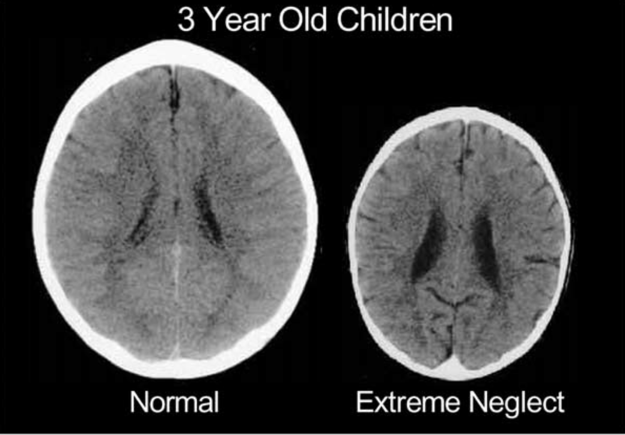
Insecure Attachment
Inconsistency in a serve and return relationship can lead to a child feeling a heightened level of anxiety. A caregiver who is inaccessible and inattentive can result in a child becoming withdrawn and lonely. Emotional regulation issues can be the result of a caregiver who has been indifferent or too intense during early childhood. All of these negative feelings arising from stressful situations can alter a child’s brain development by hindering those initial neural connections
(ResearchGate, n.d.)
According to Pound (2005) these early neural connections are needed for later learning so if they are missing, a child can switch off, have a lack of concentration and become disengaged. This will in turn have a profound affect on a child’s ability to learn while they are in their nursery year and later on throughout their school life.
In a study in 2011 by Moss and St-Laurent it was discovered that the higher the quality of the serve and return relationship between the mother and child, the more likely it is that the child will have the confidence to go off and explore and in return gain a higher level of cognitive engagement as they grow. (Mackay et al 2010).
The diagram above shows the brain of a securely attached 3 year old child compared to that of a child who has been prone to neglect. The brain on the right is significantly smaller than normal and shows the child has been seriously sensory deprived. (ResearchGate, n.d.) The neglectful caregiver would not have responded to a child's needs and been emotionally unavailable. As this child grows older they are more likely to suffer from behavioural, physical and psychological issues. Furthermore, they will not be productive due to becoming withdrawn at school and beyond. They are more likely to have suffered from other Adverse Childhood Experiences (ACES) and will not reach their full potential as adults. (Child Welfare Information Gateway, 2019)

Slide 11
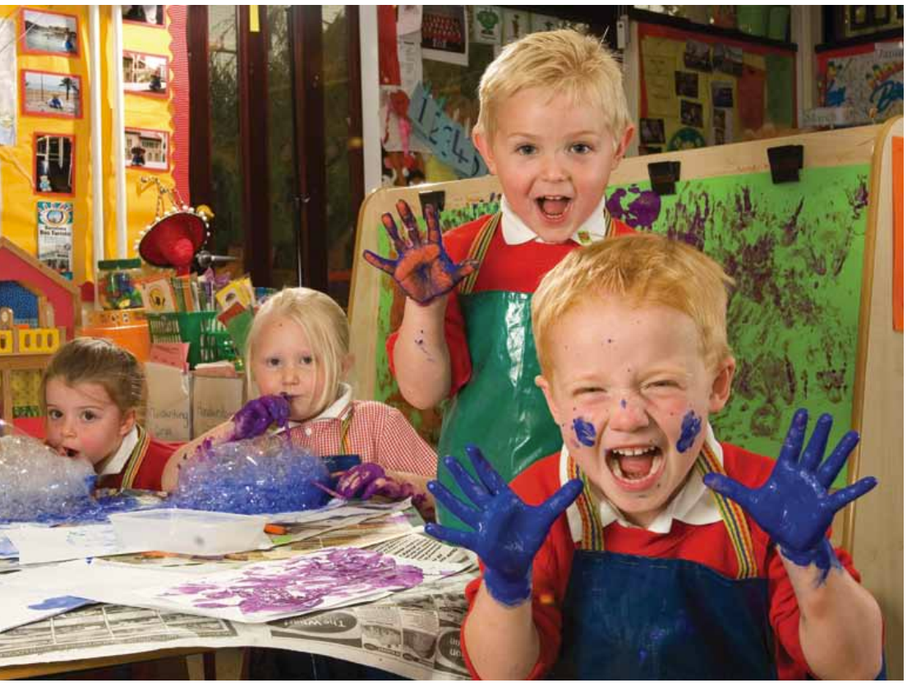
The Nurture Class Intervention
Nurture groups were designed in the 1970’s by Marjorie Boxall and Marion Bennathan. Boxall noticed and increasing amount of children presenting with behaviours associated with insecure attachment. She recognised that these children needed an intervention such as a nurture class to provide a small safe environment where practitioners could practice the reciprocal relationship more intensely and provide a learning environment more suitable for their stage of development. (Nurture in Early Years, n.d.)
According to Senedd.Cywmru (2014) there are 144 Nurture Groups in Wales which equates to 1 to every 11.8 schools.
Children who attend nurture classes have often been neglected in their early years and so are not ready to learn in a mainstream classroom. They have not developed the necessary social, emotional and cognitive skills associated with nurturing relationships with their early caregivers therefore this creates a barrier to their learning. The nurture class aims to provide a safe and predictable structured environment and gives children opportunities to revisit early missed ‘nurturing’ experiences. (Welsh Assembly Government, 2010)
The Nurture class will provide a calming, sensory space for children and should aim to replicate the home environment. Children will be given the opportunity to sit and have meals with the staff and to have real life transition experiences like visiting shops and cafes. Turn-taking and using emotional literacy in the smaller group with the guidance of the nurturing staff will contribute increasing their resilience and self-esteem.
This intervention is aimed to last for 3-4 terms and includes a transition into their mainstream class once a week with the hope that the child will be ready to go back into their mainstream setting with all the skills they need to reach their full potential.
“Many academic studies point to nurture group pupils showing widespread improvement in their self-management behaviours, social skills, self-awareness and confidence and skills for learning”. (Welsh Assembly Government, 2010, p.11)

Slide 12
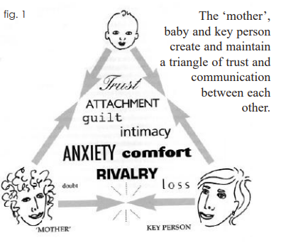
Partnerships
A smooth, effective transition from the security and comfort of the home environment into the unfamiliarity of the nursery setting can be achieved through creating positive partnerships between members of staff and parents/caregivers. Separation from their main caregiver as they step into their new classroom can bring lots of anxiety and mixed emotions for a child if there has been a lack of collaborative communication between the adults. Therefore the settling-in process is a crucial time and key to future successful transitions as a child moves through their education.
Brooker (2009) suggests the setting holding face to face informal meetings with parents and the parent spending time with the child in their new class before they start can help with familiarity and build relationships. Furthermore home visits from staff and allowing a child to transport a favourite object between setting and home can offer a sense of security. The sharing of information such as a child’s routines and preferences from home and from school, photographs of the resources and staff can help build confidence and familiarity.
In the Flying Start Transition Guidance (2017) it states if “children are prepared for change – the child is more likely to feel secure and settle more easily into the new environment when they are familiar with people, places and routines (e.g. children are given a chance to meet staff and visit settings and take part in activities there)“.
The Key Person Approach is a theory pioneered by Elinor Goldschmied amongst others. She believed that if a child is spending much of their day, in nursery, away from their family they will feel more emotionally stable if they form a positive, reciprocal relationship with one particular adult at the setting. (The Therapeutic Care Journal, 2009)
The “Triangle Of Trust” diagram on the right explores this theory and shows how important the relationship is between, the child, mother and key person. (Elfer, Goldschmied and Selleck, 2012)
Birth to 5 matters describes the Key Person as needing to possess special qualities such as being non-judgemental. They will also need to have an empathetic nature and be able have good communication skills to build positive relationships with families and other agencies. An understanding of different cultures, identities and different backgrounds can also be helpful.

Slide 13
Proposed Outcomes

Slide 14
References
Aubrey, K. and Riley, A. (2016). Understanding & using educational theories. London: Sage Publications Ltd.
Birth to 5 matters. (n.d.).
Bronfenbrenner, U. (1979). The Ecology of Human Development: Experiments by nature and design. Cambridge - Mass. & London: Harvard University Press.
Brooker, L. (2009). Supporting transitions in the early years. Maidenhead ; New York: Mcgraw Hill.
Child Welfare Information Gateway (2019). Long-Term Consequences of Child Abuse and Neglect. [online] Child Welfare Information Gateway, Children’s Bureau, pp.1–9. Available at: https://www.childwelfare.gov/pubpdfs/long_term_consequences.pdf. (Accessed on 19th November 2023)
Davids, J. (2010). The nursery age child. London: Karnac Books.
Eckstein-Koas, M. (2021). What is Maslow’s Hierarchy of Needs? Miriam Eckstein-Koas. [online] Continued Early Childhood Education. Available at: https://www.continued.com/early-childhood-education/ask-the-experts/what-maslow-s-hierarchy-needs-23715. (accessed 12th November 2023)
Elfer, P., Goldschmied, E. and Selleck, D.Y. (2012). Key persons in the early years : building relationships for quality provision in early years settings and primary schools. Abingdon: Routledge.

Slide 15
References cont..
Flying Start—Annex (2017). Transition Guidance.
Guy-Evans, O. (2023). Bronfenbrenner’s ecological systems theory. [online] Simply Psychology. Available at: https://www.simplypsychology.org/Bronfenbrenner.html. (accessed 12th November 2023)
Kok, R., Thijssen, S., Bakermans-Kranenburg, M.J., Jaddoe, V.W.V., Verhulst, F.C., White, T., van IJzendoorn, M.H. and Tiemeier, H. (2015). Normal Variation in Early Parental Sensitivity Predicts Child Structural Brain Development. Journal of the American Academy of Child & Adolescent Psychiatry, 54(10), pp.824-831.e1. doi:https://doi.org/10.1016/j.jaac.2015.07.009. (accessed 18th November 2023)
Harvard University (2021). Serve and Return. harvard.edu. Available at: https://developingchild.harvard.edu/science/key-concepts/serve-and-return/. (accessed on 18th November 2023)
Macblain, S. (2022). Learning theories for early years practice. London: Sage publications Ltd.
Mackay et al. (2010). ‘From attachment to attainment: The impact of nurture groups on academic achievement’, Educational and Child Psychology · January 2010 , article 27(3):100-110. Available at http://DOI:10.53841/bpsecp.2010.27.3.100. (Accessed on 19th November 2023)

Slide 16
References cont..
Maslow, A.H. (1943). Theory of Human Motivation. Psychological Review, Wilder Publications.
Nurture in Early Years. (n.d.). Available at: https://localoffer.haltonchildrenstrust.co.uk/wp-content/uploads/2021/03/Nurture-in-Early-Years.pdf 9Accessed 20th November 2023)
Oxford University Press (1989). The Oxford English dictionary. 2nd ed. Oxford: Clarendon Press; Oxford. https://www.oed.com/search/dictionary/?scope=Entries&q=transition (accessed 12th November 2023)
Pound, L. (2005). How children learn. London: Step Forward Publishing Ltd.
ResearchGate. (n.d.). Figure 1. Abnormal brain development following sensory neglect in early... [online] Available at: https://www.researchgate.net/figure/Abnormal-brain-development-following-sensory-neglect-in-early-childhood-These-images_fig1_225759011. (Accessed on 19th November 2023)
Senedd.cymru. (2014). Available at: https://busnes.senedd.cymru/documents/s60476/ALN%2043%20Rhwydwaith%20Grwpiau%20Anogaeth%20Saesneg%20yn%20unig.html?CT=2 (Accessed 20th November 2023).
The Circle of Security International (2022). What is the Circle of Security – Circle of Security International. [online] www.circleofsecurityinternational.com. Available at: https://www.circleofsecurityinternational.com/circle-of-security-model/what-is-the-circle-of-security/. (accessed on 19th November 2023)

Slide 17
References cont..
The Therapeutic Care Journal. (2009). Elinor Goldschmied : Pioneer of Treasure Baskets, Heuristic Play and the Key Person System. [online] Available at: https://thetcj.org/early-years/elinor-goldschmied-pioneer-of-treasure-baskets-heuristic-play-and-the-key-person-system (Accessed on 23rd November 2023).
Wallace, W. (2001) ‘Neuroscience and early years education: Brain waves’, Nursery World.
Welsh Assembly Government (2010). Nurture groups: A handbook for schools Information. [online] Available at: https://www.gov.wales/sites/default/files/publications/2018-12/nurture-groups-a-handbook-for-schools.pdf. (accessed on 20th November 2023)
Wilson-Ali, N., Barratt-Pugh, C. and Knaus, M. (2019). Multiple Perspectives on Attachment theory: Investigating Educators’ Knowledge and Understanding. Australasian Journal of Early Childhood, [online] 44(3), p.1. doi:https://doi.org/10.1177/1836939119855214. (accessed on 19th November 2023)

