Slide 1
Module Name : Signals and System
Module Code : ACDA4009
Topic : Revision 1
Lecture : 7

Slide 2
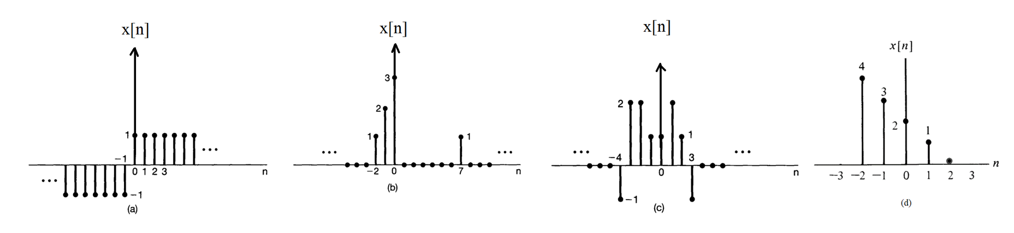
Revision 1
Exercise 1
ACDA4009 – Signals and System

Slide 3
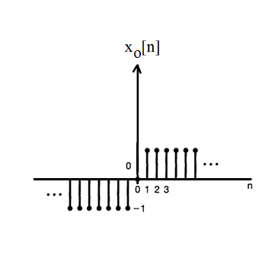
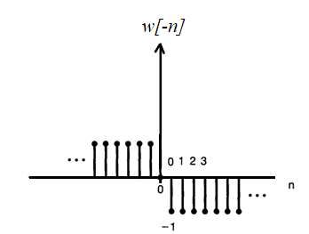
Revision 1
Exercise 2
a.
ACDA4009 – Signals and System

Slide 4

Revision 1
Exercise 3
ACDA4009 – Signals and System

Slide 5
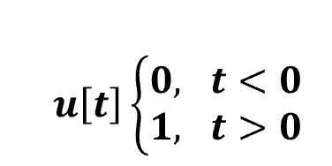

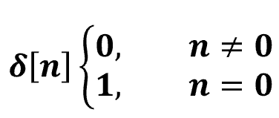

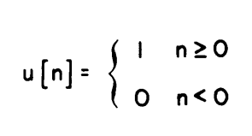
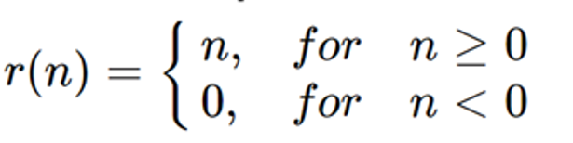
Revision 1
Exercise 4
Identify the Signal and provide the name of the function below and illustrate its graphical representations.
(a) (d)
(b) (e)
(c) (f)
ACDA4009 – Signals and System

Slide 6
Revision 1
Exercise 6
Generate a rectangular pulse for x(t) with unit amplitude and a duration of 2-time units.
Generate a triangular pulse for c(t) with the amplitude of 3 and a duration of 4-time units.
Plot a rectangular pulse x(t) for unit amplitude and unit duration.
Plot a rectangular pulse x(t) for unit amplitude and unit duration.
ACDA4009 – Signals and System

Slide 7
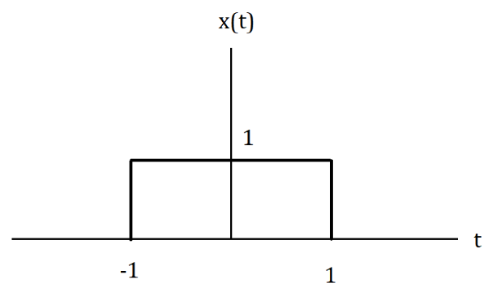
Revision 1
Exercise 7
Consider the rectangular pulse below
Illustrate the time shift and time variant representation for rectangular function y(t)=x(2t+3)
ACDA4009 – Signals and System

Slide 8
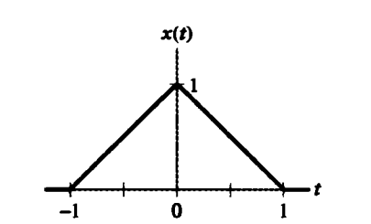
Revision 1
Exercise 8
For the triangular pulse x(t) shown below, sketch the time scaling for each of the following derived from x(t)
x(3t)
x(3t+2)
x(3t)+x(3t+2)
ACDA4009 – Signals and System

Slide 9
Thank You

