Slide 1

BA(Hons) Business Management
Session: June 2024 term
Course name: Leadership and Management Theory and Practice
Lecturer name: Laila Maazouz
Assessment title: Component 2
Practical: Group report & Presentation
Students:
Group Leader: Szabina Molnar (2121168)
Tsvetelin Brankov (2024471)
Mihael Iliyanov Velikov (2123841)

Slide 2

Introduction
What is Leadership?
Definition: Leadership is the ability to guide, influence, or direct a group towards the achievement of goals. Key Elements: Vision, communication, decision-making, and inspiration.
How Leadership Styles Changed Through Time?
Early 20th Century: Autocratic: Leaders made decisions unilaterally. Emphasis on control, command, and authority.
Mid to Late 20th Century: Introduction of more democratic and participative styles. Leaders started valuing input from team members.
21st Century: Shift towards transformational and servant leadership. Focus on empathy, collaboration, and empowering others.

Slide 3
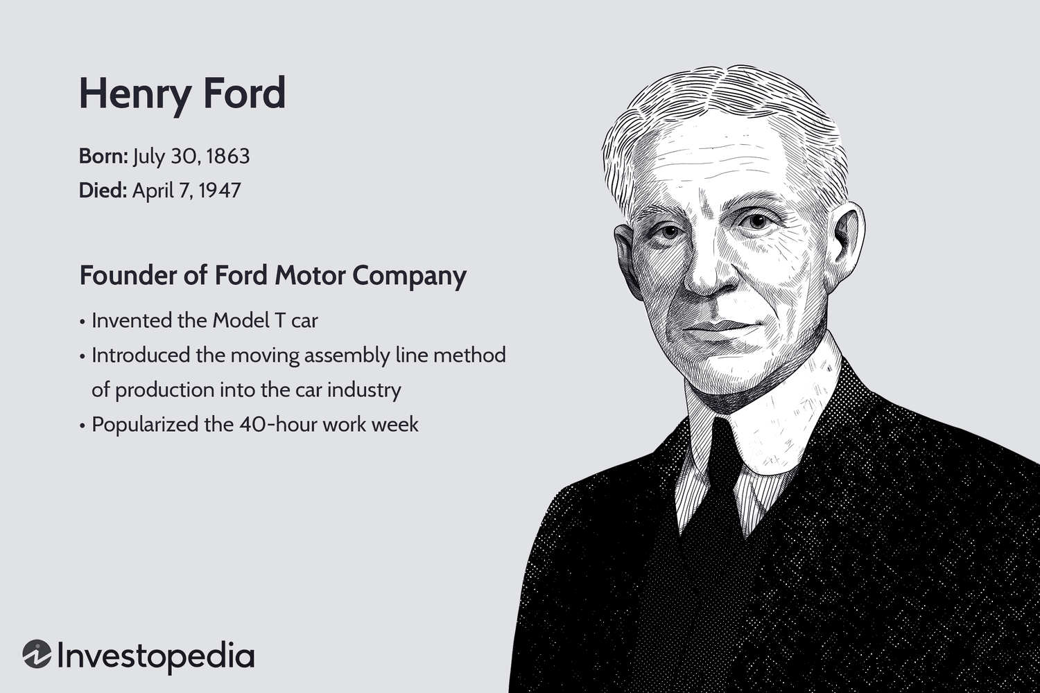
Henry Ford
Background
Henry Ford, born on July 30, 1863, in Greenfield Township, Michigan, was an American manufacturer who founded the Ford Motor Company. He transformed the automotive business by inventing the Model T in 1908 and pioneering the assembly line method of mass manufacturing. This breakthrough drastically reduced manufacturing costs, making vehicles more accessible for the ordinary American. Ford's ambition of making inexpensive automobiles available to all altered the American economy and culture.

Slide 4
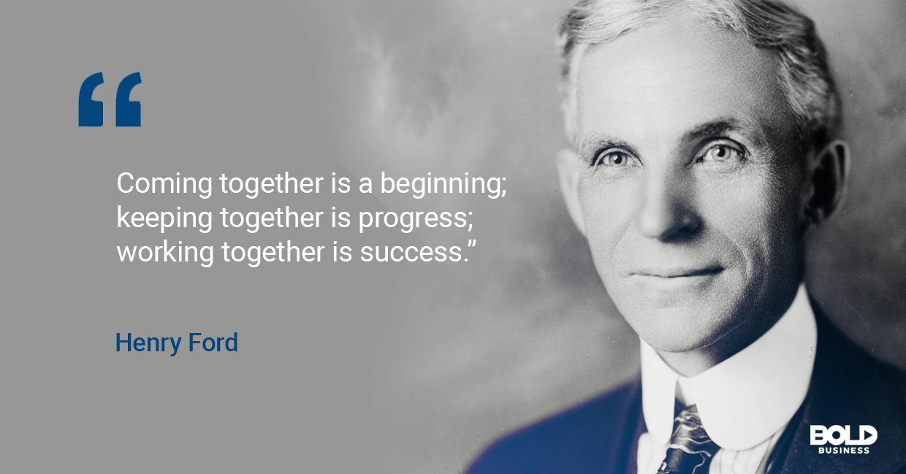
Leadership Style
Authoritarian: Ford had extensive control over his businesses. He became known for his strong-willed, often authoritarian managerial approach. He made the majority of the crucial choices himself and expected staff to obey his orders without question.
Visionary: Despite his authoritarian inclinations, Ford had a clear and compelling vision for the future of transportation and production. He saw a society in which vehicles were not only a luxury for the affluent, but a need for the average person. His ambition expanded beyond automobiles to include modifying the industrial landscape through efficient manufacturing processes.
Innovative: Ford was a pioneer in adopting new technologies and methods. His implementation of the moving assembly line revolutionized manufacturing, drastically reducing production time and costs. This innovation not only improved efficiency but also set a new standard in industrial production.

Slide 5
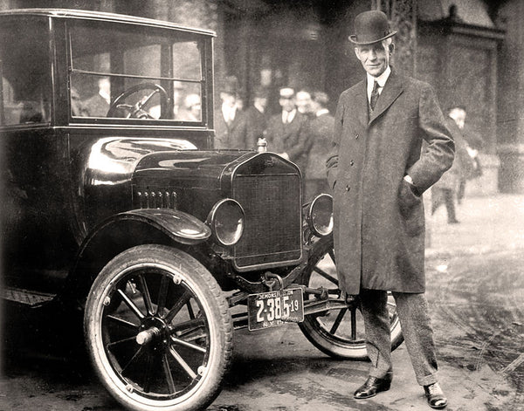
Leadership Behaviour
Hands-On Approach: Ford was heavily involved in the day-to-day operations of his firm. He paid special attention to production operations and frequently examined the factory floor.
Focus on Efficiency: He was obsessed with efficiency and aimed to remove waste in all ways. This concentration resulted in substantial advances in production procedures.
Employee Relations: While Ford was known for his demanding personality, he also created progressive measures such as the $5-a-day wage, which was twice the average wage at the time. This program not only raised the living standards of his employees, but it also decreased turnover and enhanced productivity.

Slide 6
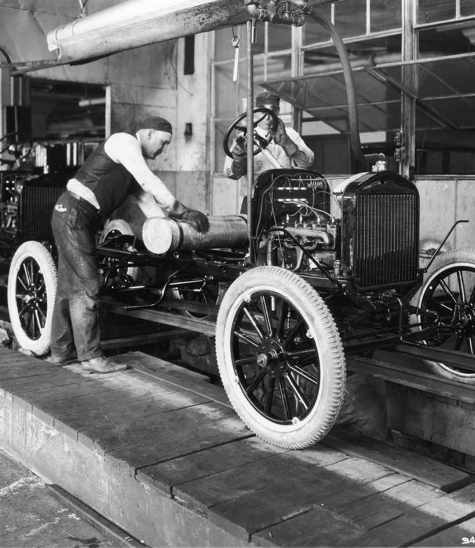
Followers Appeal
Economic Impact: Ford earned enormous devotion and admiration from both his employees and customers by providing high wages and keeping automobiles cheap. His economic measures made him a hero among the working class.
Visionary Leadership: Employees and the public were inspired by Ford’s vision of making cars accessible to the masses. His ability to articulate a clear and ambitious vision helped to rally people around his cause.
Consistency and Determination: Ford's unwavering commitment to his idea, despite obstacles, gained him respect and adoration. Many regarded him as a realistic idealist with a tireless drive to enhance industrial productivity and make automobiles more accessible.

Slide 7
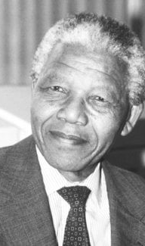
Nelson Mandela
July 18, 1918, Mvezo, South Africa
Revolutionary anti-apartheid leader
First black president of South Africa
27 years in prison for activism against apartheid and became a global symbol of resistance to racial oppression.
Released in 1990
In 1994 he led negotiations to dismantle apartheid and establish multiracial elections
His leadership not only transformed South Africa but also inspired movements for justice worldwide

Slide 8
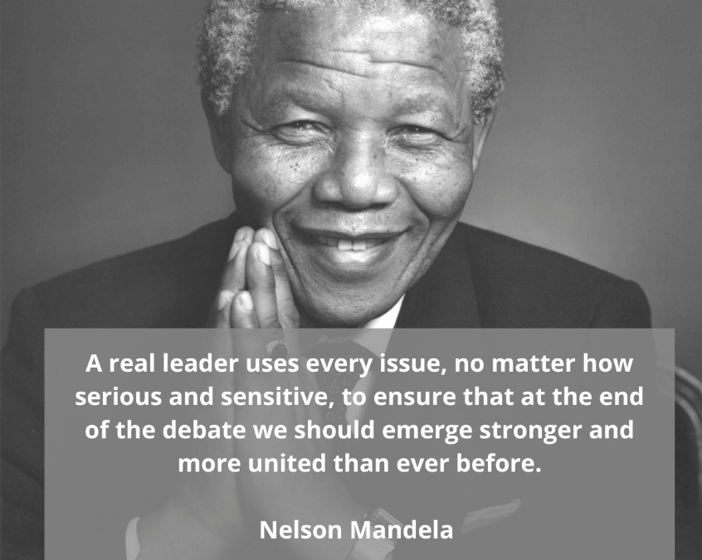
Leadership style
Transformational: Mandela inspired profound change in South Africa, shifting the country from a racially divided society to a more inclusive and democratic nation. His vision for a united South Africa guided his actions and policies.
Democratic: Mandela valued consensus and inclusivity. He often sought input from diverse groups and prioritized collective decision-making. This approach was crucial in creating a stable post-apartheid society.
Charismatic: His personal charm, humility, and ability to connect with people from all walks of life made him a beloved leader both in South Africa and globally. His charisma helped galvanize support for his vision of equality and justice.

Slide 9
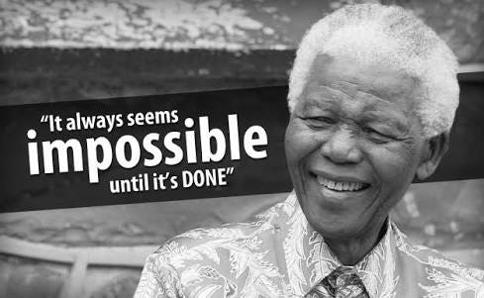
Leadership behaviour
Reconciliation: Emphasized forgiveness and reconciliation
Resilience: ability to endure hardships inspired many to continue the fight for justice.
Humility: often shared credit achievements and listened to others, demonstrating humility.
Strategic Vision: strategic in his approach to dismantling apartheid, knowing when to negotiate and when to stand firm.

Slide 10
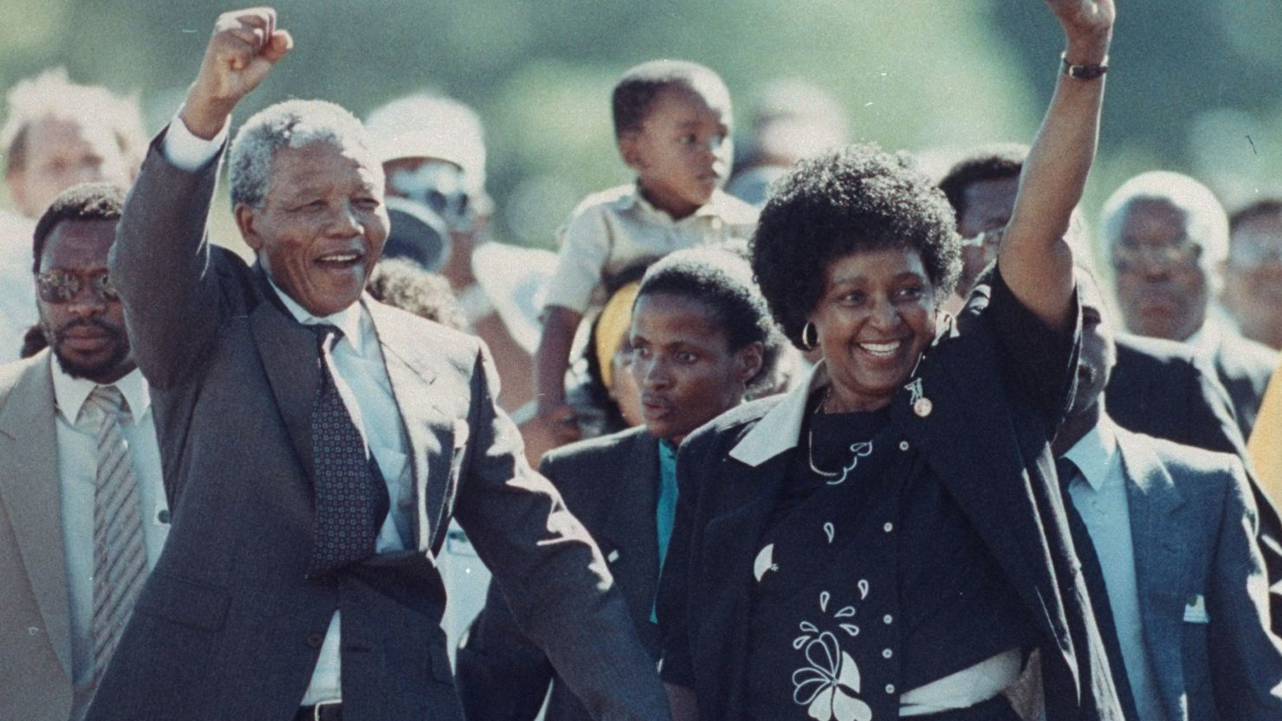
Followers Appeal
Moral Authority: His moral integrity and commitment to justice earned him immense respect. His life story of sacrifice and perseverance gave him unparalleled moral authority.
Vision of Equality: His ability to articulate his vision clearly and passionately drew widespread support.
Personal Sacrifice: His long imprisonment and willingness to suffer for his beliefs made him a symbol.
Global Icon: His ability to inspire international solidarity further bolstered his appeal.

Slide 11
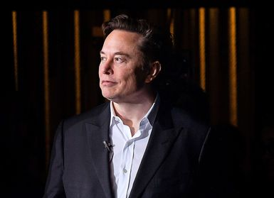
Elon Musk
June 28, 1971, Pretoria, South Africa
Entrepreneur, CEO of Tesla and SpaceX
Technology and Innovation
Involved in other projects such as Neuralink and The Boring Company

Slide 12
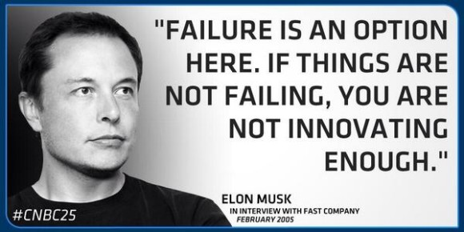
Leadership Style
Transformational: characterized by his ability to inspire and drive significant change. Clear vision for the future of technology and motivates his teams to strive towards these ambitious goals.
Autocratic: Musk often exercises a high degree of control over his companies. He is known for being deeply involved in all aspects of the business, from high-level strategy to minute technical details.
Visionary: Musk has a forward-thinking vision that encompasses electric vehicles, space exploration, sustainable energy, and advanced technologies. His ability to foresee and work towards a future shaped by these innovations sets him apart.

Slide 13
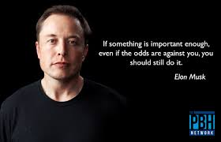
Leadership behaviour
Hands-On Approach: intense involvement in the operational details of his companies. He often works long hours and expects the same dedication from his employees.
High Expectations: he sets very high standards and is known for pushing his teams to their limits.
Innovative Mindset: he constantly pushes for innovation and is not afraid to take risks.
Transparent Communication: open communication style, often sharing company updates and future plans publicly through social media.

Slide 14
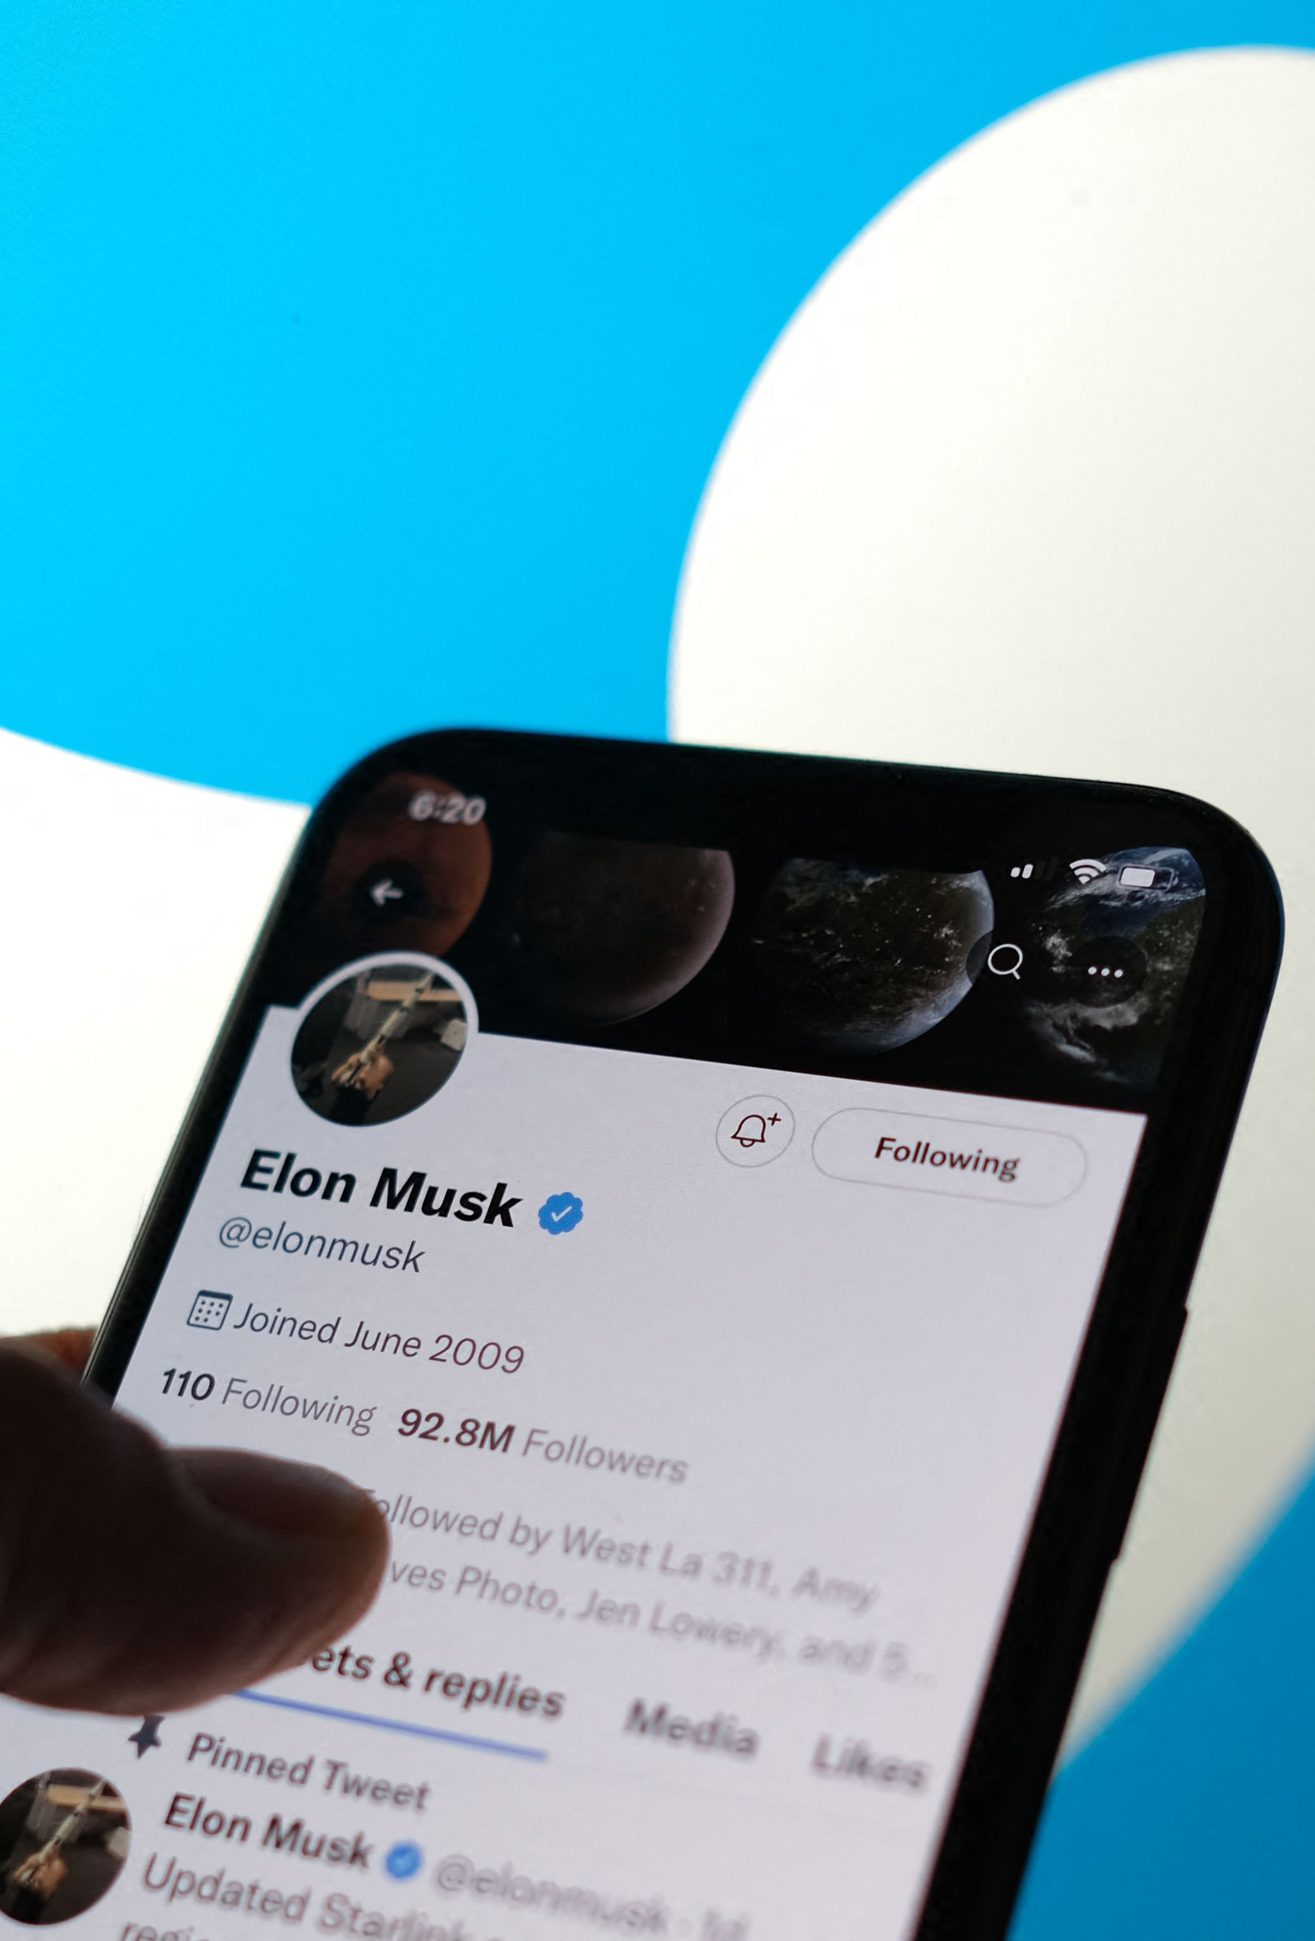
Followers appeal
Innovation and Ambition
Track Record of Success
Vision for the Future
Charismatic Leadership

Slide 15

Jacinda Ardern
July 26, 1980, Hamilton, New Zealand
Political leader
Prime minister of New Zealand (October 2017-January 2023)
Leader of the labour party
International recognition for handling crises
Christchurch Mosque shootings 2019, Covid-19
Child poverty, climate change

Slide 16
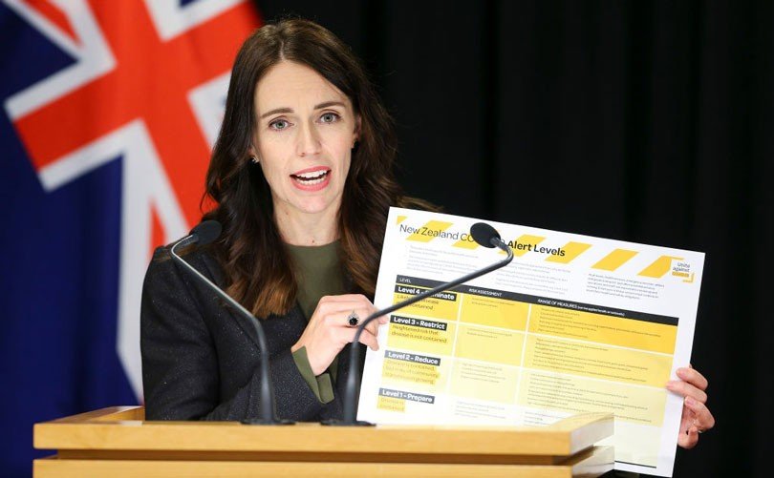
Leadership style
Transformational: Significant positive change through progressive policies and vision for a fairer and more inclusive society.
Empathetic: compassionate and empathetic leadership style, often prioritizing the well-being of citizens and showing genuine concern for their issues.
Inclusive: values inclusivity and actively seeks to represent and address the needs of all New Zealanders.

Slide 17

Leadership behaviour
Compassionate Crisis Management: in times of crisis, Ardern has shown remarkable empathy and composure.
Effective Communication: she excels in clear and transparent communication.
Collaborative Approach: She often works collaboratively with her cabinet, experts, and the public.
Focus on Social Issues: Ardern places a strong emphasis on social justice issues such as reducing child poverty, improving mental health services, and addressing climate change.

Slide 18

Followers appeal
Empathy and Compassion: ability to connect emotionally with people.
Authenticity: approachable demeanour and reliability.
Progressive Vision: progressive policies and vision for fairer.
Crisis Leadership: competent and compassionate.

Slide 19

Evaluation of similarities between Elon Musk and Jacinda Ardern
Visionary Leadership
Both leaders share the ability to articulate a compelling vision that inspires and mobilizes their followers, fostering a strong sense of purpose and direction.
Transformational Leadership
Both leaders effect significant change, whether through technological innovation or social reform, reshaping their respective fields.
Hands-On Approach
Their active and involved leadership styles ensure they remain closely connected to the core activities and issues within their domains.

Slide 20
Evaluation of differences between Elon Musk and Jacinda Ardern
Leadership context
The contexts in which they lead fundamentally shape their approaches, with Musk emphasizing innovation and market success, while Ardern prioritizes public welfare and social equity.
Leadership style
Musk's directive and high-pressure approach contrasts with Ardern's inclusive and compassionate style, reflecting their different leadership environments and goals.
Public image and communication
While Musk leverages bold and sometimes provocative communication to maintain a strong public presence, Ardern uses empathy and clarity to foster trust and cohesion among the populace.

Slide 21
Conclusion
The assessment of Henry Ford, Nelson Mandela, Elon Musk, and Jacinda Ardern exposes a wide range of leadership styles, behaviors, and follower appeals that have had a tremendous impact on business worldwide and beyond. Despite their differences, these leaders have common characteristics such as vision, resilience, and influence, illustrating that good leadership may take many forms. Understanding their individual techniques and the situations in which they led can provide vital lessons for current and future leaders seeking to make a significant difference in their areas.
Thank you for your attention. We look forward to any questions about these intriguing figures and their lasting legacy.

Slide 22
References
Bloomberg. (February 2023). Musk, in Twitter sitter appeal, says recent verdict supports him. Available at: https://www.bloomberg.com/news/articles/2023-02-21/musk-in-twitter-sitter-appeal-says-recent-verdict-supports-him?embedded-checkout=true Accessed: 2nd July
CNN. (July2021). Nelson Mandela birthday lessons for US politics today. Available at: https://edition.cnn.com/2021/07/18/us/nelson-mandela-birthday-lessons-for-us-politics-today/index.html Accessed: 1st July
Council of Women World Leaders. (n.d.). Jacinda Ardern. Available at: https://www.councilwomenworldleaders.org/jacinda-ardern.html Accessed: 10th July
Encyclopaedia Britannica. (2024). Elon Musk. Available at: https://www.britannica.com/money/Elon-Musk Accessed: 2nd July
Forbes. (2024). Elon Musk. Available at: https://www.forbes.com/profile/elon-musk/ Accessed: 2nd July
Forga, A. (n.d.). Exploring Elon Musk's transformational leadership. Available at: https://adamforga.com/exploring-elon-musks-transformational-leadership/ Accessed: 18th July
Harvard T.H. Chan School of Public Health. (November 2023). Leading with empathy: A conversation with former New Zealand Prime Minister Jacinda Ardern. Available at: https://www.hsph.harvard.edu/event/leading-with-empathy-a-conversation-with-former-new-zealand-prime-minister-jacinda-ardern/ Accessed 18th July
History.com Editors. (March 2020). Henry Ford. HISTORY. Available at: https://www.history.com/topics/inventions/henry-ford Accessed 19th July
Leverage Edu. (June 2021). Jacinda Ardern leadership style. Available at: https://leverageedu.com/blog/jacinda-ardern-leadership-style/ Accessed: 10th July
Online Manipal. (February 2023). Jacinda Ardern’s inspiring leadership. Available at: https://www.onlinemanipal.com/blogs/jacinda-arderns-inspiring-leadership Accessed: 18th July
Murphy, M. (January 2018,). The leadership model used by Steve Jobs, Henry Ford, and Thomas Edison. Forbes. Available at: https://www.forbes.com/sites/markmurphy/2018/01/14/the-leadership-model-used-by-steve-jobs-henry-ford-and-thomas-edison/ Accessed: 19th July
Nobel Prize. (n.d.). Nelson Mandela - Biographical. Available at: https://www.nobelprize.org/prizes/peace/1993/mandela/biographical/ Accessed: 1st July
Penn State University. (March 2015). Elon Musk: Transformational leadership in action. Available at: https://sites.psu.edu/leadership/2015/03/26/elon-musk-transformational-leadership-in-action/ Accessed: 2nd July
Rizvi, H. (October 2022). 20th century leadership vs 21st century leadership. Available at: https://hidayatrizvi.com/20th-century-leadership-vs-21st-century-leadership/ ​Accessed: 19th July
Towerstone Global. (July 2022). Leadership lessons from Nelson Mandela. Available at: https://www.towerstone-global.com/leadership-lessons-from-nelson-mandela/ Accessed: 1st July
Wang, R. (July 2016). Nelson Mandela Journal No. 4. Medium. Available at: https://medium.com/@rishilanwang/nelson-mandela-journal-no-4-43437b8b10c0 Accessed: 1st July
Western, S., 2008. Leadership [electronic resource] : a critical text. 1st . Los Angeles: Sage Publications.

