Slide 1

MGE LCBB 5008
(LECTURE 1)
Introduction to Markets and Market Failure

Slide 2

Contents
Introduction to Economics
What is Economics
The Economic Problem
The Production Possibility Frontier
Economic Growth

Slide 3
WHAT IS ECONOMICS ?
Economics is a social science.
It’s concerned with the production of goods and service
And also, with the consumption of goods and services
IMPLICATIONS:
How resources are allocated
How the choices are made about resource allocation

Slide 4
THEREFORE ?
Economic decisions relate to –
What gets produced (Food/ homes/ banking services/cars (electric v fuel) should the emphasis be on agriculture, manufacturing or services, should it be on sport and leisure or housing?
How to produce (When/How/How much) labour intensive, land intensive, capital intensive? Efficiency?
Who gets what ? (Distribution) even distribution? more for the rich? for those who work hard?

Slide 5

Factors of Production
Land – natural resources (including oil and minerals)
Labour – the labour force
Capital – plant, money machinery, tech
Entrepreneurship – the organizing factor of the other three factors of production

Slide 6
QP1: Factors of Production
A) Identify the 4 factors of production and their prices. Then explain the statement ‘meaning costs occur because resources are scarce and therefore command a price’
B) What are the consequences of a sharp rise in wage rates (The price of labour)on the costs of a business and how this affects its decision to employ labour.

Slide 7
Reading – to help with answer to question(b)
Article on Implication of Minimum Wage Rate
https://www.capitalontap.com/en/blog/posts/national-living-wage/

Slide 8
Guide to Answering The Question
1.Read the question carefully
Define and explain the factors of production
Associate the price of each factor of production and give an example.
Explain the concepts of scarcity and choice and how they affect the factors of production
Link this to opportunity cost.
Link this to resource scarcity and price.
Use examples.

Slide 9

BASIC ASSUMPTION
Assumption:
People behave rationally at all times.
Therefore, sub- assumptions
1) Producers – maximisation of profits
2) Consumers – maximize benefits (utility) from their income
3) Governments seek to maximize the welfare of their people.

Slide 10
SCARCITY OF RESOURCES AND OPPORTUNITY COST
Scarcity
Choice and Opportunity Cost
Scarcity – the excess of human wants over production capabilities.
Therefore, a scarce resource occurs where the quantity demanded of that resource at a zero price exceeds the available supply
Therefore, as resources are scarce a choice must be made.
This affects consumers and producers.
Definition – the cost expressed in terms of the next best alternative sacrificed/ alternative forgone

Slide 11
HSBC: The Value of Education
Key Findings
. Over half (54%) are putting a child through paid-for education, and almost two-thirds (63%) are paying for private tuition or have done so in the past.
The highest proportions of parents with at least one child in paid-for education are in India (96%), the UAE (93%) and Indonesia (87%), while the highest proportions of parents currently paying for private tuition (or who have done so in the past) are in China (93%), Indonesia (91%), Hong Kong (88%) and Egypt (88%).
Q: What is the opportunity cost to parents of the USD 44221.00 parents are spending on education?
USD 44,221.00 is the amount that parents say they spend on the child’s education from primary and secondary schools through to university
Parents are going the extra mile to ensure their children have a good start in life. Most parents (71%) started making plans for their child’s education, and 60% started making funding decisions, before their child had begun primary education

Slide 12
THINKING CAPS ON !🧘🏼 :
What examples can you use from theory and from recent economic news in the UK to explain how the concept of opportunity cost is relevant to:
(1) An individual
(2) A government
(3) A firm
What are the basic economic choices regarding the allocation of resources in the UK?

Slide 13
PPF //PPB //PPC
If the country is at point A on the PPF It can produce the combination of Zo capital goods and Xo consumer goods
Capital Goods
Zm
Zo
A
Z1
B
If it reallocates its resources (moving round the PPF from A to B) it can produce more consumer goods but only at the expense of fewer capital goods. The opportunity cost of producing an extra Xo – X1 consumer goods is Zo – Z1 capital goods.
Xo
X1
Xm
Consumer Goods

Slide 14
Can you think of further scenarios / extensions to the PPF –
What if it shifts inwards?
How could this relate to the study of the macro economy ?

Slide 15
Some Questions ?
Production inside the PPF – e.g. point B means the country is not using all its resources
Capital Goods
If we were to insert a point H outside the blue PPF – what are the implications
For the standards of living
Government policy
Industry / Business
C
Y1
Yo
.B
A
It can only produce at points outside the PPF if it finds a way of expanding its resources or improves the productivity of those resources it already has. This will push the PPF further outwards.
Xo
X1
Consumer Goods

Slide 16
IMPORTANT
The PPF is concerned primarily with fundamental productive capacity
Implication:
An increase in the size of the labour force shifts the frontiers’ position.
A fall in unemployment does not shift the curve it moves actual output closer to potential output.

Slide 17
IMPORTANT (2)
Does an increase in capital increase or decrease potential output (Increases)
Does a change in prices affect potential output . (No)

Slide 18
Positive / Normative Economics
Health care can be improved with more tax funding
Pollution control is effective through a system of fines
Society ought to provide homes for all
Any strategy aimed at reducing factory closures in deprived areas would be helpful
Positive Statements:
  Capable of being verified or refuted by resorting to fact or further investigation
Normative Statements:
  Contains a value judgement which cannot be verified by resort to investigation or research

Slide 19
Knowledge and Application: Public Health Care
Many developing countries suffer from shortages of trained professionals like doctors and nurses. In India there is one physician for every 1800 people. In China, the government spends 3.1 % of its gross domestic product on public health. In India the equivalent is just 1.4% of GDP.
This means that the poor cannot access comprehensive public healthcare. There is a lack of beds and limited doctors mean limited time with patients.
The government should increase is spending on public health care.
Q: Identify the positive and normative statements in the text.

Slide 20


Slide 21
ECONOMIC SYSTEMS
CENTRALLY PLANNED OR COMMAND ECONOMY- allocative decisions are made by government
https://www.thebalancemoney.com/command-economy-characteristics-pros-cons-and-examples-3305585
MARKET ECONOMY – market forces of supply and demand and the price mechanism allocate resources
MIXED ECONOMY – allocative decisions are made partly by the free market and partly by government

Slide 22
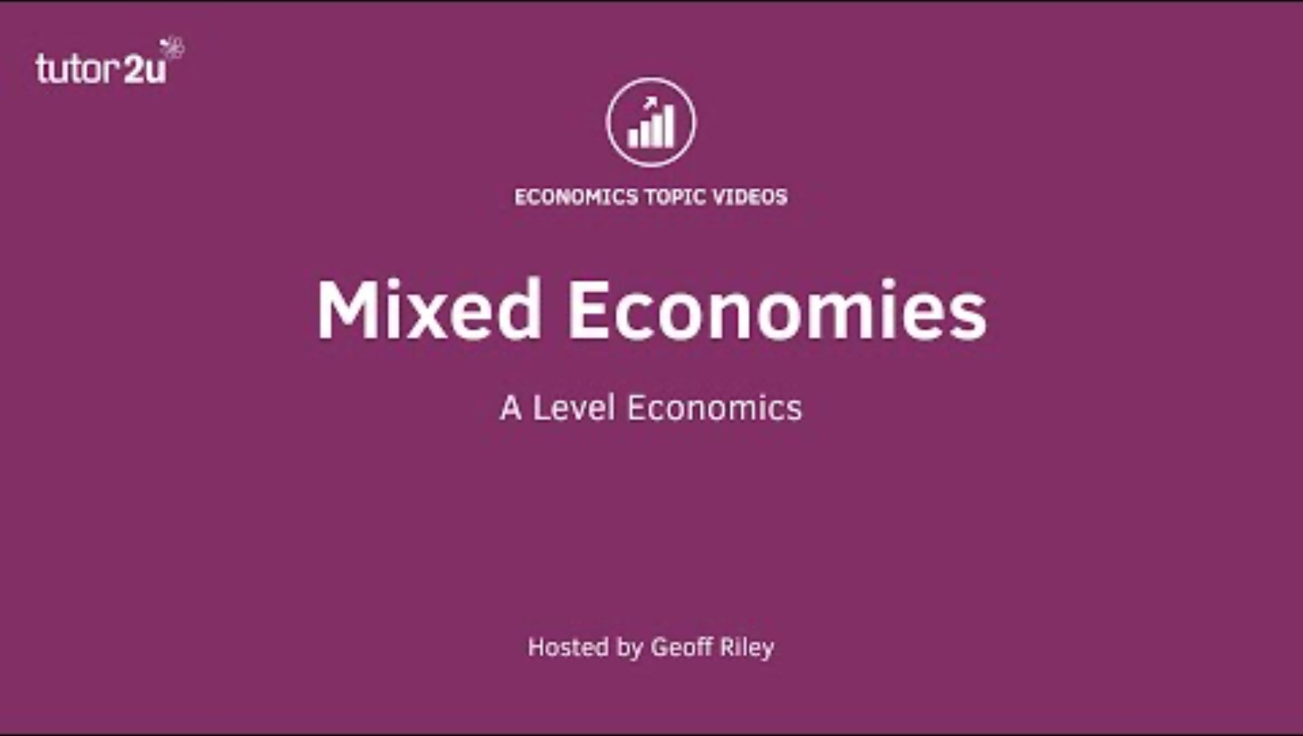

Slide 23
Learning and Revision Schedule
Saturday 14th September | Sunday 15th September | Monday /Tuesday 16/17 September | Completed & Comments [Y/N]
Review slides 1-10 and read the associated pages in your text book – Anderton . | Review slides 11-22 and read the associated pages in your textbook – Anderton | Review slides 1-22 and your notes made . Work through the questions and comprehension exercises
Work through the examples | Work through the examples | Try the Homework Question (see below)
Make notes or add to notes. Keep all your notes together | Make notes or add to notes. Keep all your notes together | Reading Anderton Ch 3 page 12 Ch 4 page 17 DRQ Civil War in Syria pg 21.

