Slide 1

Recruitment and Selection During Organisational Transformation: New Look
Student Name: Catalin-Constantin Avram
Student ID: 2422877
Module Code: LCLM5002
Case study: New Look

Slide 2

Table of Contents
Company introduction
Nature of transformation
Recruitment process
Job analysis
Job description and person specification
Advertising platforms
Interview types
Questioning techniques
Face-to-face vs virtual interviews
Conclusion and references

Slide 3
New Look and Its Transformation
New Look
Content:
UK fashion retailer founded in 1969
Strong high street and online presence
Digital transformation is central to strategy
Investing in data, AI and e-commerce
Focus on omnichannel customer experience

Slide 4

Transformation requires new skills
Right hires support business change
Poor hiring can delay implementation
Recruitment must match strategic goals
Fair selection improves performance

Slide 5
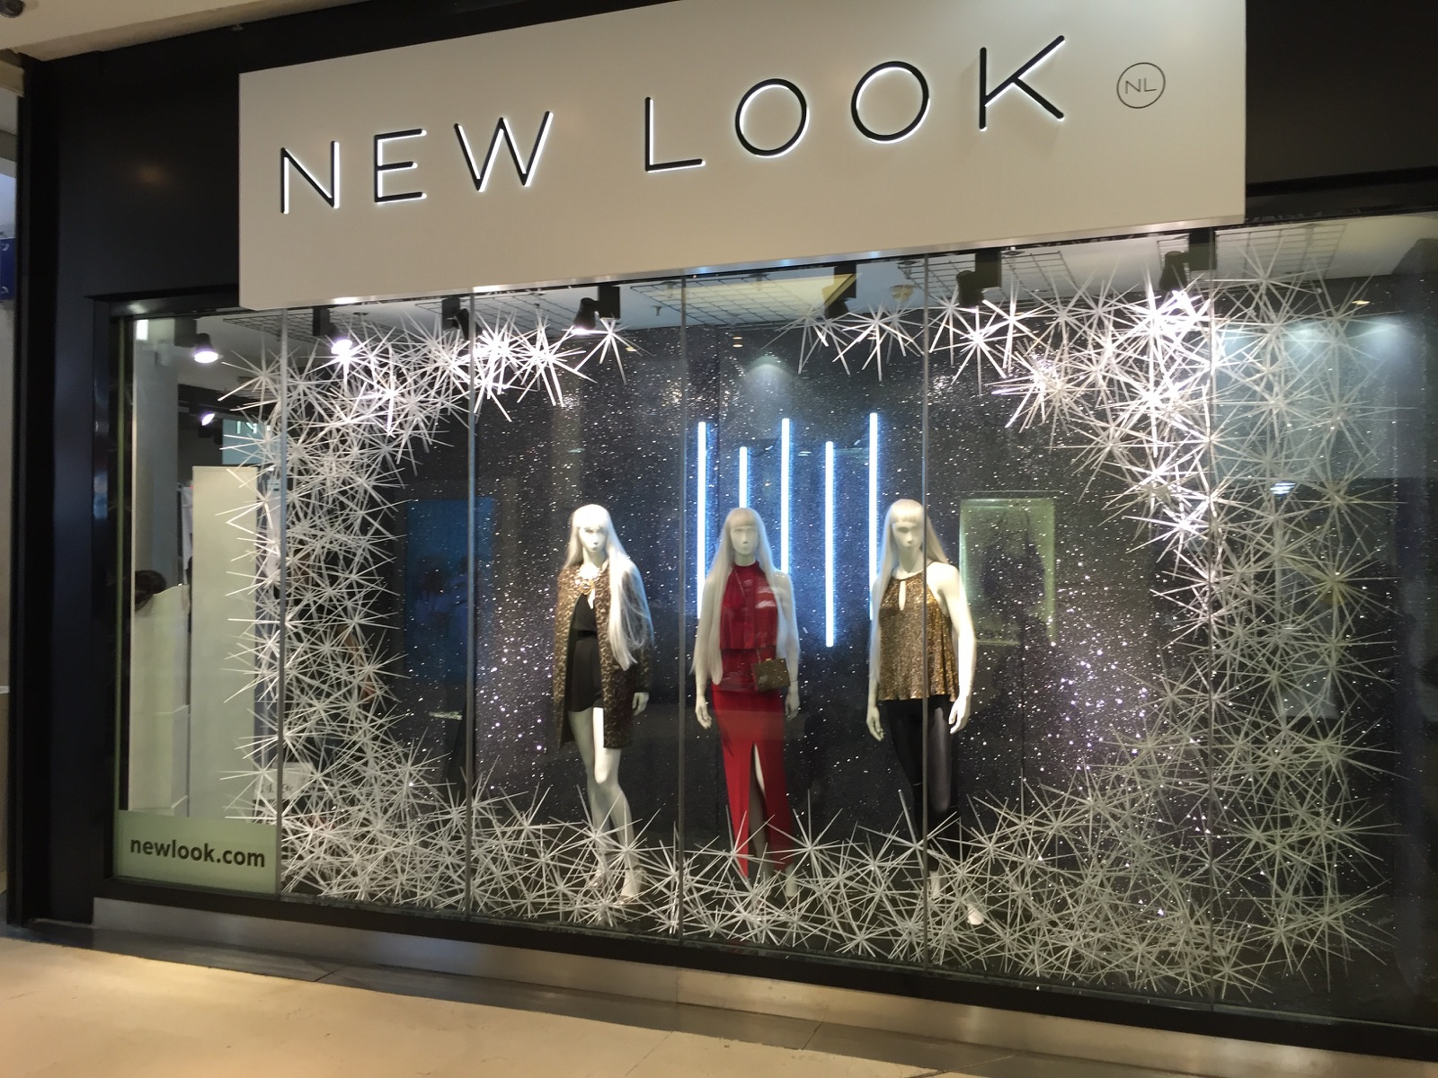
Recruitment Process Overview
Identify vacancy
Conduct job analysis
Prepare job description
Create person specification
Choose advertising platforms
Shortlist and interview candidates
Make final selection

Slide 6


Job Analysis
Identifies duties and responsibilities
Defines skills and competencies needed
Links the role to business objectives
Supports accurate recruitment decisions
Reduces role-candidate mismatch
Lead change initiatives
Manage stakeholders
Support employee engagement
Monitor progress

Slide 7


Job Description and Person Specification
Job description
Person specification
Lead digital and organisational change
Coordinate across departments
Develop action plans and timelines
Monitor risks and outcomes
Relevant qualification
Experience in change or project work
Strong communication skills
Problem-solving and adaptability
Digital awareness

Slide 8


Advertising Platforms
New Look Careers website
LinkedIn
Indeed
Reed
Totaljobs
Internal recruitment channels
Specialist recruitment agencies
Wider reach
Access to specialist talent
Better candidate quality
Supports diversity

Slide 9


Project Manager
Operations Manager
Digital Specialist
Interview Type 1: Structured Interview
Suitable for
Same questions for all candidates
Standard scoring criteria
Fair and consistent method
Easier to compare candidates
Reduces interviewer bias
Structured Interview

Slide 10

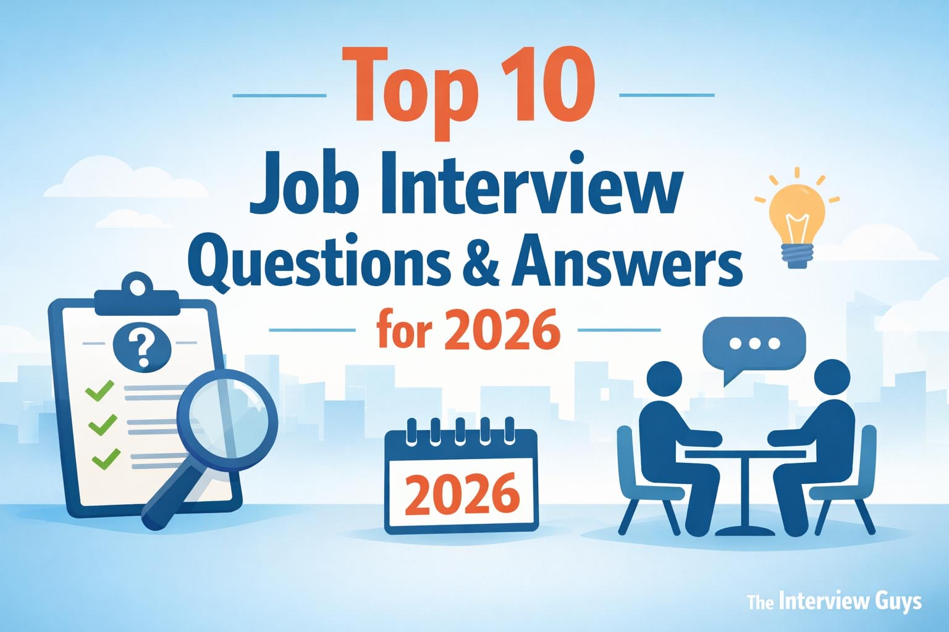
Interview Type 2: Behavioural Interview
Focuses on past behaviour
Uses real work examples
Assesses adaptability and leadership
Useful for change-related roles
Predicts future performance
Change Manager
Project Manager
HR roles

Slide 11


Interview Type 3: Panel Interview
Possible panel members
HR Officer
Line Manager
Senior Manager
Several interviewers involved
Multiple perspectives
Better assessment of role fit
Reduces individual bias
Suitable for strategic positions

Slide 12



Appropriate Questioning Techniques
Best approach for New Look
Structured competency-based questions
Behavioural questions
Situational follow-up questions
Behavioural questions
Situational questions
Competency-based questions
Probing questions
Socratic questioning
Example questions
"Tell us about a time you managed change."
"How would you handle resistance?"
"How do you align stakeholders?"

Slide 13


Face-to-Face vs Virtual Interviews
Face-to-face
Stronger personal interaction
Easier to observe body language
Better for final-stage interviews
Higher cost and less flexibility
Recommendation
Virtual for screening
Face-to-face for final selection
Virtual
Faster and cheaper
More flexible scheduling
Wider talent pool
Risk of technical issues

Slide 14

Conclusion
New Look is undergoing digital transformation
Recruitment must support strategic change
Clear role design improves hiring quality
Structured and behavioural interviews are effective
Hybrid interviewing is recommended

Slide 15

Reference List
Armstrong, M. and Taylor, S. (2023) Armstrong's Handbook of Human Resource Management Practice. 16th edn. London: Kogan Page.
Bratton, J. and Gold, J. (2017) Human Resource Management: Theory and Practice. 6th edn. London: Palgrave.
CIPD (2024a) Recruitment: an overview. Available at: cipd.org (Accessed: 13 June 2026).
CIPD (2024b) Selection methods. Available at: cipd.org (Accessed: 13 June 2026).
Dessler, G. (2020) Human Resource Management. 16th edn. Harlow: Pearson.
Just Style (2025) 'New Look lands £30m to fuel digital growth, hit £1bn online target by 2030', 7 April. Available at: just-style.com (Accessed: 13 June 2026).
New Look Group (2025) New Look to supercharge digital growth with £30m investment from shareholders. Available at: newlookgroup.com (Accessed: 13 June 2026).
New Look Group (2026) Our approach. Available at: newlookgroup.com (Accessed: 13 June 2026).
Pressbooks (n.d.) 5.3 Interviewing - Introduction to Human Resource Management. Available at: wisconsin.pressbooks.pub (Accessed: 13 June 2026).
Taylor, S. (2022) Resourcing and Talent Management. 9th edn. London: CIPD Kogan Page.
The Stack (2026) 'New Look COO shares advice for digital transformation, AI', 13 March. Available at: thestack.technology (Accessed: 13 June 2026).
Aguinis, H. (2019) Performance Management for Dummies. Hoboken: Wiley.

Slide 16


THANK YOU

