Slide 1
Module Name : Integrating Project
Module Code : ACHA4008
Topic : IEEE referencing
Id: 2209702
Name: Sohail Ali

Slide 2
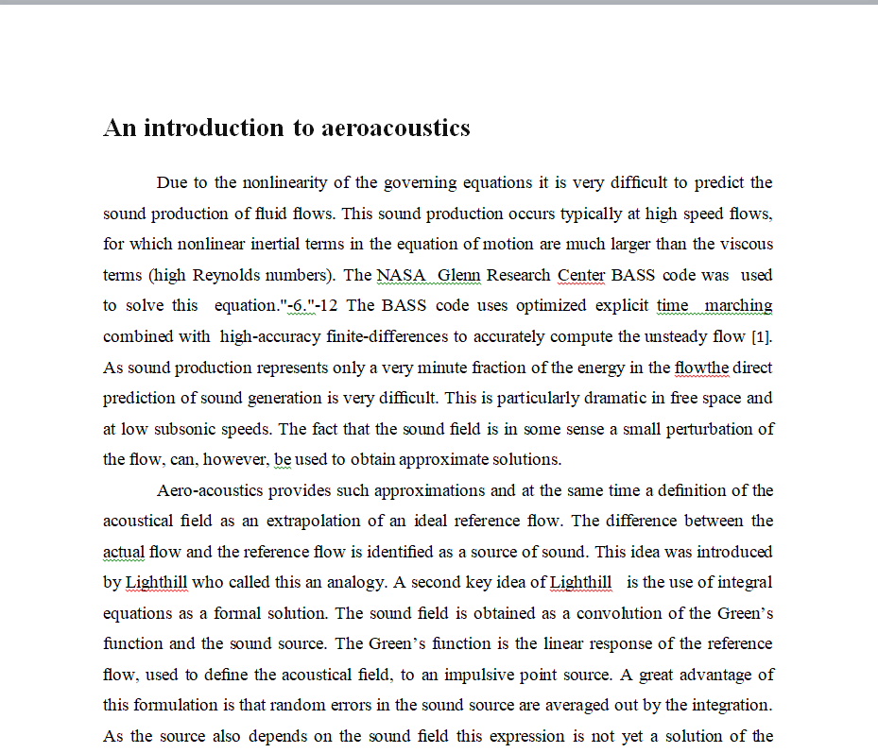
IEEE Referencing Style
Examples of IEEE Style References

Slide 3
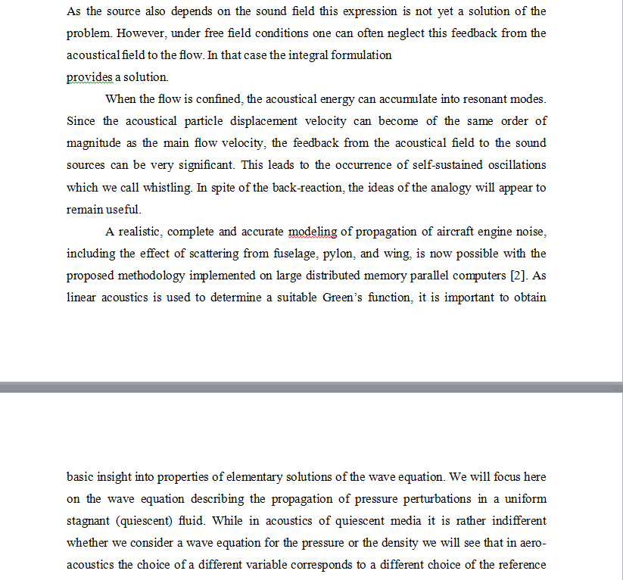
IEEE Referencing Style
Examples of IEEE Style References

Slide 4
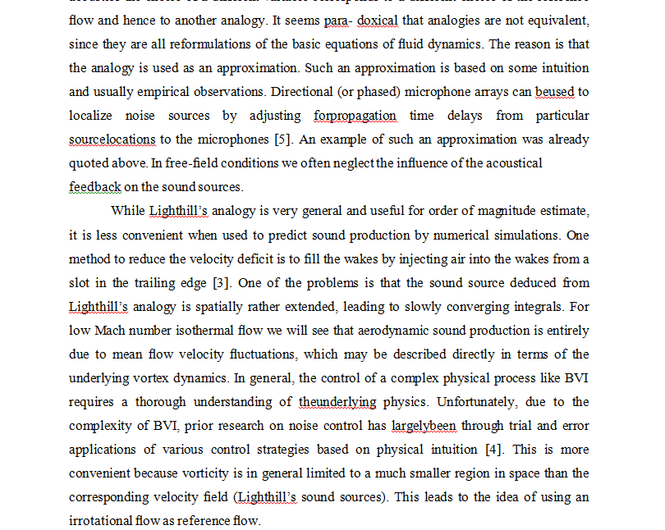
IEEE Referencing Style
Examples of IEEE Style References

Slide 5
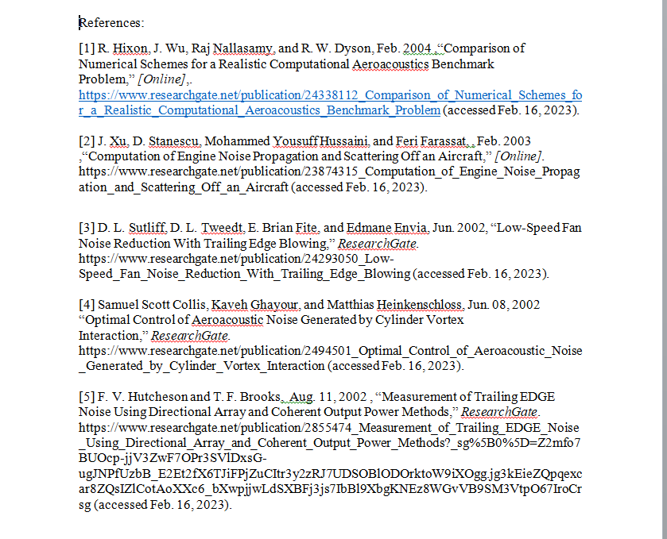
IEEE Referencing Style
Examples of IEEE Style References

Slide 6
Thank You
Prepared By,
- Jenifer Prince Devaraj M.E., M.Ed.

