Slide 1
Christological controversies in the third and fourth centuries

Slide 2
Christology: Heresies
The early Christians explored how to make sense of, and sometimes, struggled to find the language to articulate their views about Jesus.
It is in response to these challenges (including confusions and dangers) that the Early Church councils formulated the creeds, which are still central to Christian belief and praxis until today.
Several christological heresies arose during this period.
Each of the main heresies (to which creeds respond), in some way denies the orthodox claim that God became incarnate in the man Jesus.

Slide 3
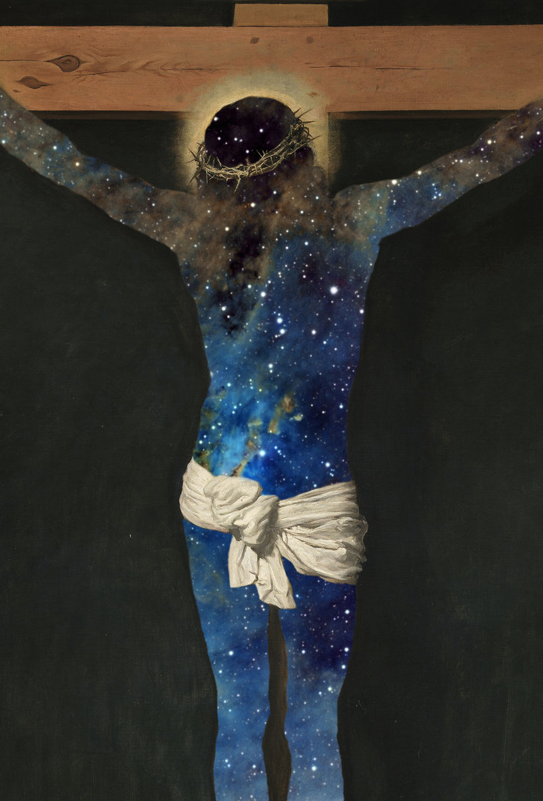
DOCETISM
From the Greek word dokeō, meaning ‘to seem’ or ‘to appear’ (‘mere appearance’).
This is the heresy that Jesus Christ was not really human. He took on the form that made him appear human , but he did not really suffer, he was not tempted, and he did not really die.
Contemporary subtle forms include a denial of the full humanity of Jesus.

Slide 4
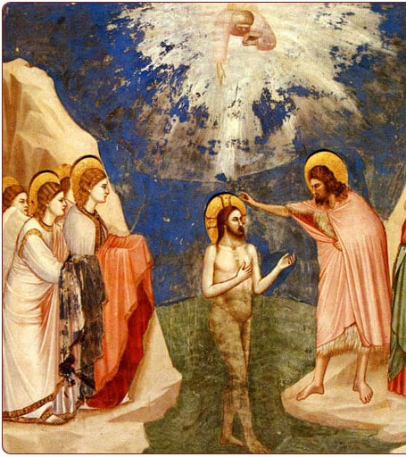
adoptionism
This heresy represents the opposite trend to Docetism.
It refers to any theology which implies that Jesus was no more than a very special, even unique, human being. He was a man who, in some way, was adopted by God to carry out his purposes, but who was not in any sense divine.
We sometimes encounter this type of idea when popular pagan or gnostic beliefs intermingle with Christianity: Jesus was just a man who more fully ‘actualized his Christ-force’, the inner divinity that is inside us all.

Slide 5
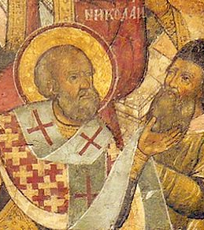
ARIANISM
The Council of Nicea in 325 CE affirmed that Jesus Christ was homoousios - one of substance, one with the Father.
It refutes the heresy of Arianism (Arius – 256-336 CE), which held that the logos incarnate in Jesus was itself no more than the highest of all creatures.
This denies the divinity of the Trinity as well as the divine nature of Christ.
Contemporary conservatives often accuse liberals of being Arians. There is an apocryphal story of St Nicholas of Myra slapping Arius at the Council of Nicaea.

Slide 6
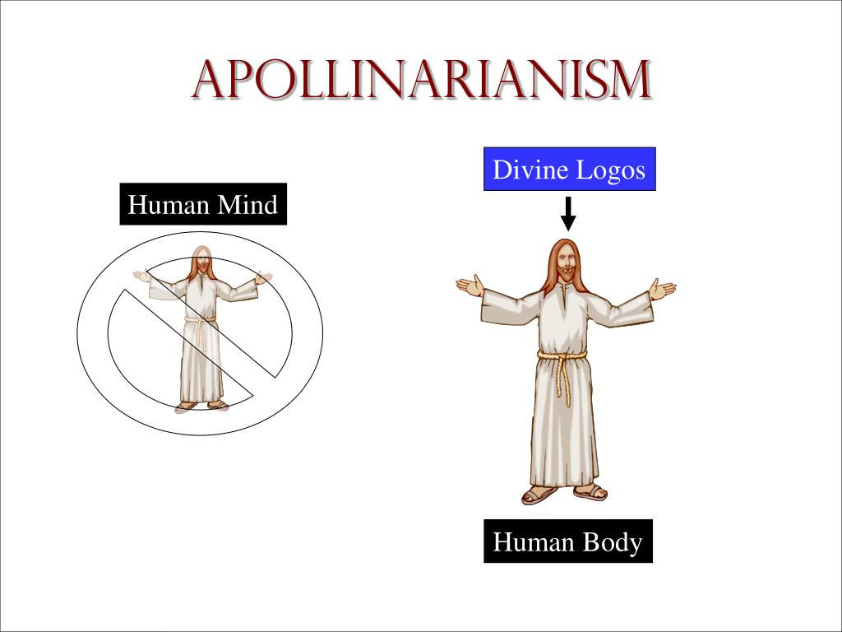
apollinarianism
The Council of Constantinople in 381 CE affirmed the full divinity of the Holy Spirit and condemned the christological view known as Apollinarianism (Apollinarius of Laodicea, c. 310-390 CE), which held that the divine logos had replaced the human mind (nous) of the man Jesus.
It denied that Christ was fully human. Because this nous is also taken to be the ‘animating spirit’ of the flesh, the implication was that the divine would in some way transform the human flesh into something unlike any other human being.
This denies the humanity of Christ.

Slide 7
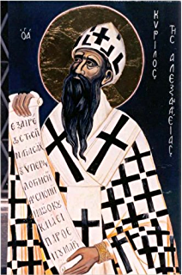
Nestorianism
The Council of Chalcedon in 451 CE condemned (echoing Ephesus in 431 CE) a heresy known as Nestorianism (Nestorius, c. 386-451 CE), which supposedly held the divine and human sides of Jesus so far apart that there were ‘two sons’ within the one man.
This leads to a schizophrenic picture of the actions and will of Christ, where they are divided between the divine and the human.
This also related to the notion of Mary as the ‘Mother of God’ or theotokos - did Mary give birth only to the human nature or also the divine nature?

Slide 8
resolution
The settlement of the council of Chalcedon states that Jesus Christ is ‘fully divine, fully human, two natures in one person, without confusion or change, separation or division’.
It therefore reiterated the condemnation of Apollinarian mixing of divine and human, and it also rejected the Nestorian complete separation.
For Chalcedon the flesh of Christ came from Mary. Thus, it declared that Christ ‘was begotten before the ages from the Father as regards his divinity, and in the last days the same for us and for our salvation from Mary, the virgin God-bearer as regards his humanity…’

Slide 9


