Slide 2
Introduction
Module Name: Group Project
Module Code: ACBA4014
Applied Computing - WISA

Slide 3
Module Lecturers
Mark Huntly
m.huntly@uwtsd.ac.uk
We shall meet Online via Teams Link
Thursdays: 17:00 – 19.00 : Lecture & Breakout Discussion
We shall meet in-person in IQ109
Saturdays: 14.00 – 18.00 : Practical Project Work
Module Information
Online Lectures on Thursdays at 5pm
Attendance will be monitored
Assessments:
  Group Project Artifact
  Individual Report

Slide 4
Module Aim
To give you practical skills to apply the knowledge gained through all modules studied in the development of a project...
As a TEAM.

Slide 5
Module Aim
The product of the project will take the form of a subject related artifact.
Software application
Web development
Project design
Prototype

Slide 6
Module Outcome
Upon completion of this module, you should be able to:
Apply knowledge and skills gained through your study to solve problems.
Work as a team.
Recognise a project and its purpose and context.
Understand a project lifecycle.
Understand tools and techniques for project management.

Slide 7
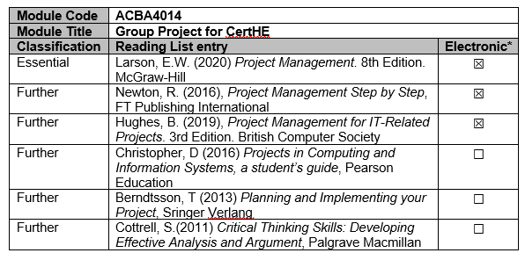
Reading List

Slide 8
Topics to cover
Team formation and teamwork
Technology, evolution and innovation
What is a project?
Goal setting and reviews (aims and objectives)
Project Requirements, analysis and design
Project lifecycle
Practical tutorials and support will be regular
Regular reviews will be conducted.

Slide 9
Topics to cover
Regular reviews will be conducted on objectives.
Assessment will be group work and individual.
  Individual work will be weighted higher than group work.
All Saturdays will be practical tutorials for groups to work together with consultation from me.

Slide 10
Assessments
To give you practical skills to apply the knowledge gained through all modules studied in the development of a project...
LEARNING OUTCOMES
Upon the successful completion of this module, the student should be able to:
To demonstrate essential knowledge and skills to work in a group / team and produce an artifact from a project.

Slide 11
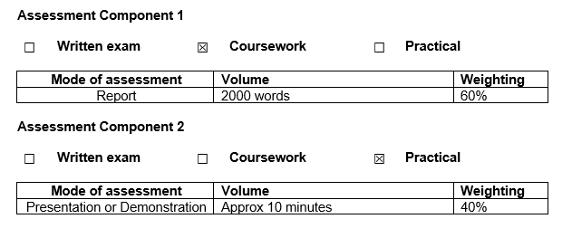
Assessments
Submission date TBC…

Slide 12
Assessments
Individual written report describing the project chosen, research conducted, individual contribution, and evaluation of the overall teamwork.
Presentation for project proposal (5 mins) to be presented in practical tutorials
Presentation and / or demonstration of artifact / prototype produced (5 – 10 mins)

Slide 13
Module Lecturers
Mark Huntly
m.huntly@uwtsd.ac.uk
We shall meet Online via Teams Link
Thursdays: 17:00 – 19.00 : Lecture & Breakout Discussion
We shall meet in-person in IQ109
Saturdays: 14.00 – 18.00 : Practical Project Work
Module Information
Online Lectures on Thursdays at 5pm
Attendance will be monitored
Assessments:
  Group Project Artifact
  Individual Report

Slide 14
Any Questions?

