Slide 1
Economic Solutions to Environmental Problems
The Market Approach - Overview
Market approach refers to incentive-based policy that encourages conservative practices or pollution reduction strategies
  Difference between market approach and command-and-control approach is how each approach attempts to achieve its objectives
Types of Market Instruments
  Pollution charge
  Subsidies
  Deposit/refund systems
  Pollution permit trading systems

Slide 2
Pollution Charges
Fee that varies with amount of pollutants released
  Based on “Polluter-Pays Principle”
Types of pollution charges
  Effluent/emission fees
  Product charge
  User charge
  Administrative charge

Slide 3
Product Charge
Fee added to price of pollution-generating product, which generates negative externality
Impose product charge as per unit tax on product, e.g., gas tax
  How does the tax on gasoline in the US compare with that of other nations?
  If the tax equals the marginal external cost (MEC) at Q_{E}, it is called a Pigouvian tax

Slide 4
Selected International Gasoline Tax Rates
Nation | Tax Rate % of Price (2011)
United States | 13.2
U.K. | 61.6
France | 58.1
Germany | 60.5
Japan | 45.8
Spain | 50.1
Source: International Energy Agency, January 2011

Slide 5
Modeling a Pigouvian Tax
$
MSC = MPC + MEC
MPC_{t}
MPC
a
Amount of tax
b
MPB = MSB
0
Q_{E}
Q_{C}
Q of gasoline
Notes:
FIGURE 5.1 A Pigouvian Tax
This model illustrates how a Pigouvian tax achieves efficiency in the market for some pollution- generating product (Q). By setting the unit tax equal to the MEC at QE, shown as distance ab, the MPC curve shifts up to MPCt. Equilibrium output is then determined by the intersection of MPCt and MSB, which is the efficient production level, QE.

Slide 6
Assessing the Model
In theory, achieves an efficient outcome
In practice, difficult to identify the value of MEC at Q_{E}
Allows only for an output reduction to reduce pollution

Slide 7
Emission (Effluent) Charge
A fee imposed directly on the discharge of pollution
  Assigns a price to pollution
Typically implemented through a tax

Slide 8
Model: Single Polluter Case
Government sets an abatement standard at A_{ST}
Policy options to polluter are:
  Abate up to A_{ST} and incur those costs OR
  Pay a constant per unit tax, t, on any abatement less than A_{ST}
    Total Tax = t(A_{ST} - A_{O})
      where A_{O} is actual abatement level
    Marginal Tax (MT) = t
      Because t is constant, t = MT
Firm will choose the least-cost option: the marginal tax (MT) or the marginal abatement cost (MAC)

Slide 9
Modeling Emission Charge
Single Polluter
$
Firm abates up to Ao since
MAC < MT; firm pays tax
between A_{O} and A_{ST}, since
MAC > MT in that range
MAC
0aA_{O} = cost to abate A_{O}
A_{O}abA_{ST} = tax on pollution
not abated up to A_{ST}
c
a
b
MT
t
0
A_{O}
A_{ST}
Abatement (A)
Notes:
FIGURE 5.2 Modeling an Emission Charge for a Single Polluter
This model illustrates the decisions of a single polluter, faced with the options of paying a tax [t (AST ␣ A0 )] or incurring the cost of abating. In this case, the firm will abate up to A 0, because up to that point MAC < MT. Its total abatement costs (TAC) are shown as area 0aA0. Beyond A0 and up to the standard, AST, the firm will pay the taxes, because MT < MAC. Its tax burden is represented by area A0abAST. Hence, the total costs to the polluter of complying with this policy are area 0ab

Slide 10
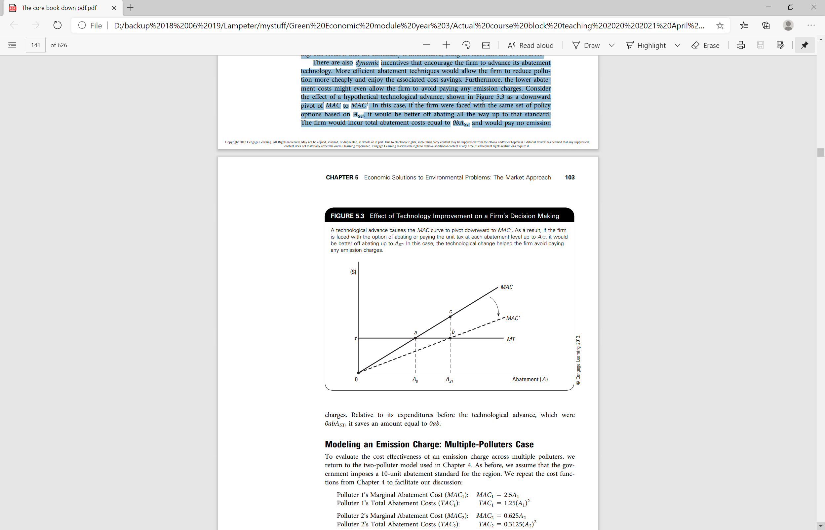
Assessing the model
Effect of Technology Improvement on a Firm’s Decision Making

Slide 11
Assessing the Model (cons)
Firms might evade tax by illegally disposing pollutants
Distributional implications
  Consumers may pay higher prices due to tax
  Job losses may result from polluter paying new taxes and/or changing technology to abate

Slide 12
Pollution Charges in Practice
Internationally, the pollution charge is the most commonly used market-based instrument
  Australia, France, Germany, and Japan use fees or taxes to control noise pollution generated by aircraft
  Canada, France, Mexico, and Poland are among the nations using effluent charges to protect water resources.
  Others levy charges on products such as batteries, tyres, lubricant oil, packaging, paint, paint containers, and gasoline

Slide 13
Environmental Subsidies
Two major types of subsidies:
  Abatement equipment subsidies
  Pollution reduction subsidies
Notes:
An alternative market approach to reducing environmental damage is to pay polluters not to pollute through an environmental subsidy. There are two major types of subsidies—abatement equipment subsidies and pollution reduction subsidies. We discuss each of these in turn.

Slide 14
Abatement Equipment Subsidy
Defined as a payment aimed at lowering the cost of abatement technology
    Goal is to internalize the positive externality associated with the consumption of abatement activities
If the subsidy (s) equals the marginal external benefit (MEB) at Q_{E}, it achieves an efficient equilibrium and is called a Pigouvian subsidy

Slide 15
Pigouvian Subsidy
Market for Scrubbers
MSC = 70.0 + 0.5Q, MPB = 350.0 − 0.9Q
+ MEB = 56.0 − 0.2Q
MSB = 406.0 − 1.1Q
($ millions)
MSC
K
P_{E} = 175
Subsidy = $14 million
P_{C} = 170
P_{E} – s = 161
L
MPB_{S}
MSB
MPB
0
Q_{C} = 200
Q_{E} = 210
Q of scrubbers

Slide 16
Assessing the Model
It is difficult to measure the MEB
May bias polluters’ decisions about how best to abate

Slide 17
Pollution Reduction Subsidy
To implement, government pays the polluter a subsidy (s) for every unit of pollution abated below some pre-established level Z_{ST}
Per unit subsidy = s(Z_{ST} - Z_{O}), where Z_{O} is the actual level of pollution
  Analogous to an emission charge
Suppose, for example, that ZST is set at 200 tons of emissions per month, and the subsidy (s) is set at $100 per ton per month. Then, if a polluter reduces its emissions to 180 tons per month
  it would receive a subsidy of $100(200 – 180), or $2,000.

Slide 18
Subsidies in Practice
Environmental subsidies typically are implemented as grants, low-interest loans, tax credits or exemptions, and rebates
Many countries around the world use these instruments, including Belgium, Denmark, Finland, Japan, and Turkey
In the U.S., common uses include federal funding to build publicly-owned treatment works and subsidies to encourage the development of cleaner fuels and low-emission vehicles

Slide 19
Deposit/Refund Systems
A deposit/refund system is a market instrument that imposes an up-front charge to pay for potential damages and refunds it for returning a product for proper disposal or recycling
Targets the potential vs. actual polluter
The deposit is intended to capture the MEC of improper waste disposal (IW) in advance
  Video link of scheme

Slide 20
Modeling Deposit/Refund System
IW disposal market
MEC_{IW}: health damages + aesthetic impairment from litter, trash accumulation, etc.
MPC_{IW}: costs to disposer (e.g., trash receptacles, collection fees, plus forgone revenue from not recycling)
MSC_{IW} = MPC_{IW} + MEC_{IW}
MPB_{IW}: demand for improper disposal
  Assume MEB_{IW} = 0, so MPB_{IW} = MSB_{IW}

Slide 21
Deposit-Refund Model
$
Deposit converts % of overall waste disposal, measured by (Q_{IW} - Q_{E}), from improper methods to proper
MSC_{IW}
MPC_{IW} + Deposit
MPC_{IW}
a
Deposit=MEC at Qe
b
MPB_{IW} = MSB_{IW}
Q_{E}
Q_{IW}
0
Improper Waste Disposal (%)
100
100
Proper Waste Disposal (%)
0
© 2013 Cengage Learning. All Rights Reserved. May not be copied, scanned, or duplicated, in whole or in part, except for use as permitted in a license distributed with a certain product or service or otherwise on a password-protected website for classroom use.

Slide 22
Assessing the Model
Promotes responsible behaviour
Requires minimal supervision by government
Can help slow the use of virgin raw materials by improving availability of recycled materials

Slide 23
Deposit/Refund Systems in Practice
Deposit/refund systems are used worldwide
  Many nations use these systems to encourage proper disposal of beverage containers
    In the US, 10 states have bottle bills
    Deposits range from 2 cents to 15 cents per container
Other applications include systems used to promote responsible disposal of used tyres, car hulks, and lead-acid batteries

Slide 24
Pollution Permit Trading Systems
A pollution permit trading system establishes a market for rights to pollute by issuing tradeable pollution credits or allowances
  Credits are issued for emitting below a standard
  Allowances indicate how much can be released
Two components of the system are
  Fixed number of permits is issued based on an “acceptable” level of pollution set by government
  The permits are marketable
Bargaining gives rise to a market for pollution rights

Slide 25
Pollution Trading Systems in Practice
Most of the evolution of trading is occurring in U.S.
  An important example is the allowance-based trading program to control Sulphur dioxide emissions under the Clean Air Act Amendments of 1990
  More innovation has occurred at state and local levels
    Ozone Transport Commission in the Northeast
    California Regional Clean Air Incentives Market (RECLAIM)
Key international example
  Trading of greenhouse gas allowances are part of the Kyoto Protocol, an international accord aimed at global warming
    Includes the European Union Greenhouse Gas Emission Trading System (EU ETS), launched in 2005
    Video on EU ETS

Slide 26
Conclusions

