Slide 1


Culture in
Samuel Kirvej
2120449

Slide 2
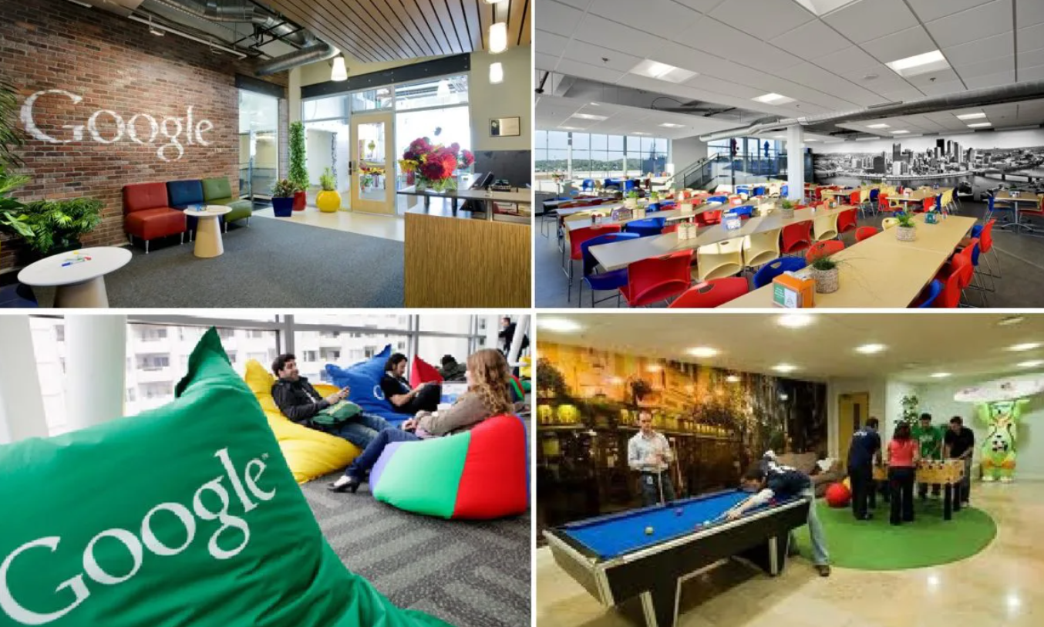
Introduction
Google which was known for its inventive approach and distinctive work culture was founded in 1998 by Sergey Brin and Larry Page, has grown into a major player in the worldwide technology industry.
The company's success may be attributed in large part to its culture, which is based on the principles of transparency, teamwork, and a strong focus on employee well-being.
The work environment at Google has a reputation for its innovative yet employee-friendly regulations, which create a distinctive and lively atmosphere that stimulates innovation and discovery (Gittell, J. H, 2013).
Because of its flat organizational structure, which encourages candid communication and idea exchange, Google places a high value on inclusion and transparency, enabling staff members to contribute and significantly influence the direction of the business.

Slide 3
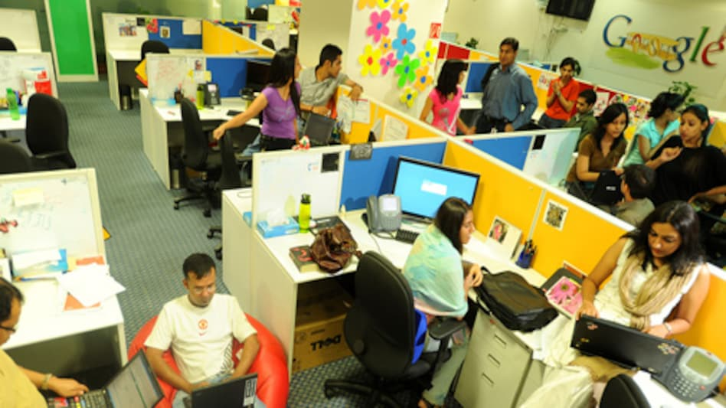
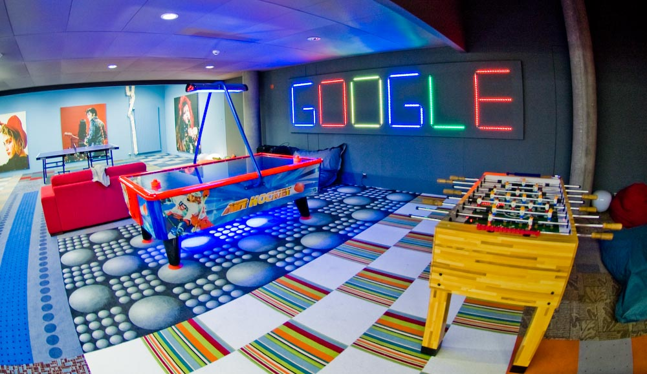
Innovation at Core
With programs like the well-known "20% time" project, which permits staff members to devote a percentage of their working hours to personal projects, Google fosters an innovative culture that produces ground-breaking goods and services.
The Android operating system, Google Glass, and many other notable inventions that have completely changed the technology environment are examples of notable advancements (Harter, J. K., Schmidt, F. L., & Hayes, 2020)

Slide 4
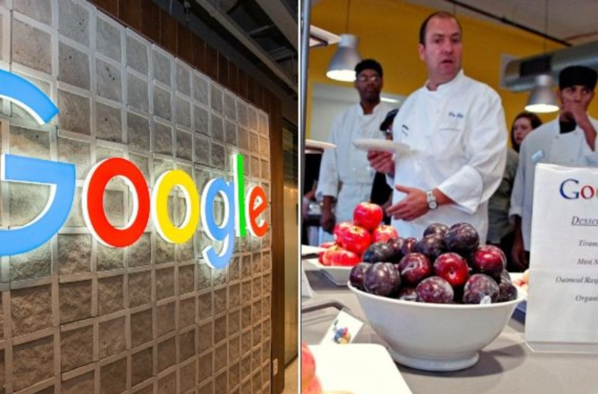
Employee Well-being and Support
Google prioritizes employee well-being and offers a range of benefits, including generous parental leave policies, complimentary gourmet meals, on-site workout centers, and complete healthcare coverage (Williams, K. Y., & O'Reilly.C, 2019)
A pleasant and healthy work-life balance is promoted by the company's employee support programs, which offer flexible work schedules, professional development opportunities, and mental health resources.

Slide 5
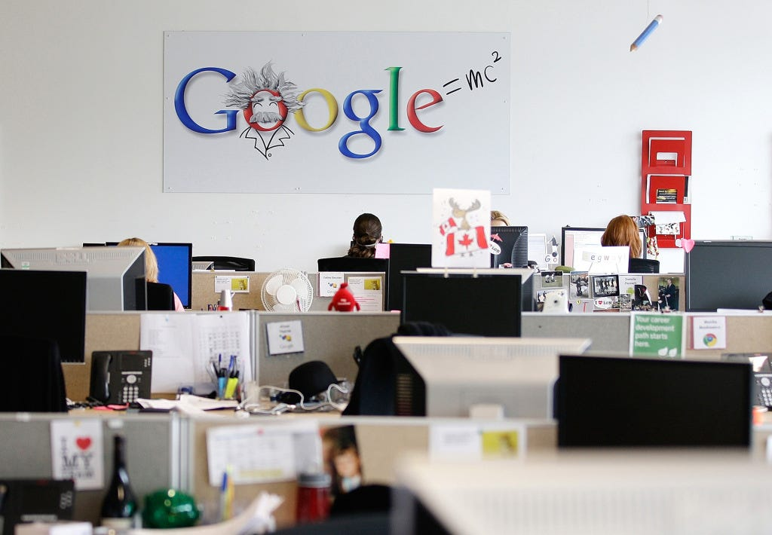
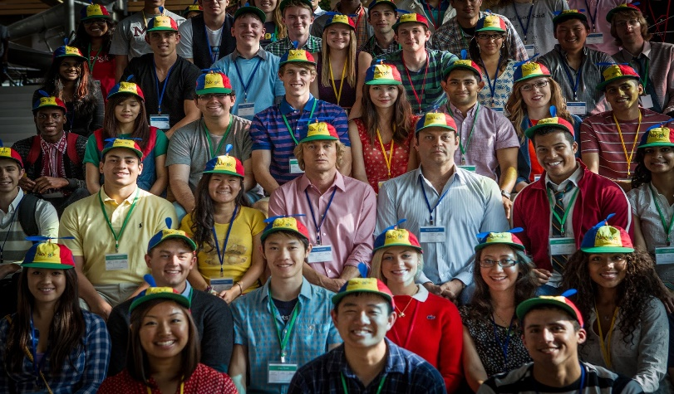
Diversity and Inclusion Initiatives
With the adoption of numerous programs including unconscious bias training, employee resource groups, and inclusive recruiting procedures, Google is dedicated to promoting diversity and inclusion throughout its workforce (Goler, L., Gale, J., & Grant, 2016)
Google wants to build an inclusive workplace that encourages creativity and welcomes a range of viewpoints, which will ultimately improve problem-solving and decision-making techniques. To that end, the company is cultivating a diverse staff.

Slide 6
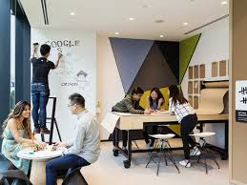

Collaboration and Communication
Google's work environment is centered around collaboration, which is supported by open office areas, interactive brainstorming sessions, and digital communication platforms like Google Meet, Google Chat, and Google Workspace.
A culture of teamwork and knowledge sharing is fostered by the company's emphasis on clear and effective communication channels, which facilitate smooth collaboration among staff (Schmidt, E., & Rosenberg, J, 2014)

Slide 7

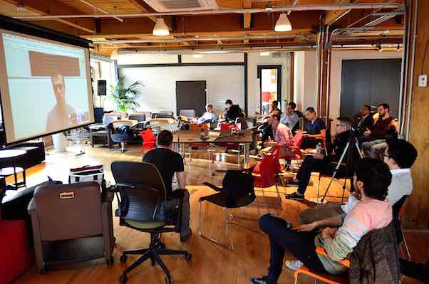
Corporate Social Responsibility (CSR) Efforts
Initiatives centered on education, sustainability, and technological access that seek to improve society demonstrate Google's dedication to corporate social responsibility.
Google is committed to making a positive impact on the world, and as such, it supports a range of philanthropic programs through Google.org, including those that focus on education, environmental sustainability, and the moral application of technology (Auletta.K, 2019)

Slide 8
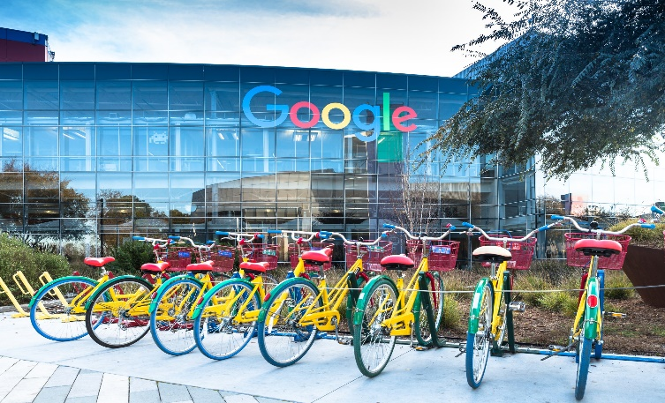
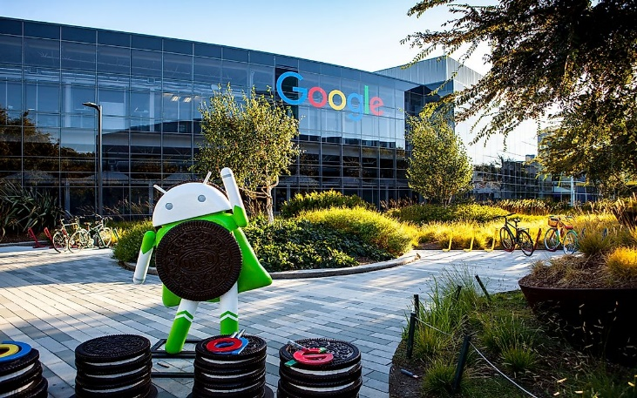
Conclusion
The culture at Google is distinguished by its unwavering focus on innovation, prioritization of employee well-being, dedication to diversity and inclusivity, encouragement of teamwork and communication, and commitment to corporate the social responsibility.
In addition to contributing to Google's success, this special fusion of values has cemented the company's leadership position in the technology sector and encouraged businesses everywhere to value a similar inclusive and high-achieving culture.

Slide 9
References:
Auletta, K. (2019). Googled: The end of the world as we know it. Penguin.
Pellegrino, J. W. (2018). Google Inc.'s Organizational Culture Characteristics (An Analysis). Panmore Institute.
Schmidt, E., & Rosenberg, J. (2014). How Google works. Grand Central Publishing.
Dillon, A. (2019). Innovation at Google: The Structure and Processes that Make Google an Innovative Company. Kogan Page.
Harter, J. K., Schmidt, F. L., & Hayes, T. L. (2020). Business-unit-level relationship between employee satisfaction, employee engagement, and business outcomes: A meta-analysis. Journal of Applied Psychology, 87(2), 268.
Goler, L., Gale, J., & Grant, A. (2016). Let’s not kill performance evaluations yet. Harvard Business Review, 94(11), 90-94.
Williams, K. Y., & O'Reilly, C. A. (2019). Demography and diversity in organizations: A review of 40 years of research. Research in Organizational Behavior, 20, 77-140.
Gittell, J. H. (2013). The Southwest Airlines way: Using the power of relationships to achieve high performance. McGraw-Hill.

