Slide 1
Customer Relationship Management in John Lewis (CRM)
Koyrul Meah:1705602, Asma Chowdhury: 1704999, Monsur Ali: 1705640, Samad Uddin: 1710009

Slide 2
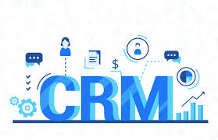
Customer Relationship Management
It is a combination of practices, strategies and technologies.
Companies use this to manage and analyse customer interactions and data.
The goal is to improve customer service relationship and assisting in customer retention.
Sales growth will increase for the company.
(Salesforce, 2019).

Slide 3
Customer Relationship Management at John Lewis and Partners
John Lewis in-store staff have expertise in customer relationship management.
This is the companies strongest selling point.
The partners are the people that foster a sense of authority and trustworthiness that customers cannot resist.
(Techwalla, 2019)

Slide 4
What are the benefits of Customer Relationship Management?
Improved informational organisation.
CRM for enhanced communication.
CRM improves customer service.
Customers are satisfied.
Increased sales growth.
(Forshew, 2018)

Slide 5
What are the drawbacks of Customer Relationship Management?
Customer Records and Data loss.
The misunderstanding of customer relationship management.
Customers sometimes feel exploited by companies.
CRM schemes can be over used by organisations.
NETFLIX had problems with CRM.
(Staff, 2018).

Slide 6
JLP and the loyalty ladder
John Lewis uses the loyalty ladder to retain its old customers and gain new ones through:
  The product advertisements
  Showrooms
  Launch events
  Website

Slide 7
Gaining Clients
The potential buyers are swooped off their feet through:
  Great marketing skills
  Products
    Visually attractive
    Full of features
    Quality
    Reliability

Slide 8
Customer Retention
John Lewis retains these customers through:
  Various such eye catching showrooms, promotions and advertisements.
  Product quality is more than enough to drive and bring back customers
  Gain more customers through recommendations.
(John Lewis and Partnership , 2019)

Slide 9
Drawback
The only drawback to their schemes is that they seem to
Attract people who are in a higher middle class financial range.
Middle aged people as a customer base.
Demographic has lowered the chance for younger people
(UKessays, 2016)

Slide 10
Re-adjusting
They can easily change this by adjusting their products and services to satisfy a bigger range of audience
Youngsters
Tech products
Musical instruments
Gaming accessories
Pop Culture related products

Slide 11
Re-adjusting (Contd.)
Package Buyers
  Camping Kits
  Cooking Kits
  Baking Kits
  Art products bundles
Deal Hunters
  Discounted prices
  Buy one get one free schemes
  Sales

Slide 12
What john Lewis do to support/develop its CRM system
John Lewis support the CRM system by creating a continuous customer experience across online and offline and gaining a deeper understanding of customer preference.
John Lewis try to keep track on the shopping experience of customers, knowing what they buy or what customers might like to buy.
John Lewis provides a more personal service in the form of relevant, curated content and access to exclusive events and rewards.
John Lewis have launched an omnichannel programme, which means that the content covers everything from personalised emails, containing products and services that john lewis believe will inspire our customers based on what we know about them, to exclusive and experiential events such as the recent 150th anniversary exhibition, and vouchers to reward and enhance the in-store shopping experience.”
(Smith, 2014).

Slide 13
JLab
John Lewis are looking for ways to better knit together the shopping experience in stores and online and for new ways to communicate with customers. customers value being able to shop with John Lewis by phone, in shops and online and anything which enhances or simplifies that experience .
John Lewis is backing a Silicon Roundabout-style technology incubator to be called JLab to develop the next big thing for its stores.
The JLAB is designed to find new talent and exciting technology which applicants are invited to apply online.
JLab will select a winner and back it with a £50,000 investment. If the project is a success the idea will be introduced across its 40 stores.
(Wood, 2013).

Slide 14
Product
John Lewis is one of the leading premium retail stores based out of UK. John Lewis provides an unparallel range of services from personal styling and nursery advice to appliance installation and technical support.
The retail stores provide several services as a part of their marketing mix. John Lewis provide products belonging to various sectors like Home and Design, Electricals and Technology, Gifts and Celebrations, Fashion and Beauty and Baby and Child.
In the home furnishings assortment, they have their own brand’s duvets, pillows and furnishing fabrics made in their Lancashire mill in Herbert Parkinson
This supports the relationship as john Lewis are proving all different range of products to keep the customers and have a good relationship, therefore customers wont need to go elsewhere for products as john Lewis have every requirements customers desire.
(John Lewis, 2019)
Notes:
14

Slide 15
People
Being a service brand, John Lewis focuses a lot on its customers and even its workforce. They ensure that the customers have a good shopping experience whenever they come to the John Lewis store. More than 38000 employees are a part of the organization. The staff is well trained and store managers ensure that all customer requests are looked into.
This would support the relationship as john Lewis are focused on their potential customers and have a strong connection with the staffs.
The CRM system is being supported as john Lewis are making the use of the information gathered by the system which will continue to enhance their system
(John Lewis, 2019)

Slide 16
Promotion
John Lewis adopts innovative promotional strategies for its products and has creatively used the occasions of festivals for developing special advertisements during the year end seasons. Since past almost ten years, every year consumers long for the creative advertisements that the company makes every year during Christmas and exploit the emotional approach to appeal.
Some of their well-known campaigns are Buster the Boxer, The Journey, The Bear and the Hare, Monty the Penguin and The Long Wait.
These Christmas campaigns all help deliver market-leading commercial performance and achieve a place in popular culture.
They have generated millions of views of YouTube, won numerous polls at the UK’s favourite ads and The Long Wait 'campaign has even become an official subject on the primary schools’ teaching curriculum. John Lewis has also stayed in line with the new age promotional tools such as joint promotion with other product/services example they entice customers to buy more products/services covered under the programme and thereby attain a loyalty status which allows them for certain amount of free purchase.
This supports the relationship as they are striving to benefit their customers with numerous types of promotion only to create a long term loyal with customers.
(John Lewis, 2019)

Slide 17
Porters Five Forces
The product john Lewis sell under their brand are high quality and value. And to ensure john Lewis offer the most competitive prices, they regularly benchmark all these products against others in the market.
John Lewis have a price-monitoring team proactively checks the prices of branded products of their competitors every day, including online and during sales.
If john Lewis find their competitors are selling the same individual product, sold with the same service conditions, at a lower price, john Lewis will meet that price in their shops and at johnlewis.com. john Lewis don’t expect you to find a lower price elsewhere.
The high-quality products with reasonable price will keep the customer relationship strong as john Lewis will be aware of the type of products customers are interested in.
In different location john Lewis's prices would be different. For example stores in London, the price for a product would be £60 and in Cardiff would be £50. this is because of the market value as London have a higher market value than Cardiff.

Slide 18
McKinsey’s 7s model
Strategy of john Lewis is the vision through customer recognition. Its all about meeting the requirements of the customers and satisfying them. This would improve the CRM system as john Lewis as the customers would be satisfied with their shopping experience and john Lewis would continue to spread their reputation as more customers will be involved with the CRM
Flat Structure of john Lewis would be ideal. John Lewis would keep good communication with customers and suppliers. This would improve the CRM system as john Lewis would understand the customers needs in depth and provide the customers with the right products.
System refers to the general flow of information between the organisation and suppliers. This would benefit the CRM system as they will have the correct information of customers knowing where and what they are looking for.
Staff represents the background and culture of john Lewis. They are well trained and know how to treat the customers. for example this would benefit the CRM system as they will meet the requirements of the customers accordingly improving the CRM system.

Slide 19
Skills are the unique and distinct abilities and specialities of individuals and the capabilities on which an organisation is based on. Example, the fundamental skills that give them an edge in the competition.
Style concerns the behaviours of the management and how the communication of values and priorities take place in the organisation of john Lewis .
John Lewis is benefitting from the CRM system as they know what customers interest are and what their dislikes are. Therefore the CRM system is a huge success for the company.
The customers are also benefiting from the CRM system as john Lewis are providing the right quality products at a good price.
The suppliers are benefiting from the CRM system as they are able to sell their goods to the company and this would maintain a long term relationship.
(Kulpa, 2017).

Slide 20

Benefits of John Lewis CRM
In 2013 John Lewis introduced their CRM system ‘my John Lewis’ programme. The aim of the programme is to establish a seamless experience for their customers to better understand customer preferences such as who they are, what they buy, and what they might like to buy in the future. (John Lewis & Partners, 2013).
This system will assist them to provide a personalised service in the form of exclusive events and rewards for the customers.
Steve Sweeney the General manager of marketing operations stated that the brand has made a major change to its CRM strategy by operating through an agency rather than managing it internally. (Smith, 2014).

Slide 21

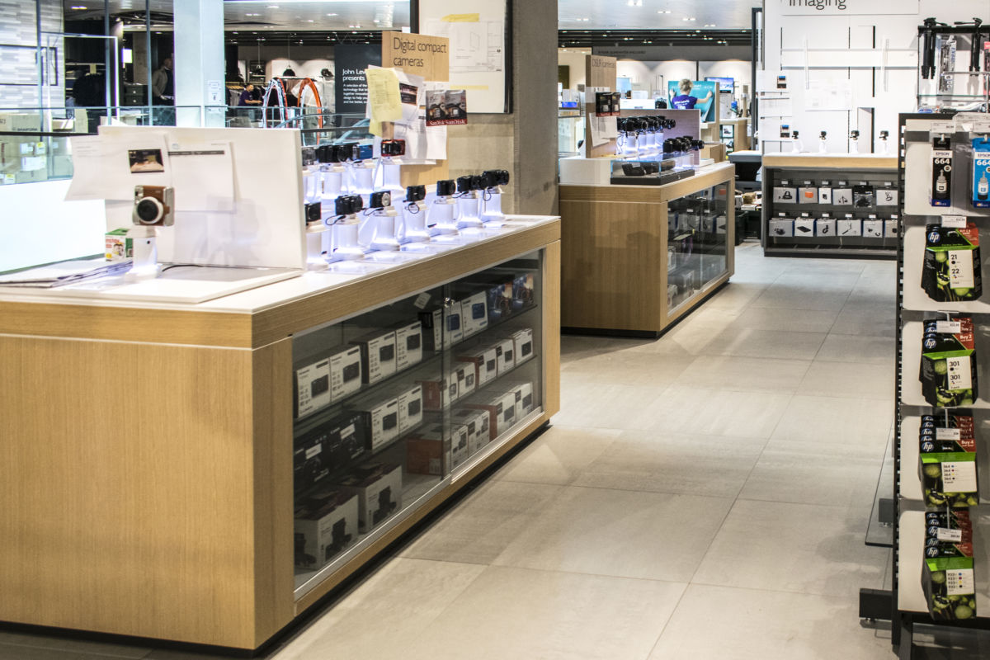
Drawbacks to John Lewis CRM system
John Lewis had a drawback on their online security system. In 2017 according to Giuseppe Sollazzo he purchased a camera from John Lewis website. And realised that John Lewis online site was hacked. (Sollazzo, 2017).
The IT system in John Lewis is so old that it makes it impossible to deal with certain problems.
There is constant pressure on employees to meet their targets even if that means they have to get the complaining customers off the phone where the their problem has been resolved or not. (Collinson, 2015).

Slide 22
SWOT Analysis on John Lewis
Strengths John Lewis has a brand name which holds a large number of loyal customers. Encourage loyalty and good customer service. Personalisation and built-in customer feedbacks. | Weaknesses They lack competitive advantages Lacks of experience to expand the business internationally. Competition from Tesco, Asda as they are more affordable.
Opportunities New product line could have been developed for younger demographics. Meet the rising demand of customer by focusing on providing more healthy food options. | Threats The current age group customer for John Lewis is over 40’s New technologies developed by the competitors. Rigorous laws and regulations. Brexit

Slide 23
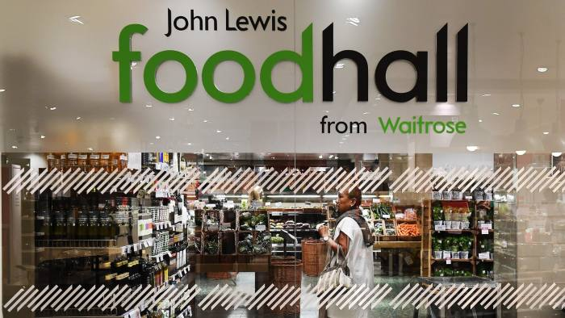
Opportunities to improve CRM system
John Lewis has the opportunities to scope to enter new markets.
In this current day people like to eat healthy and live longer where John Lewis has an great opportunity to attract new customers by introducing more healthier foods.
John Lewis has an great opportunity to expand the business internationally where there are rising living standards.

Slide 24




Recommendation
Mostly John Lewis caters for the aged 40 and over customers where they could have introduce new and price matching products with the market such as Tesco, Sainsburys and Asda so that younger generation can afford and feel comfortable to shop there.
Online stores such as Boohoo and Asos mostly cater for younger generation and reach out to influencers which inspire the younger generation. So it is recommended that John Lewis use these tactics and advertise campaigns that involve social influencers to attract younger demographics.

Slide 25

THANK YOU FOR LISTENING
ANY QUESTIONS?

Slide 26
References
Collinson, P. (2015). Has John Lewis lost its way?. [Online]
Available at: https://www.theguardian.com/money/blog/2015/sep/12/has-john-lewis-lost-the-plot-complaints
[Accessed 06 06 2019].
Forshew, A. (2018), ‘My Customer’, [Online]. Available at: https://www.mycustomer.com/experince/engagement/how -will-john-lewis-rebrand-actully-benefit-the-customere
Helgeson, L. (2017), CRM, New Jersey: John Wiley & Sons Inc.
Hobbs, T. (2017), ‘John Lewis: Human interactions are still the Primary Driver of Loyalty’, [Online]. Available at: https://www.marketingweek.com/2017/10/06/john-lewishuman-interactions-still-primary-driver-loyalty/
[Accessed 27 05 2019].
John Lewis & Partners, (2019). Never Knowingly Undersold. [Online]
Available at: https://www.johnlewis.com/customer-services/prices-and-payment/never-knowingly-undersold
[Accessed 05 06 2019].

Slide 27
John Lewis & Partners, (2013). My John Lewis. [Online]
Available at: https://www.johnlewis.com/our-services/my-john-lewis
[Accessed 08 06 2019].
John Lewis and Partners, (2019). Our Business. [Online]
Available at: https://www.johnlewispartnership.co.uk/about.html
[Accessed 09 06 2019].
Kulpa, J. (2017). [Online]
Available at: https://www.forbes.com/sites/forbesagencycouncil/2017/10/24/why-is-customer-relationship-management-so-important/#1b1734537dac
[Accessed 05 06 2019].
Nguyen, B. (2012) ‘The Dark side of customer relationship management: Exploring the underlaying reasons for pitfalls, exploitation and unfairness’, Journal of Database Marketing and customer Strategy Management, 18:1, pp. 56-70.
Sales Force, (2018),’The Six Benefits of CRM’, [Online]. Available at: https://www.salesforce.com/hub/crm/benefitsof-crm/
[Accessed 03 06 2019].

Slide 28
Smith, N. (2014). Customer relationship management (CRM) is gaining momentum. [Online]
Available at: https://www.marketingweek.com/2014/05/28/customer-relationship-management-crm-is-gaining-momentum/
[Accessed 04 06 2019].
Sollazzo, G. (2017). When security checks are not secure at all. [Online]
Available at: https://medium.com/@puntofisso/when-security-checks-are-not-secure-at-all-my-experience-with-john-lewis-is-a-warning-that-we-94c016b42823
[Accessed 06 06 2019].
Staff, (2011), ‘Netflix: Three Things to Learn from Customer Relationship Management Failure’, [Online].
Available at: https://thyblackman.com/2011/10/25/netflix-3-things-to-learnfrom-netflixs-customer-relations-failure/
[Accessed 28 05 2019].
Techwalla, (2019),’The Disadvantages of CRM Systems’, [Online].
Available at: https://www.techwalla.com/articles/the-disadvantages-ofcrm-systems [Accessed 03 06 2019].

Slide 29
UKessays, (2016). John Lewis partnership. [Online]
Available at: https://www.ukessays.com/essays/business/what-is-john-lewis-partnership-business-essays.php#.XPwtkqTzs6y.whatsapp
[Accessed 09 06 2019].
Wood, Z. (2013). John Lewis looks to digital innovation as next big thing in retail. [Online]
Available at: https://www.theguardian.com/business/2014/mar/02/john-lewis-digital-innovation-next-big-thing-retail
[Accessed 04 06 2019].

