Slide 1


Depression: Management of a Long-Term Condition in the UK
Presentation for Mental Health Professionals in the NHS
Module: Community Care and Management of Longer-term Conditions(LCHS7003)
Student Name: Md.Shohel Hossen
Student ID: 2433869
Lecturer: Muhammed Khan

Slide 2
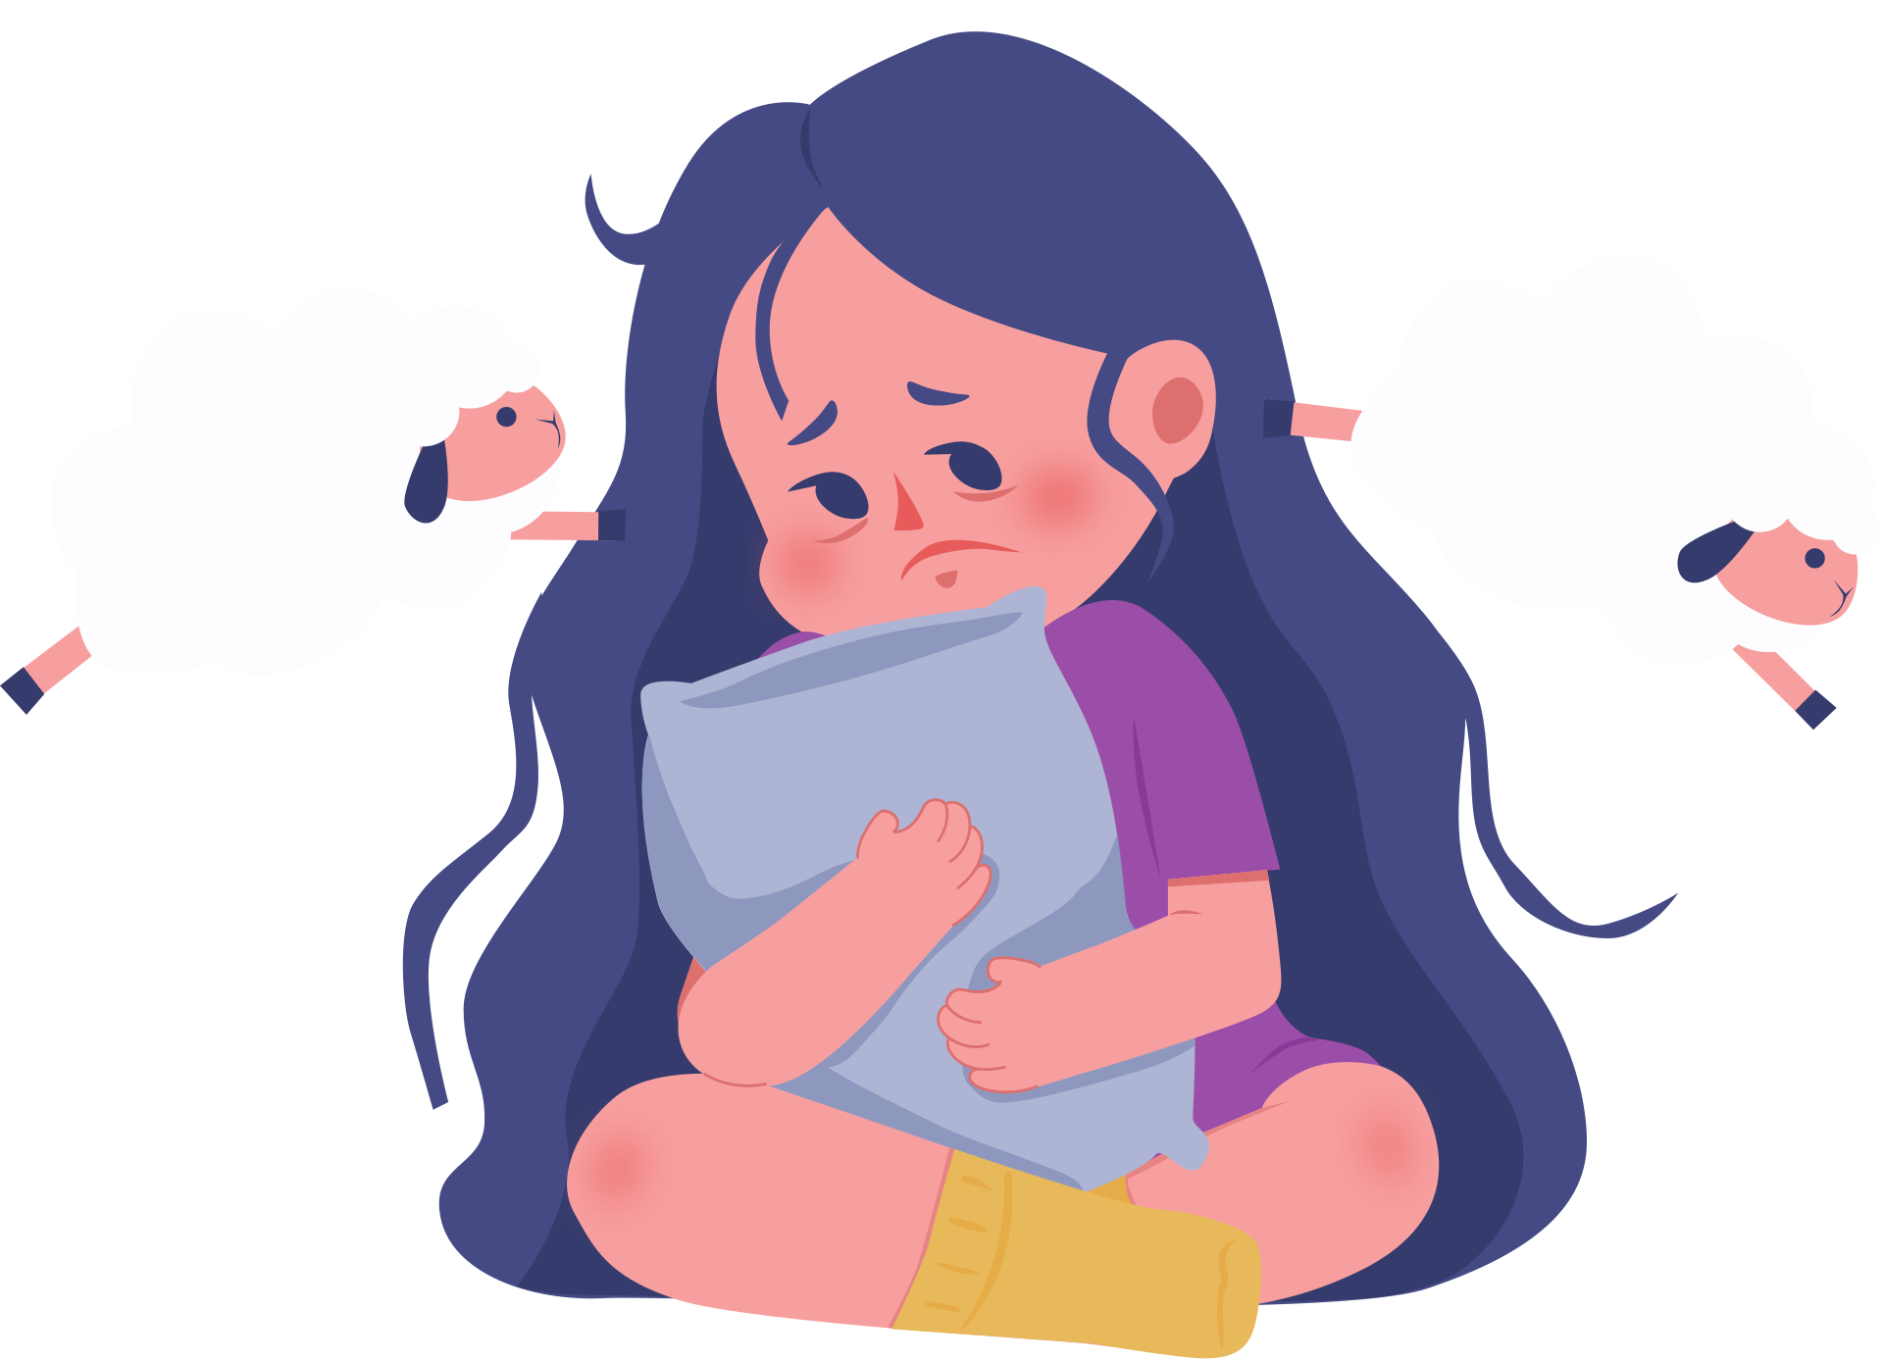
Definition
Depression is defined as a mental disorder characterised by persistent sadness, loss of interest or pleasure (anhedonia), and impaired functioning in daily life, including work, relationships, and self-care (WHO, 2023). It is not a temporary emotional response but a clinically significant condition that affects thoughts, emotions, behavior, and physical health. Depression can present in different severity levels-mild, moderate, or severe-depending on the intensity, duration, and impact of symptoms on functioning.

Slide 3
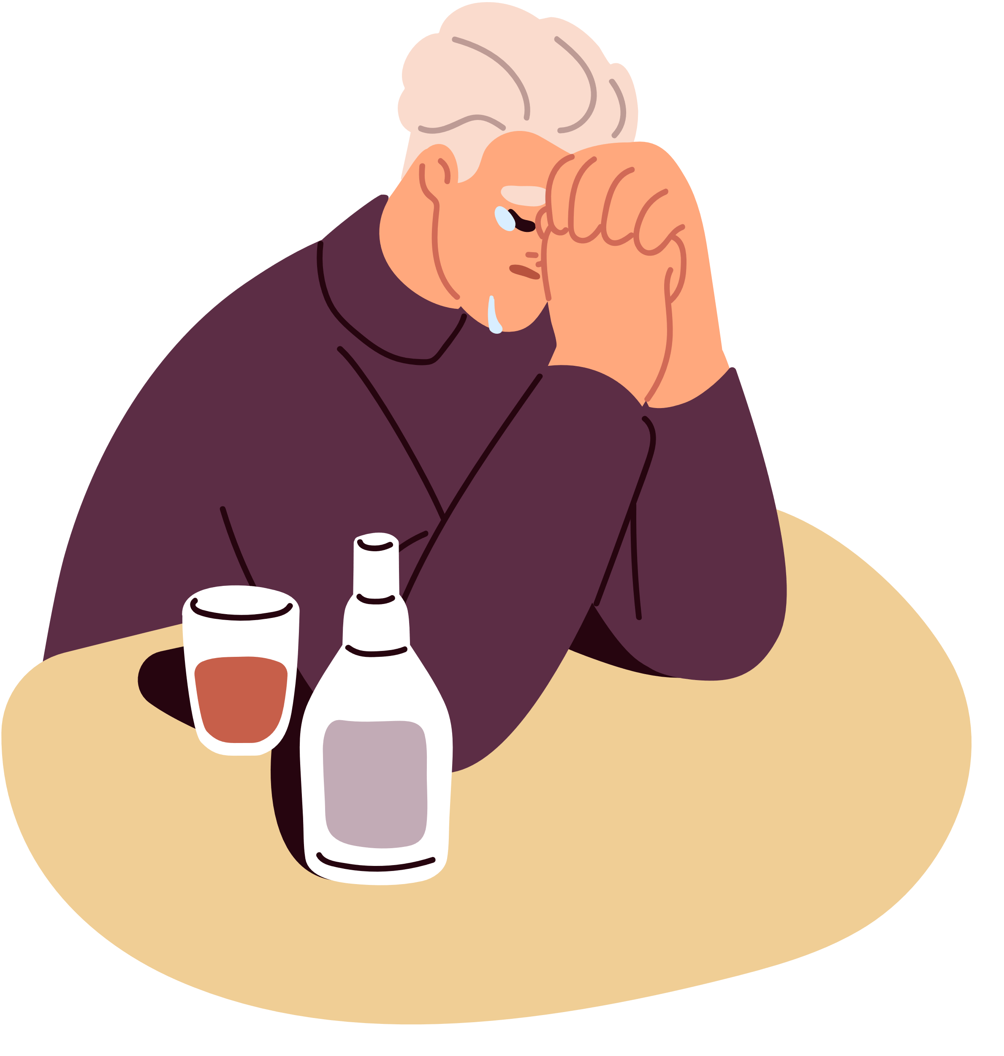
Symptoms
  Persistent low mood
  Loss of interest (anhedonia)
  Sleep disturbances
  Fatigue
  Poor concentration
  Feelings of worthlessness (NICE, 2022)

Slide 4
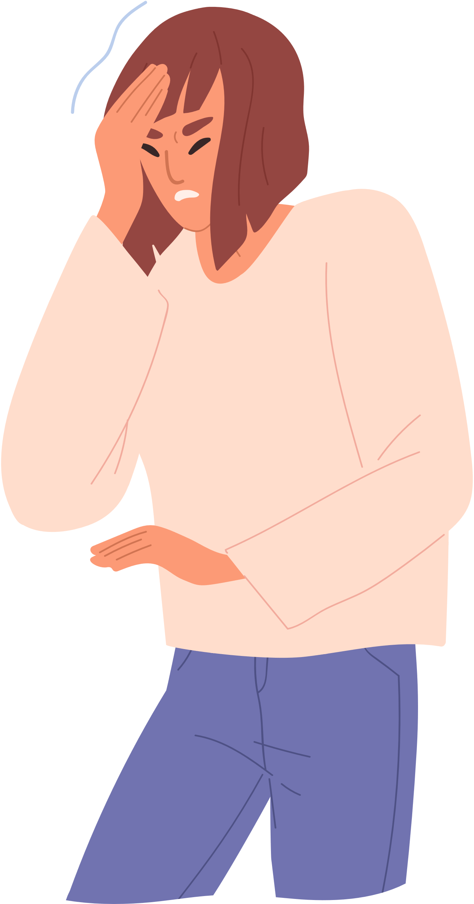
Aetiology (Causes)
  Depression results from a combination of factors:
  Biological (neurotransmitter imbalance)
  Psychological (trauma, stress)
  Social (isolation, poverty)
  (McManus et al., 2021)
  Interaction of these factors increases vulnerability.

Slide 5
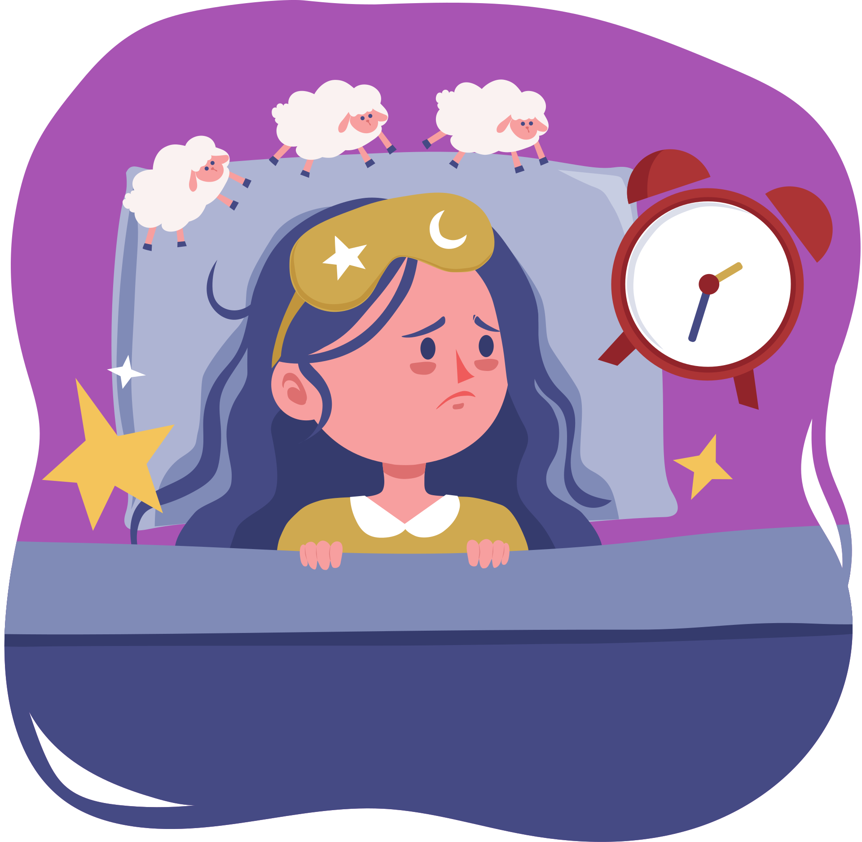
Prevalence
  Around 1 in 6 adults in the UK experience depression symptoms (NHS England, 2023).
  Globally, over 280 million people are affected by depression (WHO, 2023).
  Higher prevalence in women compared to men due to biological and social factors.
  Increased rates among people with chronic physical illnesses and long-term conditions.
  Rising prevalence linked to stress, unemployment, and social inequality.

Slide 6
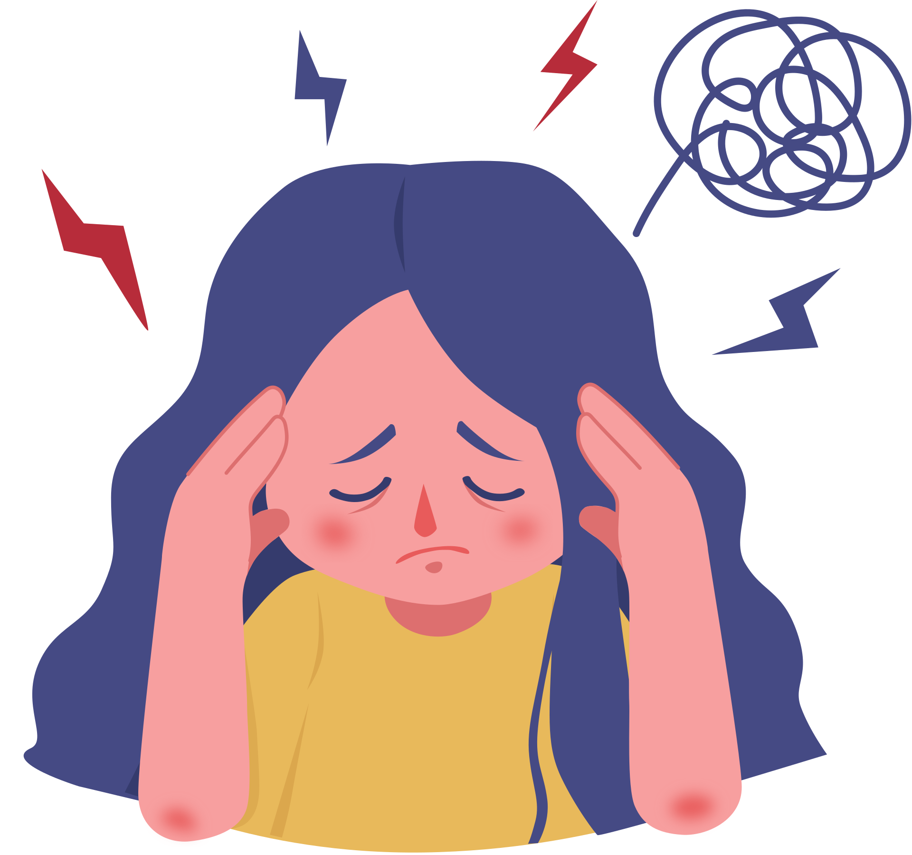
Economic Burden
  Depression increases demand for NHS services, including GP visits, psychological therapy (IAPT services), and hospital admissions.
  It contributes significantly to prescription costs, particularly antidepressant medications (SSRIs and SNRIs).
  Loss of productivity due to absenteeism (time off work) and presenteeism (reduced performance at work).
  Increased reliance on long-term disability support and welfare benefits.Estimated total cost to the UK economy is around £105 billion annually, including healthcare, social care, and lost productivity (OECD, 2021).
  Treatment-related costs include long-term psychotherapy (CBT), medication management, and crisis intervention services.

Slide 7
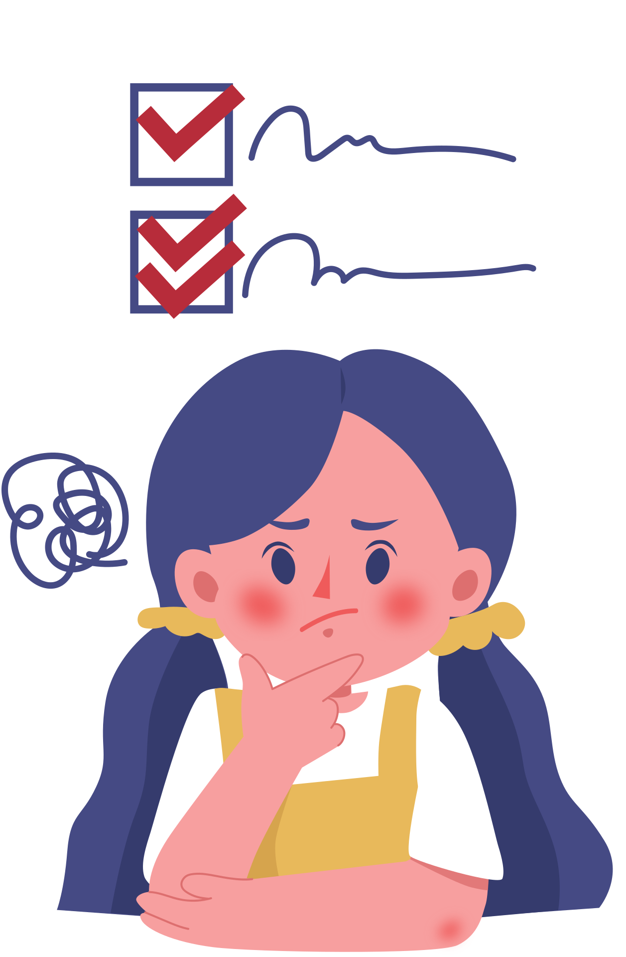
Social Impact
  Family strain due to emotional stress, caregiving burden, and breakdown in communication (PHE, 2022).
  Social isolation caused by withdrawal from friends, work, and community activities.
  Stigma and discrimination, leading to reluctance in seeking help and delayed treatment.
  Reduced quality of life affecting daily functioning, relationships, and personal wellbeing.
  Increased risk of loneliness, which further worsens depressive symptoms and recovery outcomes.
  Negative impact on employment and education participation, limiting social and economic opportunities (PHE, 2022).

Slide 8
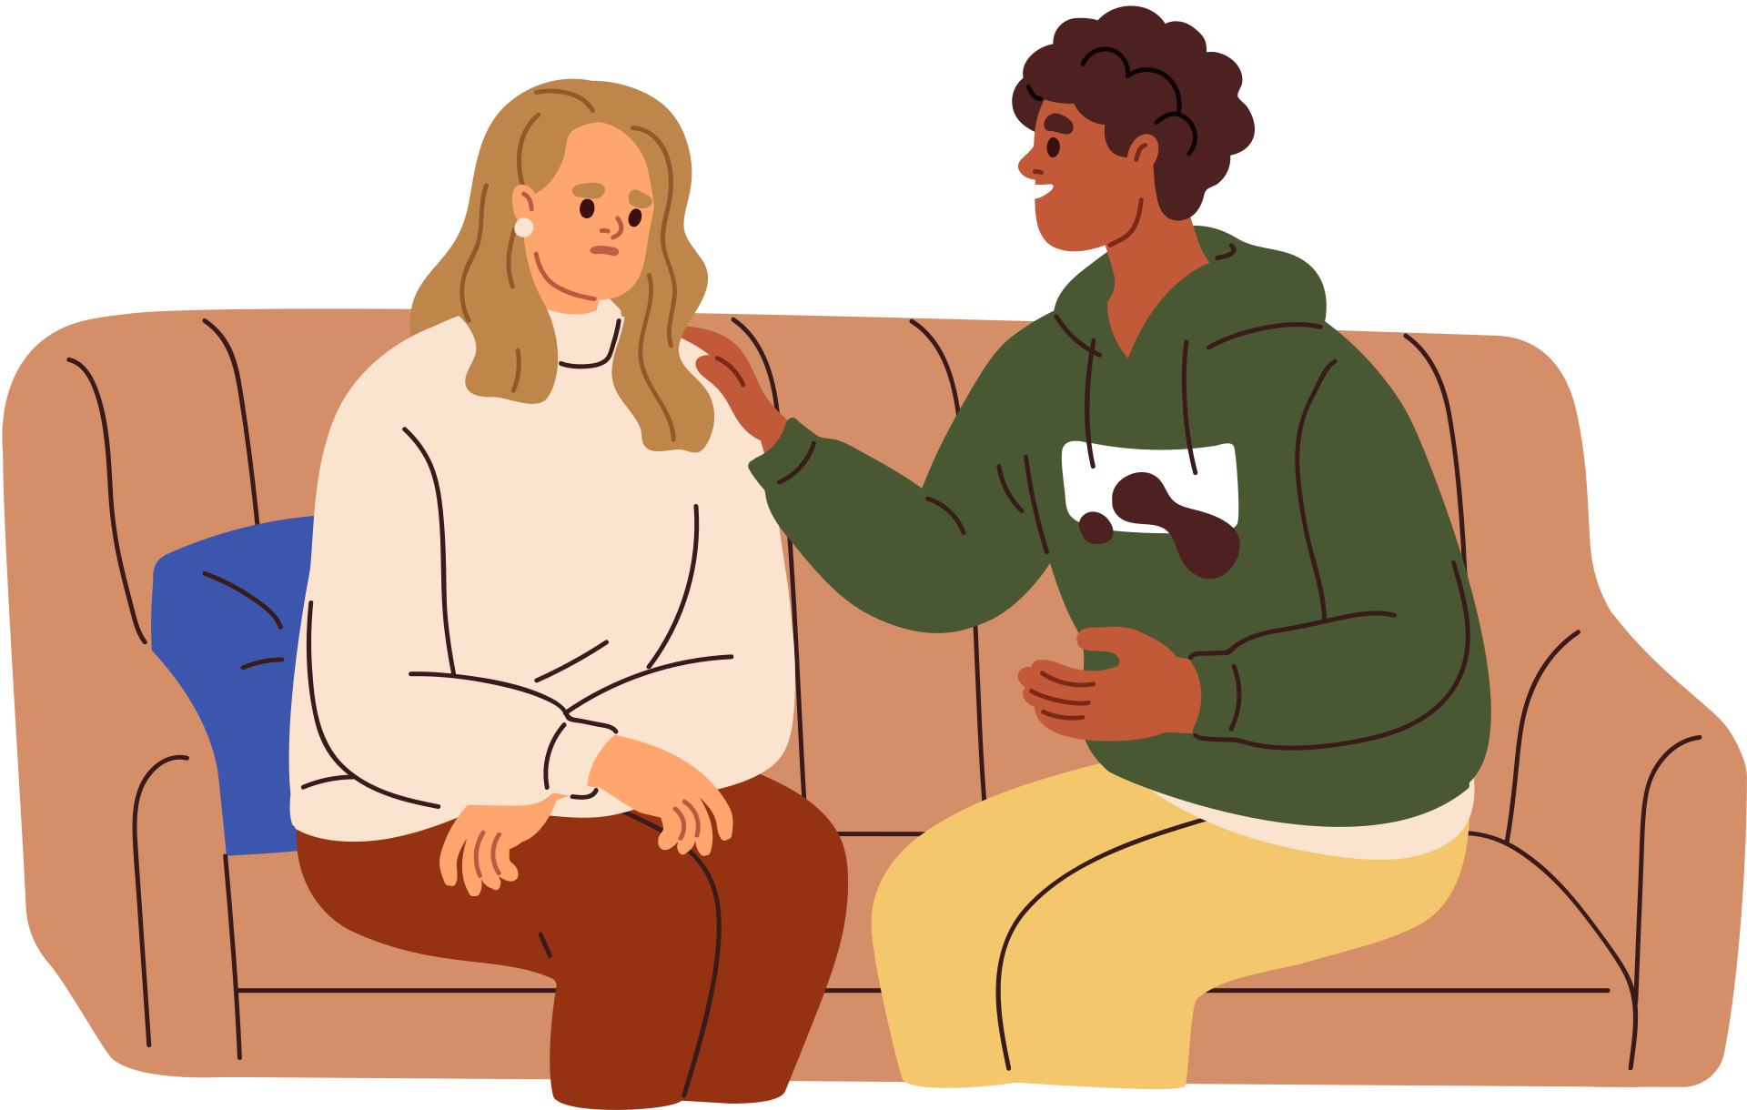
Diagnosis
  Clinical assessment by GP or mental health professional, focusing on symptoms, duration, and functional impact (NICE, 2022).
  Use of standardised tools such as PHQ-9 to assess severity and monitor progress over time.
  Assessment of risk, including suicidal ideation and self-harm.
  Medical history review to rule out other conditions (e.g., thyroid disorders).
  Referral pathway: Mild cases are usually managed in primary care with GP support and talking therapies (IAPT/NHS Talking Therapies). Moderate to severe cases are referred to secondary mental health services or community mental health teams for specialist assessment. High-risk patients may require urgent referral to crisis services or psychiatric emergency care.
  Early referral improves outcomes and ensures timely access to appropriate treatment services (NICE, 2022).

Slide 9

Initial Assessment
  Includes:
  Severity classification
  Risk assessment
  Patient history
  Important for treatment planning (NICE, 2022)

Slide 10
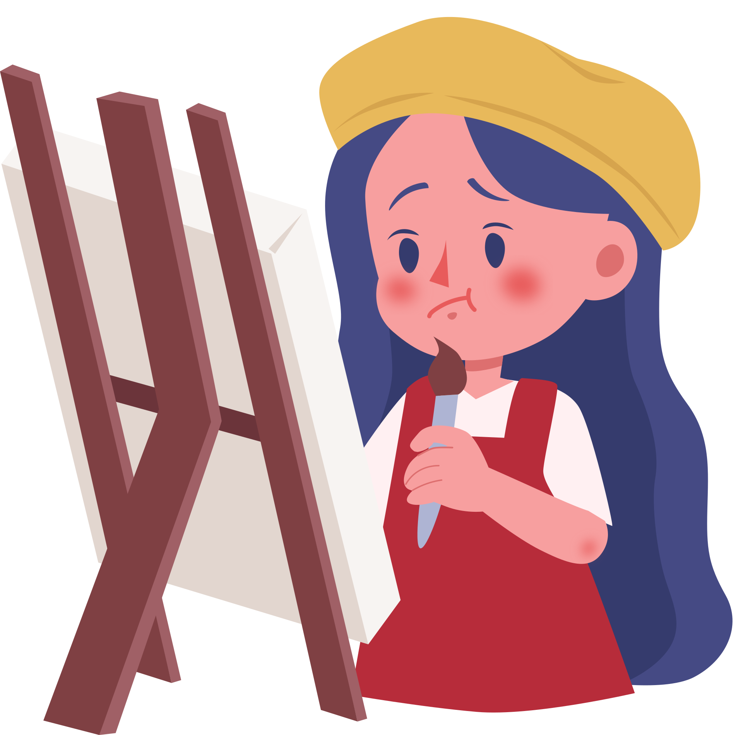
UK Guidelines Models and Frameworks
  Depression management in the UK follows the (NICE, 2022) stepped-care model, ensuring treatment is matched to severity.
  Step 1: Recognition, assessment, psychoeducation, and active monitoring in primary care.
  Step 2: Low-intensity psychological interventions for mild depression, such as guided self-help, computerised CBT, and group-based interventions.
  Step 3: High-intensity psychological therapies (e.g., CBT, IPT) and/or antidepressant medication (SSRIs) for moderate to severe depression.
  Step 4: Complex and severe cases may require specialist mental health services, combined treatments, and crisis intervention.
  Step 5: Inpatient care or intensive community treatment for high-risk patients, including those with suicidal risk or treatment-resistant depression.The model promotes personalised, evidence-based, and least restrictive care, improving recovery outcomes and efficient use of NHS resources (NICE, 2022).

Slide 11

Treatment Options
  Pharmacological Treatment: SSRIs, SNRIs, atypical antidepressants
  Psychotherapy: Cognitive Behavioral Therapy (CBT), Interpersonal Therapy (IPT), Mindfulness-Based Therapy
  Lifestyle Interventions: Exercise, healthy nutrition, adequate sleep, stress management
  Complementary & Alternative Approaches: Yoga, meditation, light therapy
  Combined Approach: Medication + therapy + lifestyle support(NHS England, 2023)

Slide 12
Comorbidity
  Depression commonly coexists with anxiety disorders, increasing severity of symptoms and reducing treatment effectiveness (Kessler et al., 2021).
  Substance misuse (alcohol or drugs) is frequently used as a coping mechanism, but it worsens depression and complicates recovery.
  Chronic physical illnesses such as diabetes, cardiovascular disease, and COPD are strongly linked with higher rates of depression.
  Comorbidity leads to poorer treatment outcomes, increased healthcare use, and longer recovery time.
  It increases the risk of hospitalization and reduces adherence to treatment plans.I
  integrated care approaches are required to manage both mental and physical health conditions together effectively (Kessler et al., 2021; NICE, 2022).

Slide 13
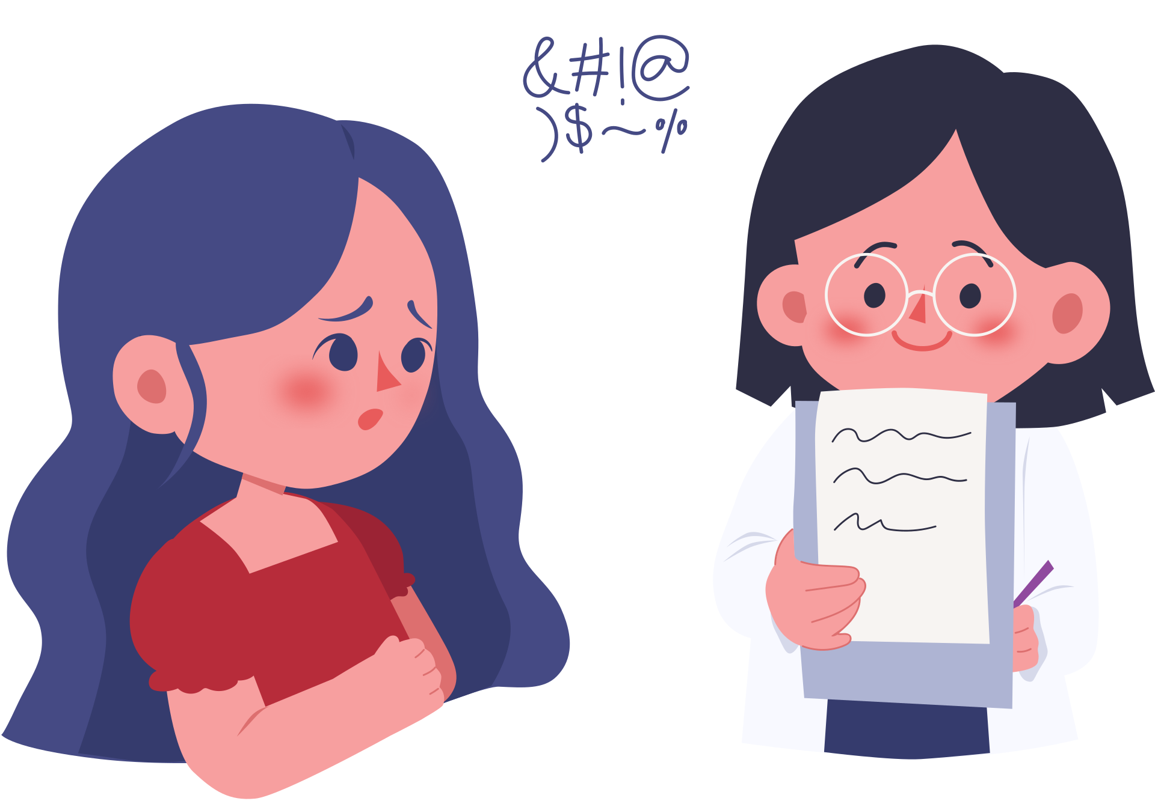
Prevention
  Early intervention
  Mental health awareness
  Keep a consistent sleep schedule
  Focus on whole foods(vegetable, fruits, fish, nuts)
  Maintain friendships and family contact
  Try mindfulness or meditation
  Lifestyle changes (exercise, social support)
  (PHE, 2022)

Slide 14
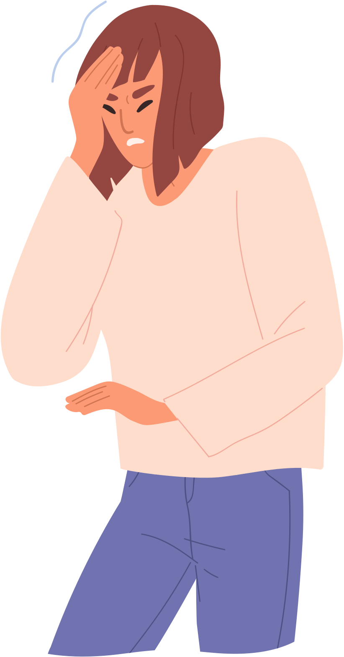
Skills, Values, Behaviour
  Healthcare professionals require:
  Empathy → builds trust
  Communication → improves engagement
  Cultural competence → reduces inequality
  Strength: Improves patient-centred care
  Limitation: Workforce shortages and time constraints
  (NHS England, 2023)

Slide 15

The Depression Management Personalised Care Model (6 Components)
1. Shared Decision-Making
4. Social Prescribing and Community Support
GP, psychologist, and community mental health nurse coordinate treatment and follow-ups.
GP and patient jointly decide treatment plan (e.g., CBT + SSRI)..
2. Personalised Care and Support Planning
5. Supported Self-Management
.
Patient referred to NHS Talking Therapies for structured CBT sessions.
Personalised Care Model
Example: A 35-year-old patient diagnosed with moderate depression in UK primary care
Care plan tailored to patient’s symptoms, work stress, and family responsibilities.
3. Enabling Choice
6. Personal Health Budgets and Integrated Funding
Patient is guided to track mood, identify triggers, and use coping strategies daily.
Weekly/bi-weekly follow-up to assess PHQ-9 scores and adjust treatment if needed (NHS England, 2023).
Overall Purpose: These six components improve depression outcomes by making care more holistic, empowering, and responsive to individual needs (NHS England, 2023).

Slide 16
Recommendation
  The personalised care model should be integrated into depression management as it promotes holistic, patient-centred care and improves long-term outcomes. However, effective implementation requires investment in workforce training and equitable service access.

Slide 17
References
BMA (2022) Mental health workforce report. Available at: https://www.bma.org.uk/ (Accessed: 2026-04-14).
Coulter, A. (2022) Personalised care in practice. Available at: https://www.kingsfund.org.uk/ (Accessed: 2026-04-14).
Coulter, A. et al. (2021) Delivering better services through personalised care. Available at: https://www.kingsfund.org.uk (Accessed: 2026-04-14).
Kessler, R.C. et al. (2021) Comorbidity of depression, The Lancet Psychiatry. Available at: https://www.thelancet.com/journals/lanpsy (Accessed: 2026-04-14).
Layard, R. et al. (2021) Mental Health: The New Frontier. Available at: https://cep.lse.ac.uk/ (Accessed: 2026-04-14).
McManus, S. et al. (2021) Mental Health of Adults in England. Available at: https://digital.nhs.uk/ (Accessed: 2026-04-14).
Mind (2023) Depression statistics UK. Available at: https://www.mind.org.uk/ (Accessed: 2026-04-14).
NHS England (2023) Adult psychiatric morbidity survey. Available at: https://digital.nhs.uk/ (Accessed: 2026-04-14).
NHS England (2023) Comprehensive model of personalised care. Available at: https://www.england.nhs.uk/personalisedcare/ (Accessed: 2026-04-14).
NHS England (2023) Mental health services statistics. Available at: https://www.england.nhs.uk/mental-health/ (Accessed: 2026-04-14).
NHS England (2023) Personal health budgets guidance. Available at: https://www.england.nhs.uk/personal-health-budgets/ (Accessed: 2026-04-14).
NHS England (2023) Social prescribing framework. Available at: https://www.england.nhs.uk/ (Accessed: 2026-04-14).
NICE (2021) Self-management support guidance. Available at: https://www.nice.org.uk/ (Accessed: 2026-04-14).
NICE (2022) Antidepressant prescribing guidance. Available at: https://www.nice.org.uk/ (Accessed: 2026-04-14).
NICE (2022) Common mental health disorders. Available at: https://www.nice.org.uk/ (Accessed: 2026-04-14).

Slide 18
16.NICE (2022) Depression in adults: treatment and management (NG222). Available at: https://www.nice.org.uk/guidance/ng222 (Accessed: 2026-04-14).
17.OECD (2021) A New Benchmark for Mental Health Systems. Available at: https://www.oecd.org/health/mental-health.htm (Accessed: 2026-04-14).
18.Office for National Statistics (ONS) (2022) Wellbeing statistics UK. Available at: https://www.ons.gov.uk/ (Accessed: 2026-04-14).
19.Office for National Statistics (ONS) (2023) Mental health trends UK. Available at: https://www.ons.gov.uk/ (Accessed: 2026-04-14).
20.Patel, V. et al. (2022) Global mental health, The Lancet. Available at: https://www.thelancet.com/ (Accessed: 2026-04-14).
21.Public Health England (2021) Preventing depression. Available at: https://www.gov.uk/ (Accessed: 2026-04-14).
22.Public Health England (2022) Health inequalities in mental health. Available at: https://fingertips.phe.org.uk/ (Accessed: 2026-04-14).
23.Public Health England (2022) Mental health and wellbeing profile. Available at: https://fingertips.phe.org.uk/ (Accessed: 2026-04-14).
24.Richards, D. (2021) CBT effectiveness, British Journal of Psychiatry. Available at: https://www.cambridge.org/core/journals/the-british-journal-of-psychiatry (Accessed: 2026-04-14).
25.Royal College of Psychiatrists (2022) Depression overview. Available at: https://www.rcpsych.ac.uk/ (Accessed: 2026-04-14).
26.Torous, J. et al. (2021) Digital mental health, World Psychiatry. Available at: https://onlinelibrary.wiley.com/journal/20515545 (Accessed: 2026-04-14).
27.WHO (2021) Mental health atlas. Available at: https://www.who.int/ (Accessed: 2026-04-14).
28.WHO (2022) World mental health report. Available at: https://www.who.int/ (Accessed: 2026-04-14).
29.WHO (2023) Depression fact sheet. Available at: https://www.who.int/news-room/fact-sheets/detail/depression (Accessed: 2026-04-14).
30.Layard, R. et al. (2021) Mental Health: The New Frontier. Available at: https://cep.lse.ac.uk/ (Accessed: 2026-04-14).

