Slide 1


Name: Andreea Mirea
Ad Student: 2523016
Module Code: LCHS4009
Module: Professional Development within Health and Social Care
Lecturer: Dr Kal Alnababtah

Slide 2

Chosen career: Childcare Worker
I aspire to pursue a career as a Childcare Worker because I am interested in supporting children's development, wellbeing and learning. The role involves providing safe, inclusive and stimulating environments where children can develop socially, emotionally, physically and cognitively.
Childcare practitioners must follow the Early Years Foundation Stage (EYFS), which establishes standards for children's learning, development, health and safeguarding (Department for Education, 2024).

Slide 3
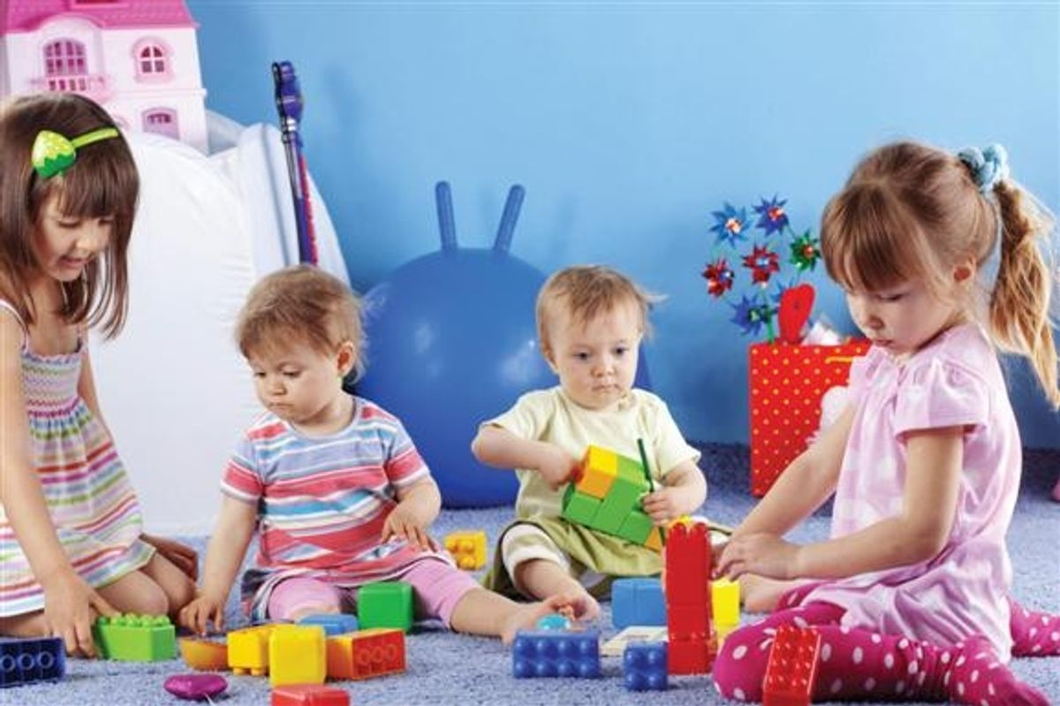
Current vacancy: Chaldcare Worker – Dudley
Care Worker by Austin Dean Healthcare Recruitment in DY5, Brettell Lane, Dudley Ref: 225647868
A current Chaldcare vacancy requires candidates to demonstrate appropriate childcare knowledge, effective communication, teamwork and a commitment to children's welfare and to supporting children across different age groups.
The advert demonstrates that childcare practitioners require both professional competence and interpersonal skills as stated by Willing Care (2026) that includes patience, responsibility and the ability to work collaboratively

Slide 4

SWOT analyses
Strengths
I am empathetic and patient, which can help me establish positive relationships with children.
My communication skills enable me to interact appropriately with children, colleagues and parents.
Weaknesses
I have limited professional experience within a nursery setting.
My knowledge of safeguarding procedures requires further development.
Opportunities
Obtain a relevant childcare qualification.
Gain practical experience through volunteering or work placement.
Competition for childcare employment.
Threats
Limited experience compared with other applicants.
Emotional and physical demands of childcare.
The significant responsibility associated with children's safety and safeguarding.

Slide 5

Overcoming Weaknesses and Threats
I can use my existing strengths to address my weaknesses and minimise potential threats.
For example, my patience and empathy can help me develop practical experience by supporting children who may be anxious or unsettled.Furthermore, my willingness to learn can help me improve my safeguarding knowledge by completing relevant training and learning from experienced practitioners.

Slide 6
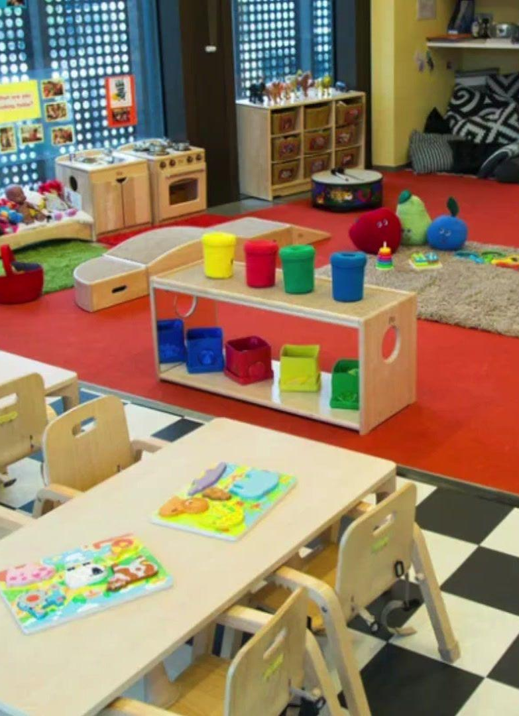
Opportunities and Career Development
Several opportunities can support my progression towards a childcare career.
I can utilise my communication, creativity, patience and willingness to learn to maximise these opportunities.
In the longer term, gaining qualifications and experience could provide opportunities for progression to positions such as Childcare Worker

Slide 7
Conclusion
Overall, my personal qualities are compatible with the requirements of a Childcare Worker. My principal strengths include empathy, patience, communication, creativity and teamwork. Although I need to develop my professional experience and safeguarding knowledge, these areas can be addressed through education.
By strategically applying my strengths and taking advantage of available training and employment opportunities, I can enhance my professional competence and progress towards a successful career in childcare.

Slide 8
Reference
Department for Education (2024) Early Years Foundation Stage Statutory Framework (EYFS). [online] GOV.UK. Available at: https://www.gov.uk/government/publications/early-years-foundation-stage-framework--2
Education.gov.uk (2026) Help for early years providers : Safeguarding. [online] Available at: https://help-for-early-years-providers.education.gov.uk/health-and-wellbeing/safeguarding
Apply job Care Worker by Austin Dean Healthcare Recruitment in DY5, Brettell Lane, Dudley Ref: 225647868

