Slide 1
John Mire project
PowerPoint by Lewis Thornton

Slide 2

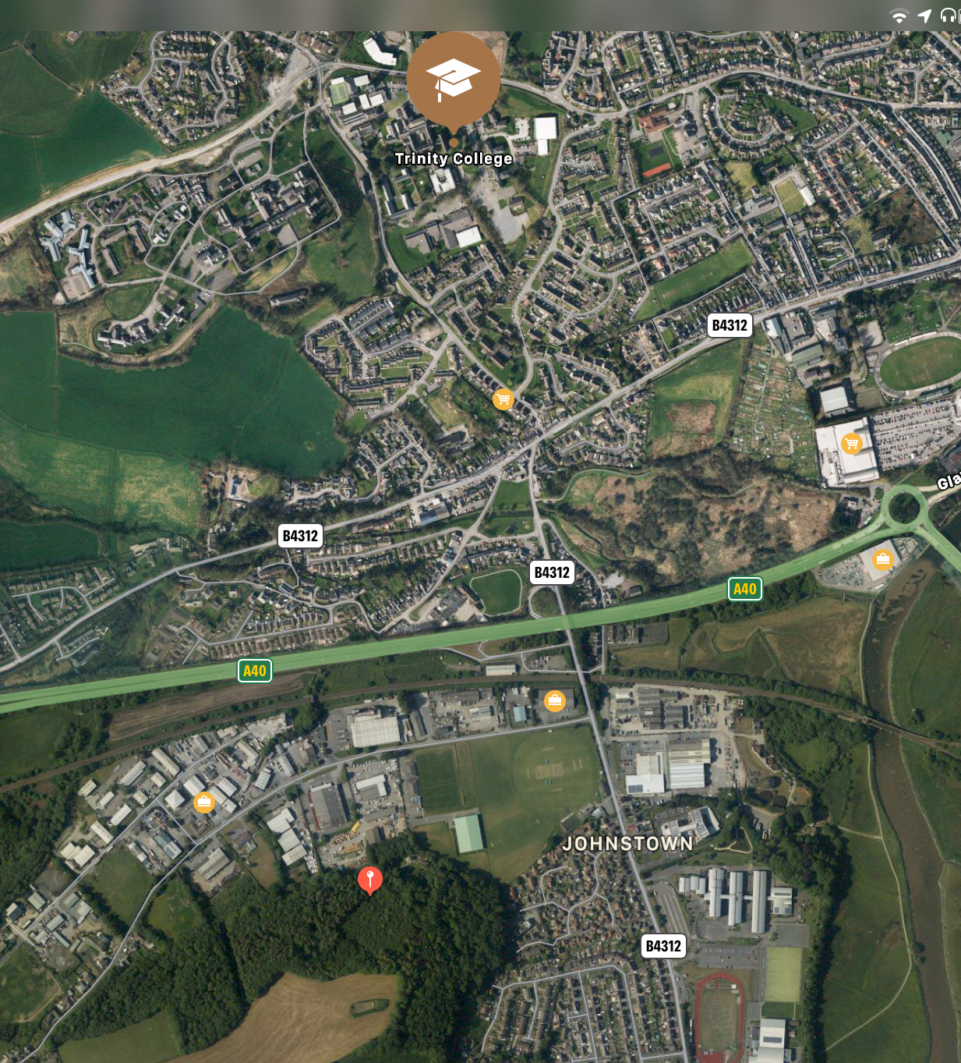
Discovery
This is the university
The place we discovered was a peace of woodland near to the university called Coed Ystrad
We found the woods by looking at the local area online and we saw this large group of trees
After seeing a route we could cycle to get there we went the next day to see what these tress had to offer
This green area is the woods

Slide 3
Discovery
We all like the outdoors for different reasons and that makes us prefer different environments however we felt that since we’ve just moved into this new area we should try and help it the best we can
I enjoy wooded areas as it’s quite a calming area and makes you feel at ease with nature, Coed Ystrad is a wonderful place filled with very old trees and I felt that we should try protect this environment to keep it for others to enjoy just as I did

Slide 4
Exploring
The day after sorting a route to the site we took a flat trip down to these woods whilst there we found wide foot paths will steps that lead all across the woodland across it and up the hills also found in the trees
We also saw a lot of litter among the trees as well as some old bike routes, from this we assumed that people used these woods as social spaces and exercise spots for walking and biking

Slide 5
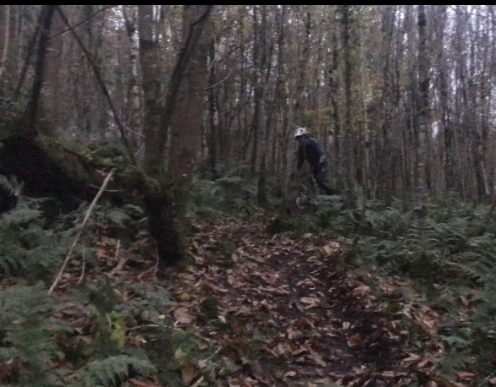
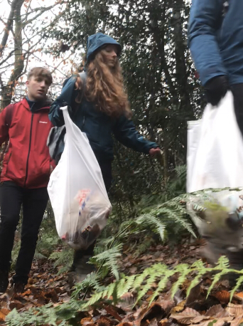
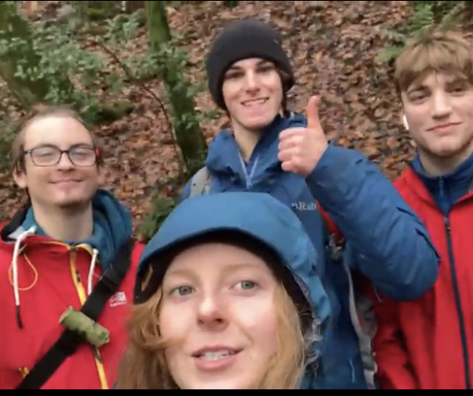
Exploring
The ancient woodland are made up of beech sweet, chestnut and Oak trees with many bush plants such as ferns, hawthorn as well as many flowers we saw snowdrops and the remains of summers blue bells
We also saw many different fungi in the area such as the Daldinia concentrica however I know as ‘king Alfred cake’ and is known for its ability to hold embers for fire starting

Slide 6
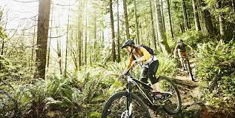
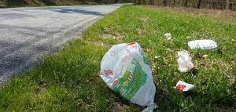
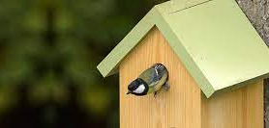
Conservation
We had many plans to help conserve this environment we started by email the land owners seeing if there’s anything they wanted doing on the land
We gave ideas such as making bike routes, due to the fact we saw old ones in the trees
putting up bird houses, which we contacted the head of art and design at the university to see if we could make the bird houses out selfs helping to reduce ecological impacts
and doing a litter sweep, as we saw a lot of litter just dumped in the woods mainly at open spaces which looked to be used as social spots
After we heard back from the land owners (woodland trust) we decided that a litter sweep would be the best route to help the environment
To demonstrate this action I made a video showing our work with a attempt to get more people into he
Ping green spaces, this is linked on the next slide

Slide 7
Social
To show our work of conservation we all filmed the day and made our own video film styles to promote our work with in the woods
The goal of my video was to show the work we had done, how easy it was and to try make a video that was fun to watch
I hope with what I made it shows how easy cleaning a green space is as I feel most people who where littering in the woods didn’t understand the impacts of litter
Here is a link to the video: https://youtu.be/PR3CW63QblI

Slide 8
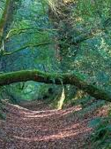
Social
My view on Coed Ystrad is higher after the other steps, I now feel more connected to the woods and after seeing the damage that people have done to the site it makes me wanna help the location more over time
My view on wild places is higher that before taking apart in this project as now I feel that these places should be shown to more people so others can feel that connection to the natural world, what could also be done is creating posters to help show the effects of litter and possibly promote to local schools these effects as these younger people are what we assume are causing the most damaging impact

Slide 9
Social
With this project and my own ambitions makes me wanna do more video projects like this in different environments as it’s started a new interest of mine with video editing, and it helps the environment with this ideas I hope to possibly do a beach/sea clean with kayaks as perosnally I’m more of a water person than a woods one
I had chosen a video and presentation style to share this as I feel like the people who should see this are more available online with sites such as YouTube and using social media to show the effects and how fun it can be to clean up a area especially one local to your self
I added a PowerPoint to the assessment as to get across the more details behind the project as I wanted the video to be more about entertainment to help gain a better interest in cleaning green space

Slide 10
References
Woodland trust (2020) Coed Ystrad available at:https://www.woodlandtrust.org.uk/visiting-woods/woods/coed-ystrad/ accessed on 30th December 2020
Nature first (2016) Daldinia concentrica available at: https://www.first-nature.com/fungi/daldinia-concentrica.php accessed on 30th December 2020

