Slide 1

Contemporary Themes in Management and Leadership
MA Leadership

Slide 2
Contemporary Themes in Management and Leadership
Module and assessment introduction.
Introduction to Transformational and charismatic leadership
Q & A

Slide 3
Module Aims
To develop the necessary skills to undertake an investigation into contemporary themes in management and leadership in a given context by utilizing strategic leadership and management approaches.

Slide 4
LEARNING OUTCOMES
Upon the successful completion of this module, the student should be able to:
Critically analyse leadership and management assumptions and practice in a work context by reflecting on the underlying beliefs and ideas of a contemporary theme in management and leadership.
Design an investigation and implementation plan of relevance to address a contemporary theme in management and leadership and be able to evaluate the results of the investigation.

Slide 5
INDICATIVE CONTENT
Theoretical approaches to management and leadership
Management and leadership in context
Behaviours, roles and capabilities of managers and leaders
The management and leadership process
Issues in management and leadership
Data gathering in a management and leadership role to inform decision making
Professional networking with specified stakeholders
Implementation planning for managers and leaders

Slide 6
TEACHING AND LEARNING STRATEGY
Student-centred learning strategies will be employed to ensure a balance of theory and practice. Concepts, theories and techniques associated with leadership tools and how they are used to developing people and organisations are provided as learning resources. Activities will engage learners in the ideas and will allow them to participate in discussion on the application of these ideas to practical situations in their own and others contexts.
Lectures will enhance knowledge of organisations already acquired and focus contemporary themes related to leadership and management. Sessions will be interactive and discussion based, and will build on the students previous study of leadership and management, and their own work experiences.

Slide 7
We will look at:
Transformational Leadership
Servant Leadership
Visionary Leadership
Entrepreneurship
Management theories such as Fayol and Mintzberg
Professional networking through allegiance with internal and external stakeholders

Slide 8

Leadership Know-how
Manager or Leader?

Slide 9

Traditional Leadership Thinking
Traditionally we thought of leadership in regards to ‘Great Man Theory’, but that thinking has evolved. Leaders are no longer thought of as ‘born’ into a position of leadership through position of birth.
Contemporary leadership theories such as transformational leadership parallels the ‘Great Man Theory’

Slide 10
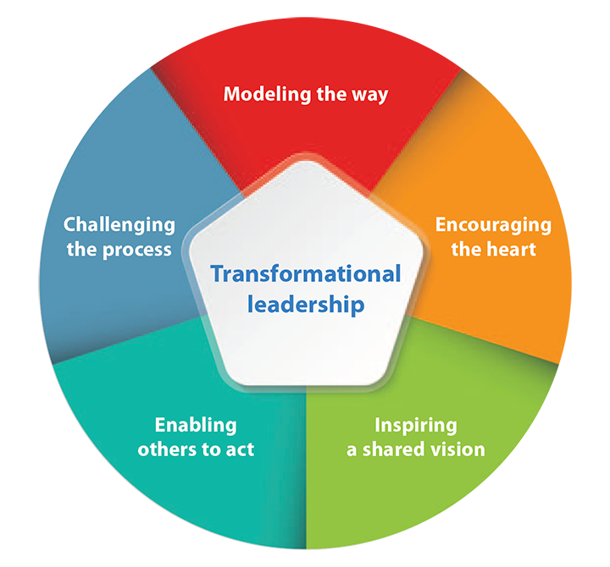
Transformational and Charismatic Leadership – Theoretical Origins

Slide 11
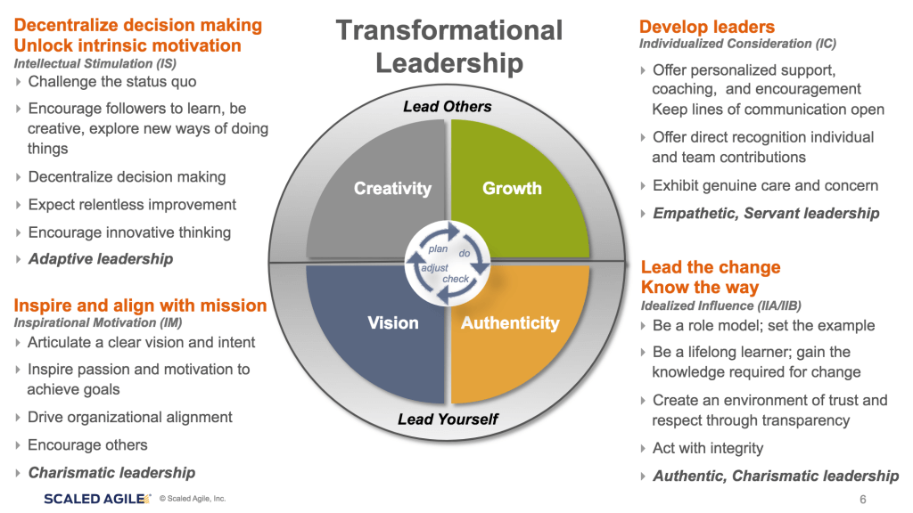

Slide 12
Activity: Manager or leader?
Even though in the corporate world the terms ‘manager’ or ‘leader’ are used interchangeably, these are very distinct roles.
You will be put into break-out rooms in pairs. Each pair should make two lists:
1. Management behaviours
2. Leadership behaviours
Consider whether these behaviours are traditional behaviours or behaviours that are aligned to more modern contemporary approaches

Slide 13
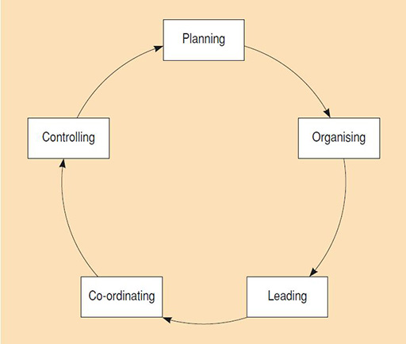
Henri Fayol (1949), suggested that management comprises five processes:
Fayol’s Management Processes

Slide 14
Next Time
We will look at the contemporary approaches to leadership and management and consider their impact upon people and organisations.
  Visionary Leadership
  Servant Leadership
  We will ask if these approaches move away from traditional methods and how they can be utilised in a managerial setting

Slide 15
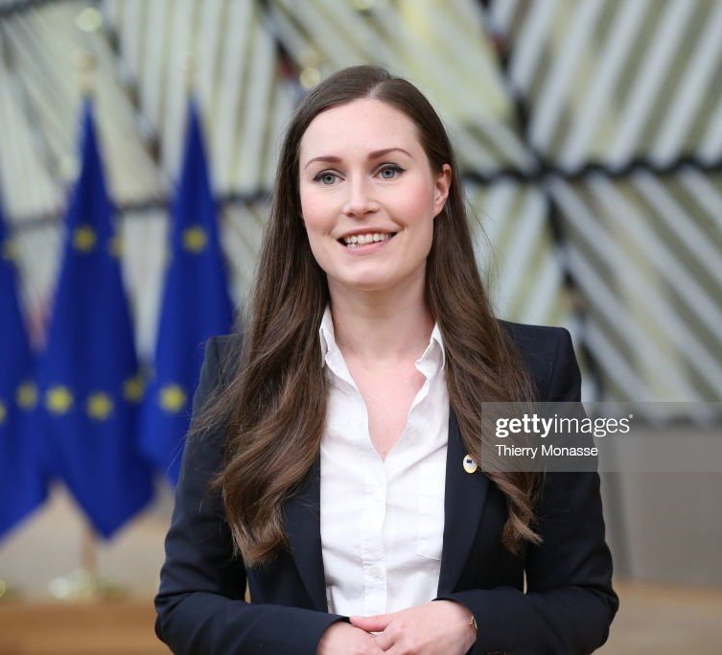
Sanna Marin
Prime Minister of Finland

Slide 16
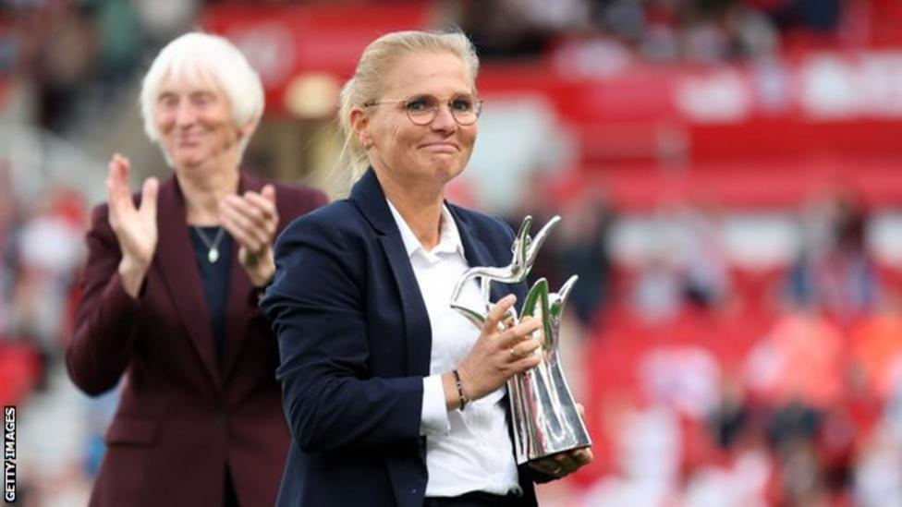
Sarina Weigman
England's Women's Football Manager
Notes:
Read the text on visionary leadership that is available on Moodle and Teams, ready for us to discuss and critique next week. We will look at examples of different leaders and whether they are considered visionary.
I will be on campus in Swansea and Cardiff for your first sessions with James, to introduce you to him.
I will also bring the assignment briefs for this module with me.

Slide 17
Modes of Assessment
The module will be assessed via two assignments.
Assignment 1: Presentation (20 minutes)
Assignment 2: Report (2,000 words)

