Slide 1
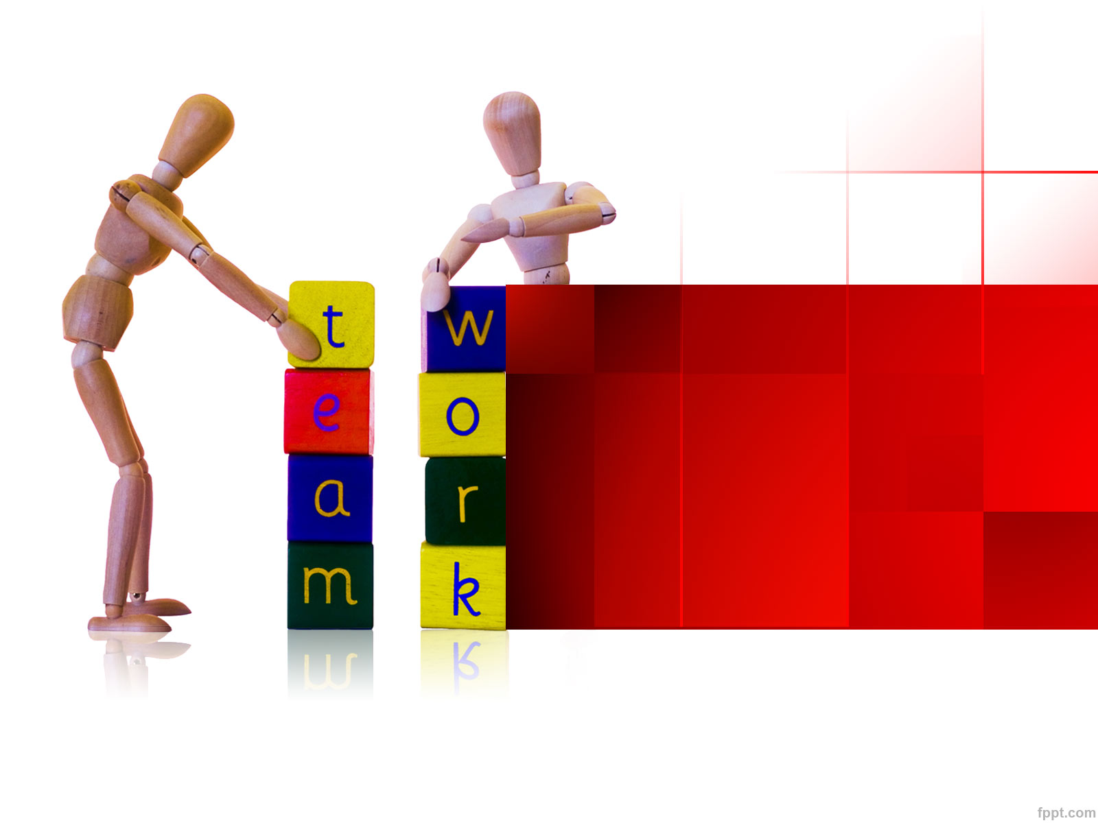
Structure and Culture of Kellogg’s
Madalin Ioan Petrovici (1813112)
Irina Bejenari (1812797)
Roxana Violeta Zanfir (1813454)
Georgiana Andreea Ene (1813123)

Slide 2
Contents page
Belbin Team Roles
2. Strengths & Weakness
3.SWOT
4. Leadership and management skills
5. Motivation and perception
6.Conclusion and recommendation
7.References

Slide 3
Strengths & Weakness of the Group members
 | Strengths | Weakness
Madalin | Communication ability | slow decision making
Irina | Development of specific goal | Inability in team arrangement
Roxana | Negotiation ability | Argumentative
Andreea | Focus on a long term goal | take time to understand

Slide 4

Madalin: Introduction
Teamwork is one of the essential
aspects of every organization.
It is important to build effective relationship among the co- workers in the organization (Barling et al., 2018),

Slide 5
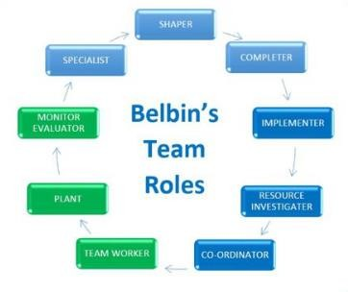
Belbin Team Roles
Irina
Roxana
Andreea
Madalin
Source: Mindtool.com, 2019

Slide 6
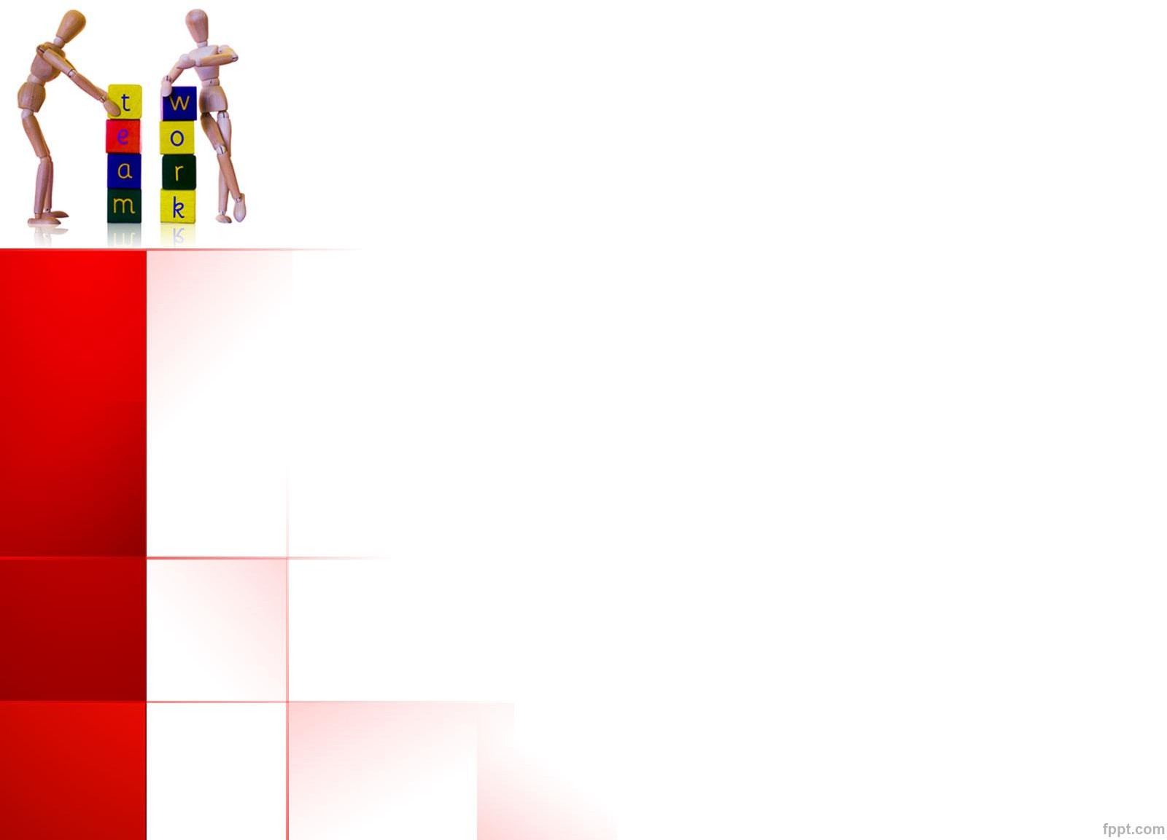
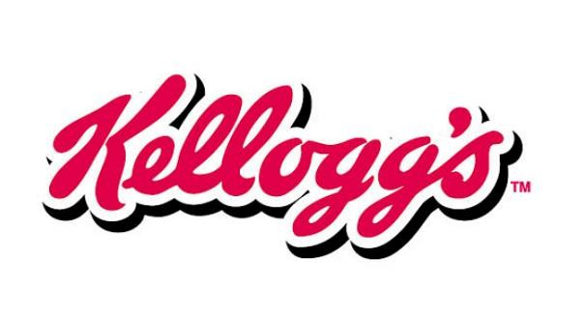
Background of the project and the
organization
Project aim: Analysing the behavior of the project
team while undertaking a collaborative task
Project requirements: explore the areas of
potential growth and development.

Slide 7
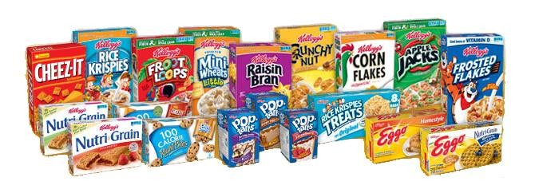
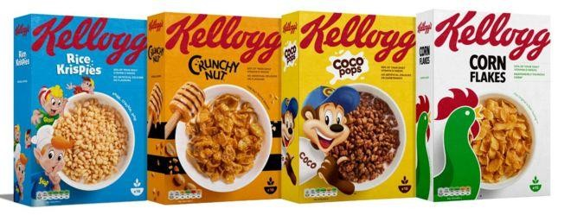
Kellogg's – pictures of cereals

Slide 8
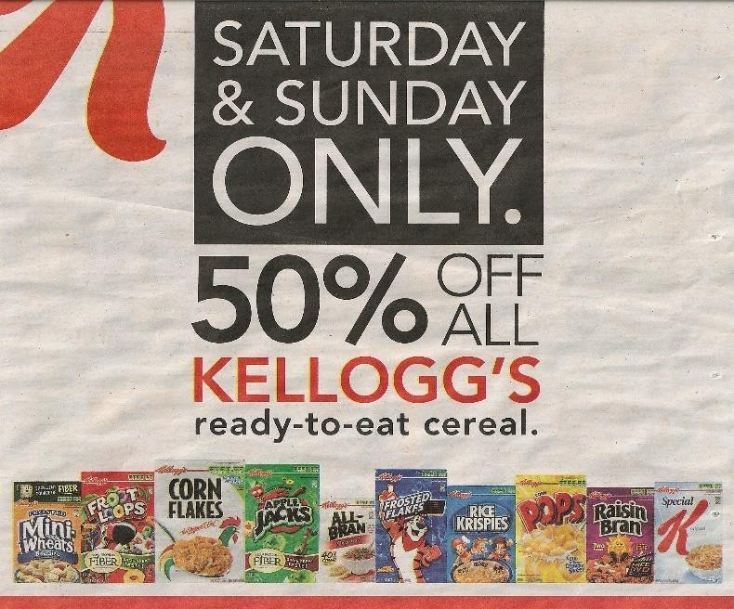
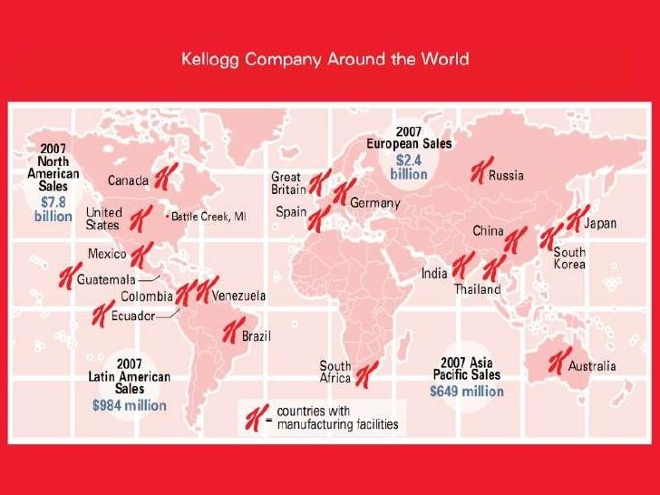
Kelloggs :Sales, employees, countries

Slide 9
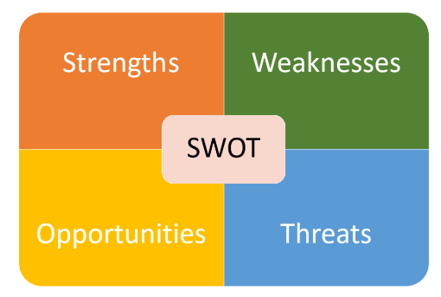
Irina: Continued(SWOT)
Kellogg is an internationally
acclaimed cereal brand.
It does not have product diversity
Owing to Brexit, people have reduced their consumption of high priced goods.
Source: Tallyfy.com

Slide 10


Goals and objectives
Kellogg’s plans to acquire a 51 percent
stake of Haldirams for an amount of
$3 billion.
(Source:https://timesofindia.indiatimes.com/business/india-business/kelloggs-eyes-haldirams-snacks-valuing-co-at-3bn/articleshow/67984096.cms )
Kellogg’s seeks to exploit the digestive and plant protein based consumption trend which pillars the foundation of a healthy biome
Kellogg’s also plans to expand its business on the e-commerce platform

Slide 11
Structure (Fatehi, 1996)- THEORY AND APPLICATION IN TO THE COMPANY
Geography: As opined by Fatehi(1996), when a business divides its market based on geography. You can divide your market by geographical areas, such as by city, county, state, region, (like the West Coast), country, or international region.
Product: Corn Flakes, Frosted lakes, Keebler, Pringles, Eggo, and Cheez-It.
Functional:
• They organizational structure creates a team- work.
• It has sufficient market share.

Slide 12
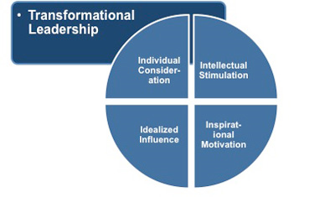
Roxana: Leadership and management skills
Leadership management: Interpersonal communication between the leaders and the individual members of the team in the organization is beneficial for the motivation of the employees (Raes et al. 2015).
Democratic leadership model: increase the involvement of both the leaders and the employees in the team work.
Source: https://culclaw91.wordpress.com/2016/03/05/most-effective-leadership-management-styles-approaches/

Slide 13
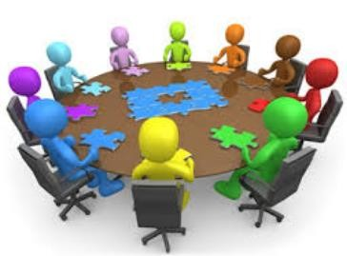
Continued
Team behaviour is highly important to
foster the work process in the team
Belbin’s team role model is very beneficial to determine the behaviour of the members in the team.

Slide 14
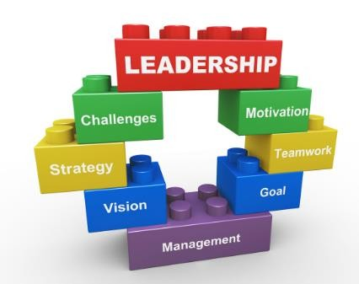
Group and team behaviors
The management department of Kellogg's is having very less concern regarding the quality of the food products
As per the opinion of Kok and McDonald (2017), action-oriented roles, people-oriented roles and thought oriented roles are the most significant to develop the work process
Source: http://www.justscience.in

Slide 15
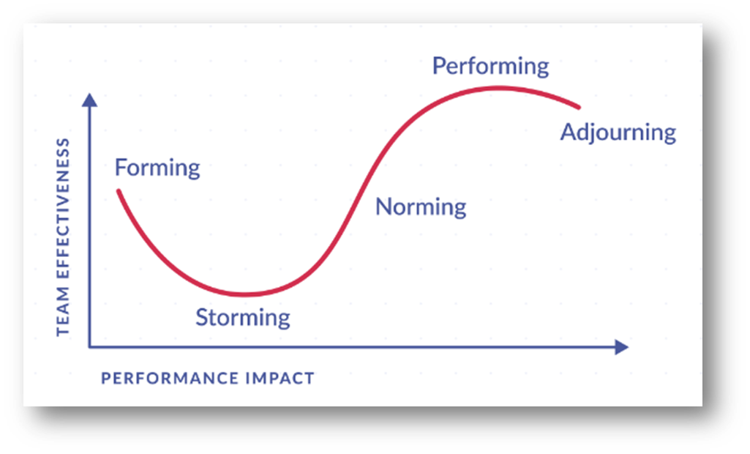

Andreea Continued
Irina
Roxana
Tuckman’s stages
of team
development are highly beneficial to strengthen the team.
Madalin
The supporting
behavior of the
team members can be beneficial at this stage to determine the success of the organization.
Andreea
Source: Mindtool.com, 2019

Slide 16

Motivation and perception
Motivation of the team members is highly
necessary in the team to maintain the work flow in the organization (Shao et al., 2017)
The team leaders have the responsibility to determine the performance level of the team members

Slide 17

Conclusion and Recommendation
It can be concluded that leadership management is the most important aspect of the organization to maintain a team effectively.
Kellogg's strategy address four pillars such as win in breakfast, Global snacks Powerhouse, Emerging market and win in shoppers-shop.
Kellogg’s offer their expert faculty for research and training to help to executive performing their best and sharpen the quality of leadership.

Slide 18
Conclusion
1.Belbin – team member perform different roles
2.Tuckman – forming and storming; later we will be performing
3.Fatehi – geographical structure
4.Transformational leadership – elements of leadership

Slide 19
References
Kelloggcompany.com 2019, KELLOGG’S available from:
https://www.kelloggs.co.uk/en_GB/home.html (Accessed on 24th July)
Kok, S.K. and McDonald, C., 2017. Underpinning excellence in higher education–an investigation into the leadership, governance and management behaviours of high- performing academic departments. Studies in Higher Education, 42(2), pp.210-231.
Raes, E., Kyndt, E., Decuyper, S., Van den Bossche, P. and Dochy, F., 2015. An exploratory study of group development and team learning. Human Resource Development Quarterly, 26(1), pp.5-30.
Shao, B., Cardona, P., Ng, I. and Trau, R.N., 2017. Are prosocially motivated employees more committed to their organization? The roles of supervisors’ prosocial motivation and perceived corporate social responsibility. Asia Pacific Journal of Management, 34(4), pp.951-974.
Steinbach, A.L., Holcomb, T.R., Holmes Jr, R.M., Devers, C.E. and Cannella Jr, A.A., 2017. Top management team incentive heterogeneity, strategic investment behavior, and performance: A contingency theory of incentive alignment. Strategic Management Journal,38(8),pp.1701-1720.

Slide 20


