Slide 1

The Volkswagen Emissions Scandal
Student 1

Slide 2
About Volkswagen
German brand
Largest car manufacturer in the world
590,000 employees
Produces approximately 41,000 cars daily
Owns 12 subsidiaries; Audi, Seat, Skoda, Bentley, Lamborghini, Porsche, Ducati, VW Passenger Cars, VW commercial vehicles, Scania and Man
(Bowler T, 2015)

Slide 3
The Scandal
September 2015, the Environmental Protection Agency, discovered that many Volkswagen cars being sold in America had been fitted with a “defeat device”. This was fitted in diesel engines and adjusted the performance to enhance emissions results (Hotten, R. 2015)
The defeat device allowed Volkswagen cars to beat tests in labs, however whilst the cars where on the road with emission controls off, the cars would pump up 40x the legal limit of nitrogen oxide (Spence, P. 2015)
A week before the scandal broke, a German press officer announced “the VW group has been listed as the most sustainable automaker in the worlds leading sustainability ranking” (Hardyment, 2015)

Slide 4
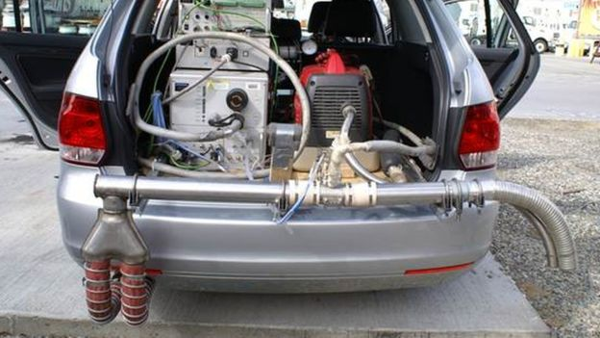
John German: the exposure of VW’s emission's scandal
”I’m just a simple engineer from Michigan, we really didn't expect to find anything” Stated John German (The Guardian, 2015)
(Kretchmer, 2015)
Notes:
John German the US co-lead of the international council on clean transportation, a not-for-profit organization dedicated to to reducing vehicle emissions. German found a high stream of data which suggested that diesel cars in Europe have high NO emissions. Due to this he decided to look at the US to find where the emissions standards are more stringent. Germans team abandoned the standard emissions lab test and instructed researchers to take VW’s cars out on the roads. When they discovered the emissions they assumed there was a problem with their own equipment. However after tests they found VW’s real world emissions were extremely high some cars with 5-20x the standard. This is where the ‘defeat device’ was discovered.

Slide 5
What made Volkswagens Dishonesty a Scandal?
Covering up lies
Breaking US and UK regulations, legislations and their code of conduct.
Fraud.
Miss selling goods.
Damaging the environment with Nitrogen Oxides and Dioxides emissions.

Slide 6
The Reason Behind the Scandal?
Volkswagen aimed to appeal to the European marke who care greatly about pollution, holding 25% in market share.
To market their cars as ‘clean diesel cars’
(Farber, R. 2015)

Slide 7
Volkswagen Code of Conduct
Volkswagen makes ecologically efficient advanced technologies available throughout the word
Volkswagen are partner to society and politics with respect to, ecologically sustainable development
Volkswagen are obligated to the truth with respects to political institutions.
(Volkswagen, 2016)

Slide 8
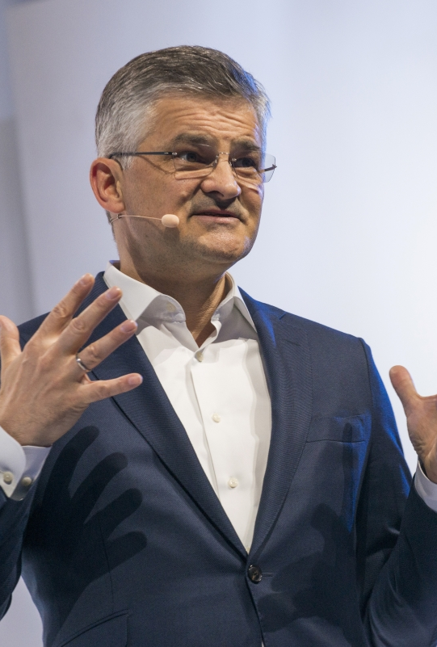
Volkswagen's Initial Response
VW said it had found some ‘irregularities’ in tests to measure carbon dioxide
The cause was due to ‘a couple of rouge software engineers’ who did it for unknown reasons, stated VW’s chief executive Michael Horn.
‘This was not a corporate decision, I agree it’s hard to believe’ (The Independent, 2016)
“We’ve totally screwed up” Horn

Slide 9
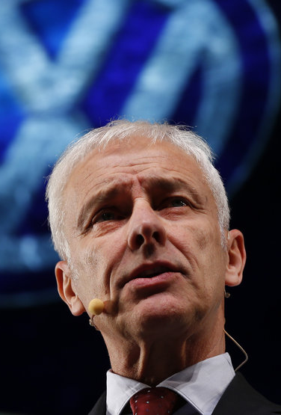
Volkswagen’s Final Response
Winterkorn, said his company ”broken the trust of our customers and the public”
Matthias Mueller the former boss of Porsche, then replaced Winterkorn. Upon taking up his new post he stated “My most urgent task is to win back trust for the Volkswagen Group – by leaving no stone unturned”
VW open an internal inquiry

Slide 10
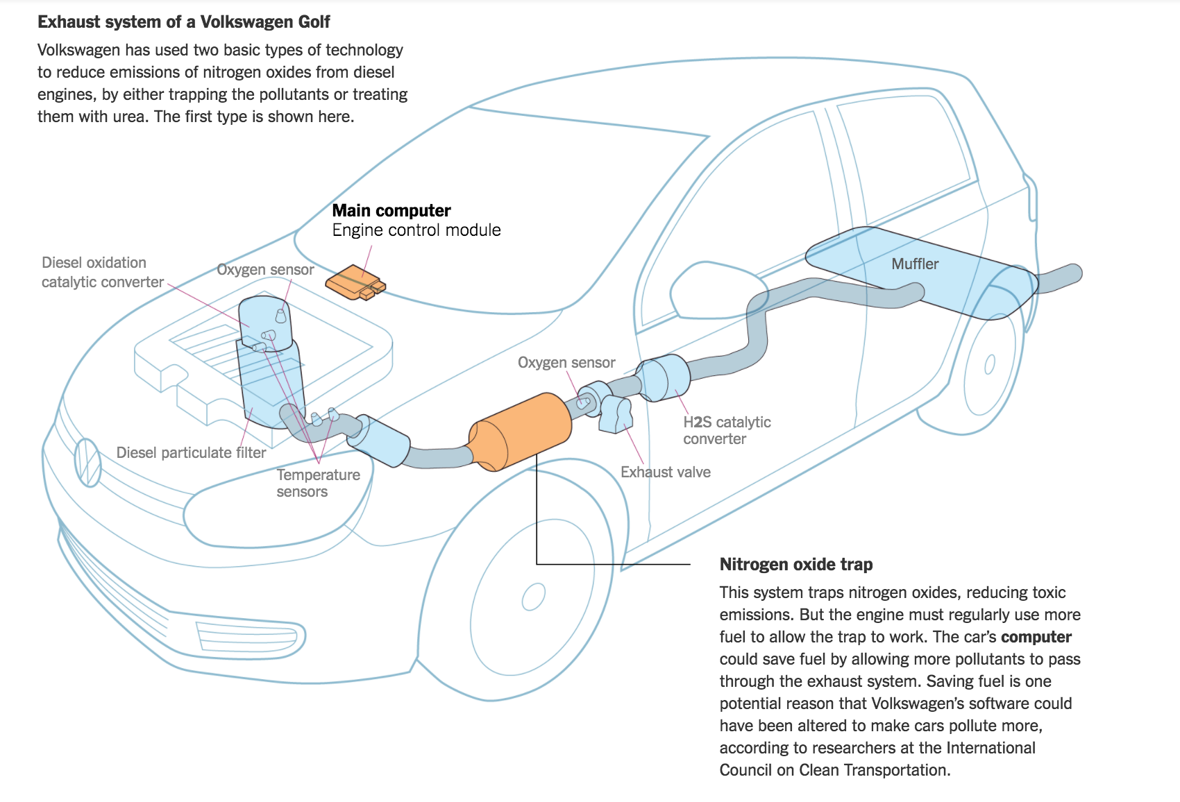
How did it work?
(Gates, 2016)
Notes:
The software installed sensed when the car was being tested and activated equipment that reduced emissions. The software was modified to adjust components such as the catalytic converter or valves used to recycle some of the exhaust gasses.

Slide 11
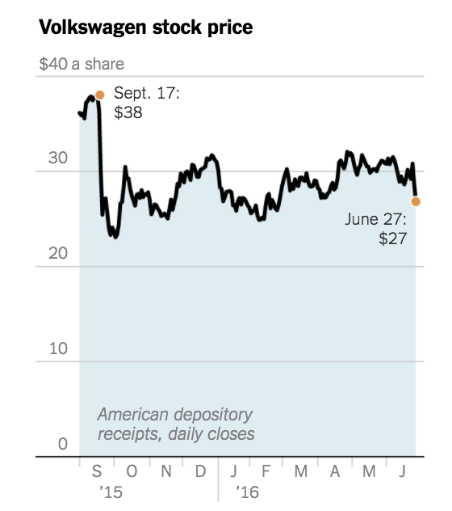
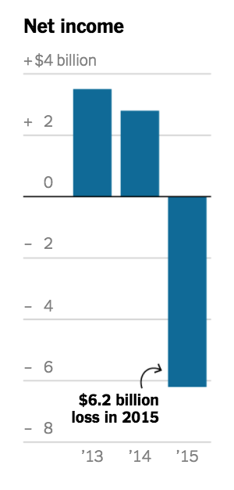
Impact of the Scandal
The New York Times (2015)
Notes:
By October Volkswagens stock prices ad plummeted from $38 per share to $24, and still hasn’t climbed back to its original price in 2016.
The scandal caused Volkswagen a reported $6.2 billion loss in 2015.
VW’s broke their customers loyalty

Slide 12
Damage Caused
Nearly 1m tones of extra pollution from the modified cars (The Guardian, 2015)
Reputation shattered
Profits lost

Slide 13
What have Volkswagen done to amend their wrong doings?
Volkswagen promised $15 billion in settlements
Owners of the 475,000 cars will be able to sell their car back to VW Group for the price of the car pre-scandal
Notes:
However, $15 billion has only been promised nothing of yet has happened to amend the cars.
A year has passed and still no action has been taken.

Slide 14
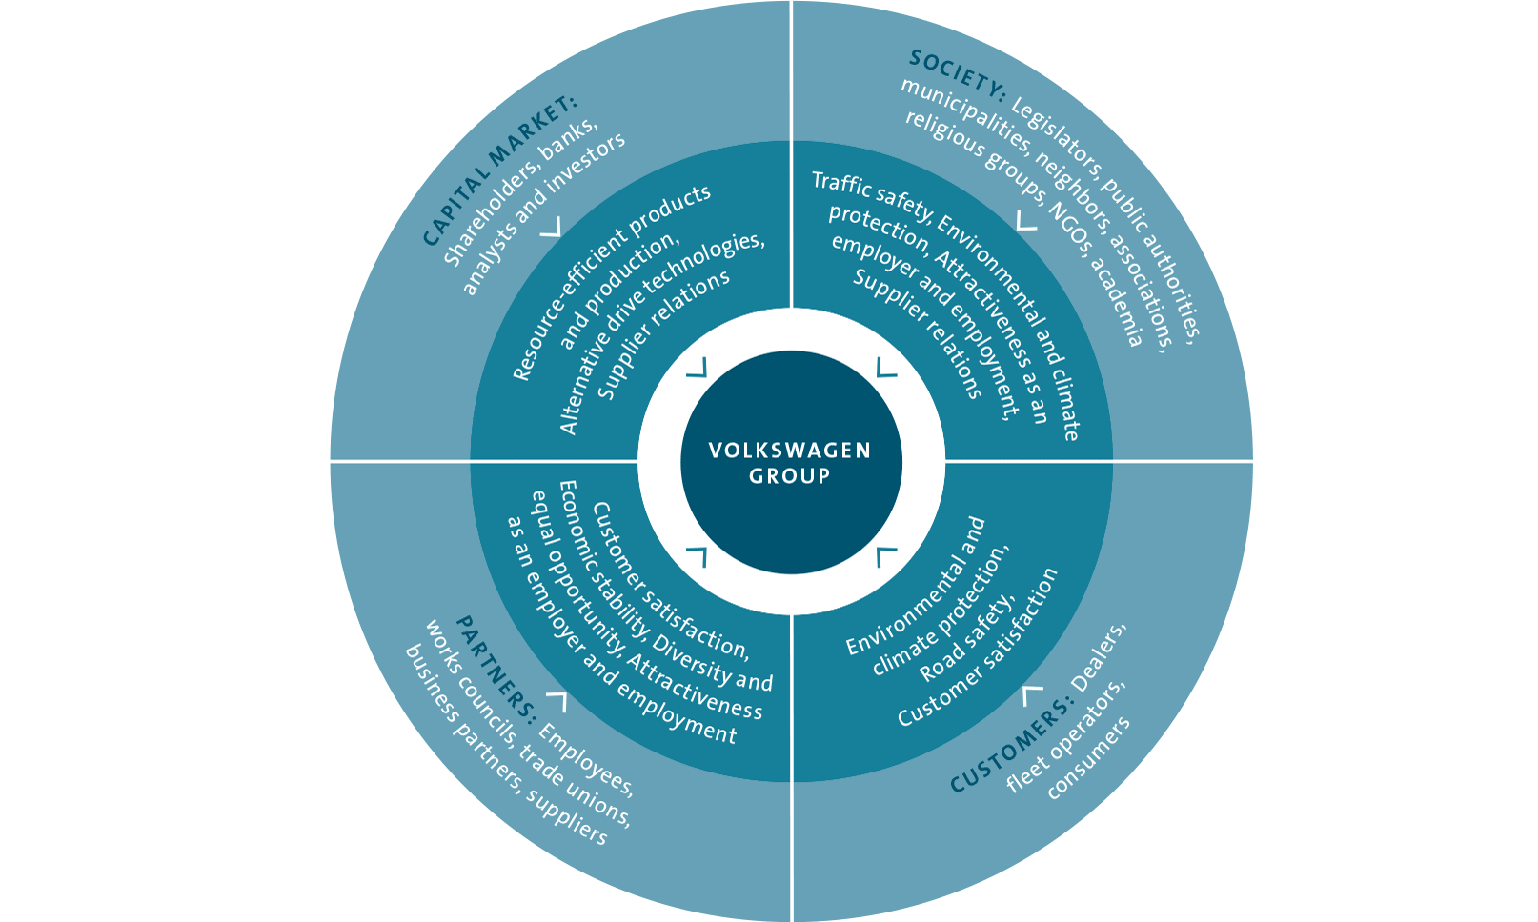
Volkswagens Affected Stakeholders
Volkswagens stakeholders that have been effected by this scandal, and why trust was broken.
(Volkswagen, 2013)
Notes:
This stakeholder map shows how VWs stakeholders are split into four categories:
-Society
-Partners
-Customers
-Capital Market

Slide 15
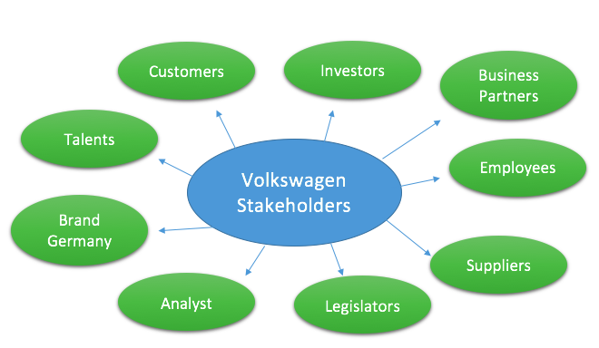
Stakeholder Analysis
Adapted from (Freeman, 2010)
Notes:
This here is a stakeholder analysis that has been adapted to fit to Volkswagen stakeholders, to show who has been affected internally and externally.
-Customers: have been the most effected stakeholder, due to them spending money on the basis of a lie, meaning they will have lost trust for VW
-Investors: Have also been hit hard by the scandal as share prices have decreased and VWs reputation has been tarnished
–Suppliers: Due to the the decrease in the amount of VW cars being sold less sales for the suppliers
-Employees: Employees can feel betrayed by VWs dishonestly.

Slide 16
What Makes it a Scandal?
Corporate scandals can be defined as “widely publicized incidents involving allegations of managerial wrongdoing, disgrace, or moral outrage of one or more members of a company” (Bonini S, & Boraschi D, 2009)
Volkswagens actions led to misleading their customers, stakeholders and the public.
Volkswagen (2016) “Volkswagens is of the firm belief that sustainable economic success can only be achieved by adhering to regulations and standards”
Notes:
This statement from Volkswagen was broken.

Slide 17
Freeman & Friedman Theories on CSR
Milton Friedman (1970, p. 1) ”the sole responsibility of a business to use its resources and engage in activities designed to increase profits so long as it stays within the rules of the game”
Edward Freeman (1988) “Managers have a duty to stockholders with the concept that managers bear a fiduciary relationship to stakeholders”
Notes:
In comparison it seems VW, utilize Freemans theory, however with VW’s scandal they have broken their relationship with their stakeholders.
In relation to Friedman's theory, where its proposed the sole purpose of an organization is to increase profits, however they have broken the law therefor do no apply to this theory.

Slide 18
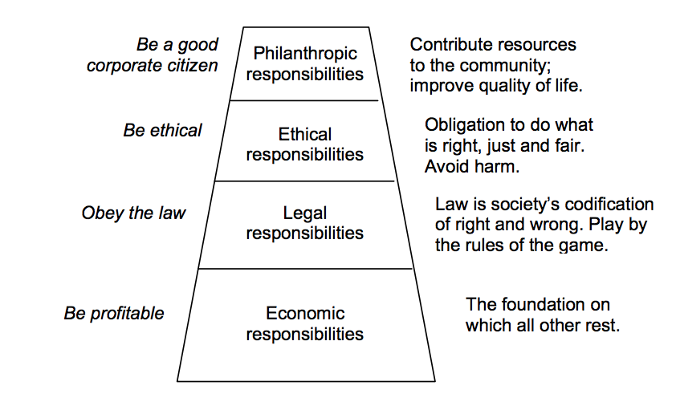
Carroll's CSR Pyramid
Carroll (1991)
Notes:
This slide shows Carroll's CSR Pyramid, where he shows CSR as 4 levels, Economic, Legal, Ethical and Philanthropic.
This Pyramid was no followed by VW because they did not keep to their legal or ethical responsibilities.

Slide 19
Conclusion
VW tarnished their customer loyalty
VW aims for profits led them to breaking the law
VW are still agreeing on settlements for their customers
Cars are said to be fixed by the end of 2017
Notes:
- October 18th, around 340,000 customers have sent in registration forms indicating they want the company to buy back their cars under the government negotiated compensation scheme.

Slide 20
References
Kretchmer, H. (2015) The man who discovered the Volkswagen emissions scandal; retrieved November 22nd, 2016, from: http://www.bbc.co.uk/news/business-34519184
The Guardian (2015) The Volkswagen emissions scandal explained; retrieved November 23rd, 2016, from https://www.theguardian.com/business/ng-interactive/2015/sep/23/volkswagen-emissions-scandal-explained-diesel-cars
Volkswagen (2016). Compliance & Risk Management; retrieved November 23rd, 2016, from : Volkswagen Compliance & Risk Management

Slide 21
References
Gates, G. (2016) How Volkswagen is Grappling with its Diesel Scandal. Retrieved from: http://www.nytimes.com/interactive/2015/business/international/vw-diesel-emissions-scandal-explained.html
Farber, R. (2015, September 2nd). Why BMW Could Be the Winner in Volkswagen Diesel Scandal. Retrieved November 27th, 2016, from 24.7 Wall St: http://247wallst.com/autos/2015/09/22/why-bmw-could-be-the-winner-in-volkswagen-diesel-scandal
Spence, P. (2015) VW emissions scandal: what's it all about? Retrieved November 29th from: http://www.telegraph.co.uk/finance/newsbysector/industry/11884738/VW-emissions-scandal-whats-it-all-about.html
Bowler, T. (2015) Volkswagen: From the Third Reich to emissions scandal. Retrieved November 29th, 2016, from: http://www.bbc.co.uk/news/business/34358783

Slide 22
References
Hotten, R. (2015) Volkswagen: The scandal explained. Retrieved December 1st 2016, from: http://www.bbc.co.uk/news/business/34324772
Hardyment, R. (2015) CSR after the Volkswagen Scandal. Retrieved December 4th 2016, from: http://www.triplepundit.com/2015/10/csr-volkswagen-scandal/
The Independent (2016) Volkswagen diesel emissions scandal: the toxic legacy. Retrieved December 4th 2016, from: http://www.independent.co.uk/news/business/Leading_business_story/volkswagen-diesel-emissions-scandal-the-toxic-legacy-a7312056.html
Bonini, S. & Boraschi, D. (2009) Corporate scandals, capital structure and contagion effect. New York University.

Slide 23
References
Friedman, M. (1970). The Social Responsibility of Business is to Increase its Profits . The New York Times Magazine .
Freeman, E. (1988). Stakeholder Theory of the Modern Corporation. Generall Issues in Business Ethics , 38-48.
Carroll , A. B. (1991). The Pyramid of Corporate Social Responsibility: Toward the Moral Management of Organizational Stakeholder. Business Horizons , 34(4), 39-48.
The Guardian (2015) Volkswagen Damage Caused: Retrieved December 4th from: https://www.theguardian.com/business/2015/sep/22/vw-scandal-caused-nearly-1m-tonnes-of-extra-pollution-analysis-shows

