Slide 1
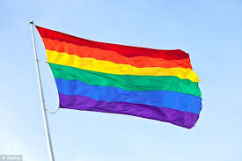
The achievement for equality for lesbian and gay citizens is part of the unfinished business of modern democracy. (Kaplan,1997,p3.)
Assignment 3
Notes:
So where did it all begin? From writing my second assignment I have given considerable thought as to what particular aspect I shall try to illustrate in this assignment. The history and the effort given by so many early activists is so endearing. Without their continued work we would not be where we are today.
Therefore I have decided to focus my work on the historical development of global lesbian and gay rights

Slide 2
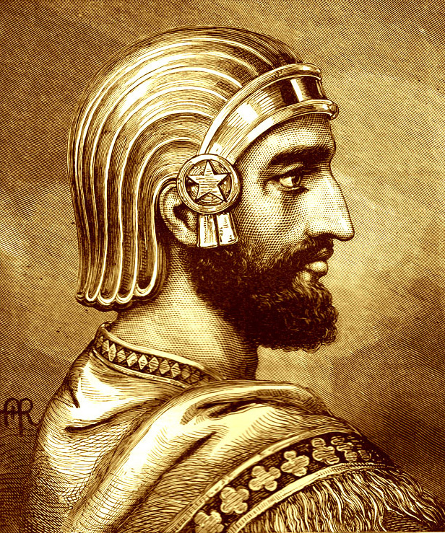
Cyrus King of Persia
www.youtube.com/watch?v=zoNrXpFwg9k&list=RDzoNrXpFwg9k&start_radio=1&t=218
Notes:
So where did it all begin?
The history of Human Rights can be traced back to as far back as 539 BC when Cyrus was King of Persia, conquered Babylon, freed the slaves and declared that all people had a right to choose their own religion and established racial equality.
From this time onwards peoples rights and responsibilities have come from religion, beliefs, customs or laws. In medieval Britain the Magna Carta a charter of rights created by King John 1166 which is considered to be the of the beginning of the legal constitution of the United Kingdom. Following this came laws and Bills setting out powers and rights.(hrlibrary.edu)

Slide 3
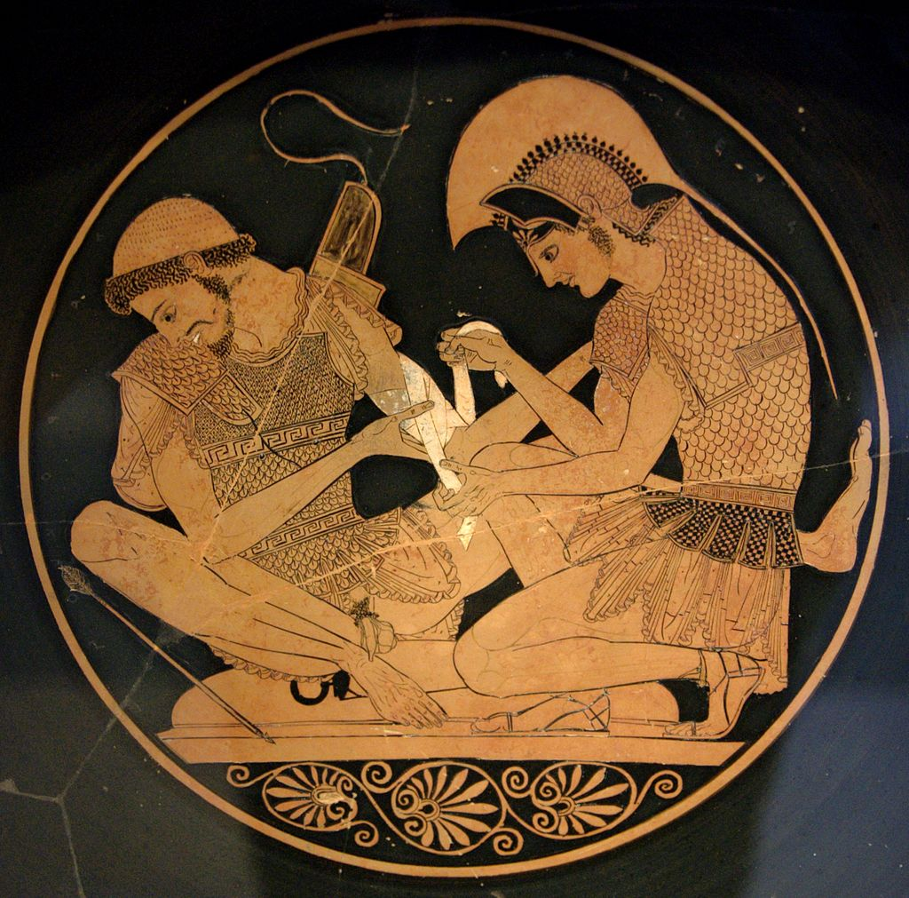
Notes:
In Greek times pederasty (love between a man and a boy) is portrayed in Homer’s Iliad. In ancient Greek history Achilles, feeling upset by the king stops fighting outside Troy. His lover Patroclus, worrying that Achilles is losing his honour puts on Achilles’ armour and goes out to fight Patroclus is killed, this makes Achilles return to the battle to kill the Trojan Hector.

Slide 4

https://youtu.be/sRS-ToNpcNY
Notes:
The idea that human beings should have a set of basic rights and freedoms has deep roots in Britain. Landmark developments in Britain include:
the Magna Carta of 1215
the Habeas Corpus Act of 1679
the Bill of Rights of 1689

Slide 5
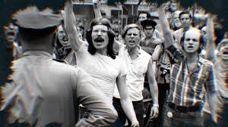
Stonewall Riots 1969
Notes:
In 1969,police raided Stonewall Inn, a divided community with a bar popular with lesbian and gays in New York. It was a riot that lasted for two nights and three days , where crowds battled the police.There was corruption within the police force as well as political resistance. The Stonewall Riots put an end to the fear of exposure and was a symbolic end to their victim status. (Cruikshank,1992,p.69) From this time a transformation occurred, the name ‘gay’ was adopted which showed an acceptance to their group identity. From being invisible or hidden they became open.Legislations were developed, papers, magazines and books were published. This all helped to change the ‘concept of homosexuality from a behavior to an identity’ (Cruikshank,1992.p.191)

Slide 6
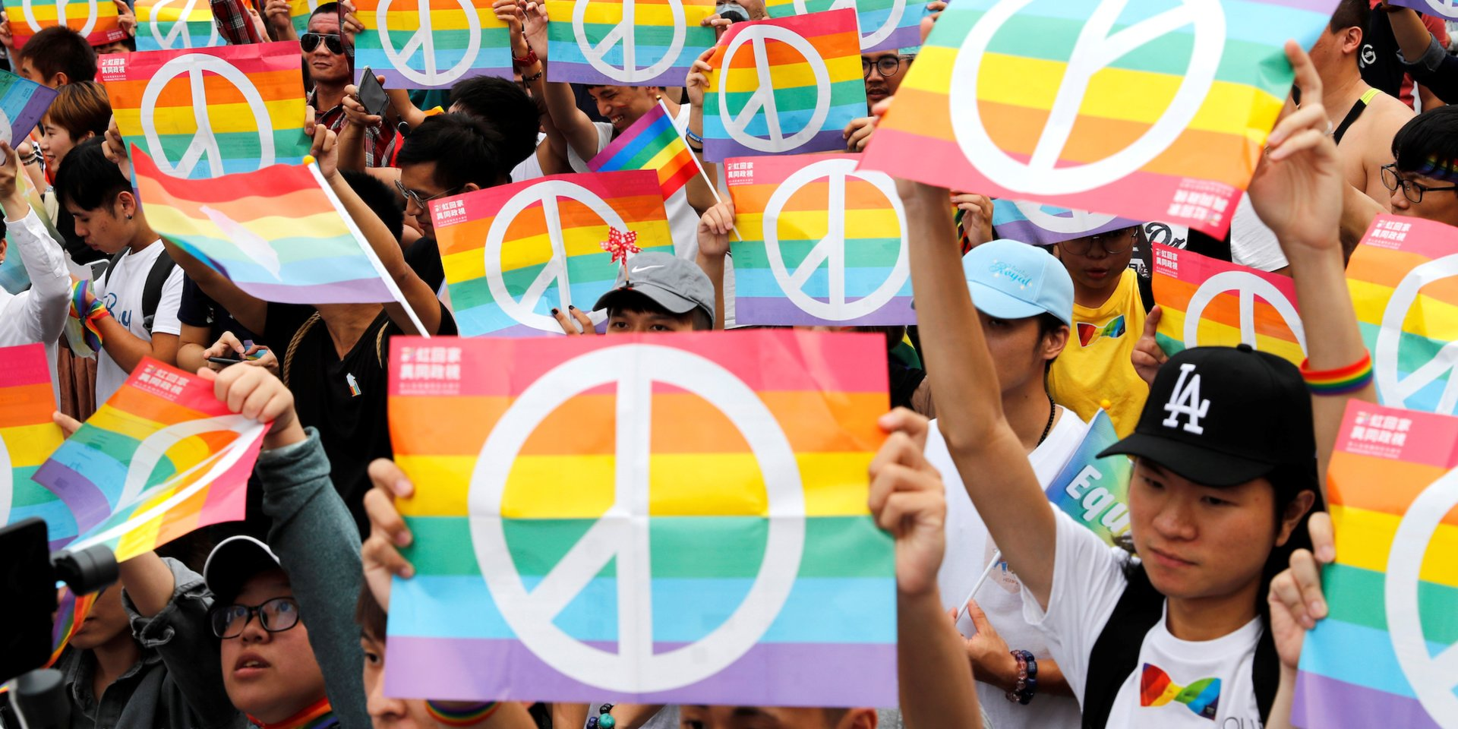
https://www.businessinsider.com/lgbtq-rights-around-the-world-maps-2018-10?r=US&IR=T
Notes:
Therefore whilst we are seeing considerable progress in Britain and parts of western Europe,according to research published by ILGA there are over 76 countries where people are still being discriminated against.In 13 countries being gay or bisexual is punishable by death. In 74 countries same sex contact is a criminal offence (Independent, 2016) Globally some countries are being denied their claim of the full set of Human Rights (Marks,2006) When these rights are not allowed it has an impact on individuals health,discrimination in housing,jobs and health care.

Slide 7
https://www.theguardian.com/world/2018/sep/06/indian-supreme-court-decriminalises-homosexuality
India

Slide 8
China

