Slide 1
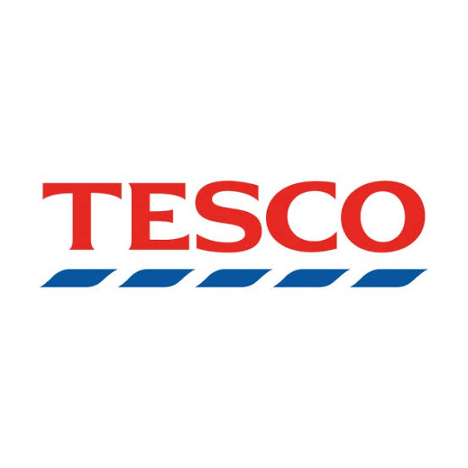

Organisational Structure Design at Tesco PLC
Module Title: Understanding Organisational Structure and Culture
Module Code: LCBB4009
Assessment: Component 1: Practical Individual Presentation
Student Name: Derya Mustafa
Student ID: 2527014
Submission Date: 24 July 2026

Slide 2
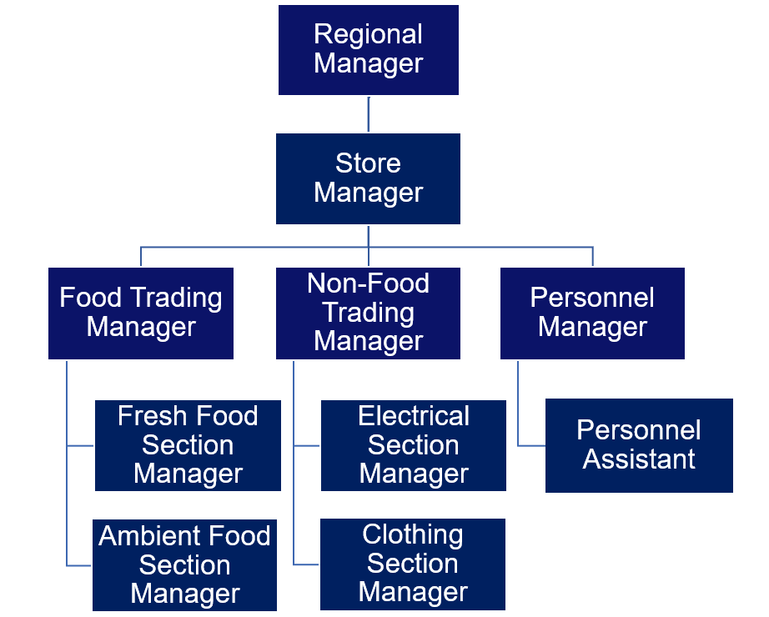
Presentation Outline
Introduction
What is organisational structure?
Importance of organisational structure
Functional organisational structure (Tesco)
Divisional organisational structure (Tesco)
Matrix organisational structure (Tesco)
Conclusion
Reference List

Slide 3
What is Organisational Structure?
Organisational structure defines how roles, responsibilities and authority are organised within an organisation.
It establishes reporting relationships and supports communication and coordination between departments.
An effective organisational structure improves efficiency, decision-making and organisational performance (Mullins and Rees, 2023; CMI, 2024).

Slide 4

Why is Organisational Structure Important?
Improves communication and coordination between departments.
Clarifies roles, responsibilities and reporting relationships.
Supports faster and more effective decision-making.
Increases operational efficiency and accountability.
Helps organisations achieve strategic goals while improving organisational performance (Robbins et al., 2021).

Slide 5
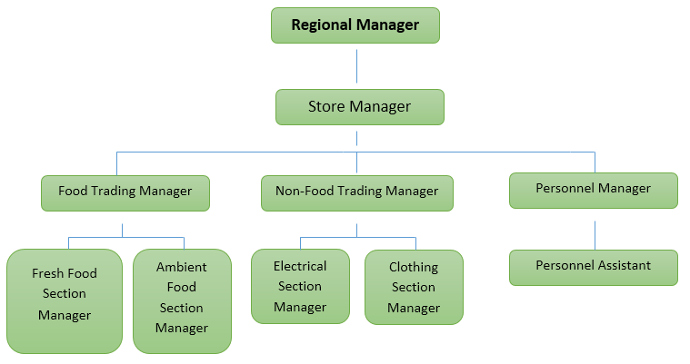
Functional Organisational Structure at Tesco PLC
Employees are grouped according to their specialised functions.
Each department is managed by a functional manager.
Tesco organises employees into specialised departments, such as Food Trading, Non-Food Trading and Personnel, with each department managed by a functional manager.
This structure improves specialisation, efficiency, operational control and customer service (Mullins and Rees, 2023; CMI, 2024).

Slide 6
Divisional Organisational Structure at Tesco PLC
Tesco PLC
UK & ROI
Central Europe
Booker
Employees are organised into divisions based on products, services or geographical areas.
Each division operates with its own management team and functional departments.
Tesco manages different business divisions, including UK & ROI, Central Europe and Booker.
This structure improves flexibility, customer focus and responsiveness to market needs (Tesco PLC, 2025; CIPD, 2025).

Slide 7
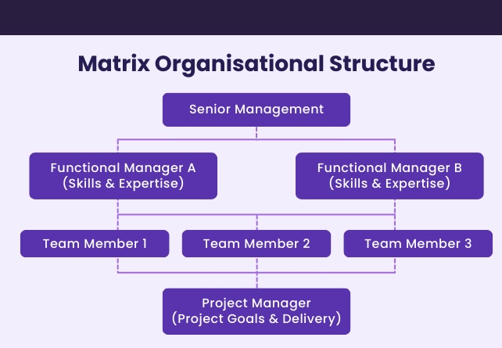
Matrix Organisational Structure at Tesco PLC
Employees report to both functional managers and project or regional managers.
This structure encourages collaboration across departments and business functions.
Tesco uses cross-functional teams to support projects, innovation and customer-focused initiatives.
Matrix structures improve flexibility, knowledge sharing and faster decision-making (Mullins and Rees, 2023; CMI, 2024).

Slide 8
Conclusion
Organisational structure defines how work, responsibilities and communication are managed within an organisation.
Tesco uses functional, divisional and matrix structures to meet different business needs.
Each organisational structure offers distinct advantages, including improved efficiency, flexibility and collaboration.
Choosing the right organisational structure helps Tesco achieve its strategic objectives and improve organisational performance (Mullins and Rees, 2023; Tesco PLC, 2025).

Slide 9
References
CIPD (2025) Organisation design. Available at: https://www.cipd.org/uk/knowledge/factsheets/organisational-development-design-factsheet/ (Accessed: 7July 2026).
CMI (2024) Chartered Management Institute. Available at: https://www.managers.org.uk/ (Accessed: 7 July 2026).
Mullins, L.J. and Rees, G. (2023) Organizational Behaviour in the Workplace. 12th ed. Harlow: Pearson Education.
Robbins, S.P., Coulter, M.K., and Randel, A.E. (2021) Management. 15th Global ed. Harlow: Pearson Education.
Tesco PLC (2025) Annual Report and Financial Statements 2025. Available at: https://www.tescoplc.com/investors/reports-results-and-presentations/ (Accessed: 7 July 2026).

