Slide 1


Responding to High Risk Incidents
Missing
Persons
Notes:
Objectives:
State the three categories of missing persons
Specify considerations for responding to common high-risk incidents

Slide 2

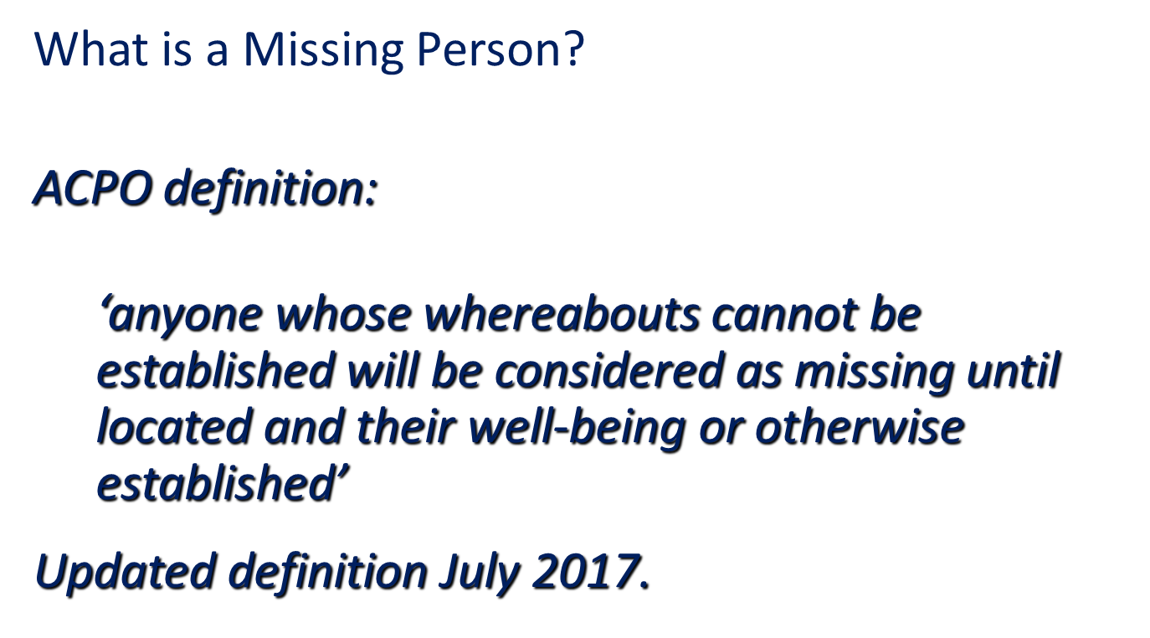
Missing Persons
Notes:
The investigation of a missing person begins at the point of first notification to the police
Prompt and thorough actions by the police can provide a positive contribution to community confidence
Missing persons cases often receive high levels of media coverage.
This is especially true when children are reported missing.
The initial approach of officers attending may have great impact on the case.
No two cases are ever the same.

Slide 3
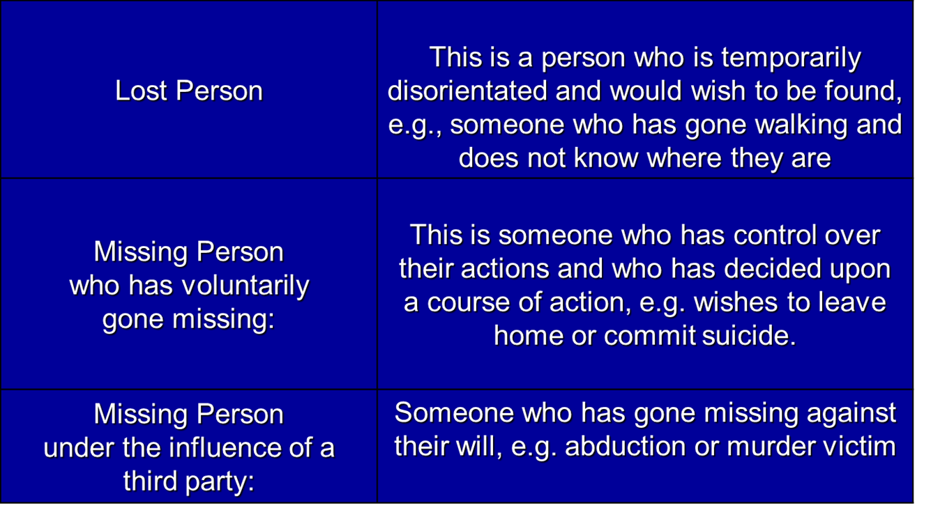
Categories of Missing Persons
Notes:
Some examples of voluntary MISPERS
Leave a partner
Escape Parental Control
Avoid Paying Debts
Seek A Different Life Style
Wander (Children)
Escape Arrest Or Investigation
Suicide
Some examples of involuntary MISPERS
Crimes Such As Murder
Assault
Child Stealing
Loss Of Memory
Mental Illness
Physical Illness
Accident Or Sudden Death

Slide 4

IF IN DOUBT, THINK THE WORST UNTIL THE CONTRARY IS PROVED

Slide 5
Missing Persons - Grading
Low risk
High risk
Medium risk
Notes:
Whilst the call handler may make the initial risk assessment and determine the level of response, a secondary risk assessment must be carried out by the first officer on the scene.
The risk assessment will result in a classification of Low, Medium or High risk.
The definition of each of these categories is as follows:
Low risk: there is no apparent threat of danger to either the subject or the public. A young person under the age of 18 should not be categorised as low risk.
Medium risk: the risk posed is likely to place the subject in danger or they are a threat to themselves or others.
High risk: the risk posed is immediate and there are substantial grounds for believing that the subject is in danger through their own vulnerability; or they may have been the victim of a serious crime; or the risk posed is immediate and there are substantial grounds for believing that the public is in danger.

Slide 6
Missing Persons - Grading
  Low risk
There is no apparent threat of danger to either the subject or the public. A young person under the age of 18 should not be categorised as low risk.

Slide 7
Missing Persons - Grading
  Medium risk
The risk posed is likely to place the subject in danger or they are a threat to themselves or others.

Slide 8
Missing Persons - Grading
  High risk
The risk posed is immediate and there are substantial grounds for believing that the subject is in danger through their own vulnerability; or they may have been the victim of a serious crime; or the risk posed is immediate and there are substantial grounds for believing that the public is in danger.

Slide 9
First Responder …..
The responsibilities of the first responder attending the report of a missing person are:
Establish what the facts are and keep accurate records of what is said and by whom.
Make an initial risk assessment based upon the circumstances of the disappearance and the risks to which that person or the community are likely to be exposed. The decision, the evidence supporting it and where the information came from should be recorded.
Gather sufficient information about the missing person to enable an effective and thorough investigation to be conducted. The depth of that information will vary according to the assessment of risk. Very detailed information and a lifestyle profile will be needed in high-risk cases.
To conduct a secondary risk assessment and submit to a supervisor.
Notes:
The responsibilities of the first responder attending the report of a missing person are:
Carry out a thorough search of the missing persons home address and/or the address they went missing from. You should ensure that a thorough ‘open door’ search is made of the premises; this will enable you to gather evidence relating to their disappearance, gather intelligence which may lead to their discovery or locate the missing person.
• Make all immediate relevant enquiries in order to locate the missing person.
• Consider obtaining any physical evidence of identity such as recent photographs, fingerprints, DNA samples.
• Identify the person who is the point of contact for the police and assess levels of support required.
• Gather the relevant information to allow the Missing Person report to be fully completed with relevant information. Where it is not considered necessary to take all the details, comments should be included about this to ensure clarity about why they have not been recorded.
• To identify and secure any potential crime scene.

Slide 10
First Contact …..
Polite, tolerant, patient
Listen
Appropriate language
Understanding of what might offend
Social and cultural customs
Cultural diversity and language
Professionally handle what might be an emotional situation
Explain the duty of the police service and its role
Explain what will need to happen next
Notes:
List is not exhaustive, the idea is to stimulate discussion around how the officer attending has to balance the circumstances they find with the need to be thorough and professional.
The investigation into a missing person begins at the point of first notification to the police. As a first responder you will play a crucial role in shaping the subsequent pace and the extent of the police investigation. It is important to remember that the act of going missing could be a possible indicator of other issues or problems in the person’s life. It could be related to their own personal circumstances or something more sinister, it is only by thorough investigation that you can uncover these circumstances. One of the primary facts to be determined is why the person has go
The ACPO Guidance on the Management, Recording and Investigation of Missing Persons 2010 states ‘whether they have been identified as being high, medium or low risk, positive action is required at every stage of the investigation, if in doubt, think murder. By doing so you will ensure that all valuable investigative opportunities are covered. ne missing.

Slide 11

SCENARIO based research
S Specify Item Sought
C Confirm Last Location
E Establish Circumstances of Disappearance
N Note Factors Influencing Discovery
A Analyse Possible Scenarios
R Raise Search Strategies
I Identify Priority Search
O Ongoing Reassessment
Notes:
Specify Item Sought. In this case it is the child but may include clothing.
Confirm Last Location. This is the Place Last Seen (PLS) or the Last Known Position (LKP) should be used as the point to begin the initial search.
Establish Circumstances of Disappearance. This stage examines the circumstances of the loss, considering why and how the disappearance occurred. All facts, no matter how trivial they might appear to be, should be considered as it is at this stage that the most successful clues to resolving a search are often found.
Note Factors Influencing Discovery. In missing person cases, friends and families may wish to involve themselves. Other influences may include the weather both current and forecast, the rising tide in shoreline searches.
Analyse Possible Scenarios. This is the ‘what happened’ phase and must include identification of all likely scenarios from the previous four stages. It will involve assessment of any relevant information and.
Raise Search Strategies. A search strategy should be planned for the most likely scenarios, identifying boundary limitations and search areas, including any possible routes.
Identify Priority Search. The knowledge gained from previous stages should be used to identify the best scenario. Each scenario must be considered to identify the most likely option. It is possible that scenarios and priorities will change as new information becomes available. Where resources permit, multiple scenarios can be searched. Where this is not the case, priority must be given to the most likely option.
Ongoing Reassessment. The whole process must be constantly reassessed to ensure the appropriate use of available resources, and that the best scenario is being pursued. When reassessing the scenario, any new information arising from the investigation must be considered. It may also be necessary to review the search strategy, which should be carried out by a supervisor and/or PolSA, particularly where expected results are not forthcoming.

Slide 12

Importance of Searching
Most missing children are found very quickly by a competent and thorough search
Missing children provoke many reactions
Police have a responsibility to provide leadership
Some cases have resulted in the death of the missing child
Notes:
Home address search
Garden and outbuildings
Immediate surrounding area
Roads, Footpaths and tracks immediate area and leading to the shops
How to you explain the need to search the house? This is to look for the person but also to pick up any clues, notes, medication taken or not taken, -it also helps to look in wardrobes to ascertain the clothing taken and any other preparations.
The minimum search is the open door search and SEARCH DON’T JUST HAVE A LOOK
This is a large area for one person to search and you may need to quickly conduct an initial visual check followed by a more thorough search. Remember to look under, up , behind and into objects, buildings, ditches etc

Slide 13


Tia Sharp
https://www.bbc.co.uk/news/uk-england-london-19223085

Slide 14
Debrief
The following information should be ascertained:
That the child / young person being spoken to is in fact the child / young person reported missing?
Why did the child / young person go missing?
Is there any assistance we can give to prevent the child / young person going missing again?
Where did the child / young person go and who did they meet?
What did they do whilst missing?
Who did they go missing with (if applicable)?
Did they plan to go missing and was there any online communication?
Did the child / young person place themselves at risk of sexual exploitation?
Is there anything else the child / young person would like to discuss with police or partner agencies?
Notes:
Officers are reminded that when a child (under 16) or young person (16-17 years) is located after being reported as missing they must be physically seen and a de-brief interview conducted by a police officer. In some circumstances it may be appropriate for some other professional to carry out a more detailed return interview such as a teacher or social worker who may have built up a rapport with the subject.
This is not an exhaustive list. The purpose of these questions is to:
• Ensure that the subject was missing of their own accord and not by kidnap or abduction
• Ascertain whether there was any trigger event that precipitated the missing episode and which requires recording and investigation
• Gather intelligence to assist enquiries should there be a repeat missing episode
• Establish whether they were the victim of any crime whilst they were missing.
A missing person is under no obligation to answer these questions and under human rights legislation their privacy is protected. The purpose of these enquiries is to ensure the wellbeing of the subject.
Officers must record the details of the above conversation on COMPACT and bring the entry to the attention of a supervisor. If the interview is carried out by another professional they should be given guidance regarding the benefit of making a written record of what was said during the interview.
It is the duty of all officers to safeguard children. Where it is considered that a child remains at risk and is likely to suffer significant harm, officers should consider use of powers under s46 Children Act 1989. Immediate steps to secure and preserve evidence should also be taken at the earliest opportunity where offences are identified.

Slide 15


