Slide 1
Foucault Presentation
By Kristi Prewitt
Engaging with Anthropological Theory (AHAN 7036)

Slide 2
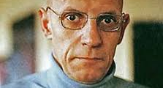
Introduction
Notes:
INTRODUCTION - It’s almost inexplicable the draw I have towards Foucault. His views on power, discourse and sexuality left me believing he was far more subversive than people knew. Although he is criticized for some of his work, theories, etc., I’m wondering if that was not on purpose on some counts. I hear what he’s saying and I’m interested but not sold however there is no question – I want to engage. Was this his purpose? Did he understand that there is a more powerful truth in communication, no matter the ‘set-up’ or complete accuracy than his peers? And with that knowledge intentionally ‘stirred the pot’. I think so.

Slide 3
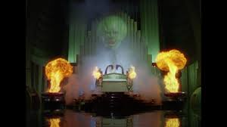
Philosophy
Notes:
He studied extensively social phenomena throughout history and discursive methodology. In my opinion, he mastered the art of ‘social discourse’. Whether you support Foucault or not, perhaps you find yourself drawn in and in a way that is not common to other philosophers. He’s not wanting you to discover what he ‘sees’ but what you see. He’s like a magician lifting the veil to the powerful politicians’ magic trick of the past like the wizard in the Wizard of Oz. Basically, he pulled back the veil so people can see history from a different and perhaps more truthful perspective and how this affects us today.
He understood it wasn’t effective enough to tell his theory and then have people agree or not agree but to leave it without offering solutions – in an effort to stimulate the masses minds and by doing so, it could guarantee more action against ‘power’. He was calculating, strategizing by NOT giving solutions in an effort to instigate or ignite a catalyst to the public so it, us, could create a solution most viable to all.

Slide 4

Theory on Mental Illness
Notes:
Theory on Mental Illness - – This points out how people in the past were simply considered different and tolerated even considered wise particularly during the Renaissance. Rather than today who must be locked away and treated. These people needed to be cured for being different. I would agree with this as conformity and superficiality are rewarded these days and just living off a piece of land to farm and be alone is fraught with obstacles. It’s as if we must be a part of a conformed society and if we don’t ‘fit the mold’ so to speak, then something must be wrong with us.

Slide 5
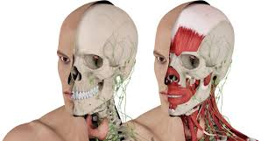
Theory on Medicine
Notes:
Medicinal View – He considered modern medicine as dehumanizing and even though it had progressed in terms of medicinal availability it had become more inhumane. An ill person was more a malfunctioning set of organs and was more of a liability to society. The patient was viewed in a way that dehumanizing. Again, I agree. When I was sick, people did not know how to cope and the mindset was to give me medicine so that I could be better and to once again become a functioning be part of the conforming society.

Slide 6
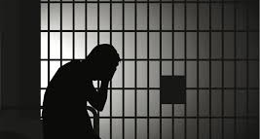
Prison and Punishment System Theory
Notes:
Prison and Punishment System Theory - regarding the present prison systems where punishment looks kinder versus in the past but actually because punishment was much more visible or public lead that belief and upon further inspection in today’s prisons, where literally all is hidden behind guarded gates, it is far more brutal and rehabilitation is more of a thought than an actual practice. The public is not aware of what the ‘power’ is actually doing.

Slide 7

Sexuality Theory
Notes:
Sexuality Theory – In one aspect of this theory, is that there is modern scientific approach to sex versus an artful erotic form in the past and that sex was repressed particularly in the nineteenth century and has gradually become more liberated. Again, Foucault uses discourse as a way to broach the subject and analyze how sexuality is in its past and current state.

Slide 8
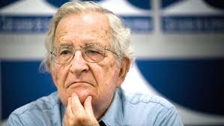
Critics and Support
Notes:
Criticism and Support - Historians widely criticize him but Foucault didn’t care for accuracy, he cared about whether we were living in a truly peaceful environment and to inspire us to philosophize ourselves. Again, his ability to invoke a different viewpoint using his style of discourse was perfectly demonstrated during a debate with Noam Chomsky.
Following the debate, Chomsky was stricken with Foucault's total rejection of the possibility of a universal morality, stating "He struck me as completely amoral, I’d never met anyone who was so totally amoral [...] I mean, I liked him personally, it's just that I couldn't make sense of him. It's as if he was from a different species, or something."
Hans-Urich Wehler says that Foucault is "because of the endless series of flaws in his so-called empirical studies ... an intellectually dishonest, empirically absolutely unreliable, crypto-normativist seducer of Postmodernism

Slide 9

Conclusion
Notes:
Conclusion - Foucault was intent on figuring out how power worked and how it could be changed by unveiling history. He was a revolutionary and intentionally controversial so as to promote his theory. We are constantly being told things today are so much better in the present than in the past but upon further investigation that is not true. Foucault prodded us to examine history to see how we can improve the present and not take our current situations for granted. The power that is present currently wants us to believe that things are better under all these ‘systems’ but they’re not. They are actually in disguise and are more oppressive and suppressive.

