Slide 1

Welcome to Academic Skills!
LCLM4001 Academic Skills
Week 5

Slide 2
Remembering last week
We learnt:
  Referencing and why it is important
  Integrity in academic and business work
  In text citations using (Author, Year)
  What plagiarism is and how to avoid it
  Using AI and library tools in an honest way
Why this matters:
It helps people trust your work
It protects you from plagiarism
It supports clear business writing
Notes:
Before we move on, let’s take a moment to remember what we worked on last week. We talked about referencing and why it is important in your studies and in business writing. We also looked at integrity, which means being honest about where ideas come from. You practised using simple in text citations with the author and the year, and we discussed what plagiarism is and how to avoid it.
We also looked at how AI and library tools can help you, as long as you use them in an honest way. You do not need to remember everything perfectly. Today we will build on these ideas, especially looking at how paraphrasing helps you avoid plagiarism and explain ideas clearly

Slide 3

From last week to this week
Let’s go to VEVOX
Notes:
Let’s start with a short Vevox warm up to remember last week’s work. These questions are not a test. They are just to help you recall the main ideas about referencing and plagiarism. Take your time and answer what feels right. After this, we will move into today’s topic, which is paraphrasing
VEVOX: 5.1,,2,3, 4

Slide 4
What today is about
Paraphrasing, which means using your own words
Understanding the difference between copying and paraphrasing
Learning simple steps to paraphrase safely
Practising paraphrasing with business and academic texts
Notes:
Today we are focusing on paraphrasing. Paraphrasing means using your own words to explain ideas from a text. This is a really important skill because it helps you avoid plagiarism and show honesty in your work. We will look at the difference between copying and paraphrasing, and we will practise using some simple steps.
We will use short business and academic texts so it feels realistic and useful. Paraphrasing is also a key skill in business, especially when you need to explain information clearly to other people. You do not need perfect English today. The focus is on understanding the idea and using your own words.

Slide 5

Paraphrasing

Slide 6
Why Paraphrasing Matters when Writing
In a paragraph:
your main idea
evidence from a source
explanation in your own words
link ideas together/link back to the question or business decision
This is also known as a TEEL paragraph structure (more on this next week!)
Paraphrasing helps you:
Use evidence safely
Show understanding, not copying
Write clear business paragraphs
Paragraphs need your words, not copied text.
Notes:
When you write a paragraph, you need evidence, but you also need to explain it in your own words. This is where paraphrasing becomes very important. Paraphrasing helps you use information from a source without copying it.
In business writing, managers do this all the time. They read reports and then explain the key ideas clearly to others. Today we are learning paraphrasing so you can do this confidently in your paragraphs
CLICK FOR ANIMATION
Remember – your own words matter, not copied text.

Slide 7
What Is Paraphrasing? What Is It Not?
Paraphrasing IS:
Using your own words
Keeping the same meaning
Showing understanding
Used in the E and E of TEEL
Paraphrasing is NOT:
Copying the sentence
Changing only one or two words
Keeping the same sentence structure
If it looks like the original, it is not paraphrasing.
Notes:
Paraphrasing means you keep the idea, but you change the words and the structure. This shows that you understand the evidence you are using. In a TEEL paragraph, this usually happens in the Evidence and Explanation parts.
Paraphrasing is not copying and it is not just changing one word.
CLICK FOR ANIMATION
If your sentence looks almost the same as the original, it is not safe. We want your writing to sound like you

Slide 8
Nick & Sarah: Who Did it Better?
Nick and Sarah are Business students working on their referencing.
Go to the worksheet and decide who paraphrased better and why.
With a partner, decide and discuss:
Which part of the extract both students used (highlight in the original)?
2) Who received the lower marks and why?
3) What are the differences between Sarah and Nick’s use of sources?
Notes:
Nwe’re going to look at an example of two Business students, Nick and Sarah, who are both working on their referencing. This will help you understand what good use of sources looks like.
Please go to the worksheet. You will see an original extract and two student versions. Your task is to decide who has paraphrased better and explain why.
Work with a partner and take your time to read all three parts carefully. Start by finding which part of the original text both students have used — you can highlight this to help you see it clearly.
Next, think about quality. One student received lower marks — discuss who this is and why. Try to be specific about what they did well or not so well.
Finally, compare the two students. What is different about how Sarah and Nick use their sources? Think about how they change the wording and how clearly they show understanding.
This is important because in business and academic work, you need to use information from sources in your own words, not just copy. This helps you show understanding and avoid losing marks.”

Slide 9
Copying vs Paraphrasing vs Summarising
Original (from a source):
Customer complaints increased by 15 percent last month.
Copying:
Customer complaints increased by 15 percent last month.
Paraphrasing
There was a clear rise in customer complaints during the last month.
Summarising
Customer complaints are increasing.
Notes:
Let’s look at the difference clearly. Copying uses the same words. Paraphrasing keeps the idea but uses your own words, which is what we want in TEEL writing. Summarising is even shorter and gives an overview.
In your TEEL paragraphs, you will usually paraphrase evidence and then explain why it matters for the business. This helps your writing sound professional and clear

Slide 10
How Paraphrasing Fits into a TEEL Paragraph
Customer complaints are becoming a serious business issue.
Reports show a noticeable increase in complaints (Smith, 2023).
This suggests customers are less satisfied with the service.
If the business does not respond, sales may fall.
Notes:
This is how paraphrasing fits into a full TEEL paragraph. The evidence comes from a source, but the explanation is written in your own words. This shows understanding and helps the reader follow your thinking. Paraphrasing is mainly used in the "Evidence" part of TEEL.
This is exactly what you will be asked to do in AS Task 2. Today we are building the skill step by step, so you feel confident when you write your assessed paragraph

Slide 11

Spot the Difference

Slide 12
What are the differences?
You will see:
One original source sentence
Three student versions
Your task is to decide:
Which version is the best paraphrase?
Which version is too close to the original?
What has changed in the best version?
Talk about
  Which words changed
  Whether the meaning stayed the same
  Which version sounds most like the student’s own writing
We are learning to choose the best option, not just what is allowed.
Notes:
Now we are going to look at how students use information from sources in different ways. None of these examples are tricks. Some are allowed, some are risky, and some are better choices for TEEL writing.
Copying with quotation marks and a reference can be correct, but it is not the main way we want you to write paragraphs. Paraphrasing is usually stronger, clearer, and more professional. Your job is to spot the difference and decide which option works best for a TEEL paragraph.
CLICK FOR ANIMATION
Remember this is not just about what is allowed but rather what is the best option.

Slide 13
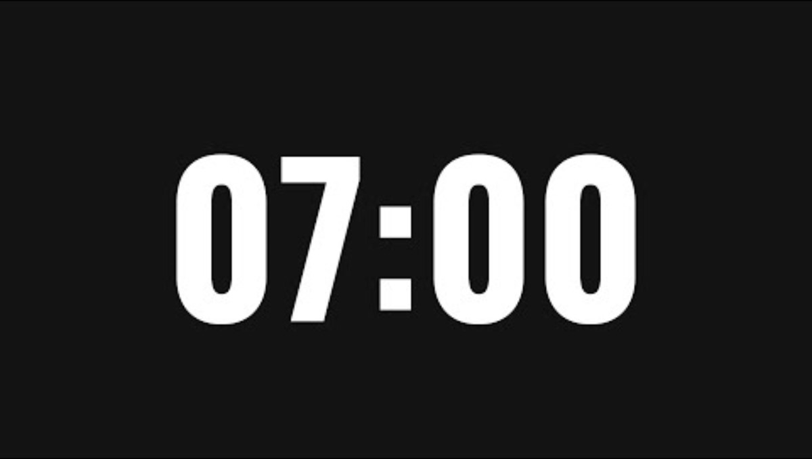
Here are the sentences
Original: Employees who receive regular training are more productive and make fewer mistakes at work.
Version A: “Employees who receive regular training are more productive and make fewer mistakes at work” (Doe, 2017, p. 4).
Version B: Regular staff training can improve productivity and reduce errors in the workplace (Doe, 2017).
Version C: Employees who get regular training are more productive and make fewer mistakes in their work (Doe, 2017).
Which version is the best paraphrase?
Which version is too close to the original?
What has changed in the best version?

Slide 14
Choosing the Best Option for TEEL
Version A: Direct quotation
  ✅ Allowed
  ⚠ Use direct quotations only sometimes. Try to use your own words most of the time. This gives direct quotations more impact when you DO use them.
Version B: Paraphrase
  ✅ Allowed
  ✅ Preferred for TEEL writing
Version C: Too close to the original
  ⚠ Risky
Notes:
Let’s check this together now. Remember, this activity was about learning how to make good choices, not about catching mistakes.
First, let’s look at Version A, the direct quotation. This version is actually allowed because it uses quotation marks and a reference. However, Direct quotations are useful, but you should not use them too much. It is important to also use your own words to show your understanding.
Now let’s look at Version B, the paraphrase. This is the one we would normally choose for TEEL writing. The meaning is the same, but the words and structure are different. This shows understanding and sounds more professional, which is what we want in business and academic writing.
Finally, Version C is the risky one. Even though it has a reference, the sentence is very close to the original. Many of the words and the structure are the same, so this could cause problems.
The key message to remember is this: quoting is sometimes allowed, but paraphrasing is usually the best choice for TEEL paragraphs. If a sentence still looks like the original, it needs more changing

Slide 15

Paraphrasing step-by-step

Slide 16
How Do We Paraphrase? Step by Step
We will do this together
Read a short paragraph
Find the key ideas
Hide the original text
Look at a paraphrase
Spot what changed
Learn simple techniques
Paraphrasing is a skill. We learn it step by step.
Notes:
Now we are going to practise paraphrasing step by step. This means I will guide you through the process and we will think together. You do not need to do this perfectly. The aim is to understand how paraphrasing works, not to memorise rules.
We will start with a short paragraph, then focus only on the key ideas. After that, we will look at a paraphrased version and notice what has changed. This will help you feel more confident when you paraphrase on your own later, especially for TEEL writing

Slide 17
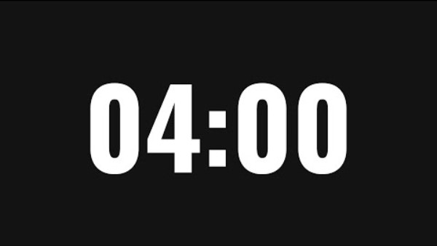
Original Paragraph
Your task:
Read the paragraph
List the key ideas
Do not worry about grammar or spelling
Focus on meaning, not wording.
Many small businesses struggle to keep customers. Long waiting times and poor communication often cause customer dissatisfaction. When customers feel unhappy, they are less likely to return or recommend the business to others. This shows that customer loyalty is important for business success.
Notes:
Please read this paragraph quietly. As you read, think about the main ideas. What is this paragraph really saying? You can list them in short words.
Do not write full sentences. We are not paraphrasing yet. We are only focusing on meaning

Slide 18
Possible key ideas
Small businesses can lose customers easily
Poor service (slow or unclear communication) leads to dissatisfaction
Unhappy customers are less likely to recommend the business
Customer loyalty is important for business success
Good service helps businesses keep customers and grow
Paraphrasing starts with ideas, not copying sentences.
Notes:
Here are some possible key ideas from the paragraph. You might have written these in slightly different words, and that is completely fine. What matters is that we are focusing on ideas, not sentences.
Notice that these are short points, not full sentences. This is important because paraphrasing becomes much easier once we let go of the original wording. Now that we have the ideas, we no longer need the original paragraph

Slide 19
Spot the Difference: Paraphrasing Techniques
Work in pairs. Look at the two texts next to each other and try and spot what has changed. Make note of the changes.
Original:
Many small businesses struggle to keep customers. Long waiting times and poor communication often cause customer dissatisfaction. When customers feel unhappy, they are less likely to return or recommend the business to others. This shows that customer loyalty is important for business success.
Paraphrased Text:
Long waits and unclear communication can make customers dissatisfied, which can make it harder for small businesses to keep them. Customers who have a negative experience may not visit the business again or suggest it to other people. Overall, loyal customers are important for businesses to succeed.
Notes:
Now we are going to look at two versions of the same idea from the text. One is the original and one is a paraphrase. Your job is to work with your partner and discover what has changed — not just what is different, but how it has changed.
Don’t worry about getting it perfect. The aim is to notice patterns in how academic writing changes information.
First, look at the two texts side by side. Read them carefully.
Now, with your partner, start by underlining any words or phrases that are the same or very similar in both versions. This helps you see what has stayed the same.
Next, look for differences. Think about these questions as you work through it:
Has any word been replaced with a different word with the same meaning?
Has the order of information changed?
Have any sentences been combined or split?
Can you spot any changes in grammar, like noun to adjective?
Are there any linking words added, like as a result or overall?
Work slowly and discuss your ideas. You don’t need to write full sentences — just note down the changes you can see.
After a few minutes, we will share ideas together and build a list of paraphrasing techniques.
If you are unsure, focus on meaning first — then think about how the wording has been changed.

Slide 20
What did you notice?
Look at your notes from the activity
What differences did you find?
Talk with another pair
Think:
What changed in the wording?
What stayed the same?
Notes:
Let’s go back to your notes from the activity. You’ve already done the hard work of spotting differences between the two texts, so now we’re just going to talk through what you found.
Work with your partner and look at your notes together. Take a moment to remind yourselves what you noticed.
Start by discussing the differences. What changed in the wording between the two texts? Think about any words or phrases that are different.
Then think about what stayed the same. Even though the wording changed, the meaning should still be similar. What ideas did not change?
Don’t worry about using perfect language — just explain your thinking to your partner in a simple way.
This step is important because in business and academic writing, we often need to change the language but keep the same meaning. That is exactly what paraphrasing does.

Slide 21
Simple Paraphrasing Techniques
You can paraphrase by:
Using synonyms: unhappy → dissatisfied; poor → unclear
Changing word order
Combining sentences
Changing word form:
The business is a success→ The business is successful.
customer dissatisfaction → customers become dissatisfied
Notes:
These are simple techniques you can use when paraphrasing. You do not need to use all of them in one sentence. Even one or two changes can make your writing much safer and clearer.
Always start by thinking about the meaning. Then choose small changes that help you express that meaning in your own words.

Slide 22
Back to Nick
Remember Nick?
He's been working on his paraphrasing after feedback from his last report. In his next report he has paraphrased the below:
"Teamwork in business helps employees complete tasks more efficiently" (Brown, 2025, p.5)
Nick changes this to:
Cooperation in business helps employees finish tasks more efficiently (Brown, 2025).
Discuss with a partner:
What has Nick changed from the original?
Will Nick's teacher be happy with this? Why or why not?
Notes:
Now it is your turn to try paraphrasing with one partner. You only need to paraphrase short sentences. Talk together first about what the sentence means, then write a paraphrase.
There is no pressure to make this perfect. This is just practice to help you build confidence. I will walk around and support you while you work. Take your time and focus on meaning.
CLICK FOR ANIMATION
AFTER THE EXERCISE:
Before we move on, let me summarise what we learned here. Good paraphrasing starts with ideas, not sentences. We change the wording and structure, but we keep the meaning the same. There is more than one correct paraphrase, and short, simple sentences are perfectly fine. What matters is that the writing sounds like you, not the source

Slide 23
Back to Nick
What has Nick changed from the original?
'Teamwork' → 'Cooperation', 'finish'→ 'complete'
2) Will Nick's teacher be happy with this? Why or why not?
No!
Nick has not changed enough of the original.
He has only selected two key words and used
synonyms. This is not enough of a change.
REMEMBER: Effective paraphrasing is a combination of
paraphrasing techniques! Changing only a few key words
still keeps the majority of the paraphrase the same!
REMEMBER:
Effective paraphrasing is a combination
of paraphrasing techniques!
Changing only a few key words
still keeps the majority of the paraphrase the same!
Notes:
Now it is your turn to try paraphrasing with one partner. You only need to paraphrase short sentences. Talk together first about what the sentence means, then write a paraphrase.
There is no pressure to make this perfect. This is just practice to help you build confidence. I will walk around and support you while you work. Take your time and focus on meaning.
CLICK FOR ANIMATION
AFTER THE EXERCISE:
Before we move on, let me summarise what we learned here. Good paraphrasing starts with ideas, not sentences. We change the wording and structure, but we keep the meaning the same. There is more than one correct paraphrase, and short, simple sentences are perfectly fine. What matters is that the writing sounds like you, not the source

Slide 24
Break time!
See you in 10 minutes ☺

Slide 25
Check Your Understanding!
Let’s go to VEVOX
Notes:
VEVOX W5. TC1-9
33. Which of these is not a paraphrasing technique?
34. What must you always include when you paraphrase from a source?
35. When paraphrasing, which of the following should you always do?
36. (Select all that apply) To effectively paraphrase, you must:
37. Choose the best paraphrased answer for this extract:
Advertising online helps small businesses reach more customers quickly.
38. Name one technique you can use when paraphrasing.
39. Which of the below extracts is the better paraphrase? Why? Original:
Clear communication in a company ensures that employees understand their tasks. It also helps prevent mistakes and misunderstandings. Managers who listen carefully can guide their teams more effectively.
40. Which of the below extracts is the better paraphrase? Why?
Original:
Regular team meetings improve collaboration and help resolve issues quickly. Managers who encourage participation can increase team motivation.

Slide 26
Let’s try it together: Gallery Walk
Move around the room and visit each poster.
At each poster:
Read the sentence.
Think about the meaning first.
Write your own paraphrase.
Try to use more than one paraphrasing technique.
Keep the same meaning.
After you have completed at least three posters, go back to your first one and look at the other answers and how they compare to yours.
Then try at least 1-2 more posters.
Remember:
There is more than one correct paraphrase.
You do not need perfect English! Just try your best.
Please do not write directly on the posters-use the sticky notes provided
Notes:
Now we’re going to get up and practise paraphrasing with a gallery walk. Around the room, you will see different posters with sentences to paraphrase. At each poster, read the sentence carefully and think about the meaning before you start writing. Then write your own paraphrase and try to use more than one technique, such as changing words, word order, sentence structure or word form. Make sure the meaning stays the same.
You do not need to complete every poster. Start by completing at least three carefully. After that, go back to your first poster and read some of the other answers. Notice how other students have expressed the same idea in different ways and compare their versions with yours. Then, if there is time, move on and try one or two more posters.
Remember, there is more than one correct way to paraphrase a sentence. The aim is not perfect English. The aim is to keep the meaning and practise expressing it in your own way.

Slide 27

Guided Practice

Slide 28
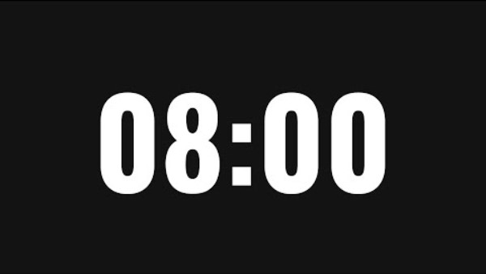
Paraphrasing Paragraphs
Work in pairs
You will:
  Read a short business paragraph
  Identify the main ideas
  Paraphrase the paragraph using your own words
Remember:
  Focus on meaning, not copying
  You do not need long sentences
  There is more than one correct paraphrase
Notes:
Now we are going to practise paraphrasing with a short paragraph instead of single sentences. This is a small step up, but you already have the skills to do it. You will work with one partner and help each other focus on the main ideas.
Your aim is not to copy the wording of the paragraph. Your aim is to explain the same ideas clearly in your own words. This is very similar to what you will do in your TEEL paragraphs for AS Task 2. I will walk around and support you while you work
REMEMBER THERE ARE TWO TEXTS: T-A AND T-B. ONE PAIR GETS ONE TEXT, THE NEXT THE OTHER TEXT.

Slide 29
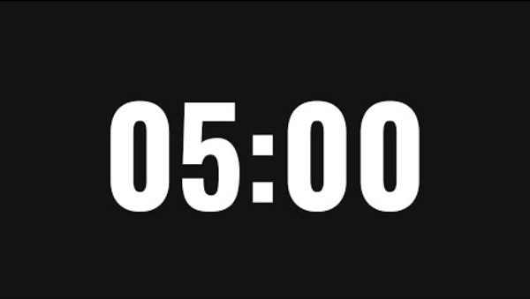
Exchange and Notice
Now work with another pair
Exchange your paraphrased paragraph
Read the other version quietly
Do not correct grammar
Do not rewrite their text
Talk about
  Is the meaning the same as the original?
  What is different from your paraphrase?
  What wording or structure works well?
Notes:
Now please exchange your paraphrased paragraph with the pair next to you. Read their version quietly first. You are not correcting grammar and you are not rewriting it.
Instead, talk together about the meaning. Ask yourselves whether the key ideas are the same as the original paragraph. Notice what they did differently from you. Different paraphrases can all be correct.
MAKE SURE THAT PAIRS THAT HAD TEXT A WORK WITH A PAIR THAT HAS TEXT B.

Slide 30
Vevox – What Did We Notice?
Notes:
Before we move on, let’s go to VEVOX for a couple of questions. I am not looking for a correct answer. I just want to see what helped you most when paraphrasing the paragraph.
You can choose one option that feels right for you. If you are still unsure, that is completely fine and you can choose that option. Paraphrasing takes practice, and today was about learning the process. I will share what I notice from the results, then we will continue.
SUMMARISE THE RESULTS BEFORE GOING ON TO THE SECOND QUESTION
VEVOX W5.5-6

Slide 31
Break time!
See you in 5 minutes ☺

Slide 32

Independent Paraphrasing Practice

Slide 33
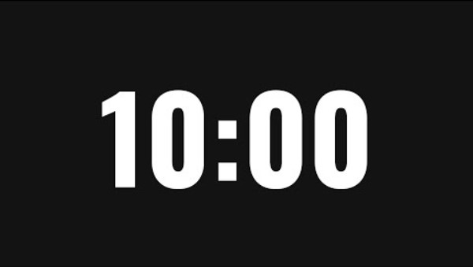
Let’s paraphrase!
Work on your own
You will:
  Read a short business paragraph on resilience
  Identify the main ideas
  Paraphrase the paragraph in your own words
Important:
Focus on key ideas, not replacing every word
You can write fewer sentences than the original
Simple language is fine
Notes:
Now you are going to try paraphrasing on your own. This is an important step because it helps you see that you really can do this without a partner. You will work quietly and take your time.
This paragraph comes from a real source. Your job is not to keep the language, but to explain the ideas clearly in your own words
Your aim is not to create a perfect paraphrase. Your aim is to show that you can identify the main ideas and explain them in your own words. This is very similar to what you will do in AS Task 2. I will walk around and support you, but I will not rewrite sentences for you

Slide 34
What Did We Practise?
Today you practised:
Finding main ideas in a source
Letting go of the original wording
Explaining ideas in your own words
Paraphrasing without copying
What matters
There is more than one good paraphrase
Simple language is OK
Paraphrasing improves with practice
Notes:
Let’s pause here and wrap up this activity. You have just worked on paraphrasing a short paragraph from a real source on your own. That is not an easy skill, especially in a second language, so well done for having a go.
The important thing to remember is that paraphrasing is about ideas first, not words first. You practised identifying key ideas and then explaining them in your own way. Different people will write different paraphrases, and that is completely normal. Simple, clear language is absolutely fine.
This is exactly the skill you need for the Evidence and Explanation parts of a TEEL paragraph. We are not aiming for perfection today. We are building confidence and a process you can reuse
CLICK FOR ANIMATION.
VEVOX INTRO:
Before we move on, let’s take one minute to check in using Vevox. This question is not testing you and there is no right or wrong answer. I just want to see how this activity felt for you.
On Vevox, please choose the one option that feels most true for you right now. If you found paraphrasing difficult, that is completely normal. If you feel unsure, that is also fine. Paraphrasing is a skill that takes time and practice.
Once everyone has answered, I will briefly look at the results and we will continue together. Thank you for giving it a try.
VEVOX W5.7

Slide 35
Reflection
Please answer:
What did you learn about paraphrasing today?
What part of paraphrasing do you still find difficult, and what would help you?
Write full and short sentences. Use simple English.
You will post your answers on Moodle in the forum “Reflection Space – Individual”.
Only you and the tutor can see your post.
This is not marked.
You do not need to share with the class.
Notes:
We’re going to finish today with a short reflection.
On the screen, you can see three sentences to complete.
You only need to write three short sentences.
Simple English is fine: this is not a test.
When you have written your three sentences, please post them on Moodle in the forum called ‘Reflection Space – Individual’.
Your post is private; only you and I can see it.
It is not marked, and you do not need to share with the class.
If you need help with Moodle or with writing your sentences, put your hand up and I will come to you.

Slide 36

Recap

Slide 37
Today we learnt:
What paraphrasing is
Why paraphrasing matters
How to use our own words
How to find key ideas in a text
How to write a short summary
Why summaries help business decisions
Notes:
Before we finish, let’s quickly look at what we learnt today. We talked about what paraphrasing is and why it is important. You practised using your own words instead of copying. You also practised finding key ideas in a text.
We then looked at how to write a short summary by keeping only the most important points. This skill is useful in your studies, but also in business, where people need clear and short information. You do not need to remember everything perfectly today. The goal was to understand the process and build confidence. We will keep practising these skills in future sessions.

Slide 38


Next Week:
Writing in a business context
Notes:
Before we finish today, I want to tell you what we will do next week.
In Week 6, we will focus on writing in a business context.

Slide 39
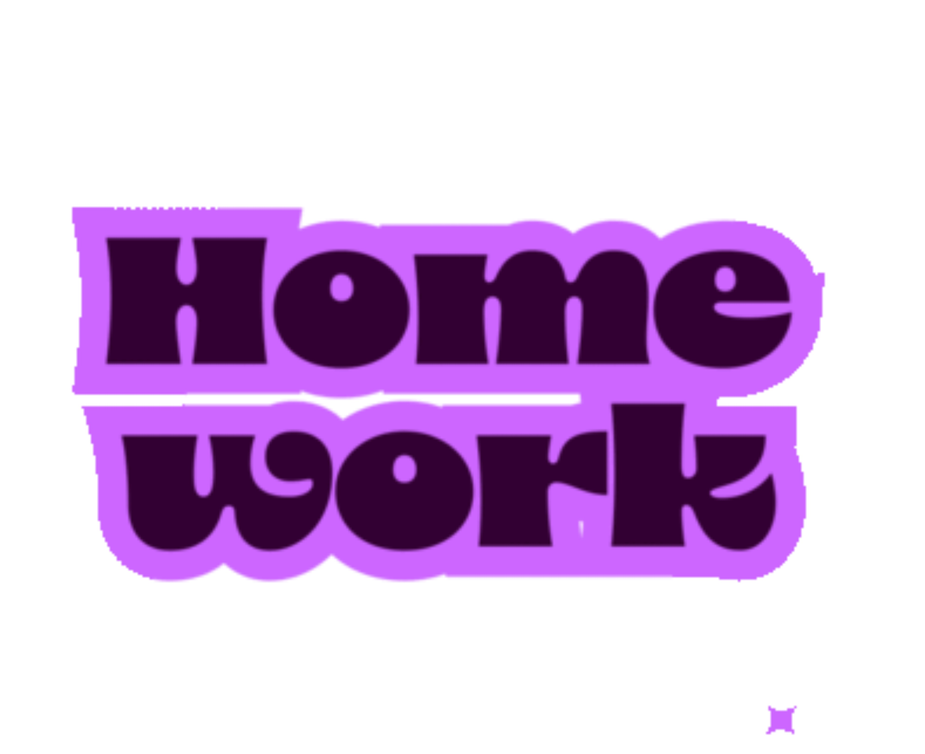
Homework for Week 6
Open Moodle
Go to this module (Academic Skills)
Click Assessment Information and Submission
If you haven't yet done so, complete the lesson:
AS2: Paragraph Writing: Assessment Information and Help
Your teacher WILL be checking if this is complete by next week!
Open Moodle
Go to this module (Academic Skills)
Click Week 5
Complete the 2 tasks identified.

