Slide 1
The purpose and effectiveness of social policy.
The impact discourse.

Slide 2
Outline
What is social policy?
What is social policy for?
What is Government for, what is its purpose?
What impacts are Government trying to achieve?
How do Governments aim to achieve this purpose?
Case study – health and mental health

Slide 3

What is Social Policy?
A field of study which entails the economic, political, sociolegal and sociological examination of the ways in which central and local governmental policies affect the lives of individuals and communities.
Jary, J. and Jary, D. (2000) Dictionary of Sociology. Glasgow, Harper Collins

Slide 4
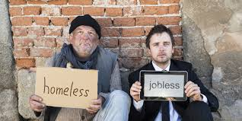
What is the problem?
If poverty is the ‘lack of material resources, especially income, necessary to participate in British society’, social exclusion ‘refers to the dynamic process of being shut out, fully or partially, from any of the social, economic, political and cultural systems which determine the social integration of a person in society’ (Walker and Walker, 1997)

Slide 5
Different discourses concerning the same social ‘problem’ , see Levitas:
SID, MUD, RED
http://www.youtube.com/watch?v=aOJ93tAbPP0&feature=player_embedded#t=0
What do you think about the idea of redistribution after watching the video clip?

Slide 6
What is social policy?
What is Social Policy?
https://youtu.be/Ccff_50dFP4 – promoting welfare and well-being?
Social Policy – More Fun, big p and small p
https://youtu.be/wXYSsA5yVSY
State of the Nation
https://www.gov.uk/government/publications/state-of-the-nation-2017

Slide 7
Limitations to Social Policy
Concerns with government led attempts to control deviancy and ‘underclass’?
Where does social policy come from?
What theoretical analysis or models underpin social policy?
Where does policy for children and young people come from?
How do these discourses influence the research being carried out into the lives of children and young people?
Central Government?
Welsh Government?
Local Government?
Organisational Level?
Poverty, welfare, underclass, economic productivity, wellbeing?
Quality, accountability, results, impact,
Children and yp centred services

Slide 8
Constructing the problem: trouble?
‘Rationing resources is integral to political life, though the nature of the state’s justifications for expenditure are contingent on time and place, and, in particular, on the state’s role, constructions of childhood and whatever other issues are most pressing at that point in time’ (Piper, 2008: 14).

Slide 9
Different ideologies?
https://youtu.be/UfmFIEh2QjU
Short video exploring differences in education systems – Finland and USA

Slide 10
Perspective is crucial to social justice
Perspective is crucial to social justice and seeing the world for what it is.

Slide 11
A matter of perspective
One of the issues surrounding mental health and young people is how the phenomenon of mental health is viewed.
Perspective is important and our world view will have an influence on what we think is true, which in turn influences how we might respond to the issue of mental health and well-being.

Slide 12
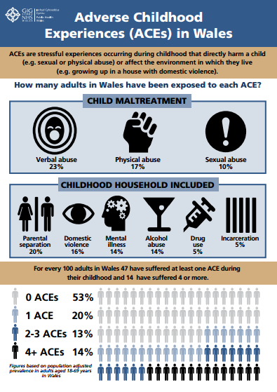
Adverse Childhood Experiences
An idea which has gained popularity among politicians and policy makers in Wales and further afield.
It has been argued that so-called risk taking behaviours such as smoking, drinking, drugs and sex are related to young people’s attempts to feel adult in the uncertain landscape of the ‘risk’ society in which they are constructing their personal and social identities (Henderson et al, 2007, 86)

Slide 13
The Scale of the problem
If you haven't experienced mental health issues personally or through someone you know, then you're lucky, because statistics have revealed that one in four of us in Wales will at some point have a mental health problem.
(Evans, 2016, 10)

Slide 14
Mental Health Issues
Professor Sir Mansel Aylward CB, chairman of the All Wales Mental Health Promotion Network, has said: "Mental illness is widespread.”
"Its consequences are multidimensional, so the potential benefits of prevention are extremely high.”
"Mental health promotion interventions can raise self-esteem and strengthen people's life and coping skills, as well as their emotional resistance.”
"The report illustrates just how much mental health problems cost the Welsh economy -- both in terms of treatment and loss of earnings."
He added: "Although there may be many gaps in the data, the economic benefits of improving mental health may be extensive."
The report underlines how mental illnesses can happen early on in life and people can end up battling the problems throughout their adult life.

Slide 15
Mental Health Issues (continued)
Professor Aylward added: "Subjective well-being increases life expectancy by 7.5 years.
"It improves recovery and health outcomes from a range of chronic diseases such as diabetes.”
"In young people, it significantly influences the use of alcohol, tobacco and cannabis.”
"A positive disposition also predicts positive social behaviour, such as participation, civic engagement and volunteering."

Slide 16
Response from the Chief Medical Officer
Dr Tony Jewell, Chief Medical Officer for Wales, added: "I welcome this analysis of the benefits of promoting mental health in Wales, and I have emphasised the need for a greater focus on mental health in Wales."
He added: "This not only applies to NHS services which treat people with mental health problems, but also to improving the mental health and well-being of the population through activities in all sectors."

Slide 17
Young People’s Mental Health
‘With the right support, people managed to overcome some of the toughest challenges to lead positive and successful lives. And yet despite the resources that have gone in to support people with mental health issues in recent years, and the campaigning to reduce the associated stigma, there is still a long way to go.’
(Robinson, 2016, 3)

Slide 18
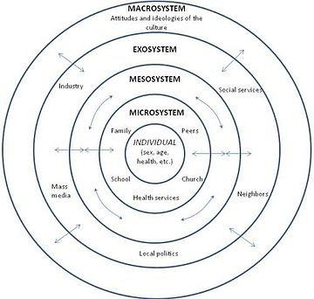
Bronfrenbrenner’s Ecological Systems Model
Microsystem: Refers to the institutions and groups that most immediately and directly impact the child's development including: family, school, religious institutions, neighbourhood, and peers.
Mesosystem: Interconnections between the microsystems, Interactions between the family and teachers, Relationship between the child’s peers and the family
Exosystem: Involves links between a social setting in which the individual does not have an active role and the individual's immediate context. For example, a parent's or child's experience at home may be influenced by the other parent's experiences at work. The parent might receive a promotion that requires more travel, which might increase conflict with the other parent and change patterns of interaction with the child.
Macrosystem: Describes the culture in which individuals live. Cultural contexts include developing and industrialized countries, socioeconomic status, poverty, and ethnicity. A child, his or her parent, his or her school, and his or her parent's workplace are all part of a large cultural context. Members of a cultural group share a common identity, heritage, and values.
Chronosystem: The patterning of environmental events and transitions over the life course, as well as sociohistorical circumstances. For example, divorces are one transition. Researchers have found that the negative effects of divorce on children often peak in the first year after the divorce. By two years after the divorce, family interaction is less chaotic and more stable.

Slide 19
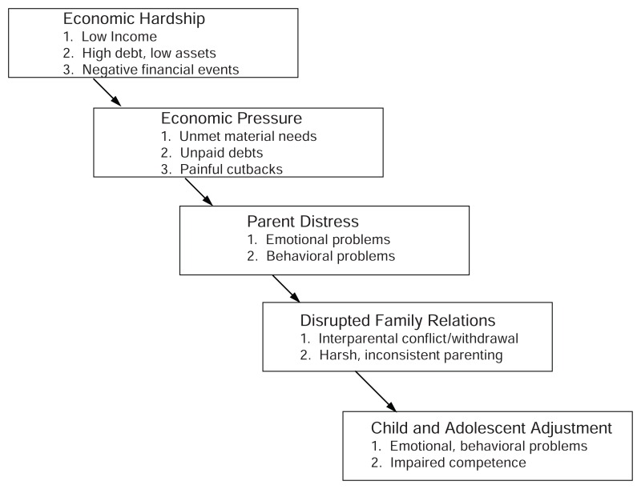
Social Policy - Austerity and Family Stress
What purpose does political Austerity have?
Conger R.D., Conger K.J. (2008)

Slide 20
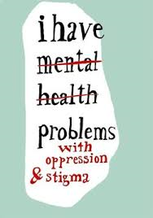
Children and Young People
For many people who live with mental illness, stigma is a significant contributor to a host of adverse consequences, such as hopelessness, reduced self-esteem, delayed help-seeking, diminished quality of life, and poorer clinical outcomes—to name a few.

Slide 21
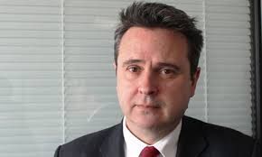
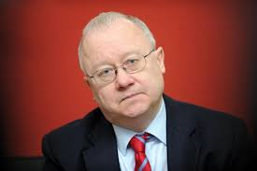
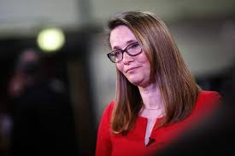
The issue of Education
Education Ministers approach to recent PISA Results
Welsh Education Ministers have consistently set targets for our education system and these targets have consistently not been met.
What does this tell us?
What does this mean for education in Wales?
What does this mean for our young people?
What does this mean for the future of Wales?

Slide 22
How can we work with children and young people to prevent problems and avoid them getting worse?
http://www.bbc.co.uk/news/uk-wales-38208738 Wales Pisa Results 2016
https://youtu.be/qRJ1hgN7uAU Finland and the USA

Slide 23
The issue of Alcohol
70% of Year 9 students and 89% of Year 11 students have had an alcoholic drink. Regular drinking is significantly lower amongst Year 9 than Year 11 students.
The most common age for a first drink was 12 to 13; usually when with an adult and celebrating a special occasion.
Year 9 students are most likely to have been drinking alcopops, beer or lager. By Year 11, students are most likely to drink beer, lager, spirits or liqueurs. In both year groups, those drinking beer and lager are consuming much larger quantities of these drinks than any other type of drink.
(JRF, 2011)
Young people are more likely to drink, to drink frequently and to drink to excess if they:
  receive less supervision from a parent or other close adult;
  spend more than two evenings a week with friends or have friends who drink;
  are exposed to a close family member, especially a parent, drinking or getting drunk;
  have positive attitudes towards and expectations of alcohol; and
  have very easy access to alcohol.

Slide 24
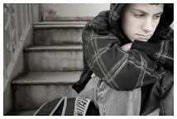
The issue of Housing
The prevalence of psychiatric disorders in homeless young people was high and considerably higher than that reported for this age group in the general population. There is a need for improved uptake of services delivering longer term treatment of psychiatric problems among vulnerable groups of socially excluded young people (Hodgson, 2014).

Slide 25

The issue of Self Harm
Self-harm is a scary and isolating experience, not just for young people, but also for parents and professionals trying to help a young person through it
https://youtu.be/uKGciUB8OSg

Slide 26

Scale of self-harm
Self-harm is a growing problem in Wales with approximately 5,500 emergency admissions to hospital each year.
It is likely that this figure grossly underestimates the number of occasions when people harm themselves because many who do so may not seek services or go to hospital and of those who do attend hospital, only a percentage is admitted.

Slide 27
Self Harm (continued)
The Welsh Government’s suicide and self-harm prevention strategy for 2015-2020, shows that the age and pattern of self-harm, to be most concerning for young women aged 15-19 who were shown to have the highest prevalence. Between 2013 and 2014 more than 1,500 patients aged 10-19 were treated at Welsh hospitals with 1,223 girls being treated for self-harm compared with 319 boys.

Slide 28
Young people talking
One 14-year-old boy who contacted Childline said: “Sometimes I get flashbacks from what happened when I was younger and I cope with the horrible memories by cutting myself. School helped take my mind off things but now that the holidays are here I’m struggling. My parents always seem to be too busy for me and I don’t want to tell my friends what happened. I feel so miserable and lonely – can you please help?”
A 14-year-old girl told counsellors: “Recently I’ve lost some people that were really close to me. When I started to self-harm it seemed to mask the emotional pain I was feeling, even if it only helped for a little while. When I get the urge, I can’t seem to stop it until it’s done; otherwise I get really upset and angry. A couple of times I’ve gone too far and ended up in hospital.”
(Bosley, 2016)

Slide 29
Policy Context
In groups, consider the document below, address the question – from your perspective, how well effectively is social policy meeting the needs of children and young people with mental health issues?
Welsh Government’s 10 year strategy for mental health and wellbeing, Together for Mental Health, published in 2012 aims to promote mental wellbeing of all people in Wales and, where possible, prevent mental ill-health from developing.
https://www.mentalhealth.org.uk/sites/default/files/FF16%20Wales.pdf

Slide 30
What does the evidence of impact say?
Corrigan summarized research regarding the outcomes of health promotion publicity campaigns as, “mostly lacking, providing moderate support for penetration at best, and failing to show meaningful impact at this time” (p. 81). In combination with the findings of other studies, our study suggests that media campaigns may be most likely to achieve improvements in health literacy outcomes (e.g., improved education and awareness) and are less effective for producing immediate or direct reductions in the personal stigma and social distance associated with mental health issues.

Slide 31
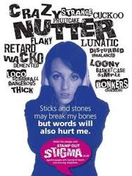
Extent of mental ill-health in Wales
The specialist Child and Adolescent Mental Health Service in Wales (CAMHS) is under more pressure than ever before. The last four years has seen a 100% increase in demand.
The rate of children subject to Child Protection Plans and on Child Protection Registers has increased in all four nations of the UK. Between 2002 and 2014, there was a 72% increase in Wales, which was the second highest across the UK.

Slide 32

First Welsh Adverse Childhood Experiences Survey
Findings from the first Welsh Adverse Childhood Experience (ACE) study shows that children who experience stressful and poor quality childhoods are more likely to adopt health-harming behaviours during adolescence and adulthood which can themselves lead to mental health problems and diseases such as cancer, heart disease and diabetes in later life.

Slide 33
Does childhood have to look like this?
Other cultures, other countries, other systems have different priorities.
The Scandinavian countries are widely recognised as having a balanced approach to childhood which emphasises enjoyment ad achievement.
Children go wild in Denmark
How to Russ

Slide 34
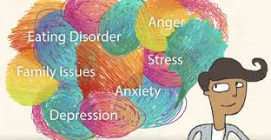
Where can children and young people get help?
CAMHS offer assessment and treatment when children and young people have emotional, behavioural or mental health difficulties, such as:
  violent or angry behaviour
  depression
  eating difficulties
  low self-esteem
  anxiety
  obsessions or compulsions
  sleep problems
  self-harming
  effects of abuse or traumatic events.
CAMHS can also diagnose and treat serious mental health problems such as bipolar disorder and schizophrenia.

Slide 35

What is new?
The T4CYP Programme was launched to improve the emotional and mental health services for children and young people in Wales. The programme is led by NHS Wales to provide improved support for children and families through new ways of working.
The programme focuses on:
Supporting early years’ development
Promoting wellbeing and resilience of all young children
Early identification and intervention
More specialist services.

Slide 36
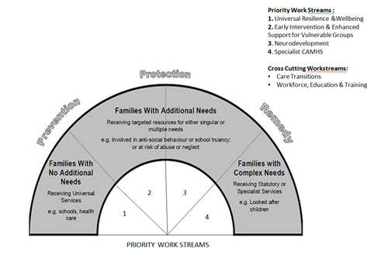
T4CYP Model: Windscreen Model

Slide 37
T4CYP is focussing on implementing service change and improvement. Specific areas of work will include:
Universal Resilience and Wellbeing; to consider the issue of building early years resilience in children and young people.
Early Intervention and Enhanced Support for Vulnerable Groups; to consider the concept of early intervention for a broad audience and explore its application in supporting young people’s mental health.
Neurodevelopment; to consider how best, and who is best placed, to meet the needs of those with neurodevelopmental and learning disabilities in a timely and effective manner, with the appropriate level of input from sCAMHS.
Specialist Child and Adolescent Mental Health Services (CAMHS); starting with a baseline variations audit of provision of sCAMHS this work stream will develop a delivery and quality framework based on achieving consistent outcomes across Wales. It will be based on the Choice and Partnership Approach, a clinical system widely adopted by CAMHS services. This framework will be implemented in 2016.
Workforce, Education and Training; to consider the staffing and training needs across, education, health social services and third sector partners to deliver effective models of care and good practice
Care Transitions; to consider all aspects of the transition of children and young people between services. This will include the transition from adolescent to adult mental health services, early years transitions and the transfers between health and youth justice services.
Health Needs Assessment; a refresh and extension of the work undertaken by Public Health Wales (PHW) in 2011;
Engagement with Children and Young People; Children and young people are being given the opportunity to develop and shape the future delivery of emotional and mental health services through broad roots engagement that captures the well being of all children and not just those who use Child and Adolescent Mental Health Services (CAMHS). This includes working closely with Children in Wales, the Children’s Commissioner’s office, and the third sector ‘High Needs Collaborative’.

Slide 38
Priority Areas for Attention 1 and 2
Early Years and Resilience of Young People:
Whole school approaches to promoting mental health and wellbeing
Attachment issues for mothers with perinatal problems
Training professionals across statutory and third sectors in child development and mental health
Early years’ support
Early Intervention and Enhanced Support:
Identification of young people at risk of development of severe mental illness such as psychosis, severe eating disorders or severe self-harm
Cross sector services with emphasis on early support
Support for the most vulnerable children and young people (CYP) including Looked After Children (LAC)

Slide 39
Priority Areas for Attention 3 and 4
Neuro Developmental Issues and Co-morbid MH/ LD:
Better understanding of ADHD/ASD across all agencies
Bespoke care pathways for individuals with ADHD/ ASD
Timely access to those needing specialist assessment and treatment services
Drawing together the skills of mental health, paediatrics, therapists and LD
Specialist CAMHS Pathway:
Crisis care and out of hours provision
Cross sector working to deliver best possible care to improve outcomes
Early intervention for young people with psychosis
Evidence based psychologically-minded therapies

Slide 40
Please consider
The Wellbeing of Future Generations (Wales) Act (2015) compliments this commitment to fostering the wellbeing of the nation by ‘improving the social, economic, environmental and cultural wellbeing of Wales.’ One of eight goals established within the Act is a vision of a ‘healthier Wales’ and a set of national indicators are being produced to monitor progress towards these goals.
Young People's Leaflet
“We have big ambitions for protecting our environment and the future generations in Wales and are leading the way with our Environment Act and Well–being of Future Generations Act” Sophie Howe | Future Generations Commissioner for Wales

Slide 41
WFG (Wales) Act
Taking a long term view: we need to build real insight as to what the future might look like if we achieve the goals, or fail to tackle the biggest threats, to help public bodies to plan for the future
Taking an integrated approach: when one organisation or department takes a decision, there is a knock on impact for another. Public bodies must work together to understand their collective contribution to all seven of the well-being goals, avoiding the temptation to simply focus on one or two
Involving people with an interest in achieving the well-being goals: I firmly believe real and meaningful dialogue between communities, individuals and their public services is crucial if we are to meet the needs of the current generation, without compromising the ability of future generations to meet their needs
Collaboration: We need to create a better understanding of what true partnership looks and feels like, along with breaking down barriers and building understanding of the benefits
Preventing problems from occurring or getting worse: Again, Wales has been discussing the concepts of prevention and early intervention for a long time. We have made progress in some areas but we need to step up the action if we are to improve the lives of citizens and if public services are to manage the challenges now and in the future

Slide 42
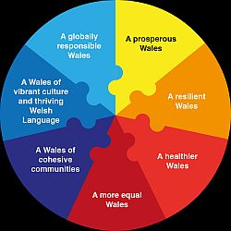
Delivery Plan of the Future Generations Commissioner for Wales
https://futuregenerations.wales/wp-content/uploads/2017/02/Draft-Strategic-Plan-ENG-1.pdf

Slide 43
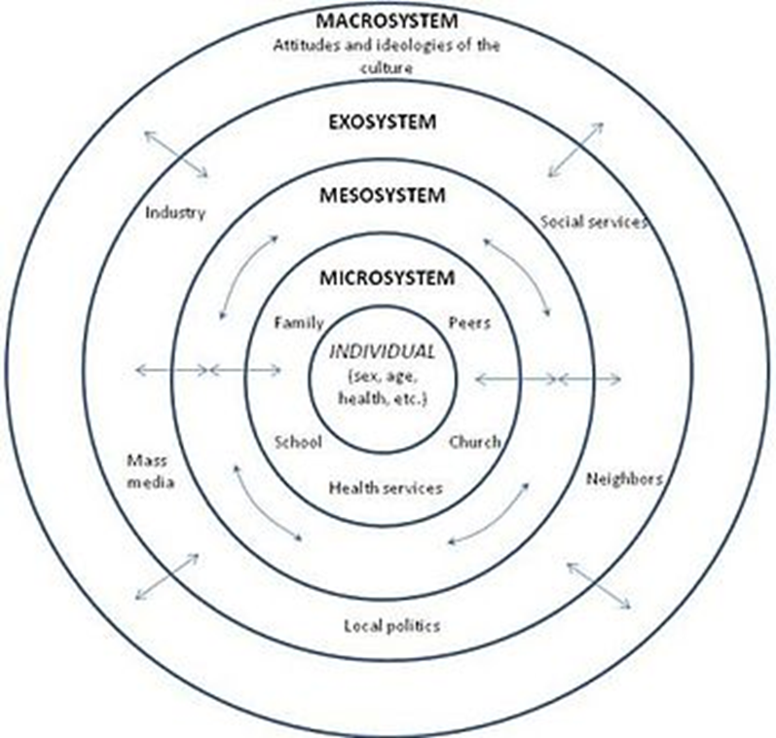
Looking at the implications for society
In groups, discuss the implications of Wales plans to improve the mental health and well-being of children and young people – draw on Bronfrenbrenner’s Ecological Systems Model to aid your understanding and provide structure for your analysis.

Slide 44
Research Informed Practice
https://www.rip.org.uk/
Centre for Youth Impact
http://www.youthimpact.uk/

Slide 45

Discussion
What questions do you have arising from the lecture today?
How can you use what you have learned to support your thinking in relation to module assessment?
How can you address some of these issues?

Slide 46
Key Points
Social policy developed at different levels.
Social policy resources at this point are increasingly rationed.
Social policy is developed in response to social problems.
How policy makers, decision makers, the public and the media construct our understanding of issues will influence our social policy climate.
The UK has a predominant narrative or discourse of social policy being rationed, that resources should be allocated where they are most needed.
What is the evidence for impact of evidence informed practice?
The role of the media in perpetuating or challenging dominant discourses.
Who is listening?

Slide 47
References
Bosley, S. (2016) Self-harm by children rises steeply in England and Wales. Guardian (online). https://www.theguardian.com/society/2016/dec/09/self-harm-children-rises-steeply-england-wales
Cavelti M, Kvrgic S, Beck EM, Rusch N, Vauth R (2011) Self-stigma and its relationship with insight, demoralization, and clinical outcome among people with schizophrenia spectrum disorders. Compr Psychiatry. doi:10.1016/j.comppsych.2011.08.001 PubMedGoogle Scholar
Conger R.D., Conger K.J. (2008) Understanding the processes through which economic hardship influences families and children, Handbook of families and poverty. Crane DR, Heaton TB, editors. Thousand Oaks, CA: Sage; 2008.
Corrigan PW, Sokol KA, Rusch N (2011) The impact of self-stigma and mutual help programs on the quality of life of people with serious mental illnesses. Community Ment Health J. doi:10.1007/s10597-011-9445-2
Evans, P. (2016) Bring mental health issues into the open. South Wales Evening Post; Swansea (UK) 19 Oct 2016.
Henderson, S, Holland, J, McGRellis, S, Sharphe, S, and Thomson, R. (2007) Inventing adulthoods a biographical approach to youth transitions. London: SAGE.
Hodgson, K, Shelton, K, van den Bree, M.M, Mental health problems in young people with experiences of homelessness and the relationship with health service use: a follow-up study. Evidence - Based Mental Health; London 17.3 (Aug 2014): 76.
Joseph Rowntree Foundation (2011) Young People, Alcohol and Influences. Online https://www.jrf.org.uk/report/young-people-alcohol-and-influences (21.02.17)
Livingston JD, Boyd JE (2010) Correlates and consequences of internalized stigma for people living with mental illness: a systematic review and meta-analysis. Soc Sci Med 71:2150–2161. doi:10.1016/j.socscimed.2010.09.030 PubMedCrossRefGoogle Scholar
National Assembly for Wales, Children, Young People and Education Committee. (2014). Inquiry into Child and Adolescent Mental Health Services (CAMHS). Retrieved from http://www.assembly.wales/laid%20documents/crld10016%20-%20report%20by%20the%20children,%20young%20people%20and%20education%20committee%20-%20inquiry%20into%20child%20and%20adolescent%20mental%20health/cr-ld10016-e.pdf [Accessed on: 19/08/2016].
Perkins, E. (2010) Report claims mental health issue costing Wales £7.2bn. South Wales Evening Post; Swansea (UK) 17 Mar 2010.
Public Health Wales. (2016). Welsh Adverse Childhood Experiences (ACE) Study: Adverse Childhood Experiences and their impact on health-harming behaviours in the Welsh adult population. Retrieved from http://www2.nphs.wales.nhs.uk:8080/PRIDDocs.nsf/7c21215d6d0c613e80256f490030c05a/d488a3852491bc1d80257f370038919e/$FILE/ACE%20Report%20FINAL%20(E).pdf [Accessed on: 22/03/2016].
Robinson, s. (2016) Tackling mental health issues: Prince's Trust. South Wales Evening Post; Swansea (UK) 18 May 2016.
Schomerus G, Matschinger H, Angermeyer MC (2009) The stigma of psychiatric treatment and help-seeking intentions for depression. Eur Arch Psychiatry Clin Neurosci 259(5):298–306. doi:10.1007/s00406-009-0870-y PubMedCrossRefGoogle Scholar
Self Harm UK. (2016). The facts: Self-harm statistics. Retrieved from https://www.selfharm.co.uk/get/facts/self-harm_statistics [Accessed on: 02/04/2016].
Walker, A. and Walker, C. (1997) (Eds.) Britain Divided: The Growth of Social Exclusion in the 1980s and 1990s, London, CPAG.

