Slide 1

Sesiwn Adolygu
Revision Session
Meryl Bowen
m.bowen@uwtsd.ac.uk

Slide 2

Adyfyrio ar y modwl
Reflecting on the module
Notes:
Er mwyn cynorthwyo ni i wella’r cwrs, allwch chi nodi ar y padlet os gwelwch yn dda?
Could you provide us with two stars and a wish as feedback for the ECAD5007 please.

Slide 3
Teitl a manylion cyflwyno
Title and submission details
Dewiswch ymyrraeth sydd yn cefnogi dysgu a datblygiad disgybl/grŵp o ddisgyblion. Adfyfyriwch yn feirniadol ar ei botensial i sicrhau cynnydd disgyblion a’r heriau posib all ymddangos.
Nifer o eiriau: 4,000 o eiriau
Dyddiad cyflwyno:
27/02/23
(23.59 p.m.)
Choose an intervention that supports the learning and development of a pupil / group of pupils. Reflect critically on its potential for ensuring pupil progression and the possible challenges that may arise.
Word Count: 4,000 words
Submission date:
27/02/23
(23.59 p.m.)
Notes:
Ydy nhw wedi penderfynu ar yr ymrraeth? Pwyso ar agwedd feirniadol, pwyso a mesur am gryfderau a gwendidau cefnogoI. Sicrhau Cynnydd. Adnabod yr heriau o gynnal ymyrraeth cost, ymrwymiad rhieni, cynorthwyydd gorfod mynd i’r dosbarth, covid gorfod gwneud gyda ag unigolyn yn hytrach na grŵp o blant - o ganlyniad mwy o amser yn mynd o fewn yr amserlen, ystafell sy’n rhydd, cost yr hyfforddiant, hyfforddiant o ran amser, oes un i un gyda pob plentyn. Stico i 4000 , o dan efallai bod chi heb drafod popeth.
Have you chosen an intervention? Can you be critical of an intervention, what are the intervention’s strengths and limitations with regard to supporting. You must ensure progression. What are the challenges facing intervention programs, cost, parental engagement, an LSA having to cover a clas and not able to provide an intervention, possible with covid, only 1:1 support rather than Group interventio, space a room to conduct effective intervention. The cost of training, time contraints with training, does every child have a 1:1. Stick to 4000 words, if you don’r have enough, perhaps you haven’t discussed everything?

Slide 4
Manylion aseiniad
Assignment details
Dewiswch unigolyn neu grŵp o blant penodol rhwng 7 ac 11 oed. Rhowch drosolwg o’u cefndir e.e. oed, rhyw, lefel datblygiad, unrhyw wybodaeth berthnasol arall.
Eglurwch pa agwedd o ddysgu neu ddatblygiad rydych chi am ei dargedu a pham e.e. iaith a llythrennedd, corfforol, emosiynol, cymdeithasol, gwybyddol, ymddygiad, lles, MATh ADY a.y.y.b
Choose a specific individual or group of children aged 7 to 11 years. Provide an overview of their background e.g. age, gender, level of development, any other relevant information.
Explain which aspect of learning or development you want to target and why e.g. language and literacy, physical, emotional, social, cognitive, behaviour, wellbeing, MAT, ALN etc.
Notes:
Pa agwedd, s’dim rhid iddo fe fod yn ADY, clwb amser cinio i wella gweithgaredd corfforol.
What aspect, the intervention doesn’t have to be ALN, it could be a ‘coding’ Group at lunch time, a physical intervention after school?

Slide 5
Manylion aseiniad
Assignment details
Esboniwch beth yn union a olygir wrth ‘gynnydd’ mewn dysgu a datblygiad a pham mae’n bwysig cefnogi’r agwedd yma o ddysgu neu ddatblygiad y plentyn. Dylai athroniaeth ac ymchwil danseilio’r drafodaeth yma.
Dewiswch ymyrraeth addas ar gyfer eich plentyn/grŵp gan esbonio pam y dewisoch yr ymyrraeth hyn yn benodol, sut y byddwch yn ei weithredu a phwy fydd yn gyfrifol am hynny. Gwerthuswch hyn yn feirniadol gan ystyried y rhinweddau cadarnhaol a’r agweddau negyddol all godi wrth ei weithredu. Gallwch gyfiawnhau eich dewis trwy adfyfyrio ar arfer dda a arsylwyd ar PAP neu o ymchwil e.e. Estyn ac ati.
Explain what is meant by 'progress' in learning and development and why it is important to support this aspect of the child's learning or development. Theory and research should underpin your discussion.
Choose a suitable intervention for your child / group explaining why you specifically chose this intervention, how you will implement it and who will be responsible. Critically evaluate this, considering the positive qualities and negative aspects that can arise in its implementation. Justify your choice by reflecting on good practice observed on PTE or from research e.g. Estyn etc.

Slide 6
Manylion aseiniad
Assignment details
Trwy gydol yr aseiniad, cofiwch ddangos gwybodaeth a dealltwriaeth gadarn o ddatblygiad plant a’r athroniaeth sy’n sail i hynny, pam mae’n bwysig cefnogi cynnydd yn eu dysgu a’u datblygiad a beth yw’r goblygiadau ar gyfer athrawon a staff ysgol.
Cefnogwch eich safbwyntiau gyda chyfeiriadau at ddarllen cefndirol ac ymchwil cyfredol trwy gydol yr aseiniad.
Throughout the assignment, demonstrate a sound knowledge and understanding of child development and the underpinning theory, why it is important to support progress in learning and development and the implications for teachers and school staff.
Support your views throughout the assignment with references to background reading and current research.
Notes:
Rhaid cynnwys cynnydd mewn dysgu, rhaid cynnwys athroniaeth, y theori
Shwt y’ch chi’n darparu yr ymyrraeth, y beth y sut, y pwy a’r ble? Ymyrraeth unigolyn, grŵp, neu ddosbarth gyfan, ble mae ymyrraeth yn ffitio
Gwerthuso fe gyda thystiolaeth o PAP 1 NEU 2 neu mewn gwaith – rhaid cofio moeseg, dim enwi plentyn ysgol BERA. Edrych am astudiaethau achos/gwelliant ysgol ESTYN adnoddau gwella
Gwneud defnydd o’r llyfrgell ac chylchgronau academaidd yn y llyfrgell ac adnoddau academaidd. Mwy beirniadol o wefannau , rhaid bod e’n gyfredol ee. CiG 2022
You must include progress, theory and philosophy.
How will you provide the intervention, the what, how, who and where? Is it an intervention for a pupil, group of pupils or a whole class? Where does the intervention fit?
Evaluate it with evidence from PTE 1 OR 2 or from your workplace – you must remember ethinicty, not to name a child from school and follow BERA guidelines. Look at ESTYN educational case studies/school improvement.
Make good use of the library, academic journals, academic resources, keep away from .com sites. Be critical, use current literature e.g. Welsh Government documents, Curriculum for Wales.

Slide 7
Ymgysylltu â llenyddiaeth
Engagement with literature
Defnyddiwch nodiadau a deunydd darllen o ddarlithoedd, deunydd ychwanegol a lwythwyd ar Moodle a llyfrau o restr ddarllen y modwl yn ymwneud â datblygiad plant a’r maes dewisol ar gyfer ymyrraeth. Dangoswch dystiolaeth hefyd o ddarllen cyfredol ehangach a ffynonellau a gyrchwyd yn annibynnol gan gynnwys llyfrau a chylchgronau academaidd. Cyfeirnodwch pob ffynhonnell gwybodaeth gan ddilyn confensiynau’r dull Harvard a chynnwys rhestr gyfeirnodi ar ddiwedd yr aseiniad - defnyddiwch Lawlyfr Canllawiau Cyfeirnodi’r Brifysgol ar gyfer hyn (Harvard-cym_v.1.2.pdf (uwtsd.ac.uk)).
Use notes and reading material from lectures, additional material uploaded on Moodle and books from the module reading list relating to child development and the chosen area for intervention. Show evidence also of wider reading and independently sourced current sources including academic books and journals. Reference all sources of information following the conventions of the Harvard style of referencing and include a reference list at the end of the assignment - use the University's Referencing Guidelines Handbook for this (Cite Them Right (uwtsd.ac.uk)
Notes:
Pwysigrwydd Harvard. Rhestr cyferinodi ar y diwedd o’r hyn maen nhw wedi defnyddio yn yr aseiniad.
Important that you use the Harvard handbook. Reference at the end of what you’veactually used in the assignment.

Slide 8
Gwybodaeth a Dealltwriaeth
Knowledge and Understanding
Dylech arddangos gwybodaeth a dealltwriaeth gadarn a chynhwysfawr o’r theori sydd yn sail i ddatblygiad cyfannol plant rhwng 7 ac 11 oed a rhai o’r tensiynau sydd yn codi rhyngddynt e.e. cam neu oed datblygiad, natur neu fagwraeth ac ati. Dylech hefyd fedru esbonio sut mae elfennau o athroniaeth berthnasol e.e. adeileddol, ymddygiadol, dynol ac ati, yn sicrhau cynnydd yn nysgu a datblygiad plant yr oedran hyn. Amlinellwch hefyd ymyrraeth addas i’w cefnogi i symud ymlaen gan ddangos ymybyddiaeth gadarn o sut y gellid gweithredu hwn yn eich cyd-destun chi.
You should demonstrate sound and comprehensive knowledge and understanding of the theories that underpin the holistic development of 7 to 11 year olds and some of the tensions that arise between them e.g. stage or age of development, nature v. nurture etc. You should also be able to explain how elements of a relevant theory e.g. constructivist, behaviourist, humanistic etc. ensures progress in the learning and development of children of this age. Outline also a suitable intervention to support a pupil/pupils in moving forward, showing a sound awareness of how this could be applied in your context.
Notes:
Datblygiad cyfannol y plentyn.
The holistic development of the child.

Slide 9
Sgiliau Gwybyddol a Chymdeithasol
Cognitive and Intellectual Skills
Esboniwch pam y dewiswyd yr ymyrraeth benodol yma ar gyfer yr unigolyn/ grŵp, sut y caiff ei weithredu, gan bwy, a sut y gwyddoch chi ei fod yn addas ac effeithiol. Dylech gyfiawnhau eich dewis o ymyrraeth gan werthuso’n feirniadol ei gryfderau a’i wendidau o ran sicrhau cynnydd plant. Dadansoddwch yn feirniadol ei effeithlonrwydd fel ymyrraeth ar sail tystiolaeth o ymchwil neu drwy adfyfyrio ar brofiadau personol.
Explain why this particular intervention was chosen for the individual / group, how it could be implemented, by whom, and how you would know whether it is appropriate and effective. You should justify your choice of intervention and critically evaluate its strengths and weaknesses in ensuring children's progress in the classroom. Critically analyse its effectiveness as an intervention based on evidence from research or through reflection on personal experiences.

Slide 10
Sgiliau Ymarferol
Practical Skills
Dylech arddangos sut mae rhai o’r theoriau datblygiad plant a gyflwynwyd yn ystod y modwl yn cysylltu gydag ymarfer ar lawr y dosbarth. Amlygwch hyn wrth werthuso a thrafod cryfderau a gwendidau yr ymyrraeth a ddewiswyd gan ystyried yr heriau posib all godi wrth ei weithredu. Gallwch gyfeirio yn ogystal at bolisïau ac enghreifftiau o arfer dda mewn ysgolion, e.e. PAP neu astudiaethau achos Estyn, os yw hynny’n berthnasol.
You should demonstrate how some of the theories of child development introduced during the module link to classroom practice. Highlight this when evaluating and discussing the strengths and weaknesses of the chosen intervention and in considering the potential challenges that may arise in its implementation. You can also refer to policies and examples of good practice in schools, e.g. PTE or Estyn case studies, if applicable.
Notes:
Cysylltu theori gydag ymarfer e.e. Vygotsky MKO, Bruner gwneud y cyswllt.
Here you must evidence that you can link the theory with practice e.g.Vygotsky, MKO, Bruner, make the links.

Slide 11
Sgiliau Trosglwyddadwy
Transferable Skills
Ysgrifennwch mewn arddull academaidd ffurfiol a defnyddiwch berson cyntaf y ferf i adfyfyrio yn unig. Ceisiwch strwythuro’ch gwaith yn glir a rhesymegol a chyflwynwch mewn iaith gywir a graenus gan ddefnyddio rhaglen megis Cysill i sicrhau cywirdeb. Os ydych yn cyfeirio at brofiadau PAP yna glynwch at gonfensiynau moesegol gan sicrhau anhysbysrwydd i bob sefydliad ac unigolyn. Er mwyn arddangos ymdrech i wella sgiliau personol, cofiwch ddefnyddio’r templed cyflwyno aseiniad (ar Moodle).
Write in a formal academic style and use the first person of the verb for reflection only. Try to structure your work clearly and logically and present it in accurate and standard language using Spellchecker to ensure accuracy. If you refer to PTE experiences, then adhere to ethical conventions and ensure anonymity for all schools and individuals. To demonstrate your effort to improve personal skills, remember to use the assignment submission template (available on Moodle).
Notes:
Ysgrifennu ffurfiol a gwirio iaith.
Formal writing and proofread.

Slide 12
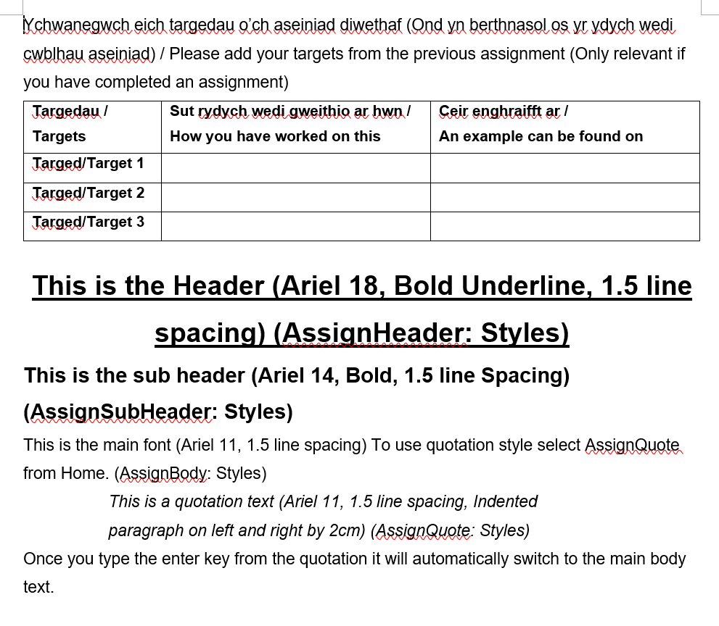
Notes:
Lan ar Moodle cynnwys y targedau a dangos yn benodol , defnyddio targedau sy’n berthnasol, 5008 afl ddim yn berthnasol yn darged, efallai bydd rhaid mynd nol i’r aseiniad flaenorol.
Only use previous targets which are suitable for this assignment.

Slide 13
Cyflwyniad
Introduction
rhowch drosolwg o nod eich aseiniad yn y paragraff agoriadol.
cyflwynwch y disgybl / disgyblion gan roi’r cyd-destun fel yr amlinellir yn 2 iii.
rhowch drosolwg cryno o'r ymyrraeth a ddewisoch, eglurwch beth yw a pham y gwnaethoch ei ddewis - canolbwyntiwch ar sgiliau / gwybodaeth / dealltwriaeth ac ati
(tua 400 gair)
provide an overview of the aims of your assignment in the opening paragraph
introduce the pupil/pupils and provide the context as outlined in 2 iii.
give a concise overview of your chosen intervention, explain what it is and why you chose it – focus on skills/knowledge/ understanding etc. (approx. 400 words)
Notes:
2iii ar gael yn y ddogfen canllawiau pellach
2iii can be seen on the further assessment guidance

Slide 14
Prif ran
Main body
ymhelaethu ar sut mae plant yn dysgu ac yn datblygu o fewn yr agwedd a ddewiswyd e.e. ymddygiad, lles, llythrennedd ac ati a chysylltu â theori fel y crybwyllir yn 2 ii.
esboniwch pam mae dilyniant mewn dysgu yn bwysig a chysylltwch â disgwyliadau'r cwricwlwm (gweler 2 iv.
ymhelaethwch ar yr ymyrraeth a ddewisoch - eglurwch sut y byddech chi'n ei weithredu a phwy fyddai'n gyfrifol am hynny, e.e. athro / cynorthwyydd cymorth / rhieni / asiantaethau allanol ac ati.
elaborate on how children learn and develop within your chosen aspect e.g. behaviour, wellbeing, literacy etc. and link to theory as mentioned in 2 ii.
explain why progression in learning is important and link to curriculum expectations (see 2 iv.).
elaborate on your chosen intervention – explain how you would implement it and who would be responsible e.g. teacher/support assistant/parents/outside agencies etc.

Slide 15
Prif ran (parhad)
Main body (continued)
gwerthuswch eich ymyrraeth, gan ystyried ei gryfderau a'i gyfyngiadau posib fel y crybwyllir yn 2 v.
ystyriwch y goblygiadau ar gyfer addysgu a dysgu. Cefnogwch hyn gyda thystiolaeth os yn bosibl (gweler 2 v.).
ceisiwch osgoi defnyddio deunydd gwefan sy'n hyrwyddo adnoddau penodol oherwydd mae’n bosib bod rhain wedi eu anelu at ddibenion masnachol.
cadwch ffocws glir ar eich disgybl/ion drwy’r aseiniad.
(tua 3,200 gair)
evaluate your intervention, considering its strengths and possible limitations as mentioned in 2 v.
consider its implications for both teaching and learning. Evidence this if possible (see 2 v.)
avoid using website material that promotes particular resources as these may be shared for commercial purposes.
keep a clear focus on your chosen pupil/pupils throughout.
(approx. 3,200 words)

Slide 16
Diweddglo
Conclusion
crynhowch eich trafodaeth at ei gilydd a nodwch y camau nesaf i’w hystyried ar gyfer y disgybl/ion a’r staff, e.e. a oes budd o gyflwyno’r ymyrraeth hon ar draws yr ysgol gyfan? A ellid cynnwys rhieni? A oes angen hyfforddiant pellach? Unrhywbeth wybodaeth arall perthnasol.
(Tua 400 gair)
draw your discussion together and identify the next steps for consideration for both the pupil/pupils and staff e.g. could this intervention be rolled out across the whole school? Could parents be included? Do you/staff need further training etc.?
(approx. 400 words)

Slide 17
‘’Top Tips!’’
Ysgrifennwch mewn arddull academaidd, ffurfiol heblaw pan fyddwch yn adfyfyrio ar brofiadau, lle mae’n dderbyniol i ddefnyddio person cyntaf y ferf.
Bydd yr aseiniad yn ‘llifo’n’ well heb is-deitlau ond defnyddiwch nifer fechan os ydy hynny’n eich helpu i drefnu’r aseiniad yn well.
Darllenwch y meini prawf asesu generig ar gyfer lefel 5 (ar gael ar ddiwedd y fanyleb asesu ar Moodle).
Ail-ddarllenwch canllawiau’r fanyleb asesu ar Moodle ac yn enwedig tudalennau 2, 3 & 4 a’r adrannau ‘canllawiau penodol i’r asesiad hwn’. Gwnewch yn siwr fod yr holl elfennau hyn wedi’u cynnwys yn eich aseiniad - dyma’r meini prawf a ddefnyddir gan y tîm marcio wrth farcio’ch gwaith.
Write in a formal, academic style except when reflecting on experiences, when the first person of the verb is acceptable.
The assignment will ‘flow’ better without subtitles but use a limited number if this helps the organisation of the assignment.
Read the generic assessment criteria for level 5 (available at the end of the assessment specification sheet on Moodle).
Re-read the assessment specification guidelines on Moodle, and particularly pages 2, 3 & 4 and the ‘guidance specific to this assignment’ sections. Make sure all these elements have been included within your assignment as these will be the criteria used by the marking team when marking your work.
Notes:
Person cyntaf pan maen nhw’n adfyfyrio ar brofiad PAP yn unig. Is deitlau i ddrafftio i sicrhau strwythur, ond tynnu fe mas wrth gyflwyno. Edrych ar y meini prawf asesu generig er mwyn gweld os allan nhw wella pethau.
Dilyn y canllaw asesu
First person when you reflect on PTE only. Use sub heading as you draft to ensure structure, but take them out when you present your work. Look at the generic assessment criteria to check if you could improve further.
Follow the assessment guidance.

Slide 18

Enghreifftiau o arfer dda
Examples of good practice
https://moodle.uwtsd.ac.uk/mod/folder/view.php?id=330495
https://moodle.uwtsd.ac.uk/mod/folder/view.php?id=330496
Notes:
Edrych dros yr enghreifftiau o arfer dda
Look over the examples of good practice

Slide 19
Sesiwn Holi ac Ateb
Q&A Session
Cwestiynau pellach i’r fforwm/Further questions to the forum: https://moodle.uwtsd.ac.uk/mod/forum/view.php?id=397904
Notes:
Unrhyw gwestiynau yn y fforwm yn hytrach nag e bostio, dim cwestiynau o 5 y.h. nos Wener Chwefror 24ain
Please post any questions on the Forum rather than email me personally. I will not be responding to questions after 5p.m. February 24th

Slide 20


