Slide 1
Presentation and Interview
By Charlotte May 1601604

Slide 2



Job Description – Mental health support assistant.
Working as part of a team on a hospital ward.
Helping and supporting nurses to assess patients in relation to their individual care plan.
Communicating with family when needed.
Observation of patient behaviour and report any concerns to the line manager.
(Indeed.co.uk, 2019)
(Google images 1, 2019)

Slide 3


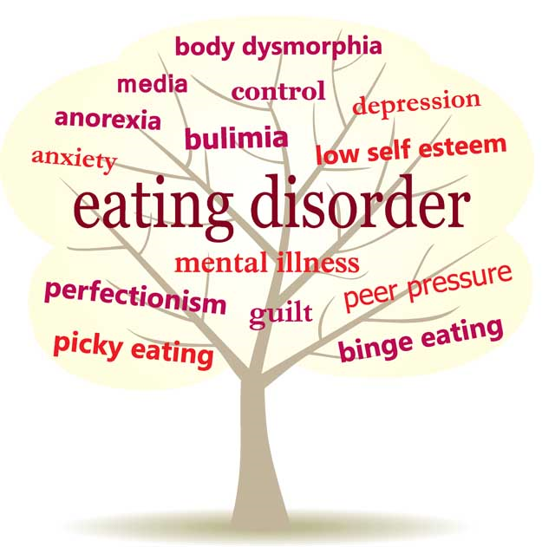
My Experiences and skills in relation to the job description
(Google images 3, 2019)
(Google images 2, 2019)
Voluntary work with Mind
Voluntary work for DeafBlind UK
Establishing an eating disorders support group
(Google images 4, 2019)

Slide 4


Being in university has been very demanding but has taught me many things. To work together as part of a team is one aspect that university has improved for me, it has also taught me to use my own initiative and work independently. I believe I have gained many new qualities such as:
Being ambitious
Approachable
Determined
Easy going
Committed
Enthusiastic
Willing to learn
Improving communication skills and Improving problem solving skills
All of these qualities will help work towards new goals in life and the Mental Health Support Assistant job role. Also, many Support Assistant jobs require a person to have a full UK driving licence. I do have an advantage here as I have a driving licence.
(Google images 6, 2019)
(Google images 5, 2019)
(Fallows, et al, 2000)

Slide 5
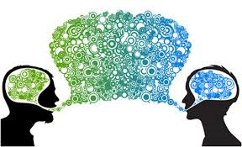
Key skills required of support assistants
Good communication skills
Good Interpersonal skills
Willingness to learn
Able to work both in a team and individually
(Cleary, et al, 2012)
(Google images 7, 2019)

Slide 6
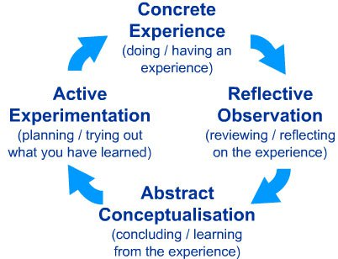
Relating to Kolb’s theory
Skills I have gained from Mind (volunteering).
Listening skills
Observation skills
Reflective skills
(Mcleod, 2017)

Slide 7

Ways to continue my professional development
Training on the job
Chances to further knowledge and understanding of mental illnesses
Enhancing skills to support mental illness
To make a difference to peoples lives
(Cleary, et al, 2012)

Slide 8


Why I believe I am good for the job?
Motivated – I will encourage patients to reach their full potential
Resilient – I am able to adapt to change and bounce back from difficult situations
Self aware – I am aware of my feelings and behaviours
Empathy – I can try to imagine what others are going through and empathise
Experience – I have experience of volunteering in mental health settings
(Google images 8, 2019)

Slide 9
References
Cleary, M., Horsfall, J., O'Hara‐Aarons, M., Mannix, J., Jackson, D. and Hunt, G.E., 2012. Views and experiences of mental health nurses working with undergraduate assistants in nursing in an acute mental health setting. International journal of mental health nursing, 21(2), pp.184-190.
Fallows, S. and Steven, C., 2000. Building employability skills into the higher education curriculum: a university-wide initiative. Education+ training, 42(2), pp.75-83.
Google images 1 (2019) Available at: https://www.google.co.uk/url?sa=i&url=https%3A%2F%2Fwww.thejobnetwork.com%2F10-entry-level-hospital-jobs%2F&psig=AOvVaw1iRDQxUOEIIylvENP1Xh2H&ust=1571335993726000&source=images&cd=vfe&ved=0CAIQjRxqFwoTCNDS6PKwoeUCFQAAAAAdAAAAABAE (Accessed on 14th October 2019).

Slide 10
Google images 2 (2019) Available at: https://www.justgiving.com/fundraising/welsy?utm_campaign=eua-email-sponsorshiprequest&utm_content=shorturl&utm_medium=emails-from-eua&utm_source=email (Accessed on 14th October 2019)
Google images 3 (2019) Available at:https://www.google.co.uk/url?sa=i&url=https%3A%2F%2Fwww.everyclick.com%2Fdeafblinduk%2Finfo&psig=AOvVaw1cHTshCnr5wldT7IP_vrXE&ust=1571336504168000&source=images&cd=vfe&ved=0CAIQjRxqFwoTCLiAoeSyoeUCFQAAAAAdAAAAABAL (Accessed on 14th October 2019)
Google images 4 (2019) Available at:https://www.google.co.uk/url?sa=i&url=http%3A%2F%2Fvoicesofhopececilmd.org%2Fevent%2Feating-disorder-support-group%2F&psig=AOvVaw0FL8Ps7xJ1fFVwHLPF0JZD&ust=1571336665293000&source=images&cd=vfe&ved=0CAIQjRxqFwoTCJimlLSzoeUCFQAAAAAdAAAAABAL (Accessed on 14th October 2019)
Google images 5 (2019) Available at: https://www.google.co.uk/url?sa=i&url=https%3A%2F%2Ffuzeinteriors.co.nz%2Foffice-design-effective-teamwork%2F&psig=AOvVaw0YrSnQcOR8V_jGFh4hxok5&ust=1571336872462000&source=images&cd=vfe&ved=0CAIQjRxqFwoTCLi58pO0oeUCFQAAAAAdAAAAABAK (Accessed on 14th October 2019)

Slide 11
Google images 6 (2019) Available at:https://www.google.co.uk/url?sa=i&url=https%3A%2F%2Fwww.dreamstime.com%2Fphotos-images (Accessed on 14th October 2019)
Google images 7 (2019) Available at: https://www.independenceplus.com/5-keys-of-effective-communication-in-the-workplace/ (Accessed on 14th October 2019)
Google images 8 (2019) Available at: https://www.google.co.uk/search?q=good+job&tbm=isch&ved=2ahUKEwjmseLTtaHlAhVQ3hoKHchgCzgQ2-cCegQIABAA&oq=good+job&gs_l=img.3..0l10.511198.512355..512626...0.0..0.463.2176.0j2j2j2j1......0....1..gws-wiz-img.......0i67.5zfVxMNLhtU&ei=vmKnXebaI9C8a8jBrcAD&bih=588&biw=1366&safe=strict#imgrc=g8f1U1B5-aXeSM (Accessed on 14th October 2019)

Slide 12
Indeed.co.uk. (2019). Mental Health Assistant Jobs in Cardiff - October 2019 | Indeed.co.uk. [online] Available at: https://www.indeed.co.uk/jobs?q=mental%20health%20assistant&l=cardiff&vjk=cb497a229177f28e [Accessed 16 Oct. 2019].
McLeod, S. A. (2017, Oct 24). Kolb - learning styles. Retrieved from https://www.simplypsychology.org/learning-kolb.html

