Slide 1

Exercise and the
Differently Abled Athlete

Slide 2
01
What is
DISABILITY?

Slide 3
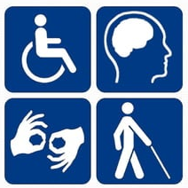
What is Disability
Disability is defined as a physical, mental, or psychological condition that limits a person's activities.
People can either be born with a disability or can aquire it
Disability is an umbrella term, covering impairments, activity limitation, and participation restriction.
  Impairment is a problem in body function or structure
  Activity limitation is a difficulty encountered by an individual in executing a task or action
  Participation restriction is a problem experienced by an individual in involvement in life situation

Slide 4
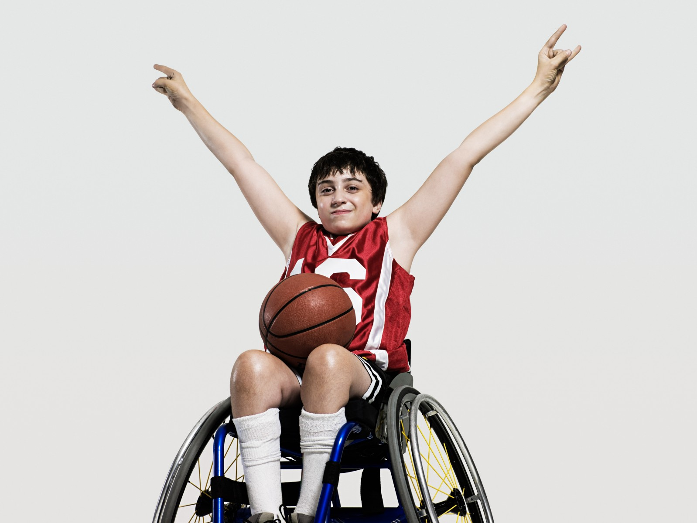
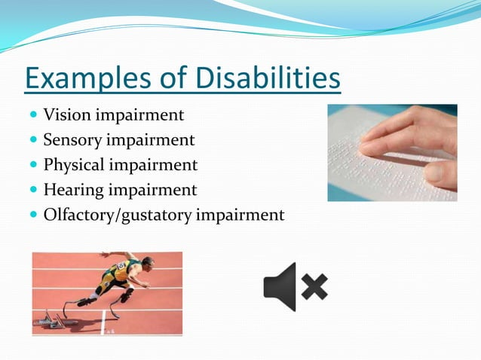
Examples of Disabilities:
Vision Impairment
Sensory Impairment
Physical Impairment
Hearing Impairment
Olfactory/gustatory (taste) impairment

Slide 5
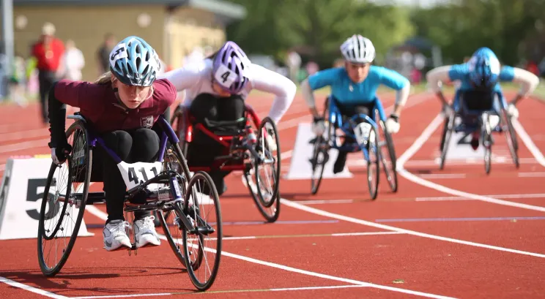
Background to subject
People with disability should be included in sports
People with disability should not be discriminated
People with disabilities are athletes too that have needs, drives and goals.
Coaching them as well as any other athlete is a crucial part for their development.
There are many organisations and associations in the world that provide facilities and support to disabled athletes.
There are also many sporting events for disabled athletes
to participate in – the Paralympics Games being the biggest.
There are different sports for disabled athletes that they
can play or compete in.
Notes:
People with a disability who get involved in sport are first and foremost athletes, and they have the same basic needs, drive, and dreams as any other athlete. And, for them as well, coaching is a crucial factor to the quality of their sport experience.

Slide 6
Disabled
sports &
Classification
02

Slide 7
Specific characteristics of people with disability in sport
People with “physical disability” are hugely diverse — treat the impairment functionally, not just diagnostically. Typical characteristics the coach/clinician must consider:
Impairment type & functional limitation (e.g., limb loss, spinal cord injury (SCI), cerebral palsy, neurological disease, limb difference, joint arthropathy) — affects mobility, balance, force production and movement patterns.
Cardiovascular and autonomic differences — SCI (especially ≥T6) can cause altered blood pressure responses, orthostatic hypotension and autonomic dysreflexia risk (potentially life-threatening). Heart-rate responses and VO₂ peak may be lower in some groups and require alternative intensity monitoring.
Musculoskeletal considerations — altered loading patterns lead to overuse injuries (shoulder pain in wheelchair users), reduced bone density (below level of SCI) and contractures.
Thermoregulation — impaired sweating and heat loss in some neurological impairments.
Fatigue & exertion perception — chronic fatigue, pain or spasticity can limit session duration and frequency.
Secondary health risks — pressure ulcers, DVT risk, urinary tract infection and respiratory compromise in some groups.
Psychosocial & access barriers — transport, facility accessibility, stigma, lack of tailored coaching and equipment affordance (important when planning sessions). Activity Alliance and Disability Rights UK have resources on practical barriers.

Slide 8
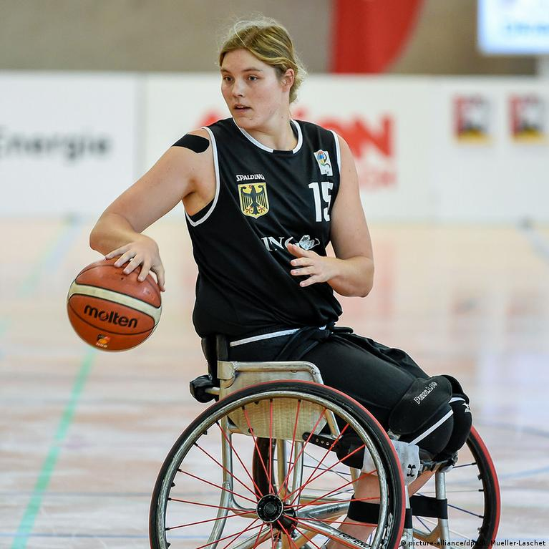
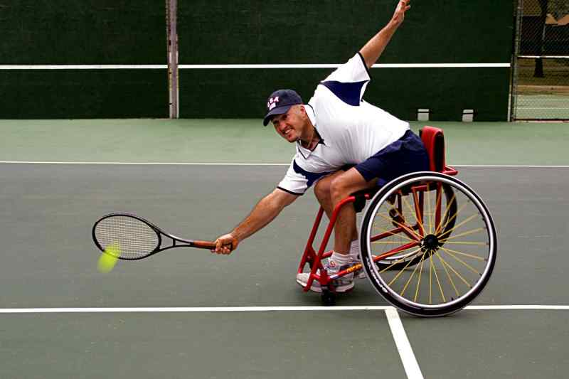
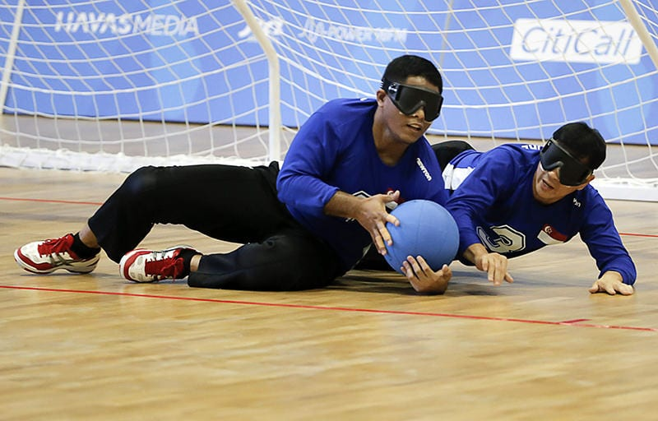
Disabled/Adapted Sports
Disabled sports, also adaptive sport or parasports, are sports played by person with a disability, including physical and intellectual disabilities.
As many disabled sports are based on existing able bodied sports, modified to meet the needs of person with a disability, they are sometimes reffered as ADAPTED SPORTS for example: wheelchair tennis or basketball
However, not all disabled sports are adapted; several sports that have been specifically created for persons with a disability have no equivalent in non-disabled sports for example: torball

Slide 9
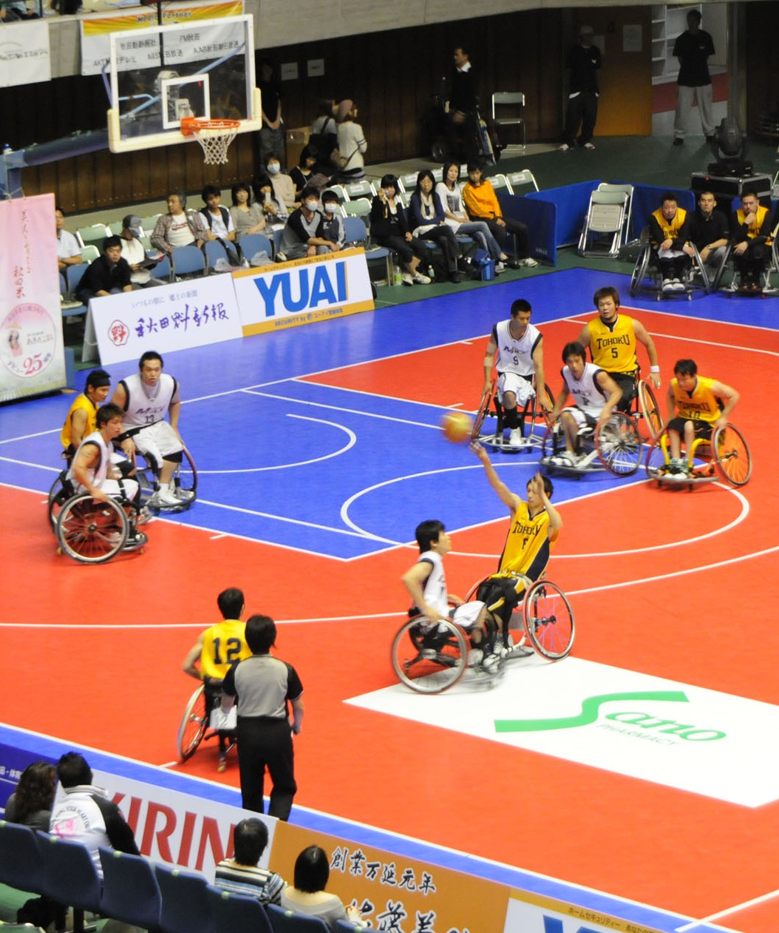
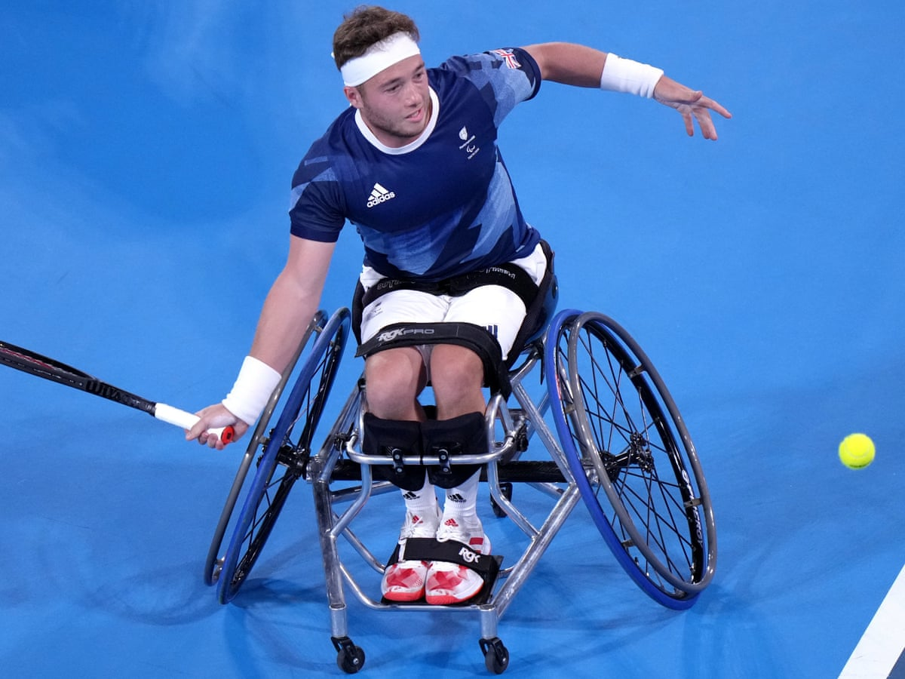
Disabled/Adapted Sports
Sports are adapted by changing aspects such as the rules, equipment, role of players, environment, playing area, time or duration. example;
  wheelchair basketball: the rules height of the ring and court size are identicle, the only adaptation is in the dribble rule - two pushes and one bounce replaces the ‘ bouncing while travelling’ rule in normal basketball.
Adaptation’s to sport may be needed for some disabled people but not others, example;
  a wheelchair tennis player can let the ball bounce twice before hitting it, but a deaf tennis player can only let the ball bounce once
Integration and seggregated activities
Integration in this context relates to the able bodied and disabled taking part together in the same activity at the same time
Segregated activity means people with disability participating among themselves

Slide 10
Disabled/Adapted Sports
Team Sports for the Physically disabled
  Wheelchair Basketball
  Wheelchair Rugby
  Wheelchair Rugby League
  Wheelchair Tennis
  Wheelchair Curling
  Wheelchair Dancing
  Powerchair Football
  Power Hockey
  Sledge Hockey
  Paralympic Football
  Sitting Volleyball
Team Sports for the Deaf
  Deaf Basketball
Track and Field events for the Disabled
  Club Throw
  Softball Throw
  Racerunning
  Wheelchair Racing
Team Sports for the Blind
  Goalball
  Torball
  Blind cricket
  Showdown

Slide 11
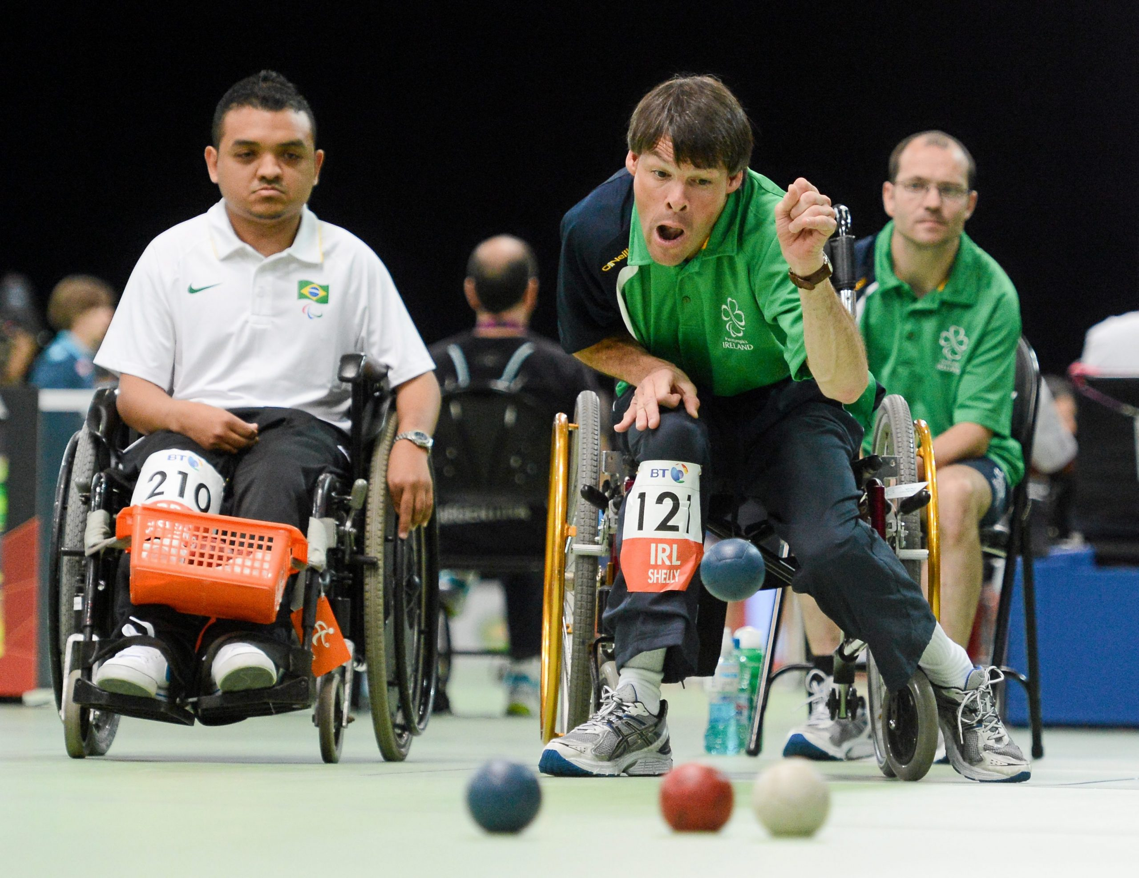
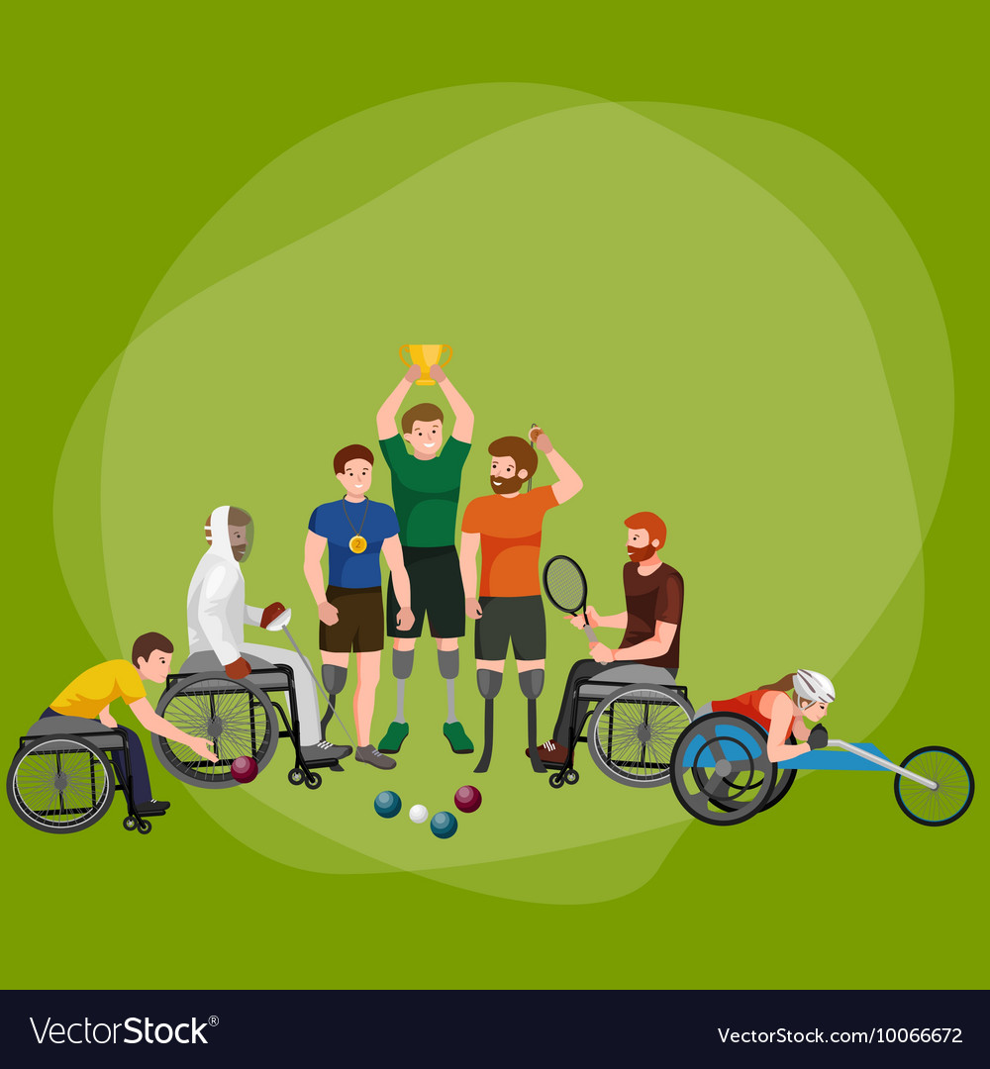
Disabled/Adapted Sports
Individual Sports for the Disabled
  Wheelchair Fencing
  Paratriathlon
  Para-Cycling
  Para-Climbing
  Boccia

Slide 12
Prevalence
According to the Department for Work and Pensions (DWP) Family Resources Survey (2022–23), there were about 16.1 million people in the UK with a disability under the definition used in the survey.
This is about 24% of the total population.
Of that 24%, it is estimated that 23% of working-age adults are disabled. “Working-age” here refers to adults between 16 and state pension age.
Physical limitations were the most common form of disability (66% or 4 million), followed by sight, hearing or speech (35% or 2.1 million). Just over half of people with a disability (3.1 million) did not specify the type of disability.

Slide 13
Source / Region | Population | By Disability | By Sex | Notes
Sport Wales, National Survey for Wales 2022–23 | Adults 16+ in Wales | • With longstanding illness/disability: ~49% did sport/physical activity in last 4 weeks • Without: ~72% | • Males: ~64% • Females: ~57% | For 3+ times per week: males 43%, females 35%; those with illness/disability 30%
Sport England / Active Lives Survey (2017) | Adults in England | • Disabled: ~43% did 150+ min/wk sport • Non-disabled: ~65% | • Men: ~63% active • Women: ~58% | Gap widens for higher intensity participation
Scottish Health Survey (2012) | Adults in Scotland | • Limiting long-term condition: 26% met guidelines • Non-limiting LTC: 41% • No condition: 44% | Sex breakdown not detailed in this dataset | Clear drop with limiting conditions
Scottish Govt. (School-aged) | Secondary pupils | Disabled: 24% had 2+ hrs PE/PA weekly Non-disabled: 53% | Not separated by sex here | Shows childhood/teen disparity
Activity Alliance (England, 2019-2024 surveys) | Disabled adults | • ~51% feel they have opportunity to be active | • Disabled women consistently less active than disabled men | Focus on attitudes & opportunity rather than strict participation stats
Sport England / Disability in Activity report | Adults in England | • Inactivity: 51% of those with 3+ impairments | • Intersection: disabled women and lower socio-economic groups least active | Demonstrates compounded inequalities

Slide 14
Nationally recommended guidelines used to prescribe & adapt exercise for people with disability (UK)
Use the same core public-health framework (FITT: Frequency, Intensity, Time, Type) but individualise dose and safety checks:
UK CMO / gov.uk physical-activity guidance — disabled adults: aim to meet standard adult targets where possible (≥150 min moderate activity/wk + strength twice weekly) and emphasise breaking up sedentary time; disabled children guidance: ~20 minutes/day or 120–180 min/week depending on age/ability, plus strength/balance recommendations.
Condition-specific UK guidance (examples):
  Spinal cord injury — the UK/National SCI exercise guidance (scientific exercise guidelines for SCI) recommends tailored aerobic and resistance training; highlights AD awareness and need for clinical oversight for high-risk individuals.
  Wheelchair users — NHS pages provide safe exercise options and emphasise shoulder care, progressive resistance training and cardio via hand-cycling or wheelchair propulsion.
Clinical professional guidance — CSP (Chartered Society of Physiotherapy) resources for physiotherapists supporting disabled people to be active; use NICE and local NHS trust protocols when working clinically.

Slide 15
03
Importance to Study

Slide 16
Importance to Study
Women and Disability Awareness Project, 1989: “Women with disabilities face double discrimination -- discrimination based on gender and discrimination based on disability. women of colour who are disabled face yet a third type of discrimination. the limited available statistics suggest that economically, socially and psychologically, women with disabilities fare considerably worse than either women who are non-disabled or men who are disabled”.
Seigenthaler, 1997: Identified the benefits of leisure as:
  Enhanced well being
  Decreased stress levels
  Improved quality of life
  Improving social aspects

Slide 17
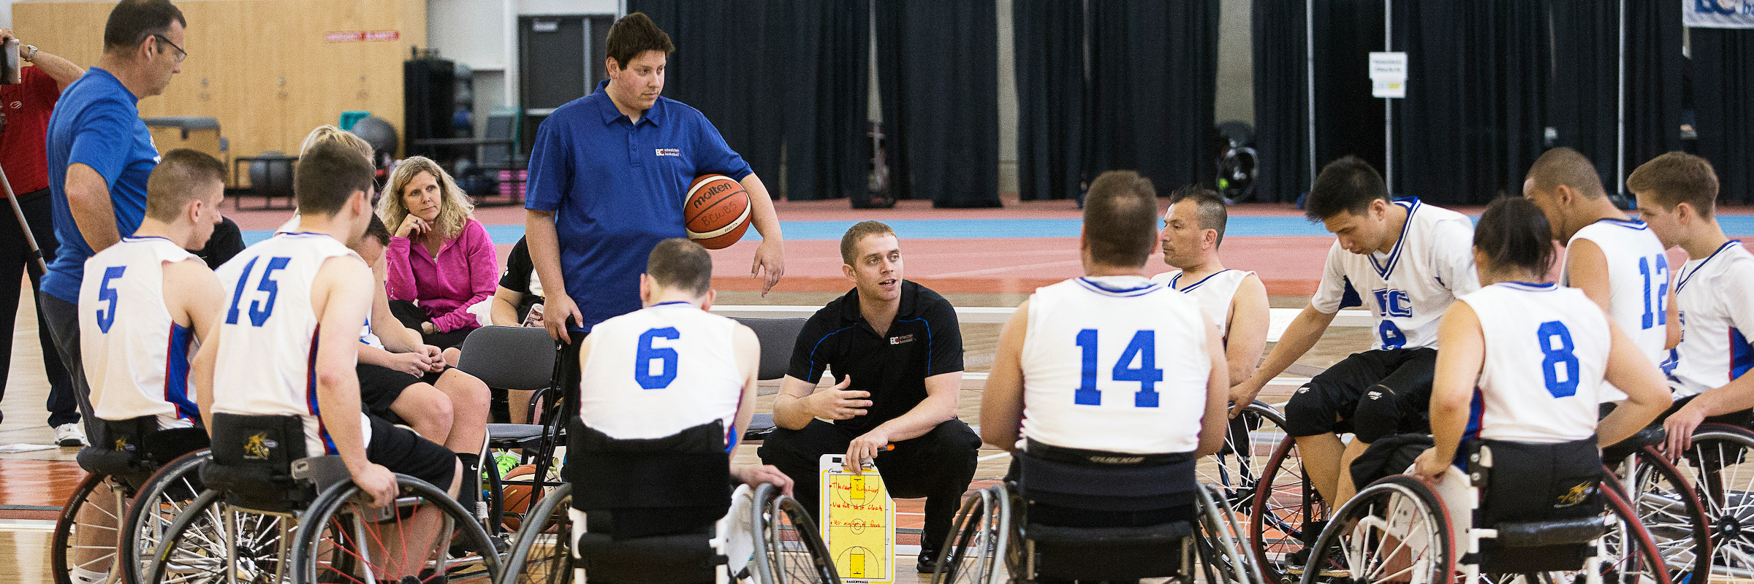
Importance to Study
Schleien, Ray & Green, 1997: Team sports benefit both abled and disabled athlete.
So, Including and coaching disabled athletes is a great way to involve them in social and physical activities.

Slide 18
Research re: use or contraindications of exercise with people with disabilities (summary of evidence & red flags)
Overall benefit — systematic reviews and guideline bodies report that appropriately prescribed exercise improves cardiorespiratory fitness, strength, function, mood and quality of life across many impairment groups. (See gov.uk infographics and SCI exercise guidelines).
Contraindications / important risks (examples to screen for and manage):
  Autonomic dysreflexia (SCI ≥T6) — exercise can trigger AD; treat as an emergency if it occurs; screen and implement bladder/bowel/skin precautions pre-exercise.
  Unstable cardiovascular disease / uncontrolled hypertension / recent thromboembolism — standard medical clearance applies. Use NICE guidance / local protocols for exercise referral.
  Severe osteoporosis (risk of fracture below level of lesion) — avoid high-impact loads where bone is fragile; adapt resistance and impact.
  Uncontrolled spasticity, open pressure ulcers or acute infection — postpone or adapt sessions until medically stable.
Dose–response — benefits increase with greater, but safe, intensity/duration; small amounts still yield health benefits. For SCI, evidence shows gains in CRF and strength with multi-week programmes.

Slide 19
Specific data collection & assessments for people with physical disability in sport
Collect baseline data that include medical, functional, performance and patient-reported measures. Examples and purpose:
A) Mandatory baseline / safety checks
Demographics, diagnosis, date/onset of impairment, level of function (e.g., wheelchair user? ambulant?), medications, devices (catheter, orthosis, prosthesis), recent surgeries, cardiovascular history, bone health, skin integrity, bowel/bladder routine (SCI). Document consent and emergency contacts. (Keep to GDPR / local record-keeping policies.)
B) Vital signs and special checks
Resting heart rate & blood pressure (supine & upright if SCI/orthostatic risk). For SCI ≥T6, baseline BP and instructions in place for AD.
C) Functional & performance tests (choose per population)
Mobility/functional: Timed Up & Go (for ambulant), 10-metre walk, 6-minute walk test (adapted where necessary).
Wheelchair users: Wheelchair propulsion test / 20 m sprint, wheelchair sport-specific field tests (e.g., slalom).
Strength: Hand-held dynamometry (grip, shoulder rotators), 1–5 rep max protocols adapted/resisted as needed.

Slide 20
Endurance/CRF: Submaximal bike/arm-ergometry tests or adapted CPET where available and indicated (with medical oversight for higher risk).
Balance: Berg Balance Scale, Functional Reach, Dynamic Gait Index as appropriate.
Spasticity and ROM: Modified Ashworth Scale, goniometry.
Bone density / fracture risk: DEXA if clinically indicated.
Patient-reported outcomes: EQ-5D / SF-36 / disease-specific QoL, Fatigue scales (FACIT), sports-specific measures and training load logs.
Sport classification data for competitive para-athletes: sport classification, impairment code and legal eligibility. Use ParalympicsGB / sport federation processes for formal classification.
D) Monitoring during sessions
RPE (modified Borg if autonomic dysfunction), regular BP checks for at-risk groups, skin checks (pressure sites), and monitoring for signs of AD (headache, flushing, sweating, bradycardia)

Slide 21
Practical tools & resources
Equality Act 2010 guidance. GOV.UK
gov.uk physical activity guidance for disabled adults & children. GOV.UK+1
Sport England – accessible & inclusive facilities guidance. Sport England
Disability Sport Wales - Official Website of Disability Sport Wales
ParalympicsGB – classification & sport pages. ParalympicsGB
NHS pages on wheelchair fitness & local physiotherapy resources (practical exercise lists). nhs.uk
Spinal Injuries Association / NHS and SCI exercise guideline PDFs for AD awareness and SCI-specific prescriptions.

Slide 22
Quick implementation checklist for a provider/coach
Complete Equality Act & reasonable-adjustment review for venue and equipment.
Obtain baseline medical history + specific red-flag screen (AD risk, uncontrolled CV disease, open wounds).
Baseline functional and PRO measures (choose appropriate tests above).
Produce an individualised FITT plan, include monitoring plan and emergency protocol.
Record outcomes and adapt every 4–6 weeks; liaise with medical/therapy teams when needed.

Slide 23
04
Role of sports for people with disability...

Slide 24
Role of sports for People with Disabilities
Sports can play a key role in the lives and communities of people with disabilities, the same as it can for people without a disability.
There are plenty of evidence to support participation in sports and physical activity for people with disability concerning trends, barriers and benefits of participation.
Numerous studies have shown that participatioin in sports results in improved functional status and quality of life among people with selected disabilities.
Studies conducted across disabilty groups reveals participation in sports leads to improved levels of physical health and well being.
It has also been shown to improve physical fitness and general mood in psychiatric patients with depressive and anxiety disorders.
It has been linked to improvements in self-confidence, social awareness and self-esteem and can contribute to empowerment of people with disabilities.
Sports can have a positive impact on the lives of people with disability but many face challenges to getting involved in sports

Slide 25
05
Benefits of Sports and Exercise

Slide 26
BENEFITS
Physically healthier & higher Energy level
Social benefits
Goal setting & confidence
Communication, teamwork and leadership skills
Learn how to deal with setbacks
A better night’s sleep & De-stressor

Slide 27
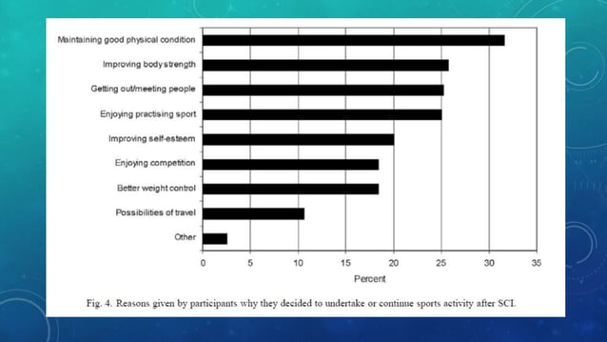
BENEFITS

Slide 28
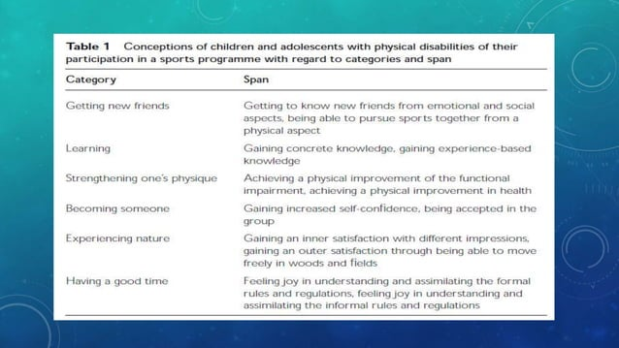
BENEFITS

Slide 29
06
Barrier to participate in competetions

Slide 30
BARRIERS
Pacirorek and Jones (1989) identified 4 barriers:
  Equipment
  Physical accessibility
  Program modification
  Attitude towards people with disability

Slide 31
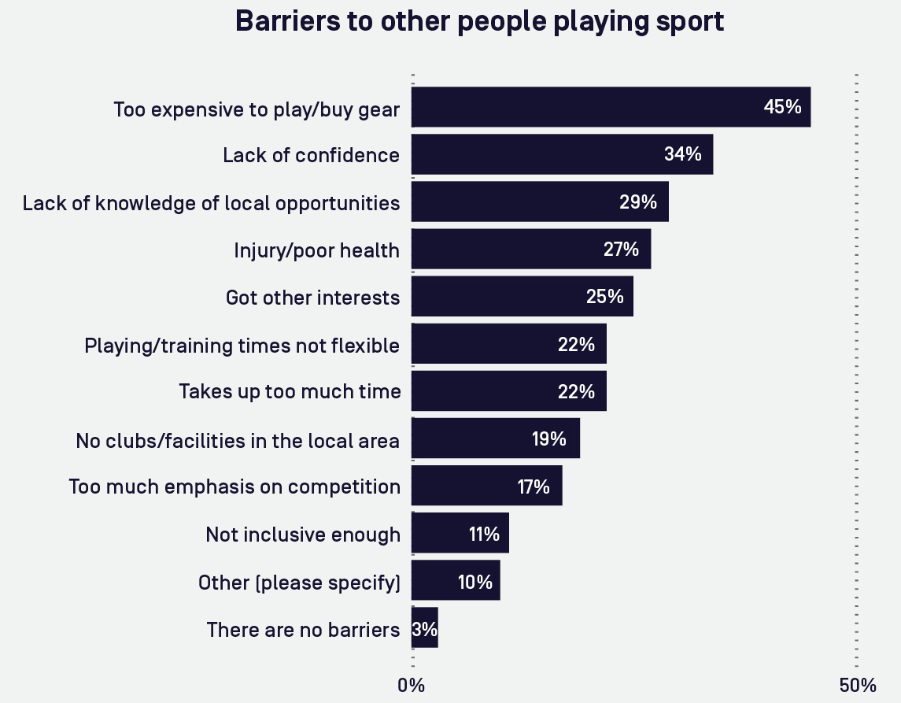
BARRIERS

Slide 32
Ethical Issues & legislation
07

Slide 33
Ethical Issues
Minimal Disability?? Where do you draw the line?
Non disabled competitors in disability sports..? Inclusion/reverse Discrimination
Cheating..?
Substance use/Boosting?
Do we really need Classification?

Slide 34
08
Coaching Disabled Athletes

Slide 35
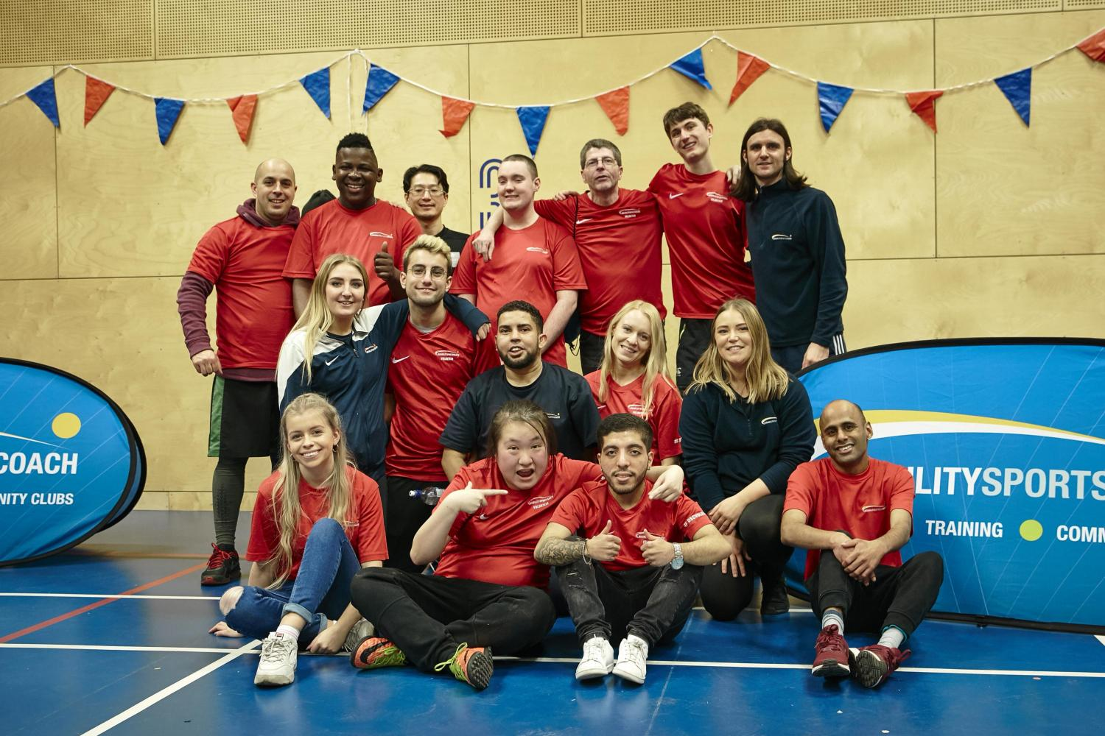
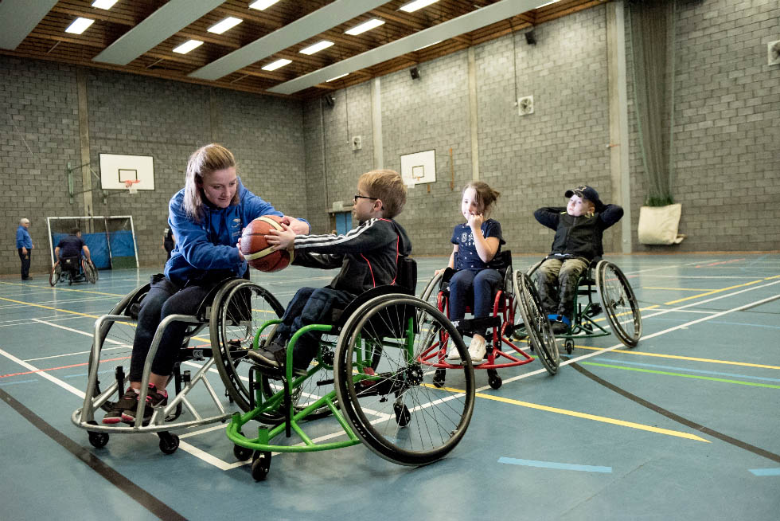
Disability Sports Coach
Provide high quality sporting opportunities for people with disabilities.
Provide coaching, training, events and community clubs to mainstream schools, special schools, clubs, charities & other professional organization.

Slide 36
Current legislative bodies, legislation and guidance (UK)
Key legislation
  Equality Act 2010 — the primary legal framework requiring “reasonable adjustments” and prohibiting disability discrimination in services (including sport/leisure).
National public-health / policy bodies & guidance
  UK Chief Medical Officers / gov.uk — physical activity guidance for disabled adults and the 2022 guidance for disabled children/young people (national activity targets, “some is better than none”, strength/balance advice).
  NICE — guidance relevant to exercise referral schemes, population physical-activity promotion and local strategy engagement. Useful when embedding disabled clients into referral programmes.
Sport governance / delivery bodies
  Sport England / UK Sport / British Paralympic Association (ParalympicsGB) — facility design, talent pathways, classification system and elite para-sport governance. Sport England publishes accessible facility guidance for venues. ParalympicsGB manages classification and elite-sport considerations. Charities & sector specialists
  Activity Alliance (formerly EFDS), Disability Rights UK, spinal cord charities (e.g., Spinal Injuries Association), Mencap, Scope and other condition-specific charities provide practical, accessible resources for participation and local delivery.

Slide 37
Coaching Disabled Athletes
Having a good coach is crucial in development and improvement of any athlete.
Working with disabled athletes, improves coaching skills and benefits the coach as well as athlete.
As a coach it is important to treat your athlete equal whether disabled or not.
It is important to have a positive first impression
Introduce the athlete witha a disability and create conditions for successful integration
For participants with disabilities, coach should use developmentally appropriate activities.

Slide 38
Coaching Disabled Athletes
For the coach it is important to know the disability or the disabilities of the athlete they coach
Coach should focus on athletes ability
It is important for the coach to adapt the activities for disabled athlete
Coach should establish good communication with disabled athlete, get to know the athlete better
It is important for the coach not to discriminate their athletes, For example;
  Thinking that an intellectually disabled athlete does not understand
  Sit down when talking to a disabled athlete on a wheelchair

Slide 39
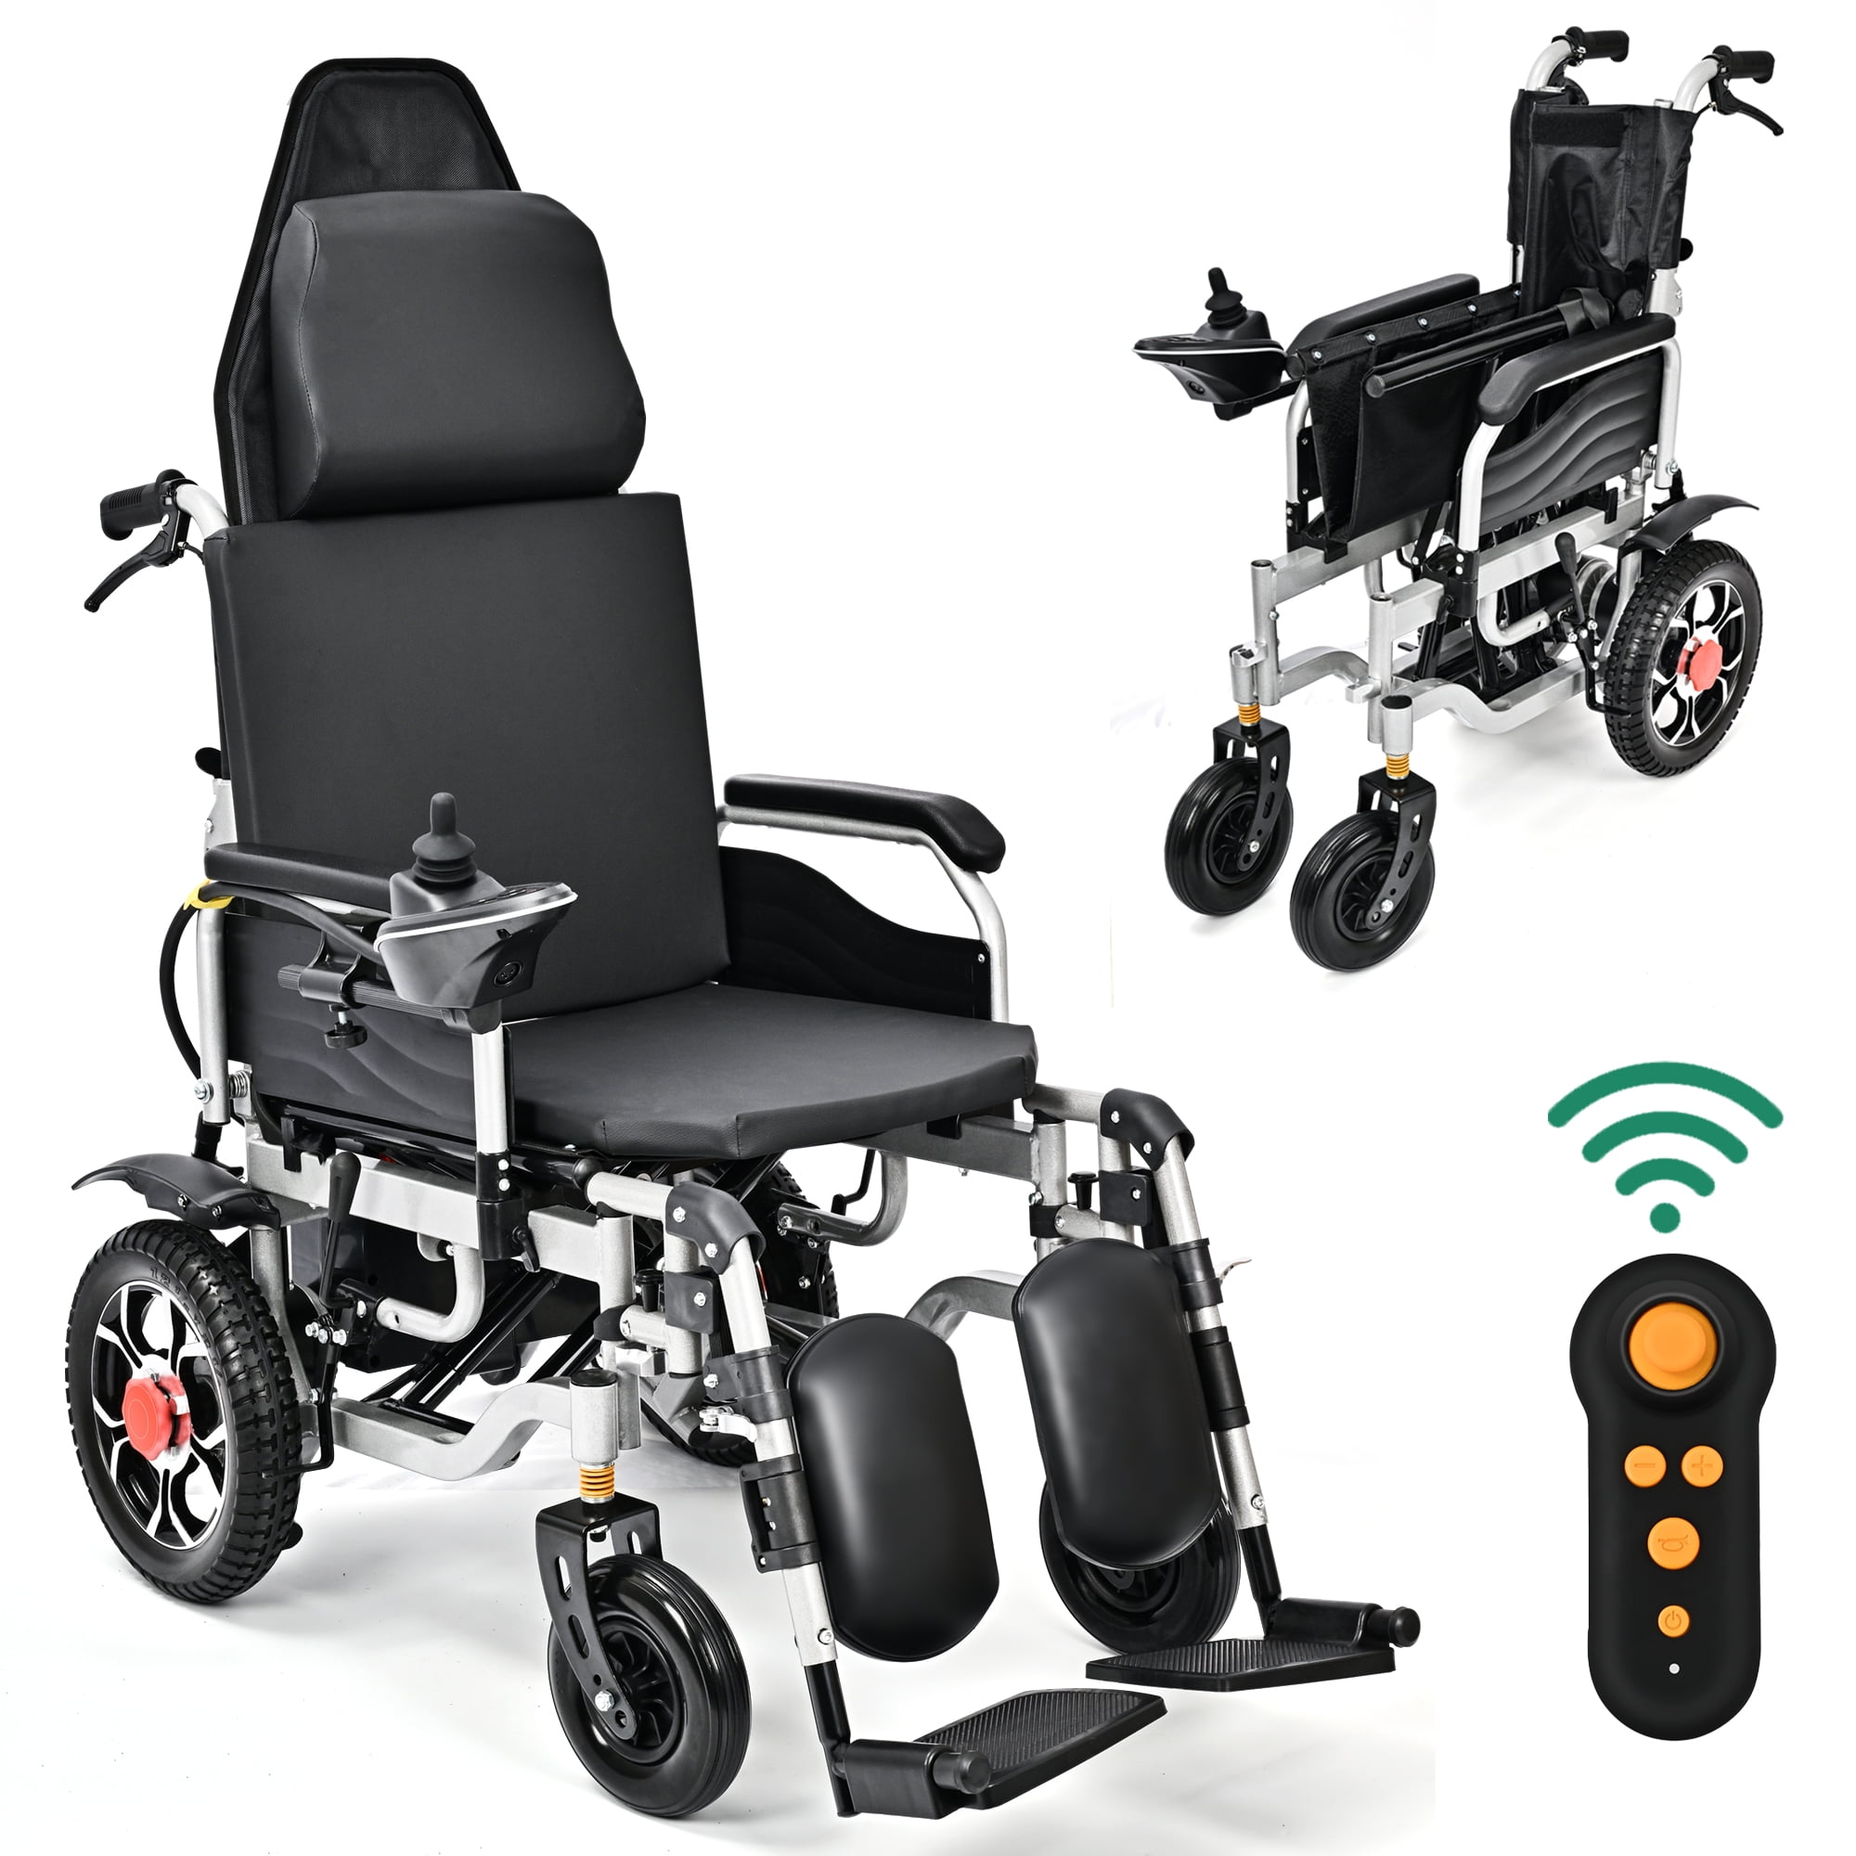
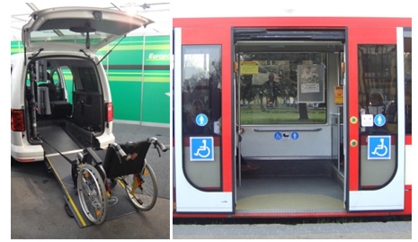
Coaching Disabled Athletes
Coach should have in mind about transportation, accessibility and facilities they provide for the disabled athletes.

Slide 40
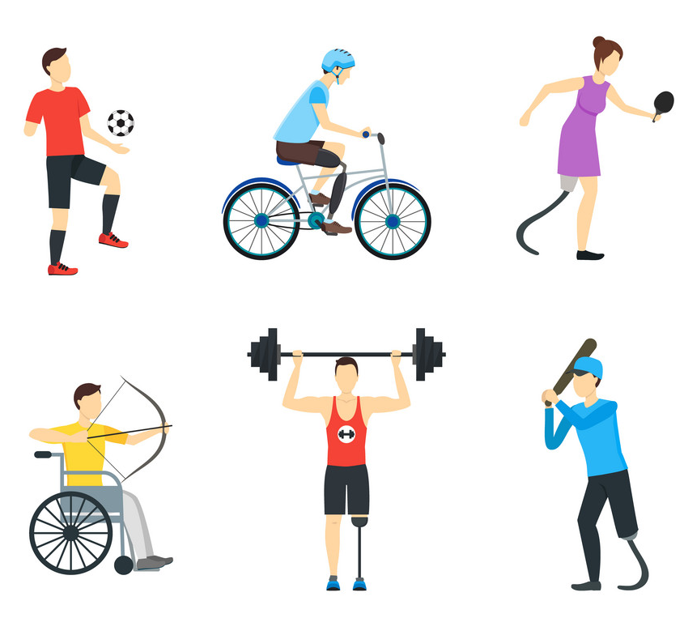
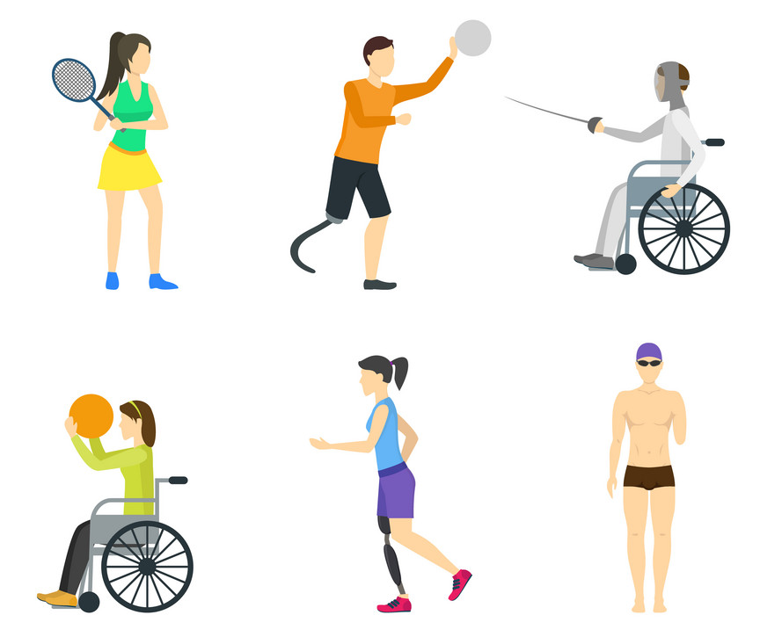
Conclusion
It is important to understand that people with disabilities should have equal oppotunities and treatement as people without disabilities. In particular focusing in coaching and mentoring.
Coaches should help disabled athletes to enjoy the activities they engage in as this will help the athlete to carry the love of sport for the rest of their life.

Slide 41
Thank You

