Slide 1


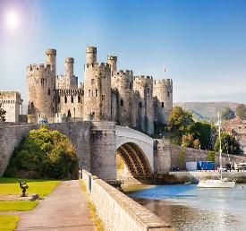
Croeso Cymru: A Festival of Welsh Soul
Module: International Meetings Management (BMIH6007)
Student ID: 2240761
Student Name: Robert-Daniel Mihalcea
Lecturer: Kathryn Roberts
”AI tools were used for research, structure, and grammar checking. No AI-generated content was directly submitted.”

Slide 2

Executive Summary
Celebrating Year of Croeso 2025 in Conwy, Wales.
This feasibility presentation proposes a 3-day cultural MICE event
Hosted in partnership with St Brides Spa Hotel and local tourism bodies.
Combines heritage, hospitality, cuisine, art, and landscape to showcase Welsh identity.
Aimed at international cultural travellers and travel professionals.
Notes:
Good afternoon.
Let me invite you to picture something.
Imagine a spectacular three-day cultural event — set in the majestic town of Conwy, framed by the historic castle walls and the raw beauty of coastal Wales. An event where international delegates don’t just visit… they connect. They taste, they listen, they feel the spirit of Wales — deeply and authentically.
Now — here’s the opportunity.
As part of the Year of Croeso 2025, I propose a hybrid cultural MICE event — Meetings, Incentives, Conferences, Exhibitions — targeted at international visitors, business groups, and culturally curious travellers.
Why? Because I am responding to two big trends: the rising global demand for immersive, meaningful travel, and the need for rural economic stimulation in Wales. This event taps both.
According to Getz and Page, events like these don’t just entertain. They generate lasting economic and socio-cultural returns, especially when they're tied into a national strategy. And mine is. This event is aligned tightly with the Welsh Government’s cultural tourism framework, and resonates with the emotional pull. Visit Britain (2024) says long-haul travellers are craving: place, identity, storytelling.
Where does it all happen?
Our anchor setting is Conwy — a location that oozes historical charm and visual impact. And we’ve secured a luxury partner in St Brides Spa Hotel to ensure every MICE delegate enjoys not just comfort, but a lasting, premium impression of Wales.
This is not a one-off festival. This is a market-smart, strategic tourism investment — with culture at its heart and measurable returns at its finish line.
(Short pause)
Let’s dive deeper into the event concept.

Slide 3

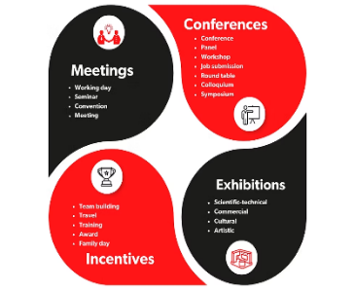
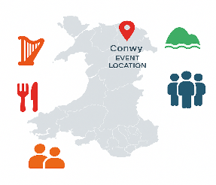
Event Concept
Event Name: Croeso Cymru: A Festival of Welsh Soul
Theme: Sense of place, Welsh identity, warm welcome
Achieve 90% satisfaction
Promote cultural tourism and local businesses
Connect international visitors with Wales through immersive activities
Reinforce Wales’ reputation for hospitality
Generate 10% profit
(Raden Ayu Trisnayoni et al., 2022)
Type: Cultural MICE Event (Corporate + Leisure mix)
Create 30+ tourism partnerships
Attract 500 guests over 3 days
Notes:
This isn’t your standard business conference — this is Cymru reimagined as an experiential stage.
So what exactly is this event?
Iam calling it a hybrid cultural MICE event — designed to blend business networking with authentic cultural immersion. It’s smart because it speaks to two audiences at once. Business delegates want ROI, connections, and professionalism. But travellers — especially post-2020 — want meaning, memory, and emotion.
This concept does both.
It’s built around storytelling, food, music, and art — but not passively. Delegates don’t just observe — they participate. Think hands-on language workshops. Curated storytelling sessions around identity and landscape. Dinners that feel like a homecoming.
Why does this matter?
Because, as Quinn (2013) points out, modern tourism is no longer just about sightseeing — it’s about experiential connection. People want to belong, even temporarily. And by fusing the legendary Welsh “Croeso” — our culture of welcome — with immersive touchpoints, we make that belonging real.
There’s also emotional branding at play here. Every touchpoint — from the music to the meals — tells a story of Wales. It makes the experience sticky in memory, shareable on socials, and, crucially, worth coming back for.
So this isn’t just an event — it’s an engine. One that drives awareness, builds pride, and stimulates the economy — all while keeping the national identity front and centre.
(Pause)
Let’s look at how we bring this ambitious vision to life — starting with the planning phase.

Slide 4
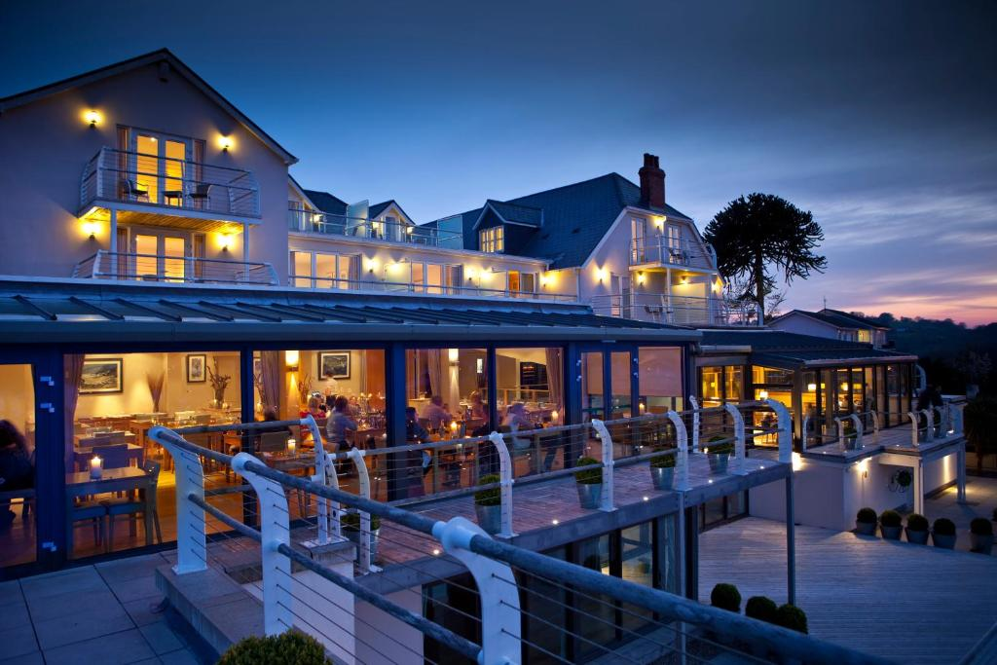
Event Cycle Phase 1: Planning
Objective Setting & Budgeting
Weather & Risk Plans
Regulatory & Accessibility Checks
AV/Catering Vendor Selection
Programme Development
Stakeholder Outreach (Visit Wales, local councils)
Market Research: Culture-focused travellers, travel agents
Venue: Conwy Castle & partner hotel (St Brides Spa Hotel)
The Planning
The Delivery ( on site)
Post Event Evaluation
(Bowdin et al., 2023)
Notes:
Now, even the most inspired event fails without sharp, strategic planning.
My approach? Simple: treat the event like a living business cycle, with three key phases — Planning, Delivery, and Evaluation.
In this phase, I am building the foundation. That means:
Clarifying aims with realism, not just excitement.
Building a line-by-line budget covering everything from AV installation to de-rigging.
And most importantly: consulting stakeholders early.
Following O'Toole’s principles, i’ve set the groundwork by balancing strategic vision with operational detail. For example: Conwy Castle is the crown jewel, but as a UNESCO World Heritage Site, it brings complexity. Permits, conservation rules, and public access are all tightly regulated.
So — what have I done?
I’ve already opened dialogues with local authorities, and we’re baking in rehearsal dates by June 2025 — to test infrastructure, flow, and staff readiness. Nothing is left to chance.
Risk? Handled.
I’ve built a contingency matrix — everything from weather to performer illness is covered. And just like Bowdin (2023) recommend, our stakeholder coordination includes public, private, and community groups, so everyone’s aligned.
I am not just planning an event. I engineer a repeatable, scalable model for Welsh cultural tourism — rooted in professionalism, pride, and preparedness.

Slide 5
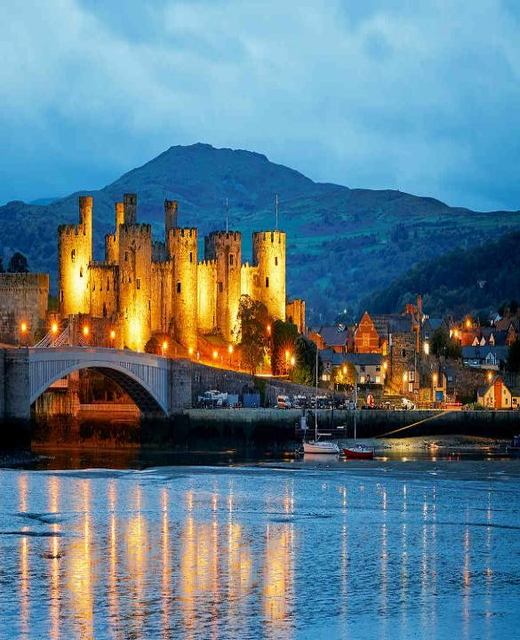
Venue-Specific Planning Considerations
Consideration | Justification
1. Castle Capacity & Licensing | Heritage sites require strict capacity limits and licensing approval from Conwy Council.
2. Hotel Room Availability | Group booking management is essential for international guests staying at St Brides Spa Hotel (Quick, 2020).
3. Transport Access (Airports) | Proximity to Manchester & Liverpool airports supports MICE attendance and international travel (The Guide Liverpool, 2024).
4. Weather Contingency (Outdoor) | Marquees and indoor backup at the hotel are needed due to Wales' unpredictable summer weather (Creative Tenders, 2021) .
5. Parking & Guest Flow | Efficient parking and flow control reduces congestion and improves safety (O'Toole, 2011).
6. AV/Power Infrastructure | Castle layout requires custom AV setup and portable power systems (Quinn, 2013).
7. Bilingual Signage (Welsh/English) | Aligns with Welsh cultural policy and ensures clarity for diverse guests (Visit Wales, 2024).
8. Safety & Emergency Routes | Clear evacuation plans and on-site first aid are essential in historic and high-traffic locations (Getz and Page, 2019).
9. Coordination with Town Events | Avoiding clashes with local festivals ensures better logistics and resource availability (Fox, D. et al., 2014).
10. Local Supplier Contracts | Using nearby caterers and performers supports sustainability and economic impact (Smith, 2012)
Notes:
Now, let’s talk venues — because location isn’t just a backdrop; it’s part of the experience.
I chose Conwy Castle not just for its beauty, but for its symbolism. It represents history, identity, and emotional power — perfect for immersing delegates in Welsh heritage. But as a UNESCO World Heritage Site, it comes with strict conservation requirements.
I’m already engaging with local authorities to secure permits, manage visitor flows, and protect the grounds. This includes planning for noise control, protected surfaces, and managing vehicle access.
Because much of the event is outdoors, I’ve arranged for marquees and sheltered areas to keep everyone comfortable and safeguard equipment in unpredictable weather.
To complement Conwy Castle’s outdoor setting, I secured St Brides Spa Hotel nearby. It offers premium accommodation and indoor spaces for workshops and contingency, ensuring delegates experience Welsh hospitality at its finest.
I’ve planned clear signage in both English and Welsh, plus accessible routes to make sure everyone feels welcome.
All this careful planning ensures the venues support the event, not hinder it.
(Pause)
Let’s now explore who’s on board to make this happen.

Slide 6
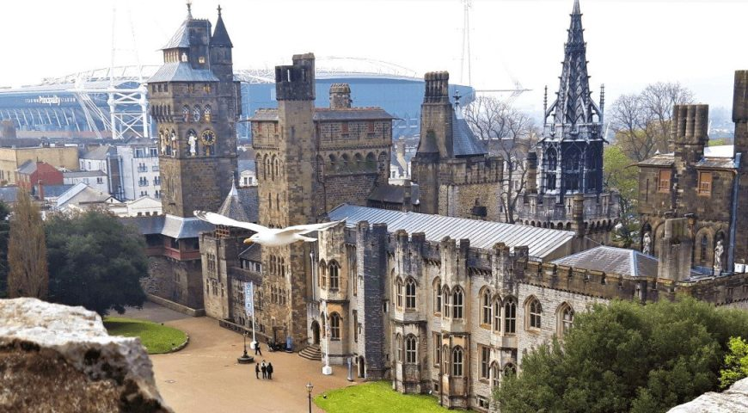
Stakeholders & Sponsorship
Tiered sponsor packages: branding, product placement, co-hosting
Sponsor | Role | Impact
Accor Hotels (Sponsor only) | Branding, international promotion of Welsh tourism | Positions Wales on global platforms; increases cross-border visibility (Meredith, 2022)
Penderyn Whisky | Cultural tasting experience, branded product placement | Adds premium local identity; engages guests with Welsh tradition
S4C (Welsh Broadcaster) | Bilingual media coverage, livestreaming support | Reinforces Welsh language, expands reach to local and diaspora audiences (Rogers and Wynn-Moylan, 2022)
Stakeholder | Role
Visit Wales | Strategic partner, promotional support, possible funding
Conwy Council | Local authority approvals, venue licensing, security coordination
St Brides Spa Hotel | Hospitality/accommodation partner, welcome dinner venue
Local Food & Craft Vendors | On-site catering, artisan stalls, workshops
Travel Media & Bloggers | Event coverage and destination marketing
Notes:
No event can succeed alone — so I’ve built strong partnerships with key stakeholders.
My major collaborators include Visit Wales, Conwy Council, and local cultural groups. They help with everything from marketing and permissions to authentic programming and community buy-in.
I’ve also aligned with sponsors like S4C, Penderyn Whisky, and Accor Hotels. These brands share our values — celebrating Welsh culture while delivering quality and professionalism.
Sponsors receive tailored packages offering visibility and engagement opportunities, which helps fund the event without compromising its cultural integrity.
By involving them early, I’ve minimised last-minute risks and ensured their commitment.
This network isn’t just financial support — it’s a shared investment in Wales’ cultural future.
(Pause)
Next, let me take you through the heartbeat of the event — the programme itself.

Slide 7
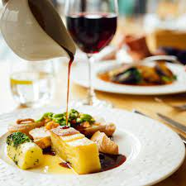
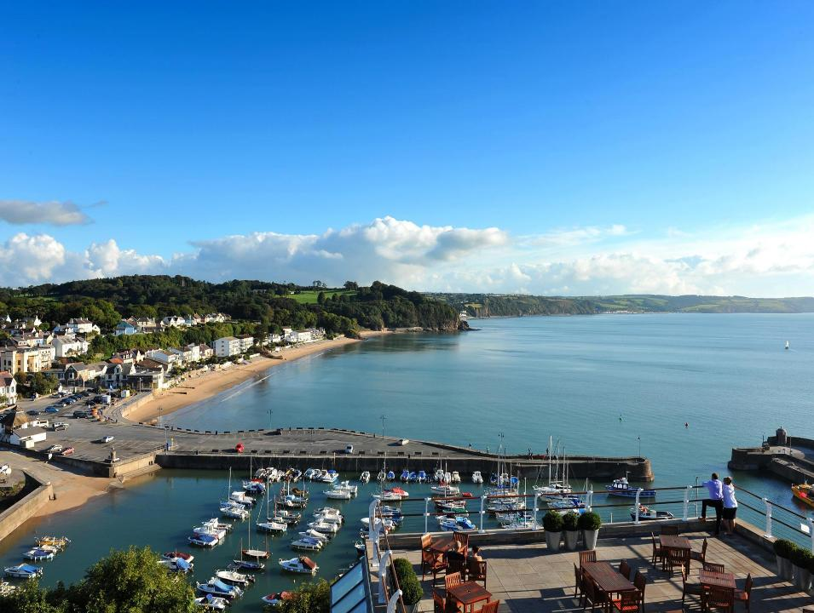
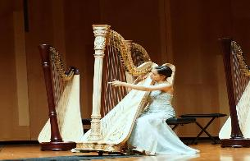
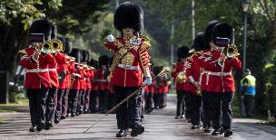
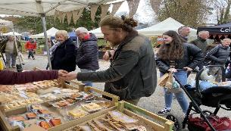
Event Programme
Day 1
Welcome dinner at St Brides
Day 2
Castle tours
Day 3
Harpist performance
Evening “Taste of Wales” chef-led feast
“Croeso Passport” zone activity trail
Cultural parade & storytelling
Welsh language mini-sessions
Nature walks
Farewell brunch
Artisan market
Notes:
The programme is designed to immerse delegates fully in Welsh culture — not as spectators, but as participants.
Day one kicks off with participatory storytelling sessions, where attendees hear legends and histories that shape Wales’ identity.
I’ve integrated Welsh language workshops to offer a hands-on connection, deepening emotional resonance.
Culinary experiences feature prominently, with local chefs demonstrating traditional Welsh dishes, creating both sensory delight and cultural education.
The “Croeso Passport” is a gamified trail that encourages exploration, interaction, and connection throughout the event spaces.
The evenings culminate in a feast that embodies Welsh hospitality, fostering community through shared meals.
On day three, I led a sustainable eco-walk in Snowdonia, underlining our commitment to environmental stewardship.
Flexibility is built in, so the schedule can adapt to MICE delegates’ needs without sacrificing cultural depth.
This multi-sensory approach ensures the event is memorable, meaningful, and shareable.
(Pause)
Now, how do I plan to bring this vision to life on the ground?

Slide 8
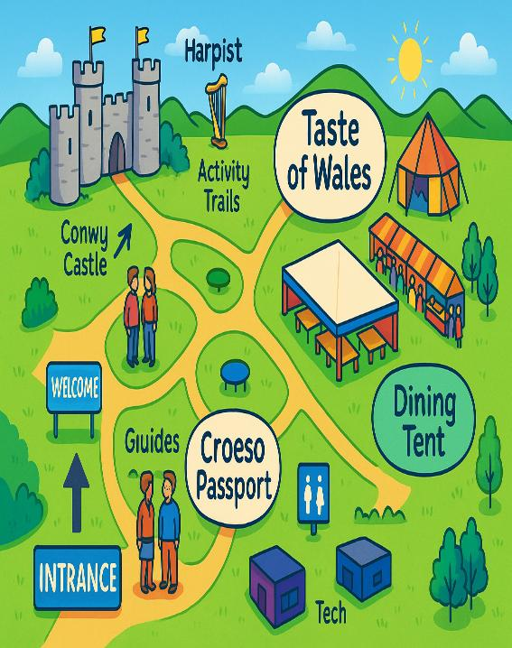
Phase 2: Delivery (On-site Execution)
Site setup and signage
Staff and volunteer roles (guides, hospitality, logistics)
Registration & info desks
Live coordination with vendors
Tech support (sound, lights, screens)
Guest experience monitoring
Daily team briefings
Notes:
Bringing the event to life requires flawless coordination, because even the best plans fail without smooth delivery.
I’ve divided responsibilities into three key teams:
Operations, managing site logistics and infrastructure.
Guest Services, overseeing registration, accessibility, and customer care.
Experience focused on entertainment, language hosts, and cultural activities.
Every morning, the team meets for briefings to align priorities and address issues.
A central command centre coordinates real-time responses, using tools like SMS alerts and live dashboards to react instantly.
I’ve also set up guest feedback stations to gather insights on the spot, allowing quick adjustments to improve experience quality.
Sustainability is baked into delivery — from reusable materials to minimising food waste — because caring for the environment is part of caring for our guests.
(Pause)
Delivery is where strategy meets reality — and I’m confident in my team’s ability to shine.

Slide 9
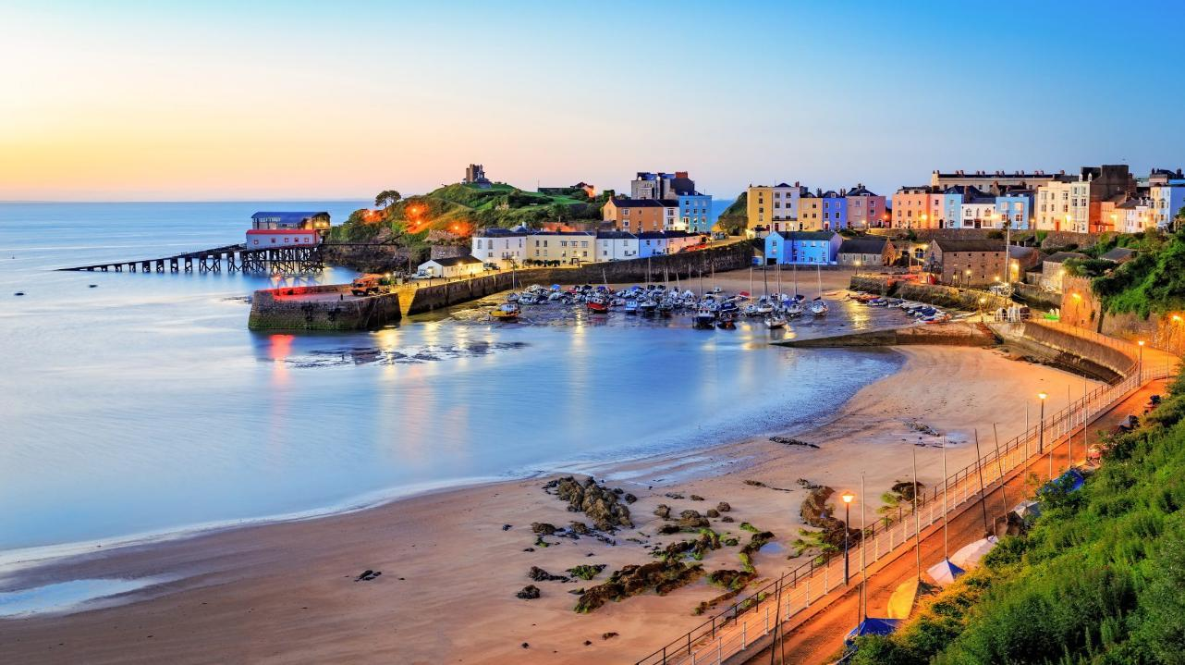
Phase 3: Post-Event Evaluation
How Success is Measured:
Guest feedback forms (QR survey)
Social media reach & engagement
Press/media coverage analysis
Local business income impact
Attendance vs forecast
Post-event debrief with stakeholders
Report shared with Visit Wales
Notes:
Evaluation isn’t an afterthought — it’s a continuous, vital process.
I will use multiple metrics to measure success: attendance figures, ROI, participant feedback, and social media engagement.
To collect this data efficiently, I’ve implemented QR-code linked surveys and will hold debrief meetings with stakeholders for comprehensive insights.
I’m also tracking media impact, with support from partners like S4C and travel bloggers.
Importantly, I’m measuring against targets set during planning, so there’s clear accountability.
The findings won’t just sit on a shelf — they’ll inform future events, helping refine the approach and build a lasting legacy.
This ongoing evaluation ensures Wales’ cultural branding evolves and remains competitive internationally.
(Pause)

Slide 10





Financial Feasibility
Cost Category | Amount (£) | Justification / Source
Venue Hire & Permits (Conwy Castle) | £10,000 | Historic venues charge £8k–£12k/day (Eventbrite, 2025)
Accommodation Collaboration (St Brides Spa) | £8,000 | 3-night group block with welcome event (GOV.WALES, 2024). Bladen et al. (2012) emphasise the role of accommodation in shaping guest experience.
Staff & Volunteer Stipends | £5,000 | 20+ staff & guides £80–100/day (O'Toole, 2008)
Performers, AV, Entertainment | £7,000 | Quinn (2013) highlights entertainment and AV as essential service provisions.
Catering & Chef's Table | £10,000 | Grant (2005) notes that strategic food offerings enhance guest satisfaction.
Marketing (Digital, Print, PR) | £4,000 | Paid media, influencer travel, bilingual materials (Eventbrite, 2025)
De-Rigging & Site Restoration | £2,500 | Site clean-up, tech dismantling, signage removal (VisitBritain, 2024)
Contingency Buffer (5%) | £3,500 | Quick (2020) recommends contingency funds to manage event risk.
Total Projected Cost | £50,000
Income Source | Amount (£) | Justification
Ticket Sales (500 x £50) | £25,000 | Based on similar cultural event pricing (Eventbrite, 2023)
Sponsorship (Accor, S4C, Penderyn) | £20,000 | Tiered sponsor benefits (Getz & Page, 2019)
Vendor Fees (20 stalls @ £300) | £6,000 | Artisan & food trader standard fees (Smith, 2012)
Product Sales (souvenirs, crafts) | £5,000 | Based on 35% avg spend per attendee (GOV.WALES, 2024)
Total Income | £56,000
Surplus: £6,000 (12% Profit)
Notes:
Now, let’s talk numbers — because this event must be financially sound.
The total projected cost is £50,000 — covering venues, staff, performers, catering, marketing, and de-rigging.
I’ve built a detailed line-item budget that includes a 5% contingency buffer (£3,500) for unexpected expenses like weather or technical issues.
Revenue streams are diversified to reduce risk:
Ticket sales forecast at £25,000
Sponsorships contributing £20,000
Vendor stall fees and product sales make up the rest
This diversity safeguards the event against dependency on any single income source.
Projected profit is £6,000 — a 12% surplus — proving the event is not just viable, but sustainable.
By partnering with local suppliers and culturally aligned brands, I keep costs competitive while enhancing authenticity and credibility.
This is smart, strategic spending — balancing impact with control, setting a foundation for growth and scalability.
(Pause)

Slide 11


Contingency Planning
Risk Area | Contingency Plan | Justification (Harvard Style)
Weather Issues | Pre-erected event tents, branded ponchos, indoor activity relocation to St Brides Spa | Outdoor events must factor weather unpredictability (O’Toole, 2008)
Low Attendance | Targeted influencer partnerships, last-minute free local invites, live-streamed content | Flexible outreach increases reach and maintains atmosphere (Bladen et al., 2012)
Overcrowding | SMS guest updates, timed entry wristbands, overflow seating areas | Crowd control critical for safety and experience (Quick, 2020)
Vendor No-Show | Pre-contracted backup vendors (local musicians, food trucks, crafts) | Stakeholder unreliability is common—backup plans must be ready (Grant, 2005)
Medical / Fire | On-site certified safety coordinator, first-aid tents, mapped evacuation zones | Public events must have formal health & safety protocols
Notes:
Now, no event is without risk, especially outdoor cultural ones.
That’s why contingency planning is not just a box-tick for me — it’s a strategic priority.
I’ve mapped out risks from weather changes and fluctuating attendance to medical emergencies.
My plan includes:
Tents and specialised weather gear are ready to protect guests and equipment.
The indoor venue at St Brides Spa Hotel is a solid backup.
Flexible ticketing with timed entry and SMS updates to manage crowd control.
Backup performers and caterers on call.
Displayed evacuation points and fully trained first-aid teams.
I’m also leveraging online streaming and influencers to extend reach in case in-person attendance drops.
This readiness aligns with Grant’s idea of strategic responsiveness — turning potential disruption into an opportunity to strengthen reputation and service.
In short, uncertainty will not derail this event.
(Pause)

Slide 12

Gantt Chart (Jan–July 2025)
Key Actions | January | February | March | April | May | June | July
Research, concept approval
Budget, venue & sponsor confirmation
Vendor selection, audience targeting
Ticket Launching & Workforce Hiring
Logistics + marketing push
Final rehearsals, safety checks, materials prep
Event delivery + data collection
Notes:
Finally, let’s talk timing.
From January to July 2025, I have a detailed Gantt chart guiding every milestone.
It begins with heavy research and stakeholder outreach, followed by vendor approvals, marketing launches, and logistical rehearsals.
I’ve built in buffers for flexibility — because, as O’Toole advises, adaptability is crucial.
From May onward, weekly quality checks keep progress on track without overloading the team or budget.
This timeline ensures everyone, internal and external, stays informed and accountable.
It’s the backbone that turns this vision into a delivered reality — on time, on budget, and brand.
(Pause)

Slide 13
References
Bladen, C., Kennell, J., Abson, E. and Wilde, N. (2012) Events management: an introduction. Abingdon: Routledge.
Bowdin, G., Allen, J., Harris, R., McDonnell, I., O'Toole, W. and Jago, L. (2023) Events management. Oxford: Elsevier.
Creative Tenders (2021) A guide to the bidding process in event management. Available at: https://www.creativetenders.co.uk (Accessed: 25 May 2023).
Eventbrite (2025) Travel influencer webinar. Available at: https://www.eventbrite.com/e/travel-influencer-webinar-tickets-1247618002029?aff=erellivmlt (Accessed: 14 May 2025).
Fox, D., Gouthro, M.-B., Morakabati, Y. and Brackenridge, C. (2014) Doing events research: from theory to practice. Oxford: Routledge.
Getz, D. and Page, S.J. (2019) Event studies: theory, research and policy for planned events. 3rd edn. Oxford: Routledge.
Ghanem, S., Nidhi Marulappa and Qiang, V. (2025). Key considerations for applying intersectionality theory to partner and stakeholder engagement in public health. Can J Public Health. Available at: https://doi.org/10.17269/s41997-025-01023-7.
GOV.WALES (2024) Business events: applicant guidance and funding criteria. Available at: https://www.gov.wales/business-events-applicant-guidance-and-funding-criteria-html (Accessed: 14 May 2025).
Grant, R.M. (2005) Contemporary strategy analysis. Melbourne: Blackwell.
Meredith, J. (2022) Project management: a managerial approach. [Publisher not specified].
O’Toole, W. (2011) Events feasibility and development: from strategy to operations. Oxford: Elsevier.
O'Toole, W. (2008) Event feasibility and development. Amsterdam: Routledge.
Quick, L. (2020) Managing events: real challenges, real outcomes. London: SAGE Publications.
Quinn, B. (2013) Key concepts in event management. London: SAGE Publications.
Raden Ayu Trisnayoni, I., I Putu Astawa and I Ketut Sutama (2022) ‘Sustainable MICE event practices: an explorative study’, International Journal of Travel, Hospitality and Events, 1(1), pp. 74–82. Available at: https://doi.org/10.56743/ijothe.v1i1.9 (Accessed: 14 May 2025).
Rogers, T. and Wynn-Moylan, P. (2022) Conferences and conventions: a global industry. 4th edn. Oxford: Routledge.
Smith, A. (2012) Events and urban regeneration: the strategic use of events to revitalise cities. Oxford: Routledge.
The Guide Liverpool (2024) Eurovision: Liverpool’s legacy redefines the European Song Contest. Available at: https://theguideliverpool.com/liverpool-legacy-redefines-eurovision/ (Accessed: 14 May 2025).
Visit Britain (2024) The official website for UK tourism. Available at: https://www.visitbritain.com/en (Accessed: 14 May 2025).
Notes:
I’ve shown you a culturally rich, strategically planned, financially sound event that will shine a spotlight on Welsh heritage while driving economic growth.
With your investment and partnership, I can bring Croeso Cymru to life, creating unforgettable experiences for international visitors and lasting benefits for Wales.
Together, we can turn this vision into reality.
Thank you.

